Slide 1
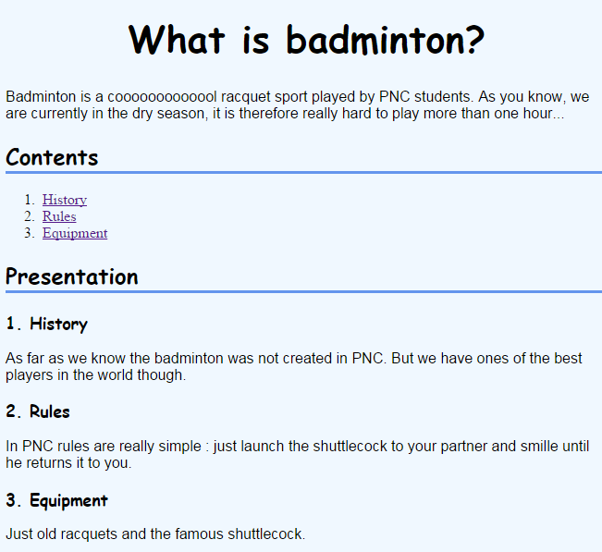
Use external method :
- 1 HTML file
- 1 CSS file
The background color must be blue
The main title must be centered with a big size and bold
All title font must be "Comic Sans MS"
Each item shall be linked to a chapter of this document
All paragraph font must be Arial
TO HELP YOU !!
How to set colors : https://www.w3schools.com/css/css_howto.asp
- How to use CSS font-family Property: https://www.w3schools.com/cssref/pr_font_font-family.php

Slide 2
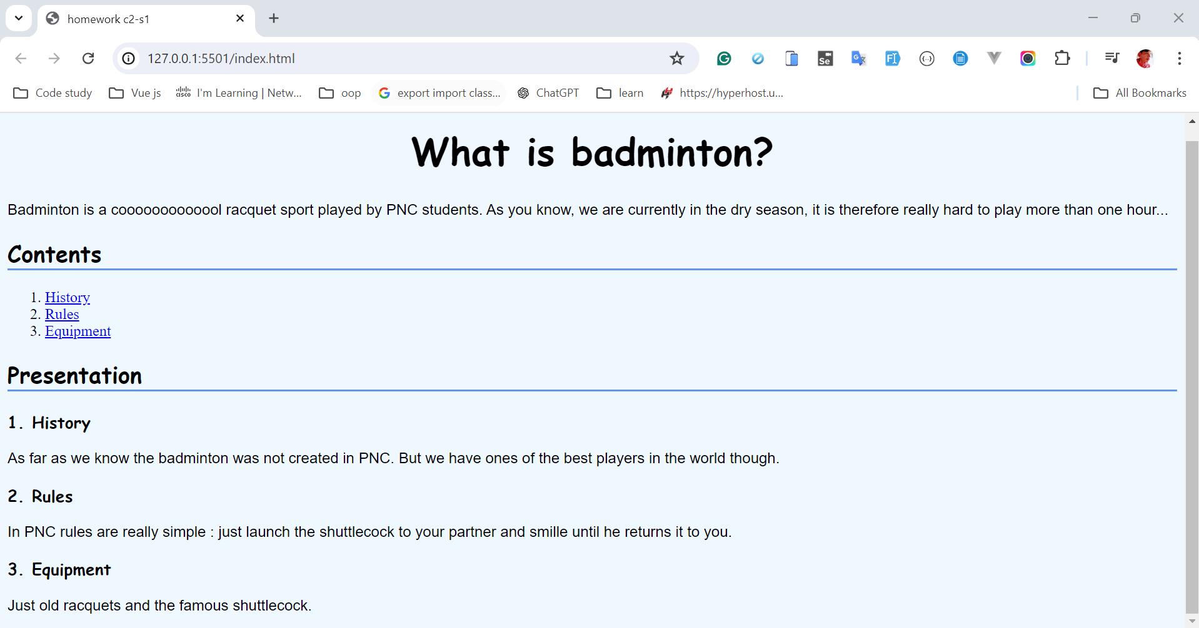
what we expected

