Slide 2
Outline
Introduction
Uses of machine learning in real life
Supervised Learning
Regression
Linear Regression
Decision Tree Regression
Machine Learning
Classification
Logistics Regression
Decision Tree Classification
Project
Diabetes Prediction using Supervised learning(Classification)

Slide 3
Introduction
Machine learning is a branch of artificial intelligence that focuses on creating computer systems capable of learning and improving from data without being explicitly programmed. It involves developing algorithms and models that can automatically analyze data, identify patterns, and make predictions or decisions based on that analysis.
The core idea behind machine learning is to enable computers to learn from examples, experiences, and feedback, similar to how humans learn. Instead of providing explicit instructions, machine learning algorithms learn from data and extract meaningful insights that can be used for various tasks.

Slide 4
Types of machine learning
Supervised learning: In supervised learning, the algorithm is trained on labeled data, where each data instance is associated with a specific target or output. The algorithm learns to map the input data to the correct output by generalizing from the labeled examples. This type of learning is used for tasks such as classification (assigning labels to data) and regression (predicting continuous values).
Unsupervised learning: Unsupervised learning involves training algorithms on unlabeled data, where the goal is to discover underlying patterns or structures in the data. These algorithms learn to group similar data points together, identify anomalies, or reduce the dimensionality of the data. Unsupervised learning is commonly used for tasks like clustering and dimensionality reduction.
Reinforcement learning: Reinforcement learning involves an agent learning to interact with an environment and make decisions based on feedback or rewards. The agent learns through trial and error, exploring different actions and observing the consequences. It aims to maximize cumulative rewards over time and is often used in applications like game playing, robotics, and autonomous systems.

Slide 5
Process of machine learning
Define the problem: Clearly articulate the problem you want to solve or the goal you want to achieve with machine learning. This involves understanding the problem domain, identifying the relevant data, and defining the desired output or prediction.
Data collection: Gather the necessary data that will be used to train and evaluate the machine learning model. The data should be representative of the problem and include both input features (attributes) and the corresponding target or output values (labels).
Data preprocessing: Clean, preprocess, and transform the collected data to ensure its quality and compatibility with the machine learning algorithms. This step may involve handling missing values, removing outliers, scaling features, and encoding categorical variables.
Feature engineering: Select or create meaningful features from the available data that can effectively represent the problem. Feature engineering can involve techniques such as feature selection, dimensionality reduction, or creating new features based on domain knowledge.

Slide 6
Contd.
Model selection: Choose an appropriate machine learning algorithm or model that matches the problem type and the available data. The choice of model depends on factors like the nature of the problem (e.g., classification, regression), the complexity of the data, and the desired performance metrics.
Model training: Train the selected model using the preprocessed data. During training, the model adjusts its internal parameters based on the input data to minimize the prediction errors or optimize an objective function. This step involves an iterative process of feeding the data to the model and updating its parameters.
Model evaluation: Assess the performance of the trained model using evaluation metrics and validation techniques. This step involves splitting the data into training and testing sets or using cross-validation methods to evaluate the model's ability to generalize to new, unseen data.
Model optimization: Fine-tune and optimize the model to improve its performance. This can involve adjusting hyperparameters (settings that influence the learning process) or applying techniques like regularization to prevent overfitting.
Model deployment: Once the model is trained and validated, it can be deployed in a production environment to make predictions or decisions on new, real-world data. This may involve integrating the model into a larger software system or creating an API for interaction.

Slide 7
Uses of machine learning in real life
Healthcare: Disease diagnosis(diabetes prediction), Personalized medicine, Drug discovery
Finance: Credit scoring, Algorithmic trading, Fraud detection
Transportation: Autonomous vehicles, Traffic prediction
Retail and E-commerce: Customer segmentation, Demand forecasting
Energy: Energy consumption optimization, Renewable energy forecasting

Slide 8
Supervised Learning
Supervised machine learning is a type of machine learning where a model is trained using labeled data. In supervised learning, the algorithm learns from a given dataset that contains input features (also called independent variables) and corresponding output labels (also called dependent variables). The goal is to build a model that can make predictions or classifications on unseen or future data based on patterns learned from the labeled examples.
Supervised learning is widely used in various applications, including spam detection, sentiment analysis, image recognition, fraud detection, and many others. By providing labeled data, supervised learning algorithms can be trained to learn from past examples and generalize their knowledge to make accurate predictions on new, unseen data.

Slide 9
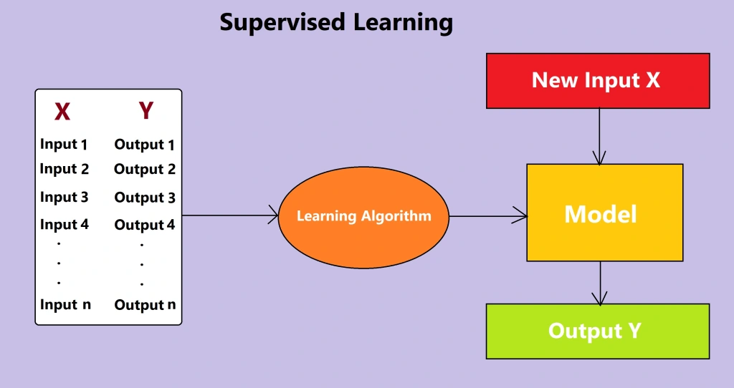
Contd.
Architecture of Supervised Learning

Slide 10
Types of supervised learning
There are several types of supervised learning algorithms, each suited for different types of problems. The main types of supervised learning include:
Classification: Classification algorithms are used when the output variable is categorical or discrete. The goal is to classify new instances into predefined classes or categories. Examples of classification algorithms include logistic regression, support vector machines (SVMs), decision trees, random forests, and naive Bayes.
Regression: Regression algorithms are used when the output variable is continuous or numerical. The goal is to predict a value or quantity based on input features. Regression algorithms aim to find a relationship between the input features and the continuous output variable. Examples of regression algorithms include linear regression, polynomial regression, support vector regression (SVR), and random forests for regression.

Slide 11
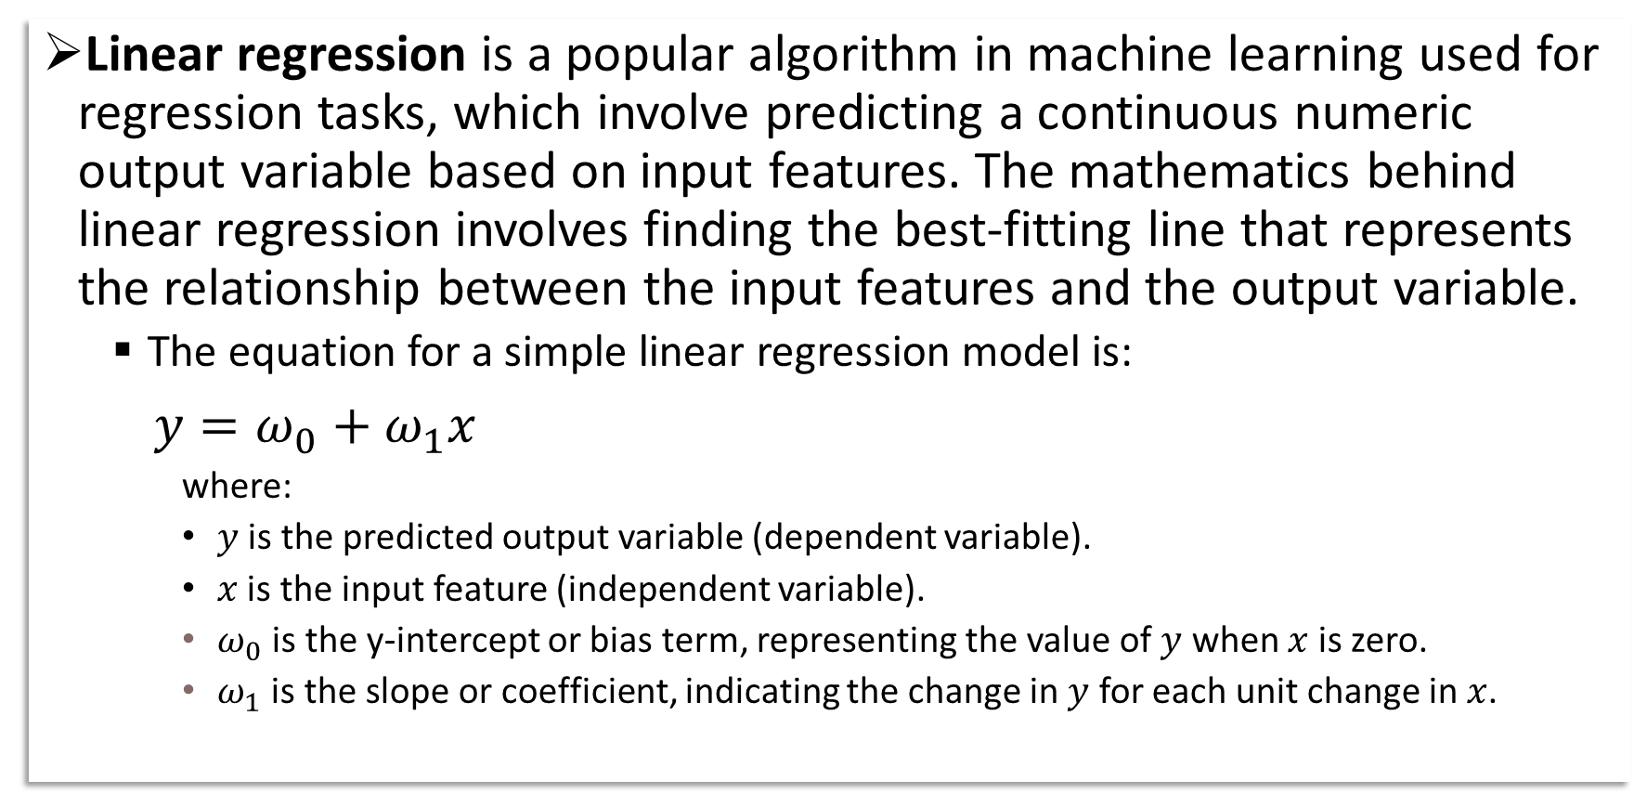
1. Linear Regression
Linear regression is a popular algorithm in machine learning used for regression tasks, which involve predicting a continuous numeric output variable based on input features. The mathematics behind linear regression involves finding the best-fitting line that represents the relationship between the input features and the output variable.
The equation for a simple linear regression model is:
$y=ω_{0}+ω_{1}x$
where:
$y$ is the predicted output variable (dependent variable).
$x$ is the input feature (independent variable).
$ω_{0}$ is the y-intercept or bias term, representing the value of $y$ when $x$ is zero.
$ω_{1}$ is the slope or coefficient, indicating the change in $y$ for each unit change in $x$.

Slide 12
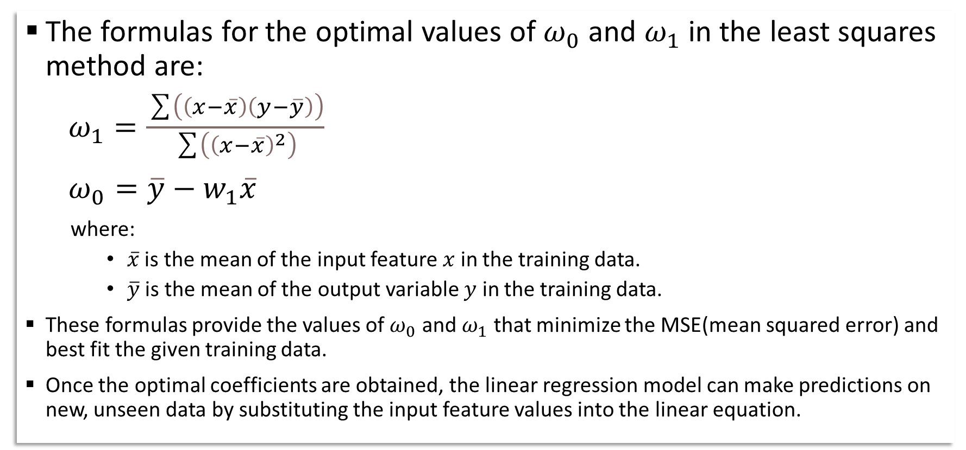
Contd.
The formulas for the optimal values of $ω_{0}$ and $ω_{1}$ in the least squares method are:
$ω_{1}=\frac{\sum{\left(\left(x−\overline{x}\right)\left(y−\overline{y}\right)\right)}}{\sum{\left({\left(x−\overline{x}\right)}^{2}\right)}}$
$ω_{0}=\overline{y}−w_{1}\overline{x}$
where:
$\overline{x}$ is the mean of the input feature $x$ in the training data.
$\overline{y}$ is the mean of the output variable $y$ in the training data.
These formulas provide the values of $ω_{0}$ and $ω_{1}$ that minimize the MSE(mean squared error) and best fit the given training data.
Once the optimal coefficients are obtained, the linear regression model can make predictions on new, unseen data by substituting the input feature values into the linear equation.

Slide 13
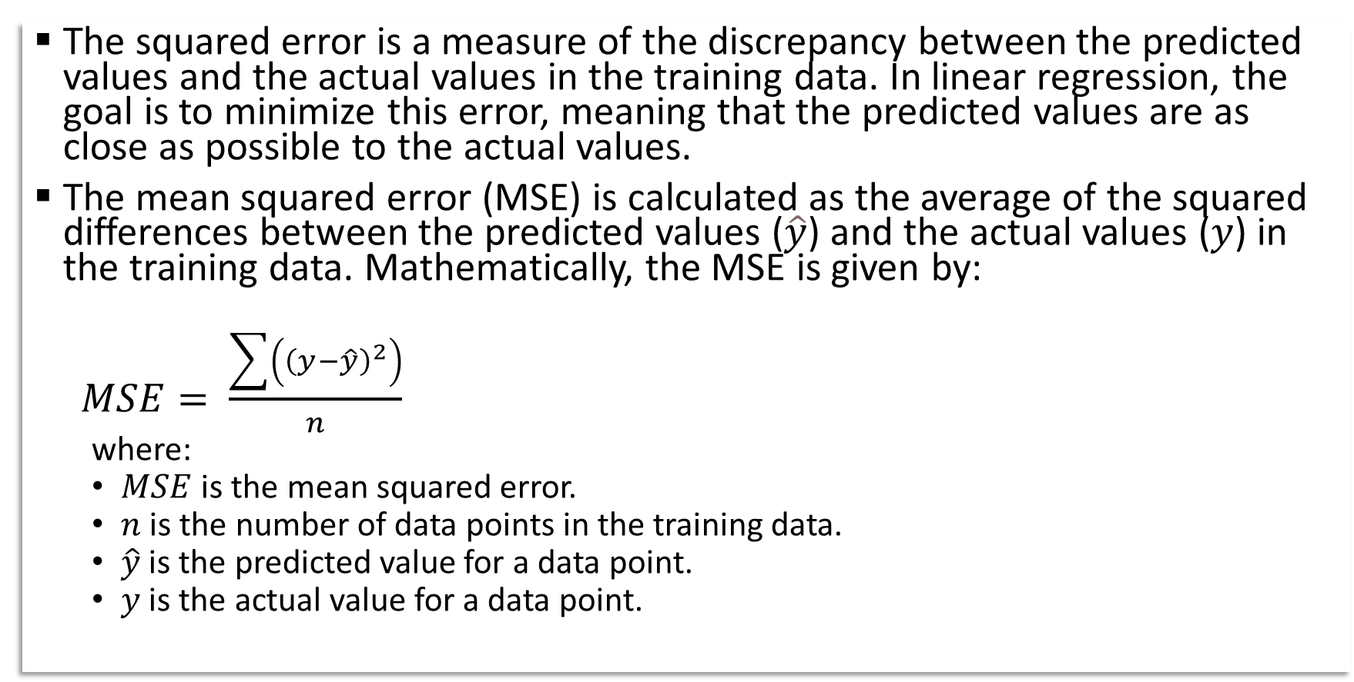
Cost function in linear regression
The squared error is a measure of the discrepancy between the predicted values and the actual values in the training data. In linear regression, the goal is to minimize this error, meaning that the predicted values are as close as possible to the actual values.
The mean squared error (MSE) is calculated as the average of the squared differences between the predicted values ($\hat{y}$) and the actual values ($y$) in the training data. Mathematically, the MSE is given by:
$MSE= \frac{\sum{\left({\left(y−\hat{y}\right)}^{2}\right)}}{n}$
where:
$MSE$ is the mean squared error.
$n$ is the number of data points in the training data.
$\hat{y}$ is the predicted value for a data point.
$y$ is the actual value for a data point.

Slide 14
Contd.
The goal in linear regression is to find the coefficients (weights) that minimize the MSE. This process involves adjusting the weights iteratively through techniques such as the least squares method or gradient descent to minimize the MSE.
By minimizing the MSE, the linear regression model aims to find the line that best fits the training data, minimizing the overall squared differences between the predicted and actual values. In other words, the model seeks to reduce the average squared error between its predictions and the true values.
Once the coefficients are optimized, the linear regression model can make predictions on new, unseen data by substituting the input feature values into the linear equation.
In summary, the cost function in linear regression is the Mean Squared Error (MSE), and the objective is to minimize this error by finding the optimal weights that best fit the training data.

Slide 15
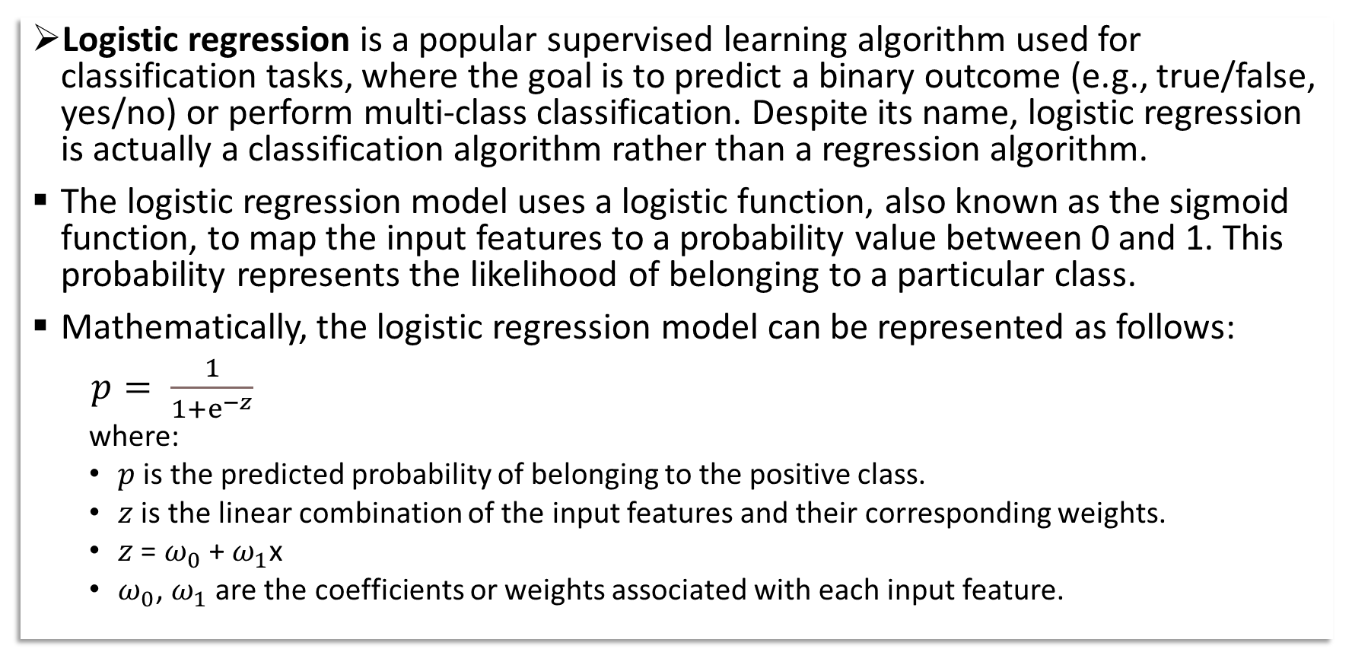
2. Logistic Regression
Logistic regression is a popular supervised learning algorithm used for classification tasks, where the goal is to predict a binary outcome (e.g., true/false, yes/no) or perform multi-class classification. Despite its name, logistic regression is actually a classification algorithm rather than a regression algorithm.
The logistic regression model uses a logistic function, also known as the sigmoid function, to map the input features to a probability value between 0 and 1. This probability represents the likelihood of belonging to a particular class.
Mathematically, the logistic regression model can be represented as follows:
$p= \frac{1}{1+ⅇ^{−z}}$
where:
$p$ is the predicted probability of belonging to the positive class.
$z$ is the linear combination of the input features and their corresponding weights.
$z$ = $ω_{0}$ + $ω_{1}$x
$ω_{0}$, $ω_{1}$ are the coefficients or weights associated with each input feature.

Slide 16
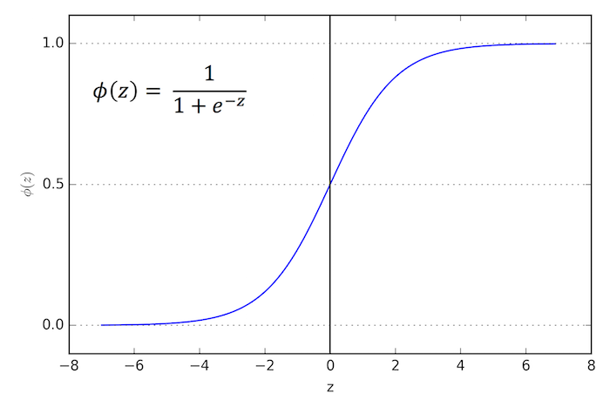
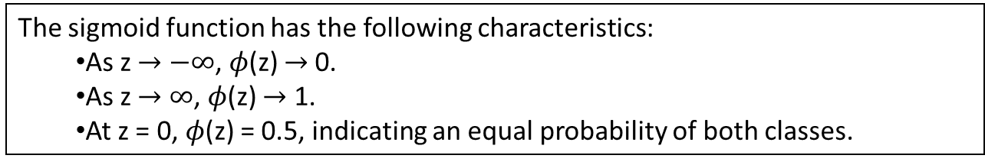
Graph of sigmoid function
The sigmoid function has the following characteristics:
As z $→$ $−∞$, $φ$(z) $→$0.
As z $→$ $∞$, $φ$(z) $→$ 1.
At z = 0, $φ$(z) = 0.5, indicating an equal probability of both classes.

Slide 17
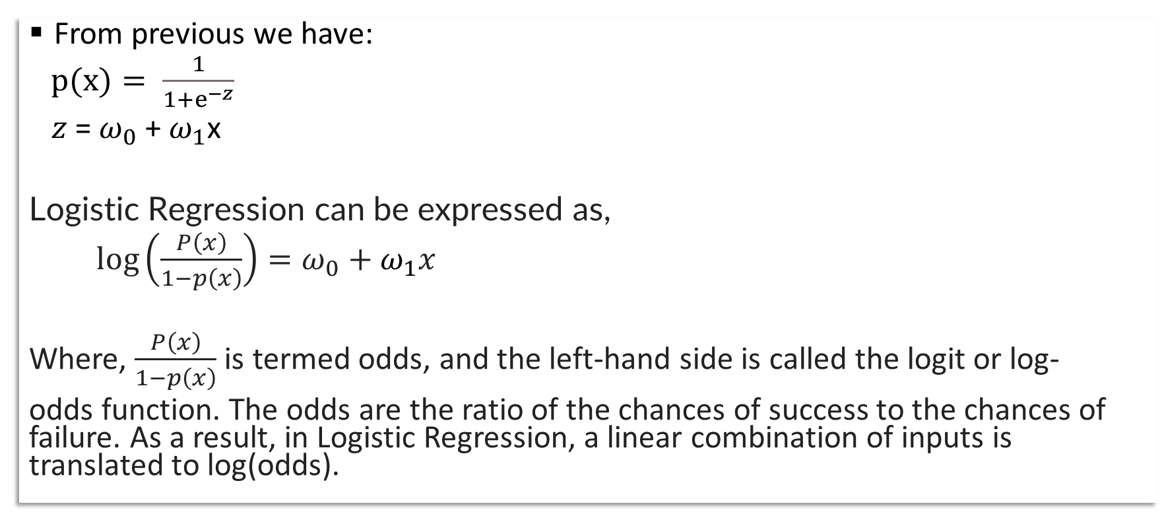
Logit function to Sigmoid Function
From previous we have:
$p(x)= \frac{1}{1+ⅇ^{−z}}$
$z$ = $ω_{0}$ + $ω_{1}$x
Logistic Regression can be expressed as,
$\log\left(\frac{P\left(x\right)}{1−p\left(x\right)}\right)=ω_{0}+ω_{1}x$
Where, $\frac{P\left(x\right)}{1−p\left(x\right)}$is termed odds, and the left-hand side is called the logit or log-
odds function. The odds are the ratio of the chances of success to the chances of failure. As a result, in Logistic Regression, a linear combination of inputs is translated to log(odds).

Slide 18
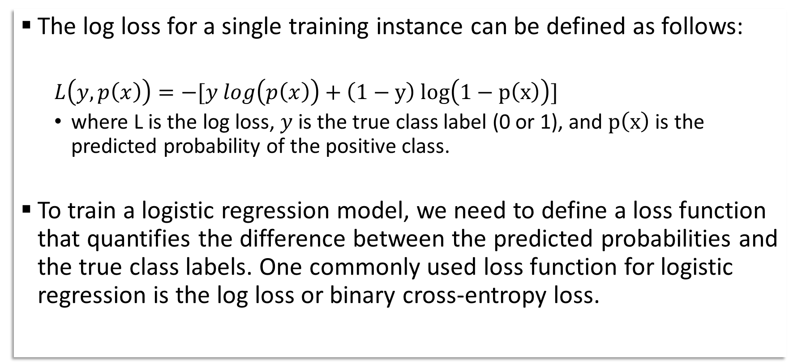
Lost function in logistic regression
The log loss for a single training instance can be defined as follows:
$$L\left(y,p\left(x\right)\right)=−[y log\left(p\left(x\right)\right)+\left(1−y\right) log\left(1−p\left(x\right)\right)]$$
where L is the log loss, $y$ is the true class label (0 or 1), and $p\left(x\right)$ is the predicted probability of the positive class.
To train a logistic regression model, we need to define a loss function that quantifies the difference between the predicted probabilities and the true class labels. One commonly used loss function for logistic regression is the log loss or binary cross-entropy loss.

Slide 19
Contd.
The optimization process typically involves iterative techniques such as gradient descent or other optimization algorithms. These techniques adjust the parameters based on the gradients of the cost function with respect to the parameters, moving towards the minimum of the cost function.
The ultimate goal of logistic regression is to build a predictive model that can accurately classify new, unseen instances based on their input features. By estimating the optimal parameters that minimize the cost function, logistic regression can provide probabilistic predictions and make decisions based on the predicted probabilities.
In summary, the objective of logistic regression is to find the optimal parameters that maximize the likelihood or minimize the cost function, allowing for accurate classification and probabilistic predictions.

Slide 20
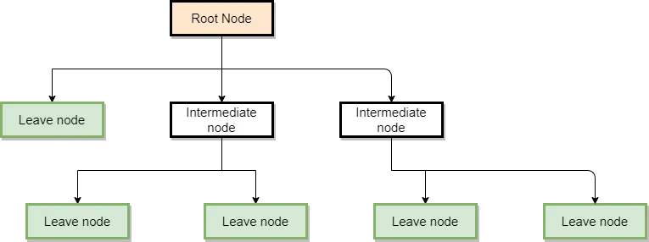
3. Decision Tree
Decision trees are versatile machine learning models that can be used for both regression and classification tasks. The structure of a decision tree consists of internal nodes representing decisions, branches representing outcomes of those decisions, and leaf nodes representing the final predictions or class labels.
The Root Node: Is the node that starts the graph.
Intermediate nodes: These are nodes where variables are evaluated but which are not the final nodes where predictions are made.
Leaf nodes: These are the final nodes of the tree, where the predictions of a category or a numerical value are made.

Slide 21
Decision Tree for Regression
Each internal node in the tree represents a feature or attribute along with a decision rule based on a threshold value. The decision rules split the dataset into subsets based on the feature values.
The goal is to minimize the variance within each subset, so the algorithm finds the best split by evaluating different feature thresholds.
At each leaf node, the predicted value is the average (or median) of the target values in the corresponding subset.
The process continues recursively until a stopping criterion is met (e.g., maximum depth reached, minimum number of samples per leaf).

Slide 22
Decision Tree for Classification
Similar to regression, each internal node represents a feature or attribute, but instead of thresholds, decision rules are based on discrete feature values.
The algorithm finds the best split by evaluating different feature values to maximize information gain or minimize Gini impurity or entropy.
At each leaf node, the majority class (or class probabilities) of the corresponding subset is assigned as the predicted class.
Again, the process continues recursively until a stopping criterion is met.

Slide 23
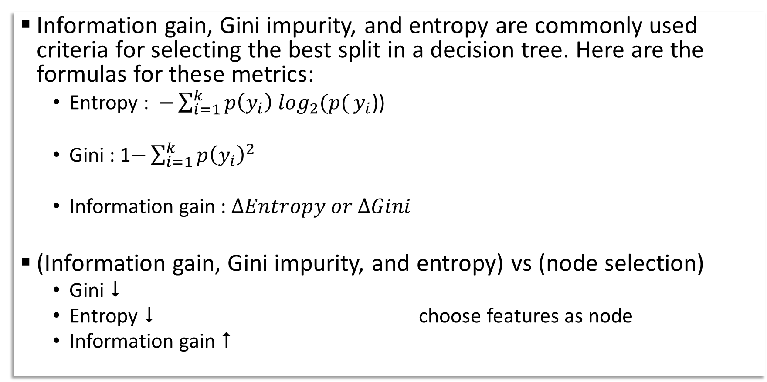
Split in a decision tree
Information gain, Gini impurity, and entropy are commonly used criteria for selecting the best split in a decision tree. Here are the formulas for these metrics:
Entropy :$−\sum_{i=1}^{k}{p\left(y_{i}\right) \log_{2}(p(}y_{i}$))
Gini : 1$−\sum_{i=1}^{k}{{p\left(y_{i}\right)}^{2}}$
Information gain : $∆Entropy or ∆Gini$
(Information gain, Gini impurity, and entropy) vs (node selection)
Gini 
Entropy  choose features as node
Information gain 

Slide 24
Project : Diabetes Prediction
Description:
The goal of this project is to develop a machine learning model that can predict the likelihood of an individual having diabetes based on certain features or risk factors. This project focuses on binary classification, where the outcome variable is either "diabetic" or "non-diabetic".
Dataset:
Obtain a dataset containing relevant information about individuals, such as age, BMI, blood pressure, glucose level, insulin level, etc.
The dataset should include a target variable indicating whether the individual has diabetes or not.

Slide 25
Contd.
Data Preprocessing:
Perform exploratory data analysis to understand the distribution of variables, identify missing values, outliers, and potential correlations.
Handle missing values by either imputing them or removing the corresponding rows/columns based on the data quality and quantity.
Scale or normalize the numeric features to ensure that all variables are on a similar scale.
Encode categorical variables using techniques like one-hot encoding or label encoding, if necessary.
Split the dataset into training and testing sets for model evaluation.

Slide 26
Contd.
Model Development:
Choose an appropriate classification algorithm to train the model. Some popular algorithms for this task include logistic regression, decision trees, random forests.
Train the chosen model on the training data.
Model Evaluation:
Assess the performance of the trained model on the testing data to determine its generalization capability.
Deployment:
Save the trained model to a file (e.g., pickle) for future use.
Develop a simple interface (e.g., web application) to allow users to input their information and receive a prediction of their diabetes risk.
Test the deployment to ensure that the model is working correctly in a real-world scenario.

Slide 27
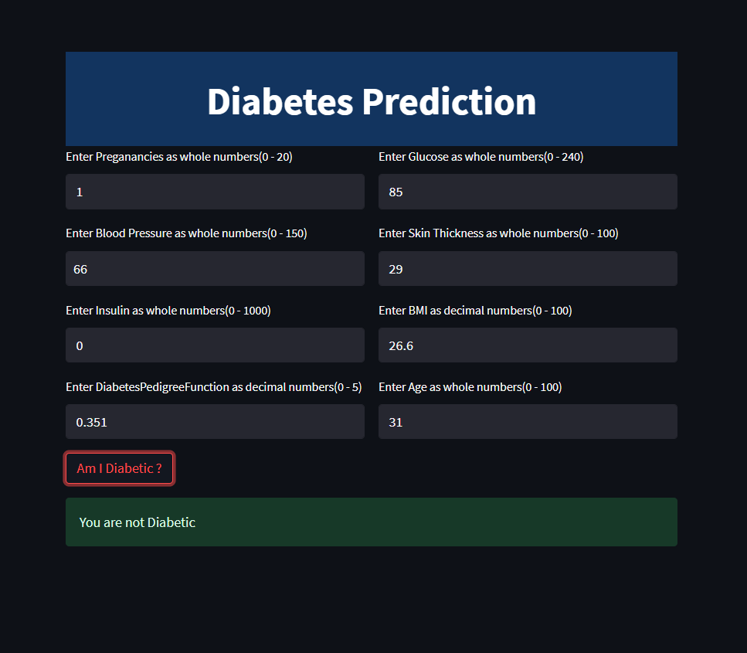
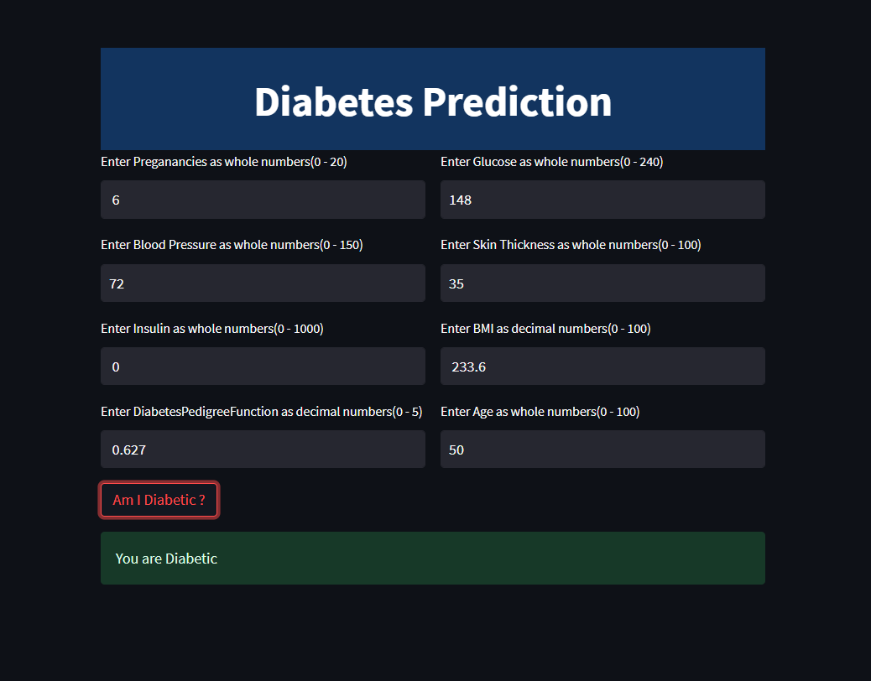
User Interface
Creating a diabetes prediction app using Streamlit

Slide 28
Result
Diabetes Prediction Models Score:
Score | Model
0.818182 | Decision Tree_2
0.798701 | Random Forest
0.766234 | Logistic Regression
0.727273 | Decision Tree_1
Based on the scores provided, the Decision Tree_2 model has the highest score of 0.818182, followed closely by the Random Forest model with a score of 0.798701. The Logistic Regression model has a score of 0.766234, and the Decision Tree_1 model has the lowest score of 0.727273.

Slide 29
Conclusion
In this project, we developed a machine learning model for diabetes prediction based on a set of relevant features. The goal was to accurately classify individuals as either diabetic or non-diabetic.
We started by preprocessing the data, handling missing values, scaling numeric features, and encoding categorical variables as necessary. Exploratory data analysis helped us gain insights into the distribution of variables and identify potential correlations.
We selected an appropriate classification algorithm, such as logistic regression, decision trees, random forests to train our model. We fine-tuned the model's hyperparameters to optimize its performance.

Slide 30
Conclusion(Contd.)
The developed model can have practical applications in healthcare settings, assisting healthcare professionals in early detection and intervention. It can potentially help identify individuals who need further screening or lifestyle modifications to manage their diabetes risk.
It is important to acknowledge that this model has certain limitations. The accuracy of predictions depends on the quality and representativeness of the data used for training. Additionally, the model should be regularly updated and validated with new data to maintain its accuracy over time.
Overall, this diabetes prediction project showcases the potential of machine learning in assisting healthcare professionals and empowering individuals to proactively manage their health.

Slide 31
THANK YOU

