Slide 3
Original Sample
Bootstrapped Sample
ID | Y | X_1 | X_2 | X_3 | X_4 | X_5
1
2
3
4
ID | Y | X_1 | X_2 | X_3 | X_4 | X_5
3
4
2
2
Out-of-Bag Sample
ID | Y | X_1 | X_2 | X_3 | X_4 | X_5
1

Slide 4
Original Sample
Bootstrapped Sample
ID | Y | X_1 | X_2 | X_3 | X_4 | X_5
1
2
3
4
ID | Y | X_1 | X_2 | X_3 | X_4 | X_5
1
3
3
2
Out-of-Bag Sample
ID | Y | X_1 | X_2 | X_3 | X_4 | X_5
4

Slide 5
Original Sample
Bootstrapped Sample
ID | Y | X_1 | X_2 | X_3 | X_4 | X_5
1
2
3
4
ID | Y | X_1 | X_2 | X_3 | X_4 | X_5
4
4
2
1
Out-of-Bag Sample
ID | Y | X_1 | X_2 | X_3 | X_4 | X_5
3

Slide 6
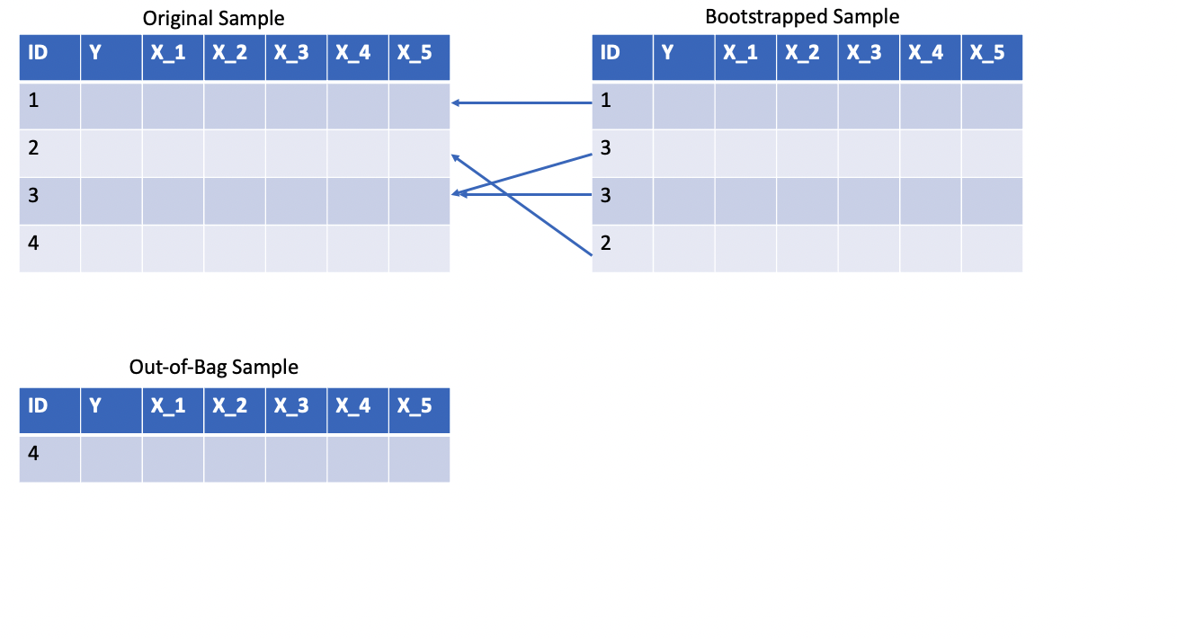
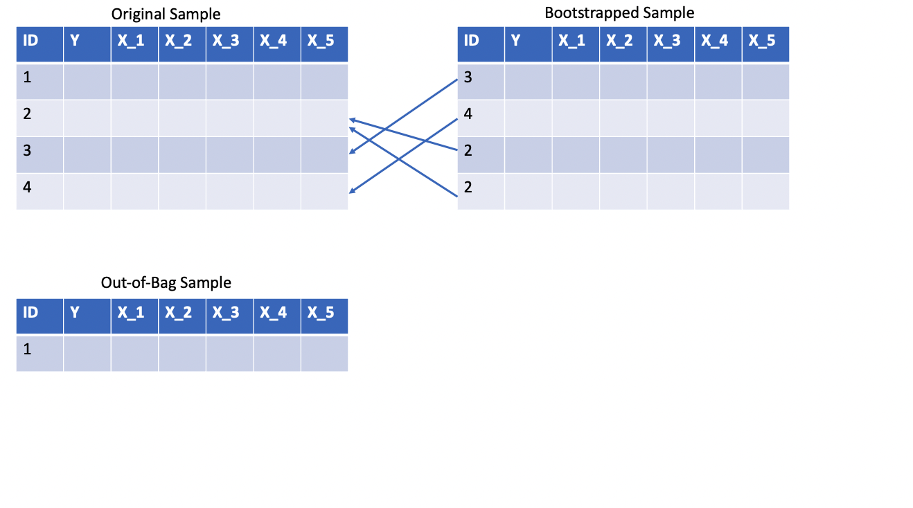
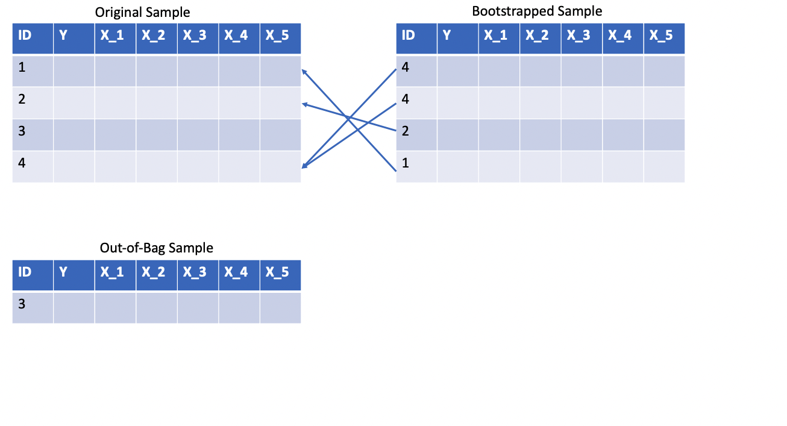

Slide 7
Available Subset of Predictors
X_1 | X_2 | X_3 | X_5
Available Subset of Predictors
Available Subset of Predictors
X_2
X_2
X_4
X_1
X_2 | X_3 | X_4 | X_5
X_2 | X_3 | X_4 | X_5
Available Subset of Predictors
X_1 | X_2 | X_3 | X_4

Slide 8



ID | X_1 | X_2 | X_3 | X_4 | X_5
1
2
3
4
$$\hat{Y}$$

Slide 9


ID | X_1 | X_2 | X_3 | X_4 | X_5
1
2
3
4
$$\hat{Y}$$

