Slide 1
物體分割

Slide 2
目標任務
對此次課程提供的影像進行影像二值化(Image Thresholding)，以達到分割的效果
使用函數：
cv2.threshold
cv2.adaptiveThreshold
使用以下5種方法對影像做簡單二值化(門檻值：130)：
cv2.THRESH_BINARY：將大於門檻值的灰階值設為最大灰階值，小於門檻值的值設為0。(Threshold Binary)
cv2.THRESH_BINARY_INV：將大於門檻值的灰階值設為0，其他值設為最大灰階值。(Threshold Binary, Inverted)
cv2.THRESH_TRUNC：將大於門檻值的灰階值設為門檻值，小於門檻值的值保持不變。(Truncate)
cv2.THRESH_TOZERO：將小於門檻值的灰階值設為0，大於門檻值的值保持不變。(Threshold to Zero)
cv2.THRESH_TOZERO_INV：將大於門檻值的灰階值設為0，小於門檻值的值保持不變。(Threshold to Zero, Inverted)
使用以下3種方法對影像做自適應二值化：
cv2.THRESH_OTSU：透過窮舉法來從256個像素值內找出最佳的門檻值，該門檻值能使類間變異數最大(類內變異數最小)。
cv2.ADAPTIVE_THRESH_MEAN_C：將一個尺寸為blockSize的均值卷積核的計算結果減去常數C，以此來作為門檻值。
cv2.ADAPTIVE_THRESH_GAUSSIAN_C：將一個尺寸為blockSize的高斯卷積核的計算結果減去常數C，以此來作為門檻值。
OTSU解說連結

Slide 3
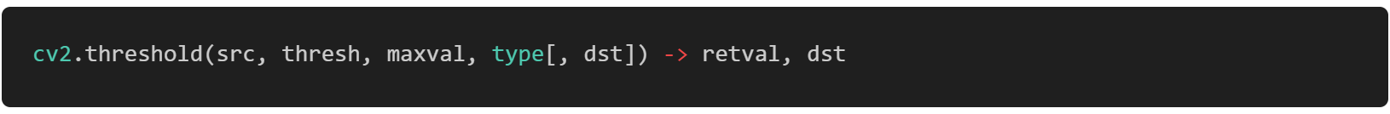
簡單二值化
Parameters | Description
src | input array (multiple-channel, 8-bit or 32-bit floating point).
dst | output array of the same size and type and the same number of channels as src.
thresh | threshold value.
maxval | maximum value to use with the THRESH_BINARY and THRESH_BINARY_INV thresholding types.
type | thresholding type (see ThresholdTypes).

Slide 4
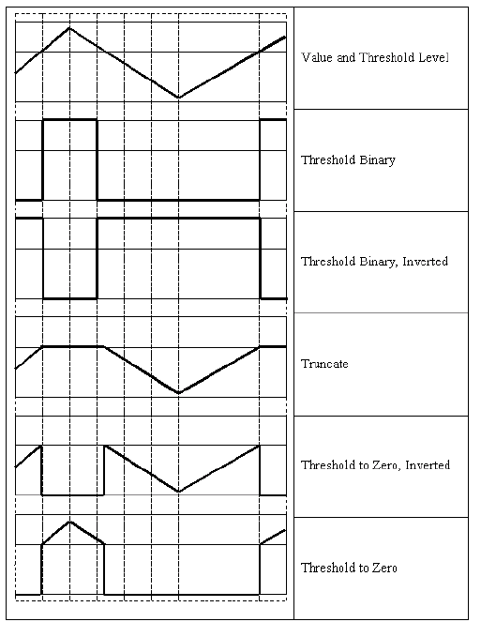
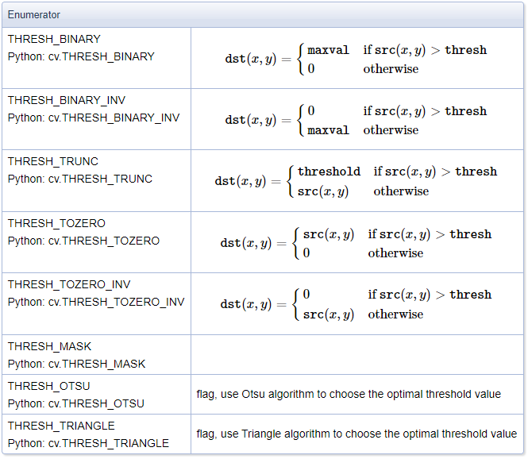

Slide 5
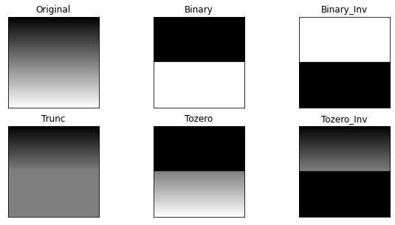
Threshold Type | Description
cv2.THRESH_BINARY | 如果大於 127 就等於 255，反之等於 0
cv2.THRESH_BINARY_INV | 如果大於 127 就等於 0，反之等於 255
cv2.THRESH_TRUNC | 如果大於 127 就等於 127，反之數值不變
cv2.THRESH_TOZERO | 如果大於 127 數值不變，反之數值等於 0
cv2.THRESH_TOZERO_INV | 如果大於 127 等於 0，反之數值不變

Slide 6
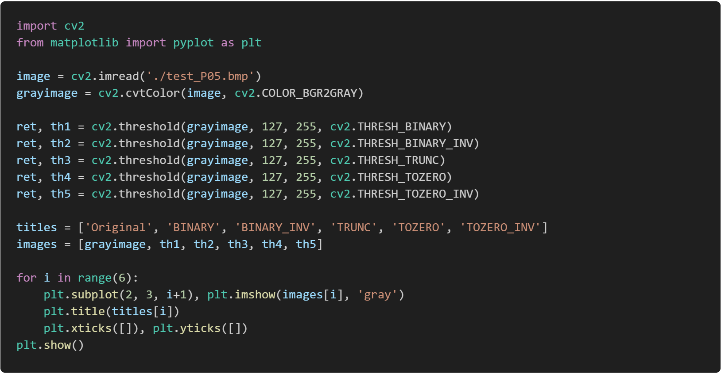
CODE

Slide 7
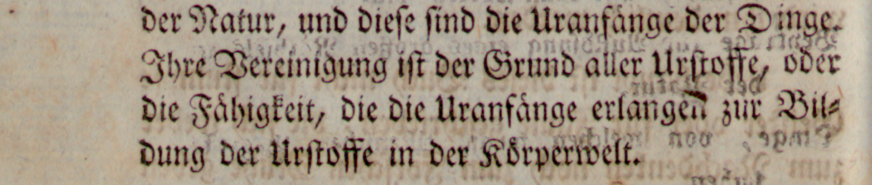
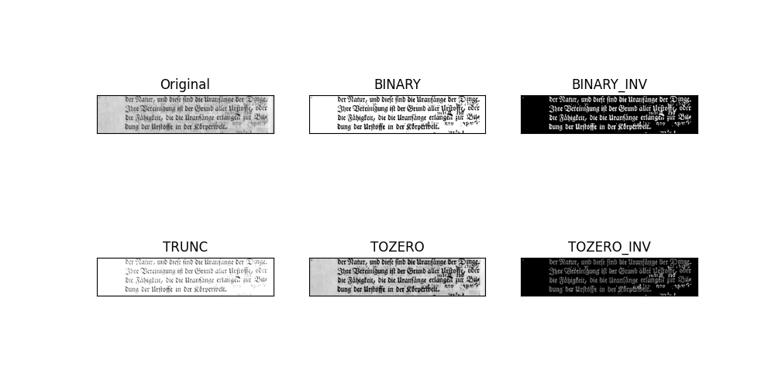
實作結果

Slide 8
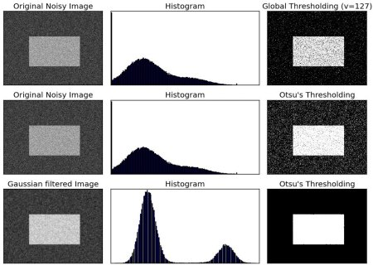
OTSU 大津演算法

Slide 9
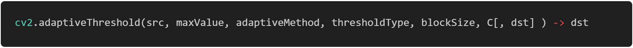
自適應二值化
Parameters | Description
src | Source 8-bit single-channel image.
dst | Destination image of the same size and the same type as src.
maxValue | Non-zero value assigned to the pixels for which the condition is satisfied
adaptiveMethod | Adaptive thresholding algorithm to use. (cv2.ADAPTIVE_THRESH_MEAN_C or cv2.ADAPTIVE_THRESH_GAUSSIAN_C)
thresholdType | Thresholding type that must be either THRESH_BINARY or THRESH_BINARY_INV
blockSize | Size of a pixel neighborhood that is used to calculate a threshold value for the pixel: 3, 5, 7, and so on.
C | Constant subtracted from the mean or weighted mean. Normally, it is positive but may be zero or negative as well.

Slide 10
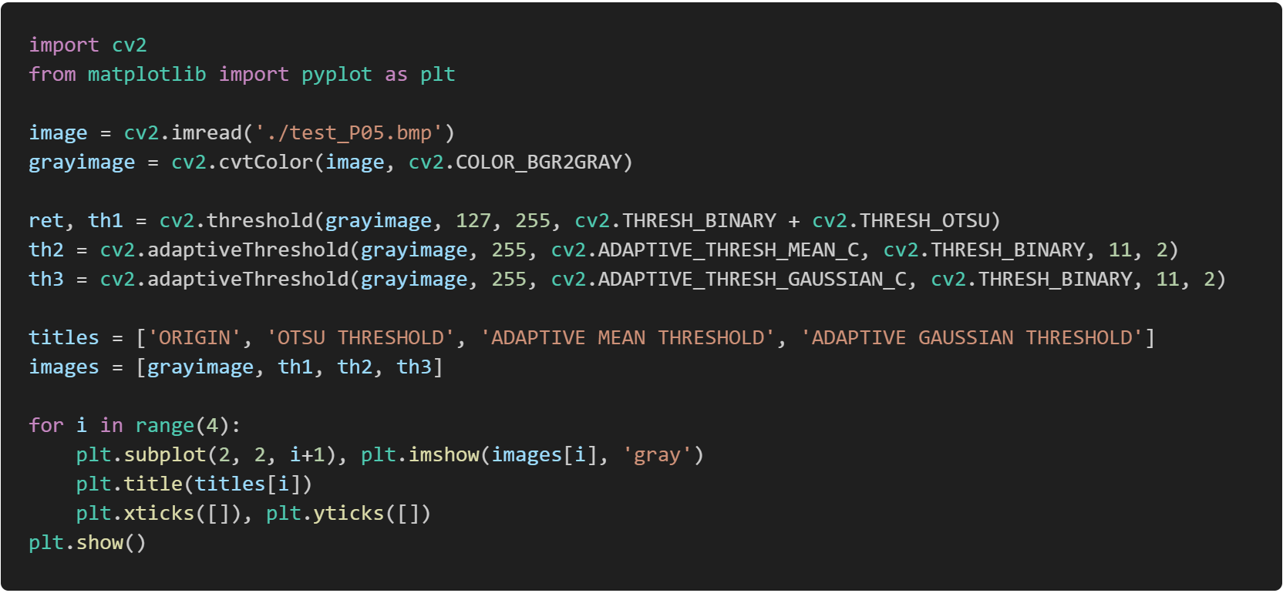
CODE

Slide 11
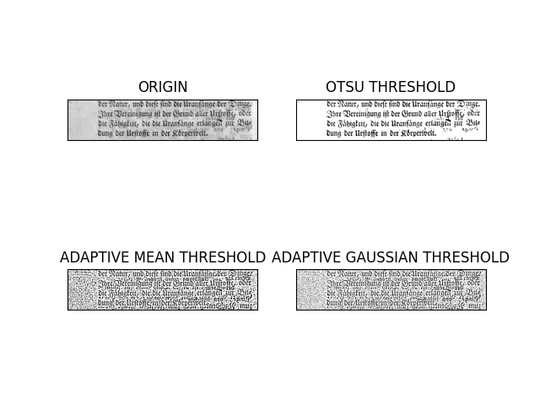
實作結果

Slide 12
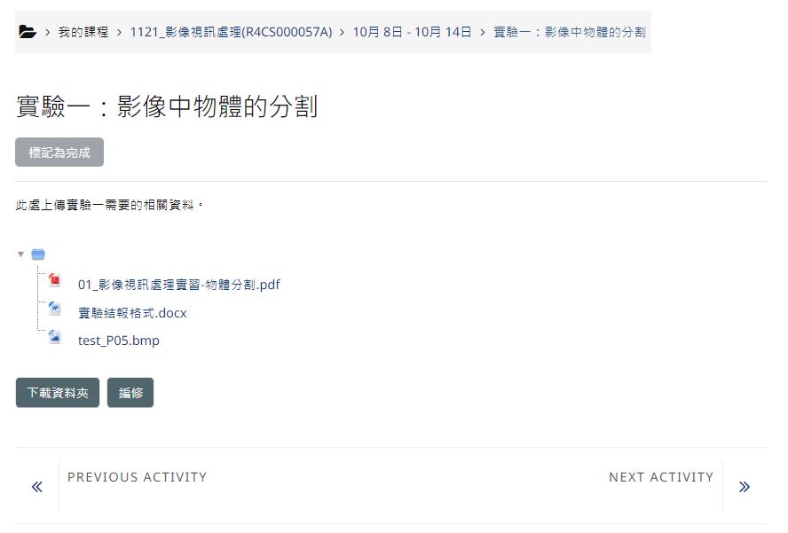
檔案命名規則
+
(組別)
實驗一：影像中物體的分割 (組別一)

Slide 13
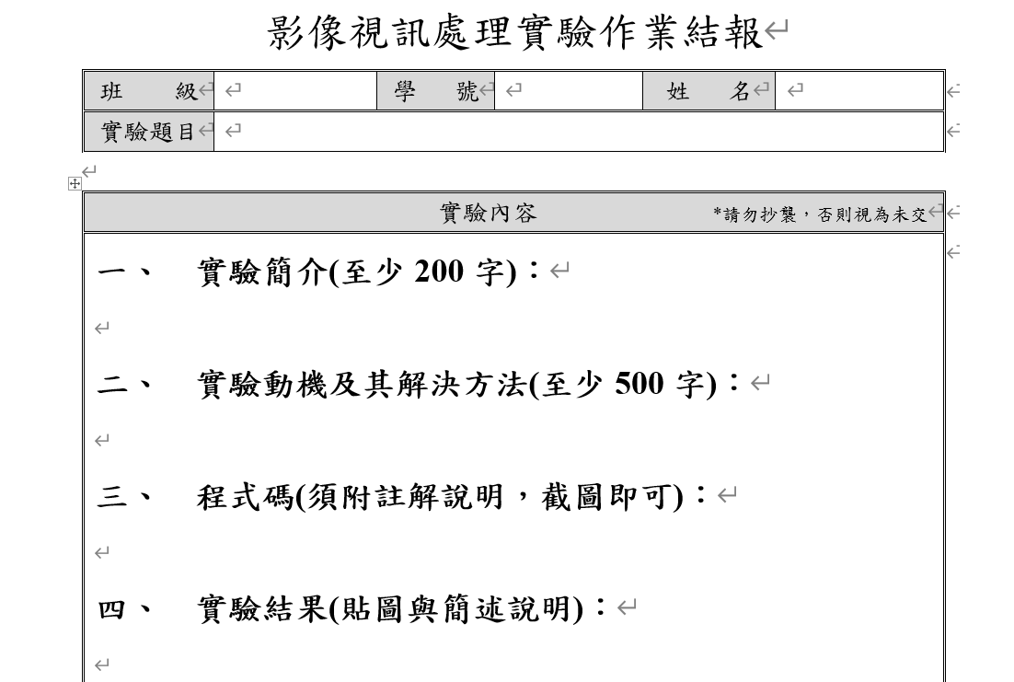
檔案內容
組長的
組長的
組長的

Slide 14
Thanks for listening

