Slide 1
提取輪廓

Slide 2
目標任務
對此次課程提供的影像使用Sobel運算子、Laplacian濾波器、Hough直線檢測進行邊緣檢測(Edge Detection)
使用函數：
cv2.Sobel
cv2.Laplacian
cv2.HoughLines
使用以下參數對影像做Sobel操作
使用cv2.CV_ 32F型態
使用尺寸為3的卷積核(Kernel)
使用cv2.threshold對Sobel處理後的影像進行細線化步驟
使用以下參數對影像做Laplacian操作
使用cv2.CV_8U型態
使用尺寸為3的卷積核(Kernel)
使用以下參數對影像做HoughLines操作
使用cv2.Canny處理後的輪廓影像作為輸入
設定rho的數值為1
設定theta的數值為np.pi/180
設定threshold的數值為200

Slide 3
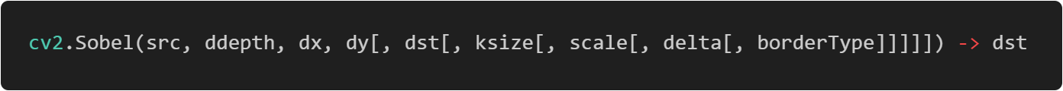
Sobel濾波器
Parameters | Description
src | input image.
dst | output image of the same size and the same number of channels as src .
ddepth | output image depth; in the case of 8-bit input images it will result in truncated derivatives.
dx | order of the derivative x.
dy | order of the derivative y.
ksize | size of the extended Sobel kernel; it must be 1, 3, 5, or 7.
scale | optional scale factor for the computed derivative values; by default, no scaling is applied.
delta | optional delta value that is added to the results prior to storing them in dst.
borderType | pixel extrapolation method. BORDER_WRAP is not supported.

Slide 4
Sobel Operator
Horizontal changes
-1 | 0 | 1
-2 | 0 | 2
-1 | 0 | 1
10 | 10 | 10 | 10 | 10 | 10
10 | 100 | 100 | 100 | 10 | 10
10 | 10 | 100 | 100 | 10 | 10
10 | 10 | 100 | 100 | 10 | 10
10 | 10 | 100 | 100 | 10 | 10
10 | 10 | 10 | 10 | 10 | 10
10 | 10 | 10 | 10 | 10 | 10
0 | 180 | 0 | 180 | 180 | 0
0 | 255 | 90 | 255 | 255 | 0
0 | 255 | 255 | 255 | 255 | 0
0 | 255 | 255 | 255 | 255 | 0
0 | 255 | 255 | 255 | 255 | 0
0 | 90 | 90 | 90 | 90 | 0
0 | 0 | 0 | 0 | 0 | 0
Vertical changes
-1 | -2 | -1
0 | 0 | 0
1 | 2 | 1

Slide 5
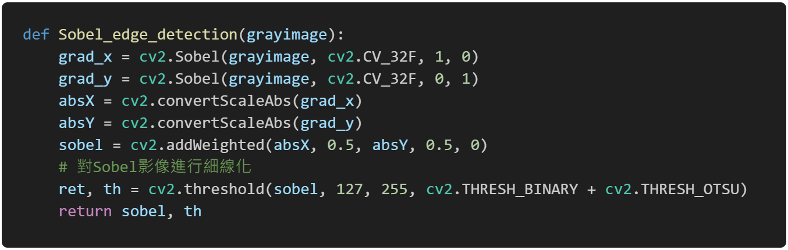
Sobel Operator

Slide 6

Laplacian Operator
Parameters | Description
src | input image.
dst | Destination image of the same size and the same number of channels as src .
ddepth | Desired depth of the destination image, see combinations.
ksize | Aperture size used to compute the second-derivative filters. The size must be positive and odd.
scale | Optional scale factor for the computed Laplacian values. By default, no scaling is applied.
delta | optional delta value that is added to the results prior to storing them in dst.
borderType | pixel extrapolation method. BORDER_WRAP is not supported.

Slide 7
Laplacian Operator
10 | 10 | 10 | 10 | 10 | 10
10 | 100 | 100 | 100 | 10 | 10
10 | 10 | 100 | 100 | 10 | 10
10 | 10 | 100 | 100 | 10 | 10
10 | 10 | 100 | 100 | 10 | 10
10 | 10 | 10 | 10 | 10 | 10
10 | 10 | 10 | 10 | 10 | 10
255 | 255 | 255 | 255 | 255 | 0
0 | 255 | 255 | 255 | 180 | 0
255 | 255 | 180 | 255 | 255 | 0
0 | 255 | 255 | 255 | 255 | 0
0 | 180 | 255 | 255 | 180 | 0
0 | 180 | 180 | 180 | 180 | 0
0 | 0 | 0 | 0 | 0 | 0
Laplacian
0 | 1 | 0
1 | -4 | 1
0 | 1 | 0

Slide 8
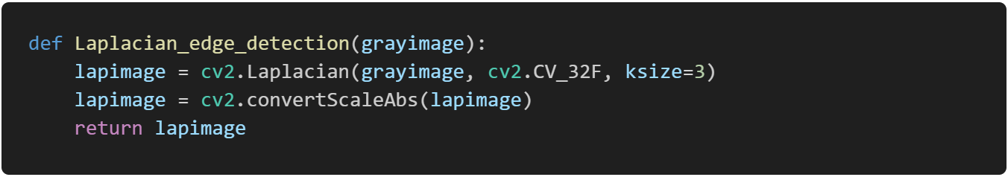
Laplacian Operator

Slide 9
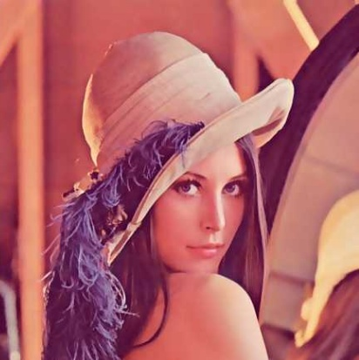
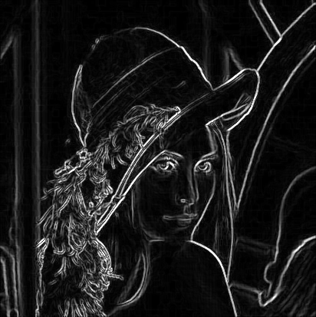
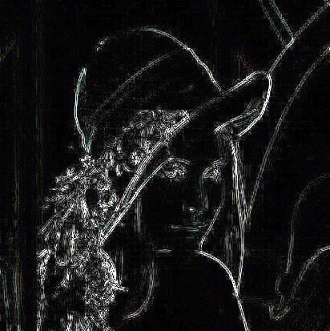
Operator Difference
ORIGIN
SOBEL
LAPLACIAN

Slide 10




Operator Difference
$$f$$
高頻特徵
Sobel Operator
$$f^{′}$$
Laplacian Operator
$$f^{′′}$$

Slide 11

Hough Line Transform
Parameters | Description
image | 8-bit, single-channel binary source image. The image may be modified by the function.
lines | Output vector of lines.
rho | Distance resolution of the accumulator in pixels.
theta | Angle resolution of the accumulator in radians.
threshold | Accumulator threshold parameter. Only those lines are returned that get enough votes.
srn | For the multi-scale Hough transform, it is a divisor for the distance resolution rho. The coarse accumulator distance resolution is rho and the accurate accumulator resolution is rho/srn. If both srn=0 and stn=0, the classical Hough transform is used. Otherwise, both these parameters should be positive.
stn | For the multi-scale Hough transform, it is a divisor for the distance resolution theta.
min_theta | For standard and multi-scale Hough transform, minimum angle to check for lines. Must fall between 0 and max_theta.
max_theta | For standard and multi-scale Hough transform, an upper bound for the angle. Must fall between min_theta and CV_PI. The actual maximum angle in the accumulator may be slightly less than max_theta, depending on the parameters min_theta and theta.

Slide 12
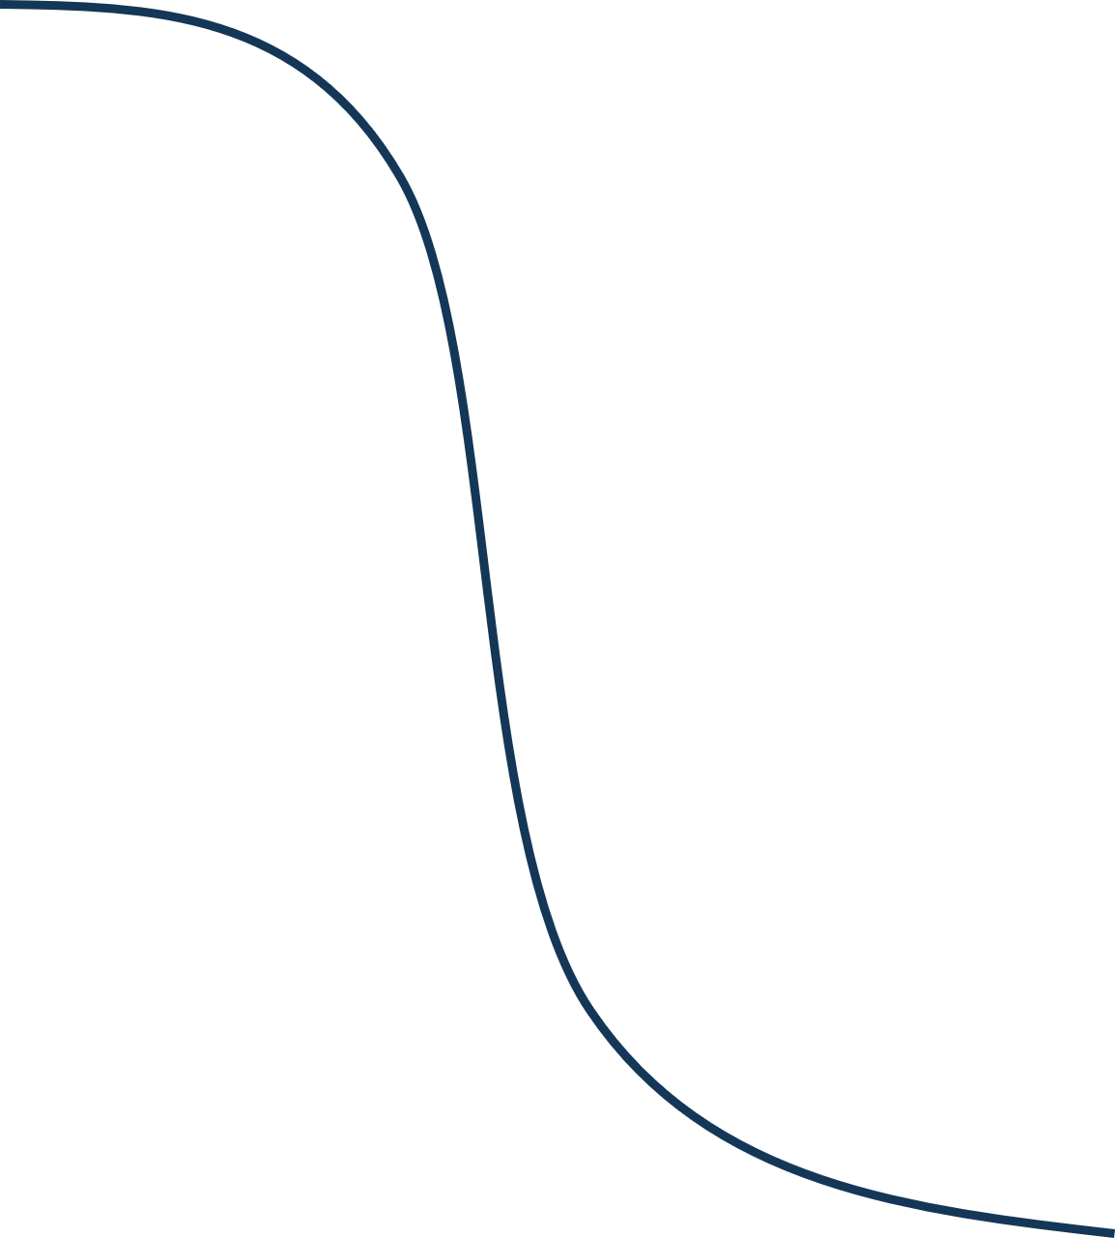
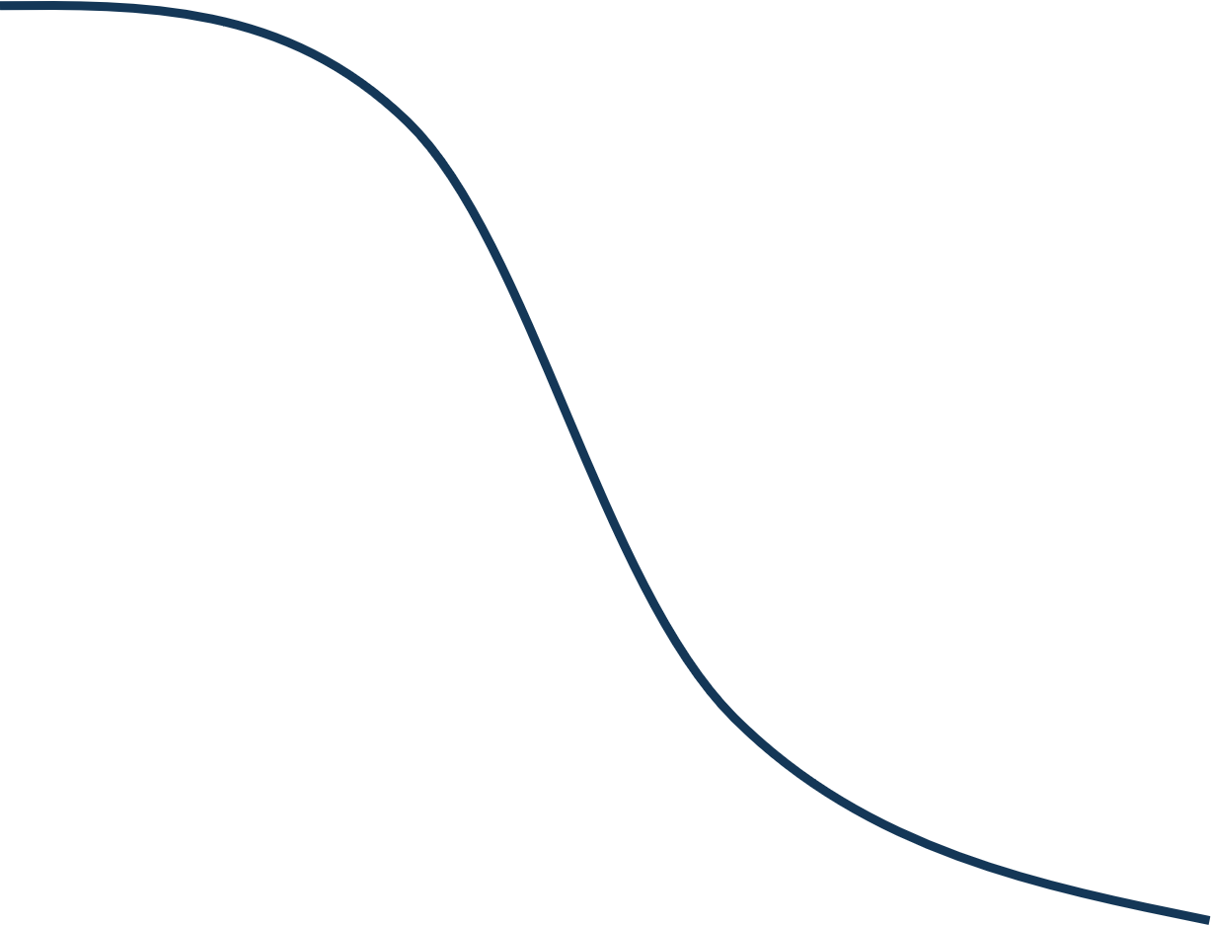













Hough Line Transform
$$y$$
$$ρ$$
$$ρ=x_{1}\cos{θ}+y_{1}\sin{θ}$$
$$(x_{1},y_{2})$$
$$ρ=x_{2}\cos{θ}+y_{2}\sin{θ}$$
$$(x_{2},y_{2})$$
$$ρ=x_{3}\cos{θ}+y_{3}\sin{θ}$$
$$(x_{3},y_{3})$$
$$ρ_{r}$$
$$(θ_{r},ρ_{r})$$
$$θ_{r}$$
$$θ$$
$$x$$
影像空間
(Image Space)
霍夫空間
(Hough Space)

Slide 13
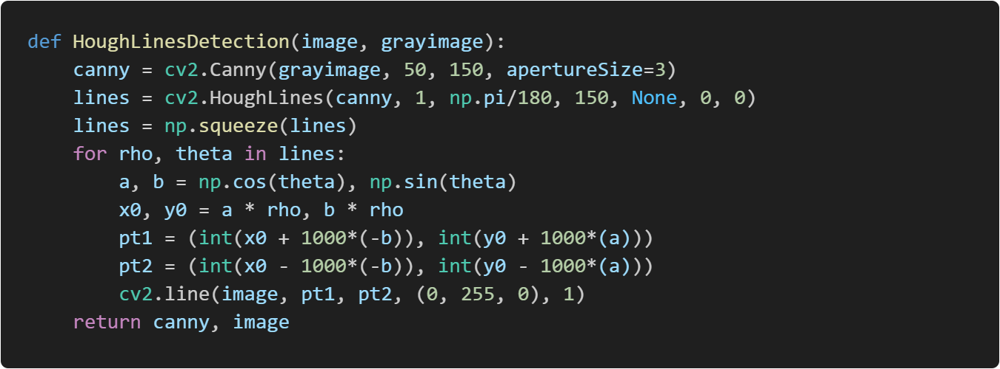
Hough Line Transform

Slide 14
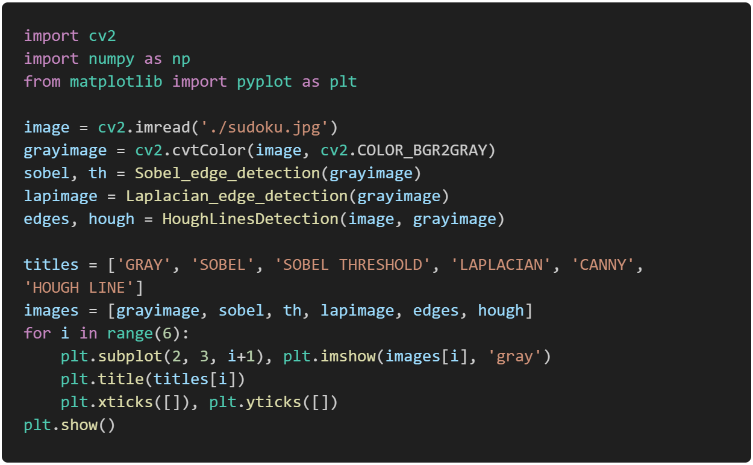
Main Function

Slide 15
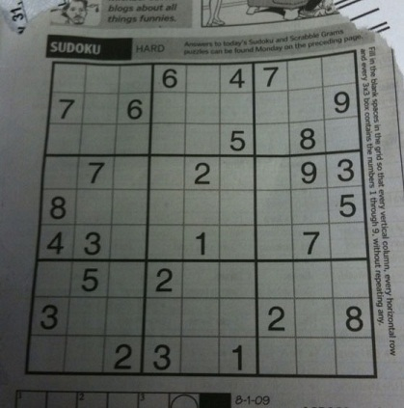
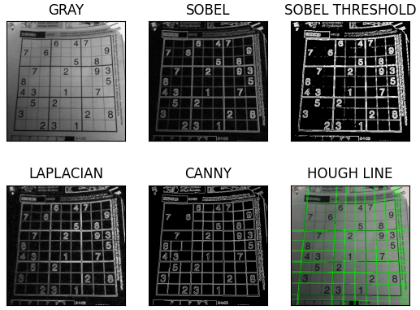
實作結果

Slide 16
Thanks for listening

