Slide 1
去除雜訊干擾

Slide 2
目標任務
對此次課程提供的影像使用中值濾波、均值濾波、高斯濾波，以及形態學進行去除雜訊干擾
使用函數：
cv2.medianBlur
cv2.blur
cv2.GaussianBlur
cv2.morphologyEx
使用以下參數對影像做(中值、均值、高斯)濾波操作：
Kernel_size：3
sigmaX：0 (only for gaussian)
sigmaY：0 (only for gaussian)
使用以下參數對影像做形態學操作：
Kernel_size：3
Operation：cv2.MORPH_RECT

Slide 3

01
OpenCV：Denoise

Slide 4
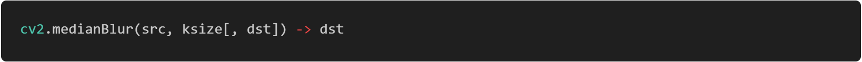
中值濾波
Parameters | Description
src | input 1-, 3-, or 4-channel image; when ksize is 3 or 5, the image depth should be CV_8U, CV_16U, or CV_32F, for larger aperture sizes, it can only be CV_8U.
dst | destination array of the same size and type as src.
ksize | aperture linear size; it must be odd and greater than 1, for example: 3, 5, 7 ...

Slide 5
中值濾波
10 | 10 | 10 | 10 | 10 | 10
10 | 100 | 100 | 100 | 10 | 10
10 | 10 | 100 | 100 | 10 | 10
10 | 10 | 100 | 100 | 10 | 10
10 | 10 | 100 | 100 | 10 | 10
10 | 10 | 10 | 10 | 10 | 10
10 | 10 | 10 | 10 | 10 | 10
10 | 10 | 10 | 10 | 10 | 10
10 | 10 | 100 | 10 | 10 | 10
10 | 10 | 100 | 100 | 10 | 10
10 | 10 | 100 | 100 | 10 | 10
10 | 10 | 10 | 10 | 10 | 10
10 | 10 | 10 | 10 | 10 | 10
10 | 10 | 10 | 10 | 10 | 10
[10, 10, 10, 100, 100, 100, 100, 100, 100]

Slide 6
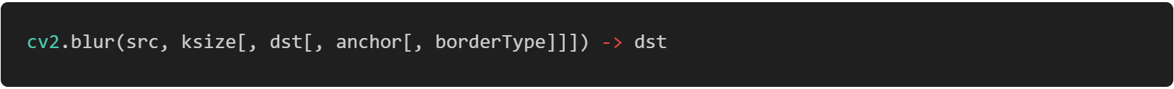
均值濾波
Parameters | Description
src | input image; the image can have any number of channels, which are processed independently, but the depth should be CV_8U, CV_16U, CV_16S, CV_32F or CV_64F.
dst | output image of the same size and type as src.
ksize | blurring kernel size.
anchor | anchor point; default value Point(-1,-1) means that the anchor is at the kernel center.
borderType | pixel extrapolation method. BORDER_WRAP is not supported.

Slide 7
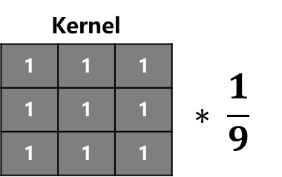
均值濾波
(100+100+100+10+100+100+10+100+100) / 9
10 | 10 | 10 | 10 | 10 | 10
10 | 100 | 100 | 100 | 10 | 10
10 | 10 | 100 | 100 | 10 | 10
10 | 10 | 100 | 100 | 10 | 10
10 | 10 | 100 | 100 | 10 | 10
10 | 10 | 10 | 10 | 10 | 10
10 | 10 | 10 | 10 | 10 | 10
50 | 50 | 70 | 50 | 30 | 10
30 | 40 | 60 | 50 | 30 | 10
30 | 50 | 80 | 70 | 40 | 10
10 | 40 | 70 | 70 | 40 | 10
10 | 30 | 50 | 50 | 30 | 10
10 | 20 | 30 | 30 | 20 | 10
10 | 10 | 10 | 10 | 10 | 10
Kernel
1 | 1 | 1 | $$∗ \frac{1}{9}$$
1 | 1 | 1
1 | 1 | 1

Slide 8
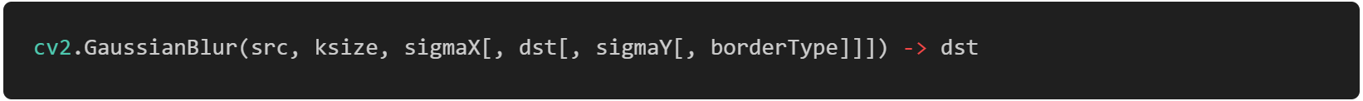
高斯濾波
Parameters | Description
src | input image; the image can have any number of channels, which are processed independently, but the depth should be CV_8U, CV_16U, CV_16S, CV_32F or CV_64F.
dst | output image of the same size and type as src.
ksize | Gaussian kernel size. ksize.width and ksize.height can differ but they both must be positive and odd. Or, they can be zero's and then they are computed from sigma.
sigmaX | Gaussian kernel standard deviation in X direction.
sigmaY | Gaussian kernel standard deviation in Y direction; if sigmaY is zero, it is set to be equal to sigmaX, if both sigmas are zeros, they are computed from ksize.width and ksize.height, respectively; to fully control the result regardless of possible future modifications of all this semantics, it is recommended to specify all of ksize, sigmaX, and sigmaY.
borderType | pixel extrapolation method. BORDER_WRAP is not supported.

Slide 9

高斯濾波
(100*1+100*2+100*1+10*2+100*4+100*2+10*1+100*2+100*1) / 16
10 | 10 | 10 | 10 | 10 | 10
10 | 100 | 100 | 100 | 10 | 10
10 | 10 | 100 | 100 | 10 | 10
10 | 10 | 100 | 100 | 10 | 10
10 | 10 | 100 | 100 | 10 | 10
10 | 10 | 10 | 10 | 10 | 10
10 | 10 | 10 | 10 | 10 | 10
33 | 44 | 55 | 44 | 21 | 10
33 | 49 | 72 | 61 | 27 | 10
21 | 44 | 83 | 78 | 33 | 10
10 | 33 | 78 | 78 | 33 | 10
10 | 27 | 61 | 61 | 27 | 10
10 | 16 | 27 | 27 | 16 | 10
10 | 10 | 10 | 10 | 10 | 10
Kernel
1 | 2 | 1 | $$∗ \frac{1}{16}$$
2 | 4 | 2
1 | 2 | 1

Slide 10
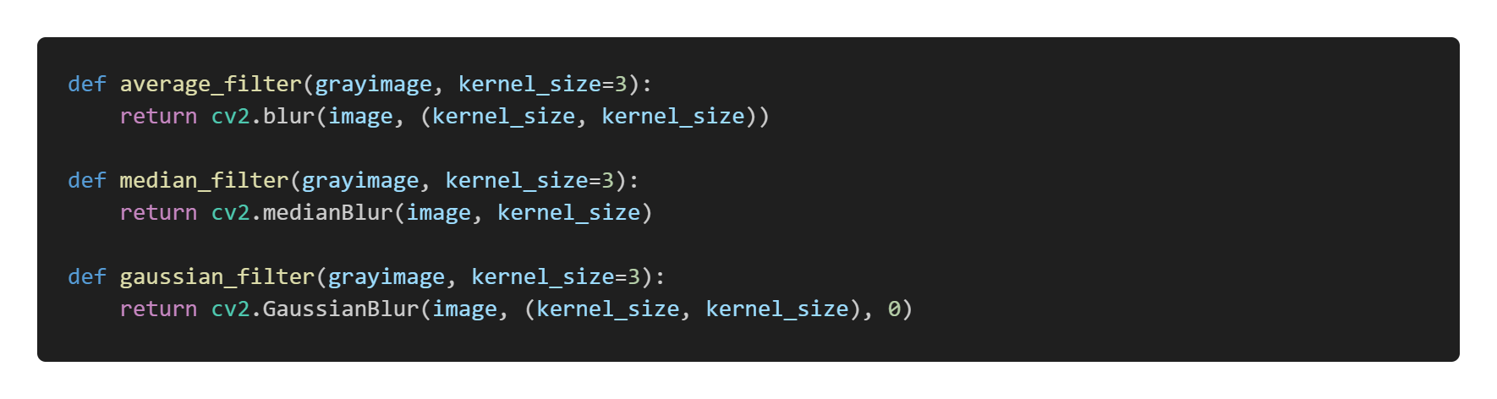
濾波操作

Slide 11
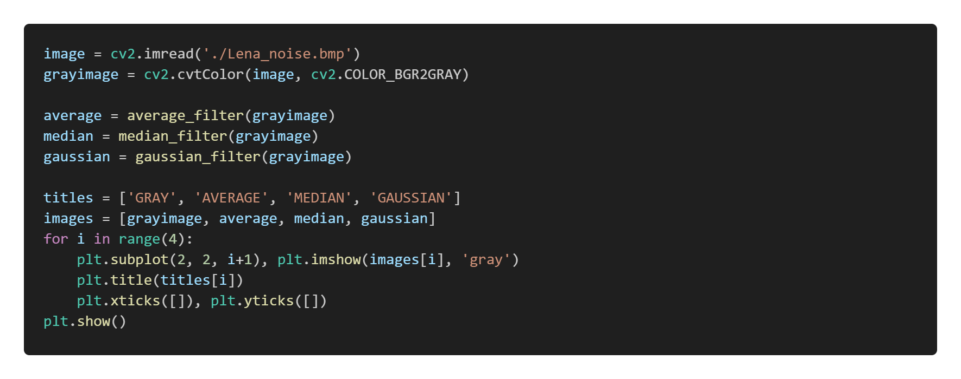
主程式

Slide 12
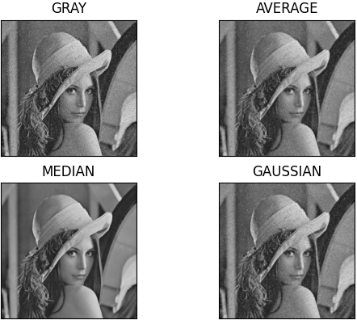
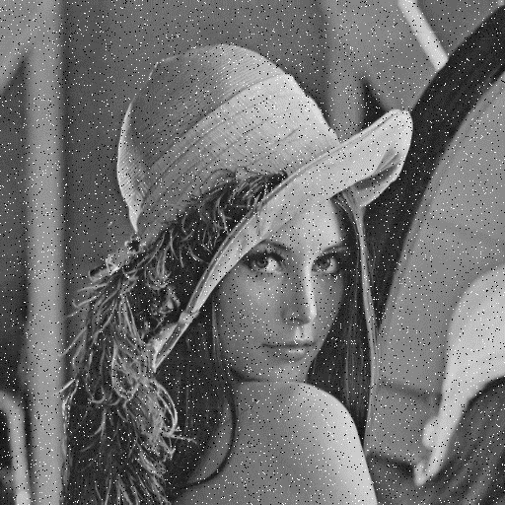
實作結果

Slide 13
02
OpenCV：Morphology

Slide 14
卷積核結構
0 | 0 | 1 | 0 | 0
0 | 0 | 1 | 0 | 0
1 | 1 | 1 | 1 | 1
0 | 0 | 1 | 0 | 0
0 | 0 | 1 | 0 | 0
0 | 0 | 1 | 0 | 0
1 | 1 | 1 | 1 | 1
1 | 1 | 1 | 1 | 1
1 | 1 | 1 | 1 | 1
0 | 0 | 1 | 0 | 0
1 | 1 | 1 | 1 | 1
1 | 1 | 1 | 1 | 1
1 | 1 | 1 | 1 | 1
1 | 1 | 1 | 1 | 1
1 | 1 | 1 | 1 | 1
cv2.MORPH_CROSS
cv2.MORPH_ELLIPSE
cv2.MORPH_RECT
Shape | Description
cv2.MORPH_CROSS | 生成由0、1構成的十字架卷積核
cv2.MORPH_ELLIPSE | 生成由0、1構成的橢圓形卷積核
cv2.MORPH_RECT | 生成全為1的方形卷積核

Slide 15

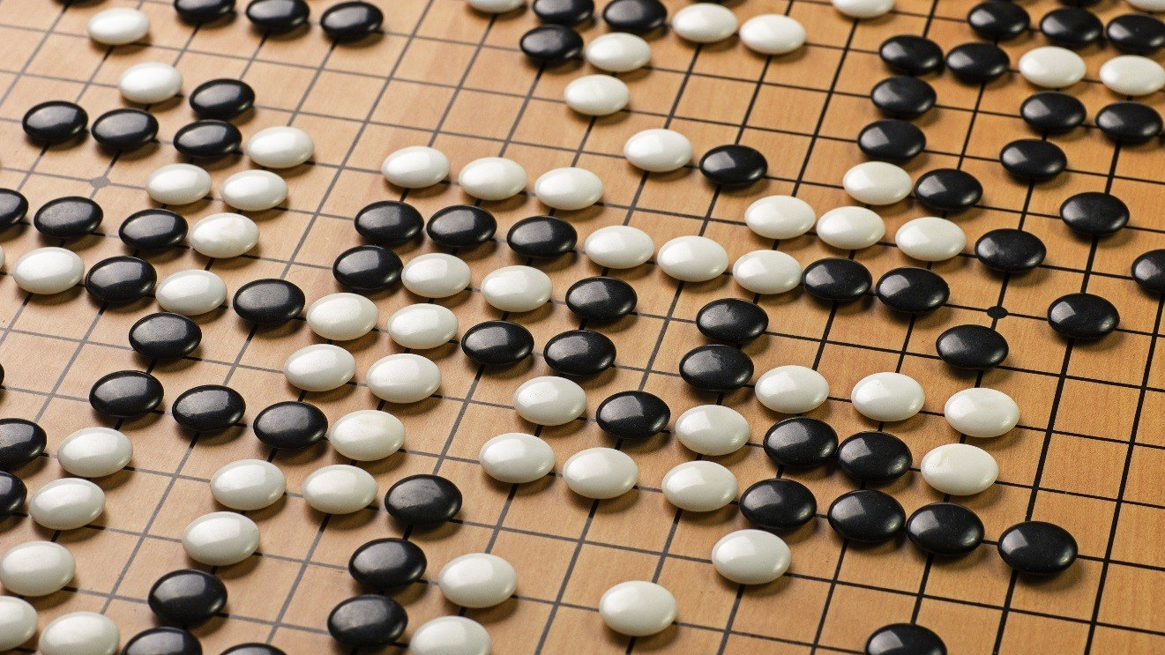


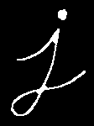

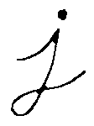

膨脹 & 侵蝕
原圖
膨脹
侵蝕

Slide 16
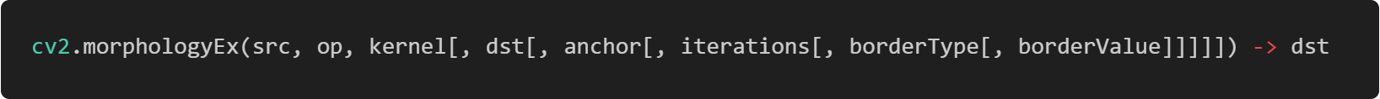
形態學
Parameters | Description
src | Source image. The number of channels can be arbitrary. The depth should be one of CV_8U, CV_16U, CV_16S, CV_32F or CV_64F.
dst | Destination image of the same size and type as source image.
op | Type of a morphological operation.
kernel | Structuring element. It can be created using getStructuringElement.
anchor | Anchor position with the kernel. Negative values mean that the anchor is at the kernel center.
iterations | Number of times erosion and dilation are applied.
borderType | pixel extrapolation method. BORDER_WRAP is not supported.
borderValue | Border value in case of a constant border. The default value has a special meaning.

Slide 17
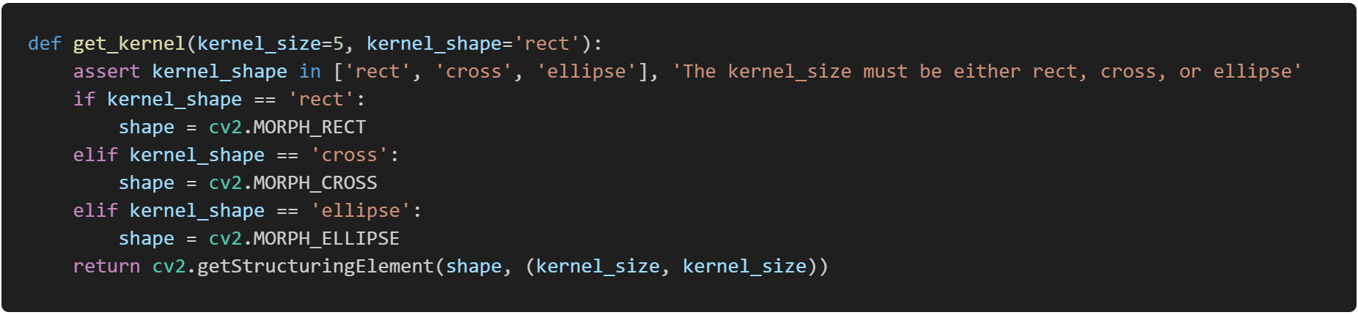
取得卷積核

Slide 18
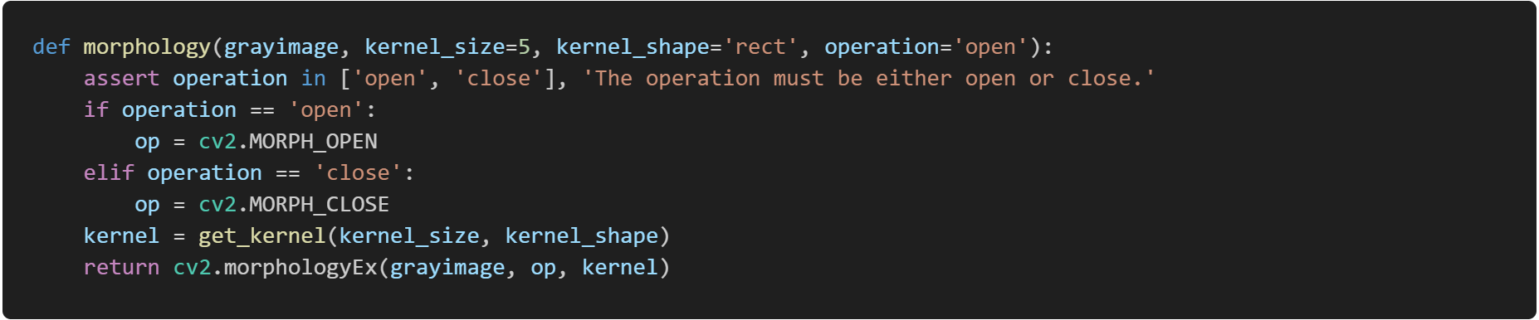
形態學操作

Slide 19
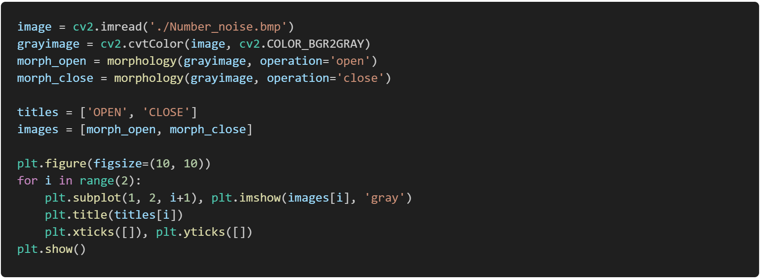
主程式

Slide 20
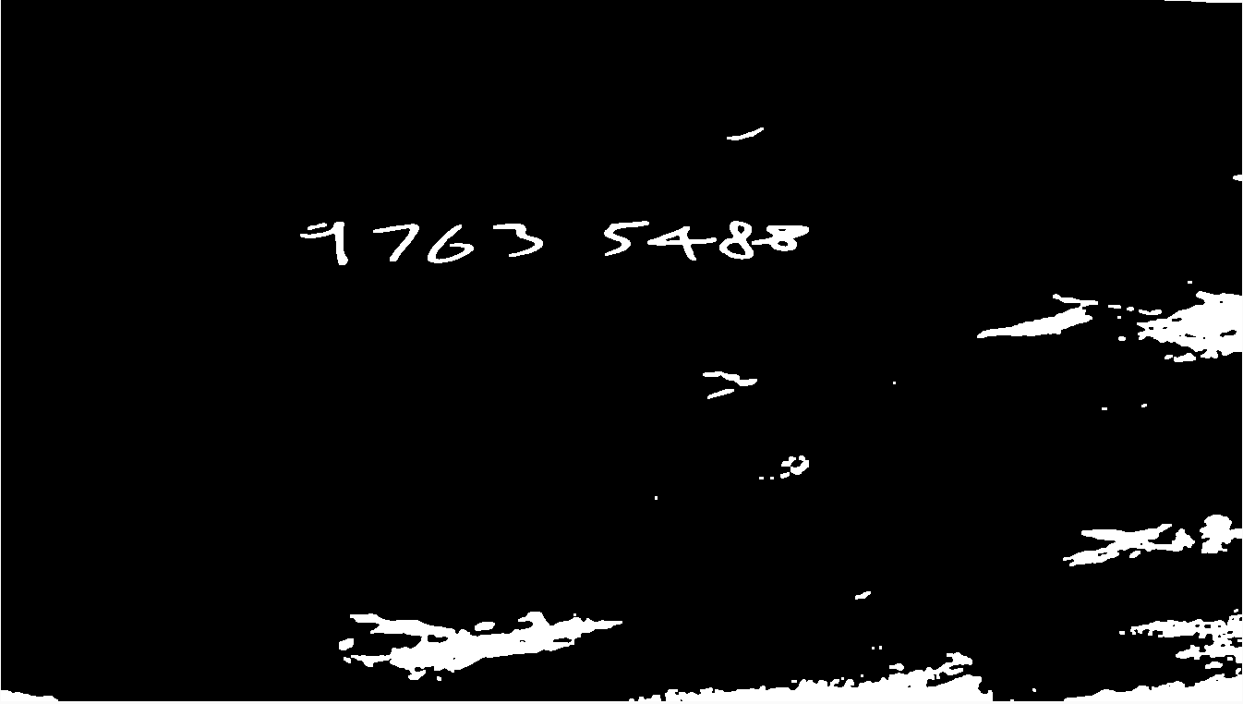
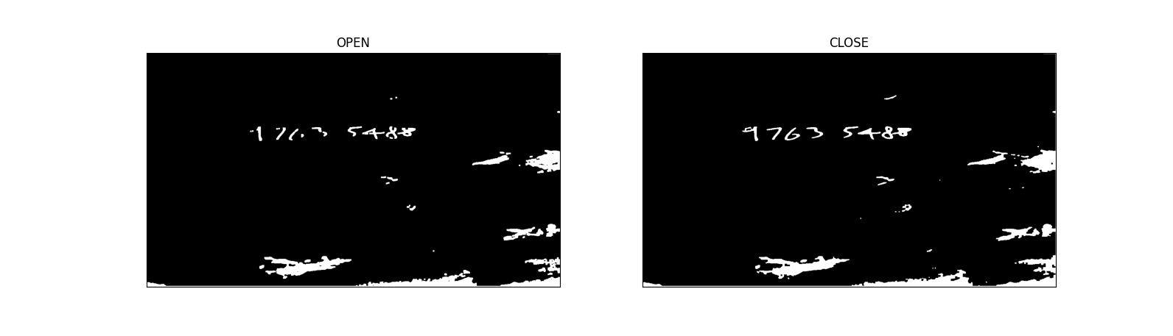
實作結果

Slide 21
Thanks for listening

