Slide 1
影像強化處理

Slide 2
目標任務
對此次課程提供的影像使用直方圖等化(Histogram Equalization, HE)和限制對比度自適應直方圖等化(Contrast Limited Adaptive Histogram Equalization, CLAHE)進行影像增強(Image Enhancement)
使用函數：
cv2.equalizeHist
cv2.createCLAHE
使用以下參數對影像做CLAHE操作：
clipLimit：2.0
tileGridSize：8

Slide 3

01
OpenCV：Histogram

Slide 4

影像直方圖
Parameters | Description
images | Source arrays. They all should have the same depth, CV_8U, CV_16U or CV_32F , and the same size. Each of them can have an arbitrary number of channels.
channels | List of the dims channels used to compute the histogram. The first array channels are numerated from 0 to images[0].channels()-1 , the second array channels are counted from images[0].channels() to images[0].channels() + images[1].channels()-1, and so on.
mask | Optional mask. If the matrix is not empty, it must be an 8-bit array of the same size as images[i] . The non-zero mask elements mark the array elements counted in the histogram.
histSize | Array of histogram sizes in each dimension.
ranges | Array of the dims arrays of the histogram bin boundaries in each dimension. (see more…)
hist | Output histogram, which is a dense or sparse dims -dimensional array.
accumulate | Accumulation flag. If it is set, the histogram is not cleared in the beginning when it is allocated. This feature enables you to compute a single histogram from several sets of arrays, or to update the histogram in time.

Slide 5
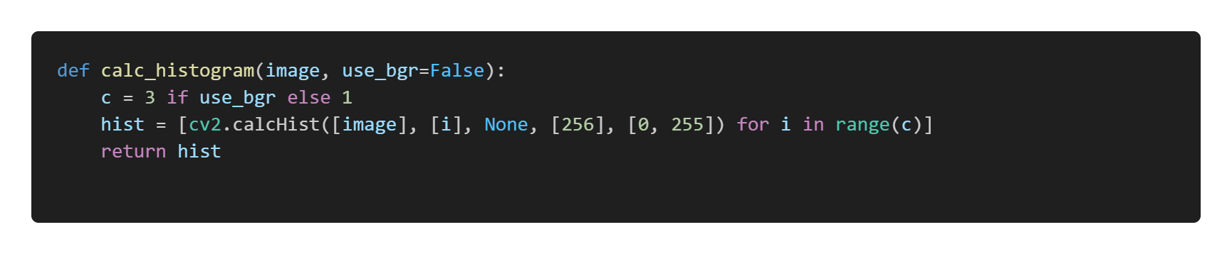
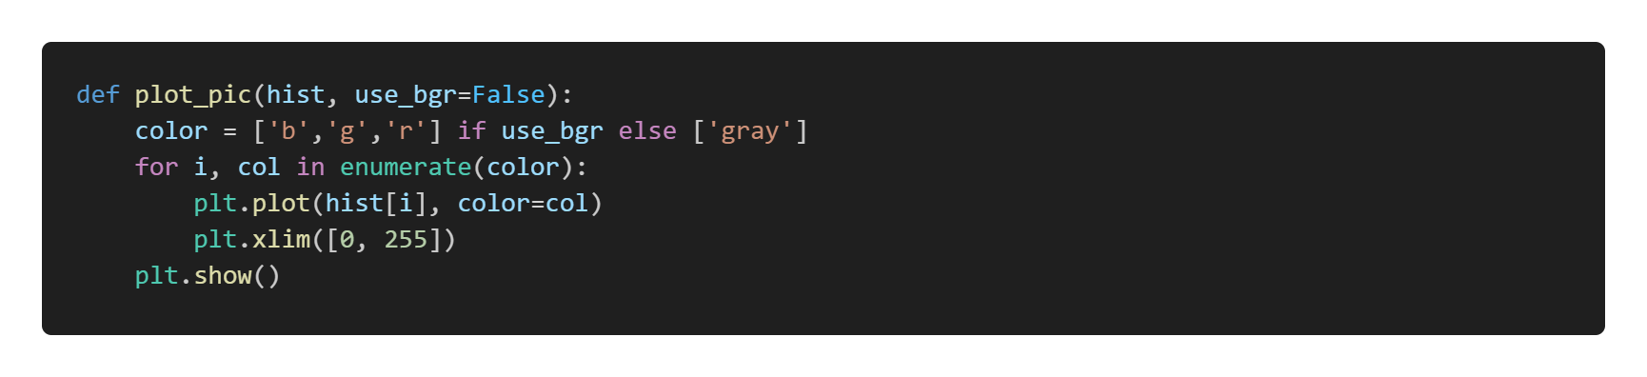
影像直方圖

Slide 6
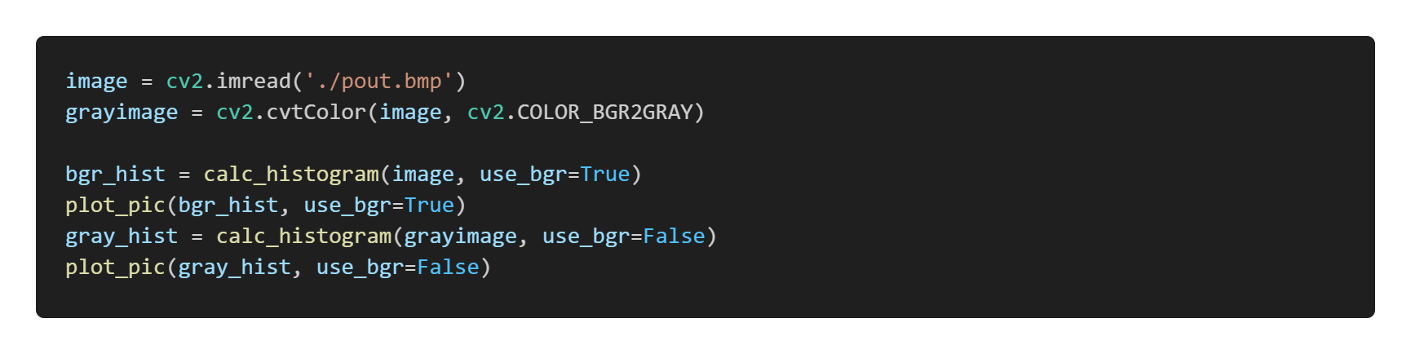
影像直方圖

Slide 7

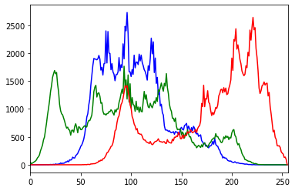
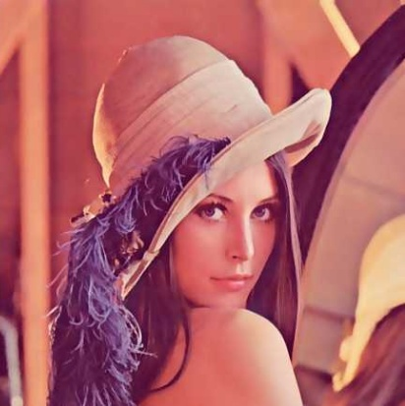
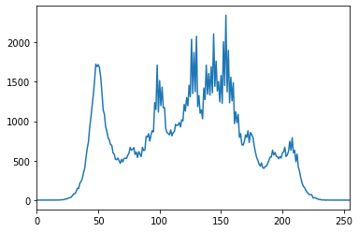
影像直方圖

Slide 8
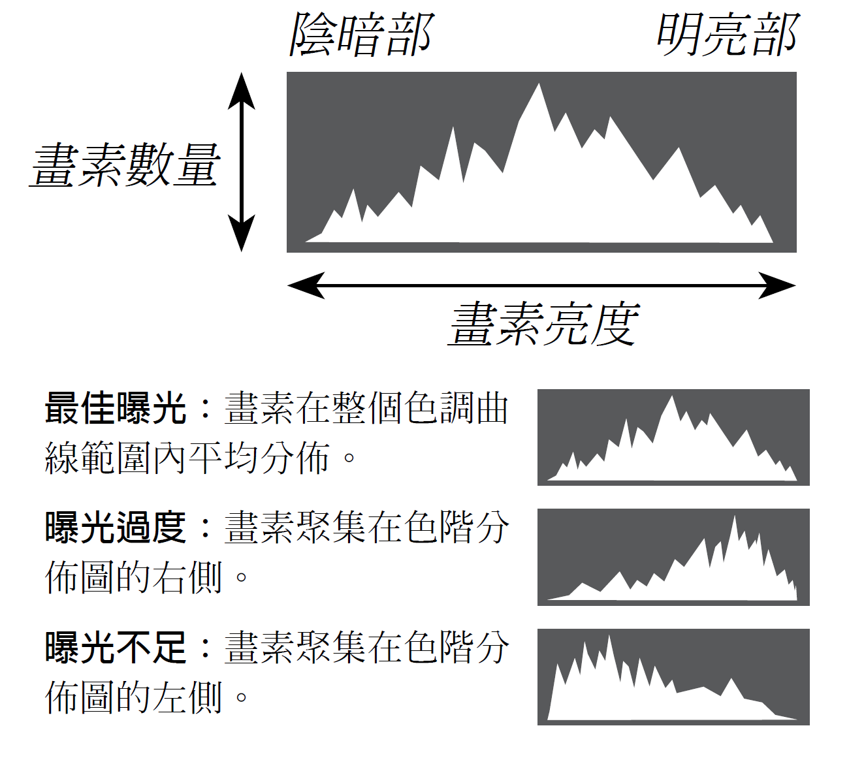
影像直方圖
富士相機Fujifilm Taiwan

Slide 9

直方圖等化
Parameters | Description
src | Source 8-bit single channel image.
dst | Destination image of the same size and type as src .

Slide 10
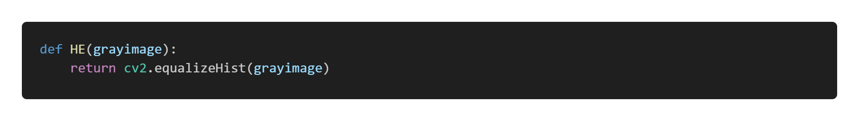
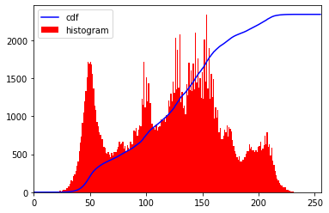

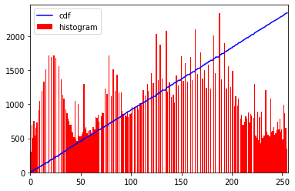
直方圖等化

Slide 11
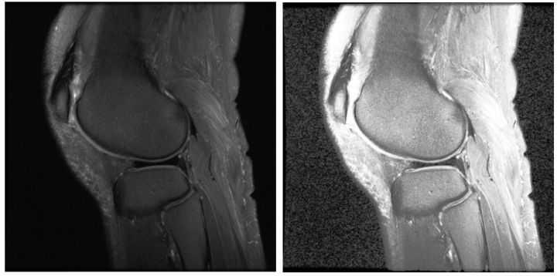
直方圖等化

Slide 12

限制對比度自適應直方圖等化
Parameters | Description
clipLimit | Threshold for contrast limiting.
tileGridSize | Size of grid for histogram equalization. Input image will be divided into equally sized rectangular tiles. tileGridSize defines the number of tiles in row and column.

Slide 13
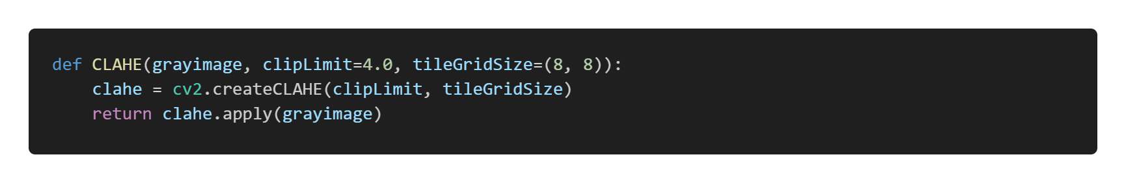
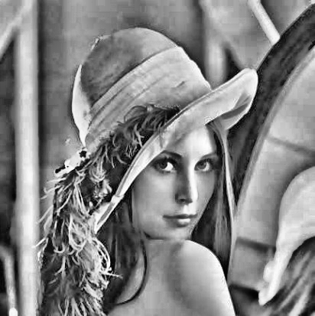
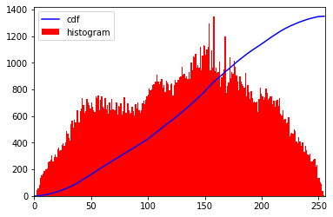
限制對比度自適應直方圖等化

Slide 14
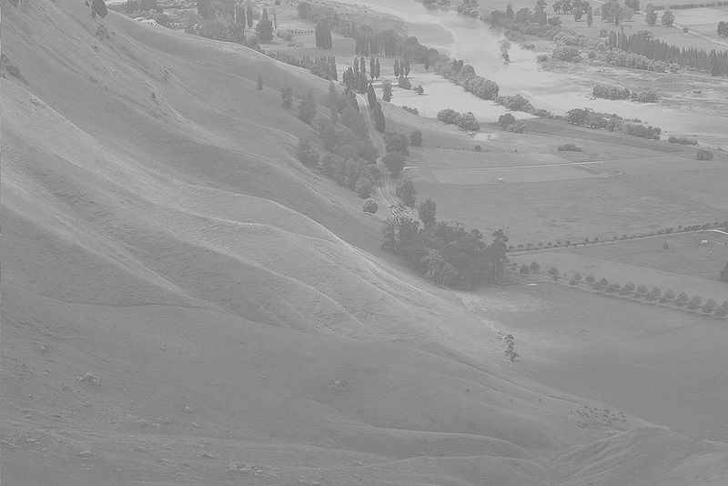
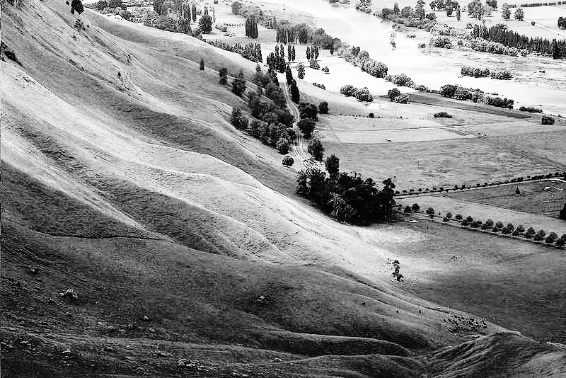
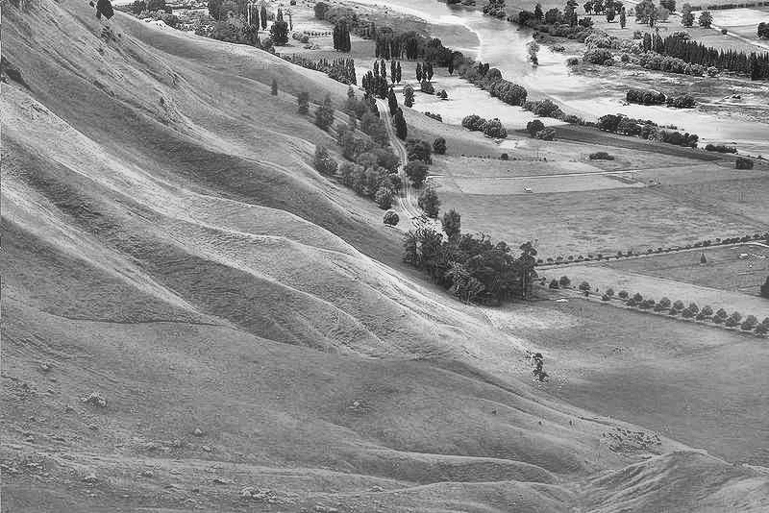
超級比一比
原圖
HE
CLAHE
S. Jenifer, S. Parasuraman, and A. Kadirvelu, “Contrast enhancement and brightness preserving of digital mammograms using fuzzy clipped contrast-limited adaptive histogram equalization algorithm,” Applied Soft Computing, vol. 42, pp. 167-177, 2016.

Slide 15
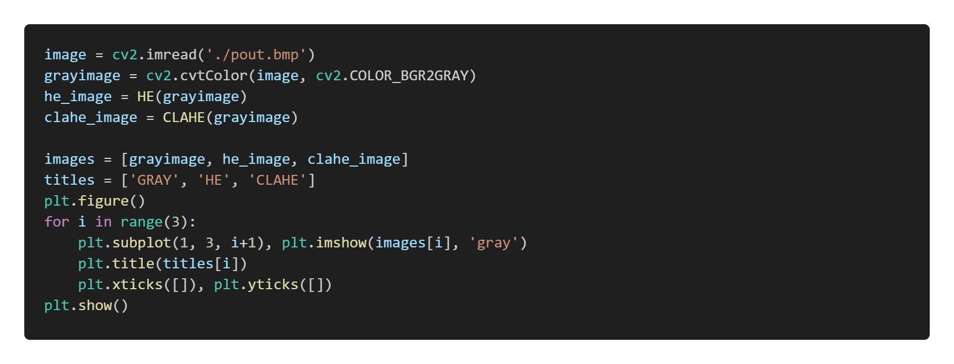
主程式

Slide 16
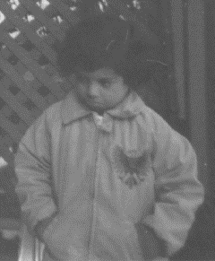
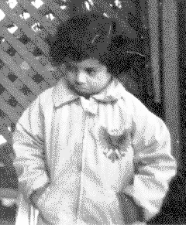
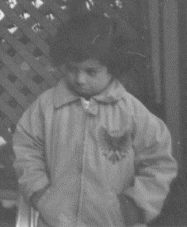
實作結果
原圖
HE
CLAHE

Slide 17
Thanks for listening

