Slide 1
EQUIPMENT’S CLASSROOM MANAGEMENT
Group 10:
Trần Vĩnh Quang – SE61078
Tăng Việt Hưng – SE61019
Đoàn Nguyễn Minh Chí – SE60717
Supervisor:
Kiều Trọng Khánh

Slide 2

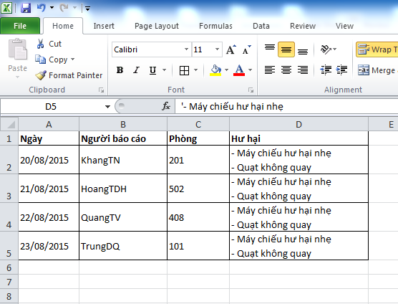


Slide 3





Slide 4
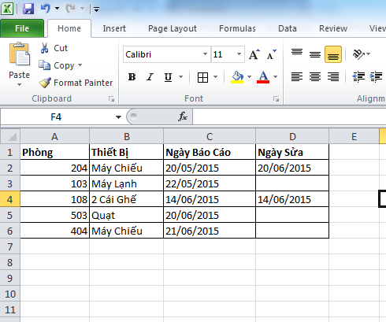


Slide 5
Disadvantage
Waste time
Require human resource
Hard to manage
Hard to notice about changing

Slide 6
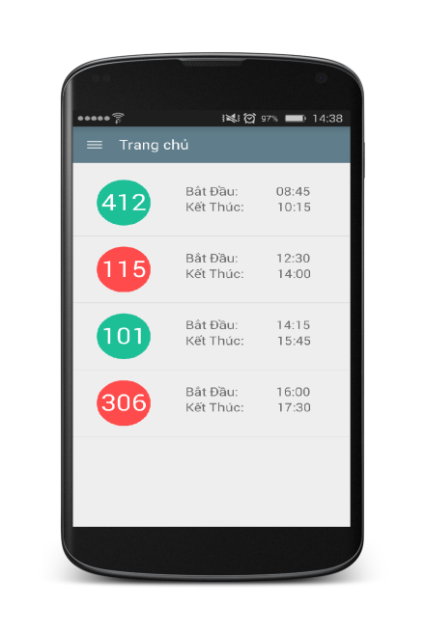

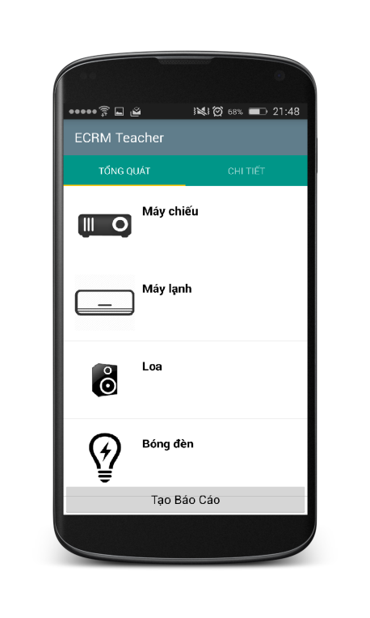
Create Report

Slide 7





Create Report

Slide 8
Analyze data and make decision

Slide 9
1. Get all newest reports
Classroom name
List of equipment and evaluation of each
Evaluation of teacher about classroom

Slide 10

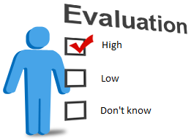


2. Check damaged level of reported classroom
High
Medium
Low
Damaged level

Slide 11



Priority: Medium
Evaluation: Don’t know
Damaged level = 30
Priority: High
Evaluation: Don’t know
Damaged level = 50
Evaluation: Don’t know
Number: 3
Damaged level = 15
Damaged level of classroom: 95%
Change room

Slide 12




3. Get all schedule and change room:
Find available classroom
Change room

Slide 13
Find available classroom
Classroom name: 205
Room type: “25 chỗ”
202
303
201
301
402
101
503
201
202
101
301
303
402
503
101
201
202
301
303
402
503
Compare room type
Sort
Undamaged classrooms
Result list
Result: 205 -> 101

Slide 14

At 06:00 and 12:15 everyday

Slide 15
At 07:00 everyday

Slide 16

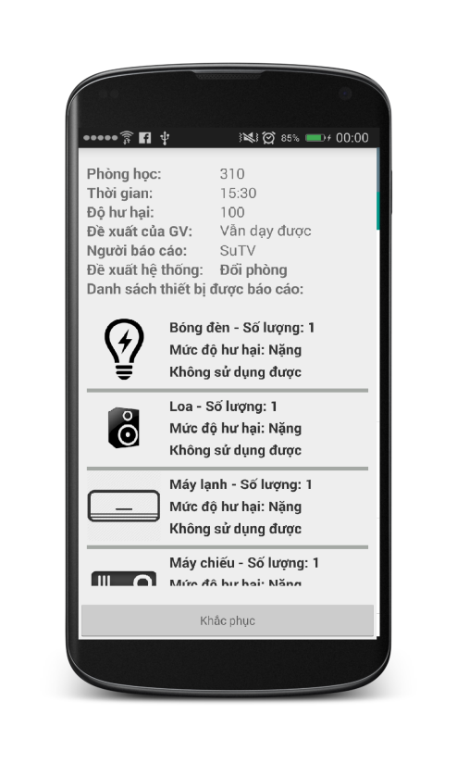

Resolve Report

Slide 17
Q&A

