Slide 1
EQUIPMENT’S CLASSROOM MANAGEMENT
Group 10:
Trần Vĩnh Quang – SE61078
Tăng Việt Hưng – SE61019
Đoàn Nguyễn Minh Chí – SE60717
Supervisor:
Kiều Trọng Khánh

Slide 2

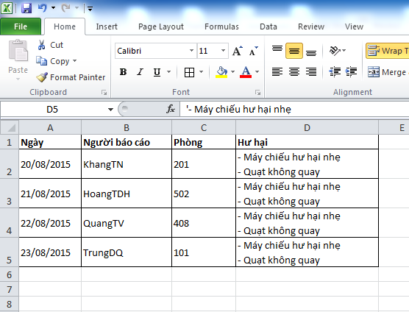


Slide 3





Slide 4
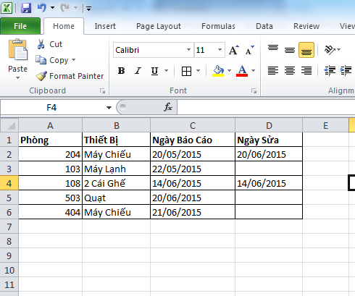


Slide 5
Disadvantage
Waste time
Require human resource
Hard to manage
Hard to notice about changing

Slide 6
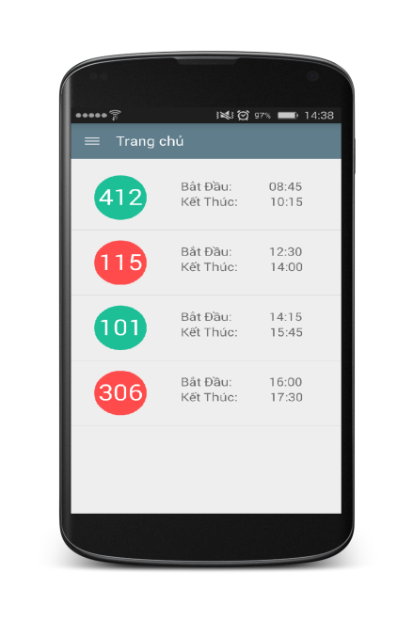

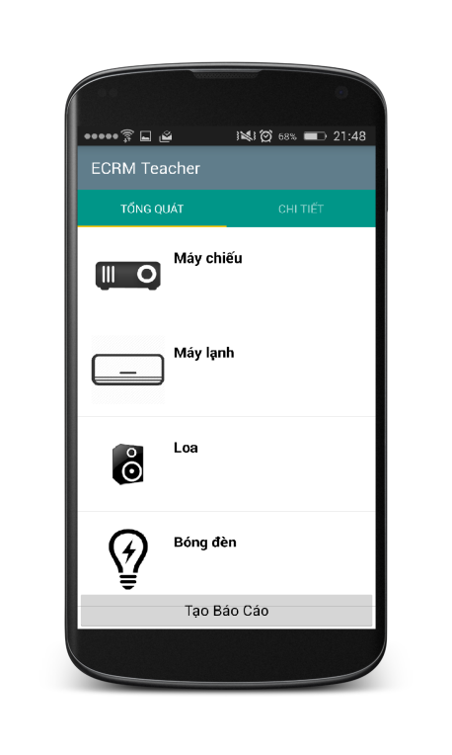
Create Report

Slide 7





Create Report

Slide 8

At 06:00 and 12:15 everyday

Slide 9
At 07:00 everyday

Slide 10

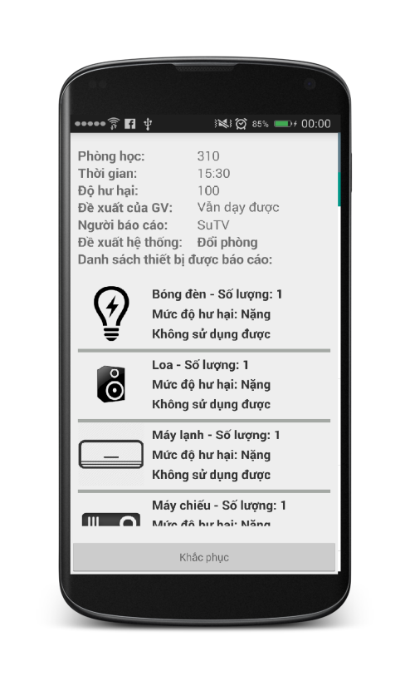

Resolve Report

Slide 11
Q&A

