Slide 1
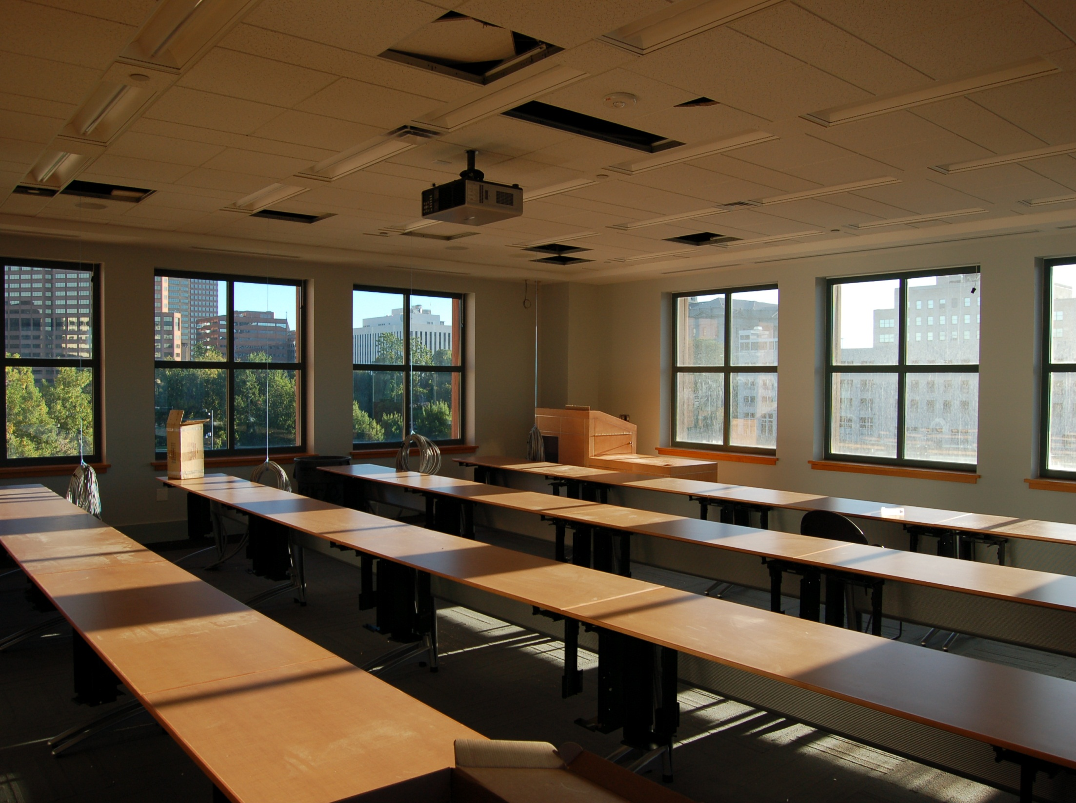
EQUIPMENT’S CLASSROOM MANAGEMENT
Group 10:
Trần Vĩnh Quang – SE61078
Tăng Việt Hưng – SE61019
Đoàn Nguyễn Minh Chí – SE60717
Supervisor:
Kiều Trọng Khánh

Slide 2

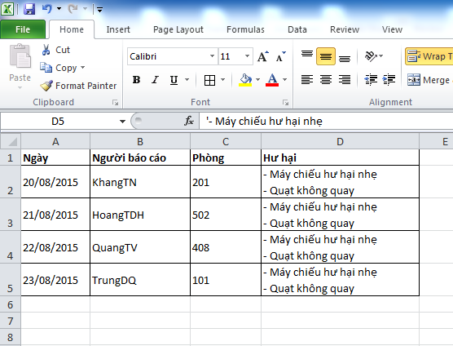





Slide 3
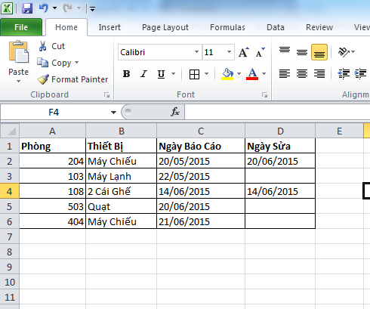


Slide 4
Disadvantage
Waste time
Require human resource
Hard to manage
Hard to notice about changing

Slide 5
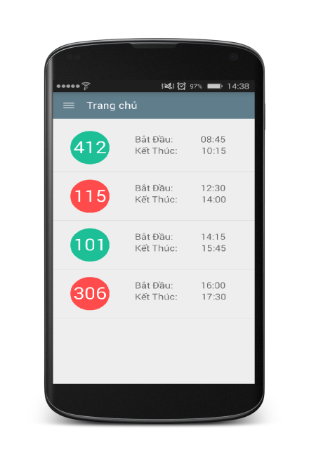

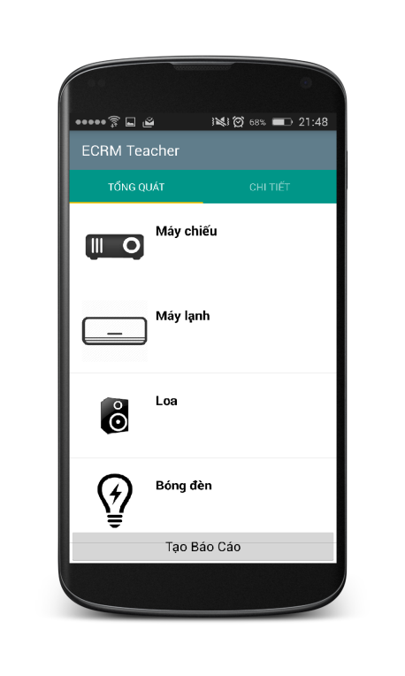
Create Report

Slide 6





Create Report

Slide 7

At 06:00 and 12:15 everyday

Slide 8
At 07:00 everyday

Slide 9

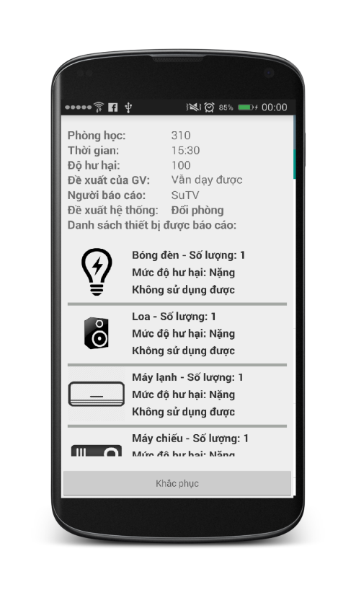

Resolve Report

Slide 10
Q&A

