Slide 1

Chapter 6:
Functions

Slide 2
6.1
Modular Programming

Slide 3

Modular Programming
Modular programming: breaking a program up into smaller, manageable functions or modules
Function: a collection of statements to perform a task
Motivation for modular programming:
  Improves maintainability of programs
  Simplifies the process of writing programs

Slide 4
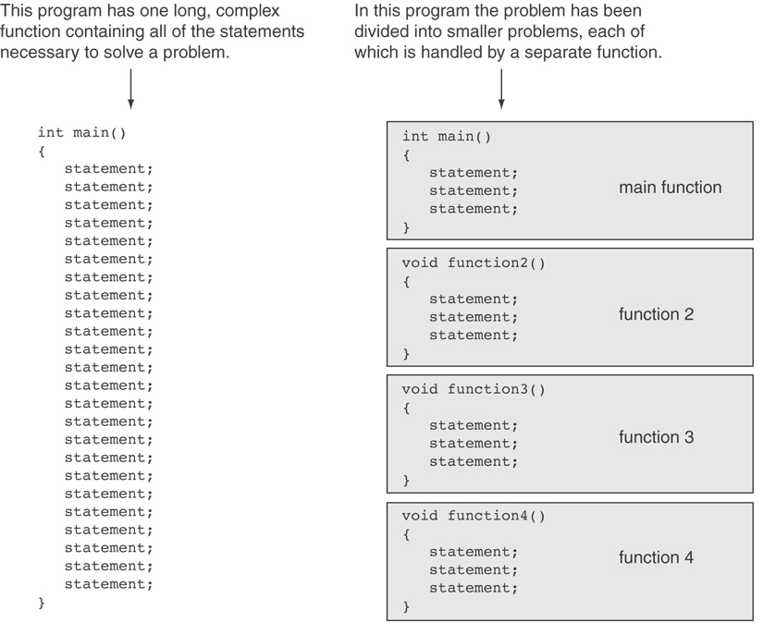

Slide 5
6.2
Defining and Calling Functions

Slide 6
Defining and Calling Functions
Function definition: statements that make up a function
Function call: statement causes a function to execute

Slide 7
Function Definition
Definition includes:
  return type: data type of the value that function returns to the part of the program that called it
  name: name of the function. Function names follow same rules as variables
  parameter list: variables containing values passed to the function
  body: statements that perform the function’s task, enclosed in {}

Slide 8
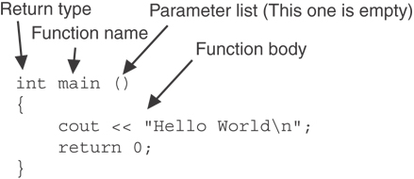
Function Definition
Note: The line that reads int main()is the function header.

Slide 9
Function Return Type
If a function returns a value, the type of the value must be indicated:
  string printHeading()
  {
  return "Monthly Sales\n";
  }
If a function does not return a value, its return type is void:
  void printHeading()
  {
  cout << "Monthly Sales\n";
  }

Slide 10
Calling a Function
To call a function, use the function name followed by () and ;
  printHeading();
When called, program executes the body of the called function
After the function terminates, execution resumes in the calling function at point of call.

Slide 11
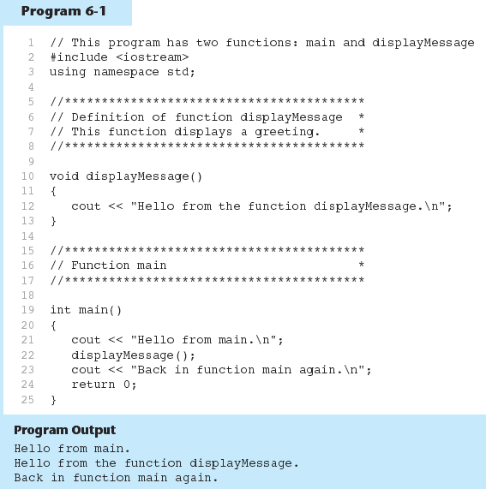
Functions in Program 6-1

Slide 12
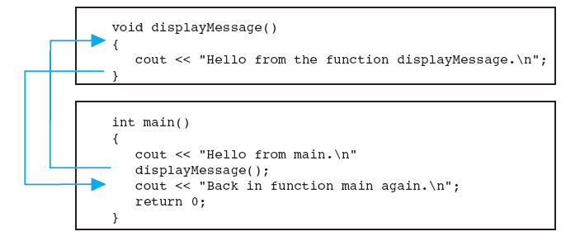
Flow of Control in Program 6-1

Slide 13
Calling Functions
main can call any number of functions
Functions can call other functions
Compiler must know the following about a function before it is called:
  name
  return type
  number of parameters
  data type of each parameter

Slide 14
6.3
Function Prototypes

Slide 15
Function Prototypes
Ways to notify the compiler about a function before a call to the function:
  Place function definition before calling function’s definition
  Use a function prototype (function declaration) – like the function definition without the body
    Header: void printHeading()
    Prototype: void printHeading();

Slide 16
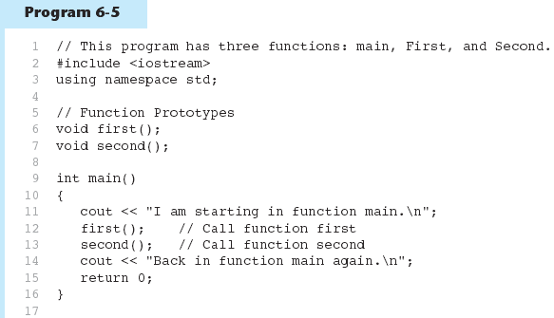
Function Prototypes in Program 6-5
(Program Continues)

Slide 17
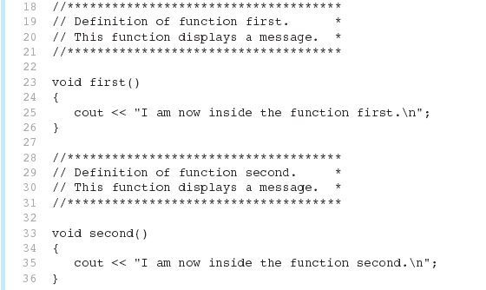
Function Prototypes in Program 6-5

Slide 18
6.4
Sending Data into a Function

Slide 19
Sending Data into a Function
Can pass values into a function at time of call:
  c = pow(a, b);
Values passed to function are arguments
Variables in a function that hold the values passed as arguments are parameters

Slide 20
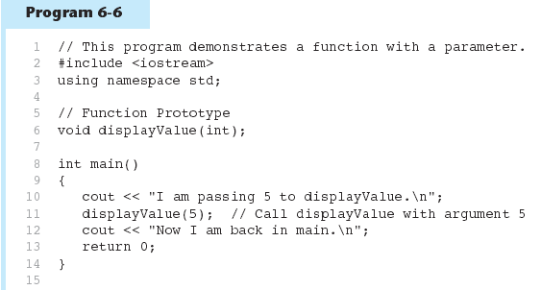
Function with a Parameter in Program 6-6
(Program Continues)

Slide 21
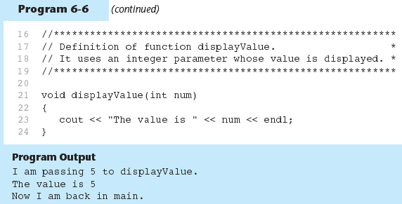
Function with a Parameter in Program 6-6

Slide 22
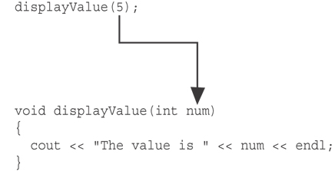
Function with a Parameter in Program 6-6
The function call in line 11 passes the value 5
as an argument to the function.

Slide 23
Other Parameter Terminology
A parameter can also be called a formal parameter or a formal argument
An argument can also be called an actual parameter or an actual argument

Slide 24
Passing Multiple Arguments
When calling a function and passing multiple arguments:
  the number of arguments in the call must match the prototype and definition
  the first argument will be used to initialize the first parameter, the second argument to initialize the second parameter, etc.

Slide 25
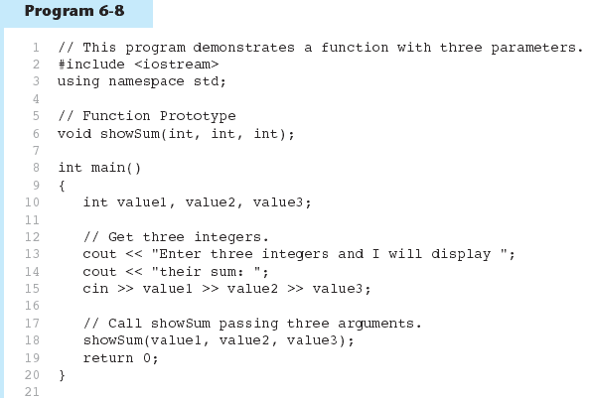
Passing Multiple Arguments in Program 6-8
(Program Continues)

Slide 26
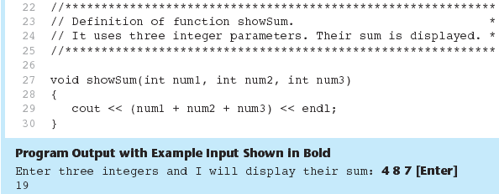
Passing Multiple Arguments in Program 6-8

Slide 27
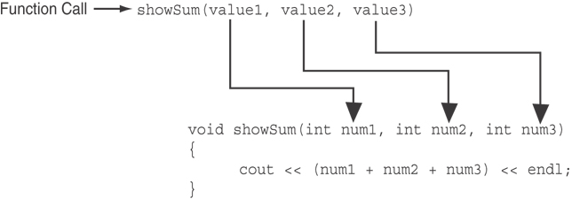
Passing Multiple Arguments in Program 6-8
The function call in line 18 passes value1,
value2, and value3 as a arguments to the
function.

Slide 28
6.5
Passing Data by Value

Slide 29
Passing Data by Value
Pass by value: when an argument is passed to a function, its value is copied into the parameter.
Changes to the parameter in the function do not affect the value of the argument

Slide 30
Passing Data by Value
void change(int a)
{
  a = 10;
  cout << a << endl;
}
int main()
{
  int a = 5;
  change(a);
  cout << a << endl;
  return 0;
}

Slide 31
6.7
The return Statement

Slide 32
The return Statement
Used to end execution of a function
Can be placed anywhere in a function
  Statements that follow the return statement will not be executed

Slide 33
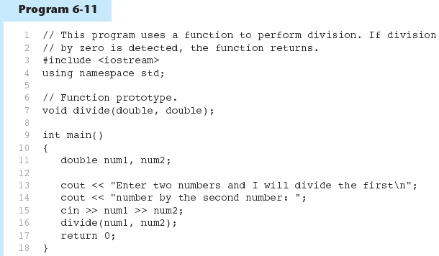
Performing Division in Program 6-11
(Program Continues)

Slide 34
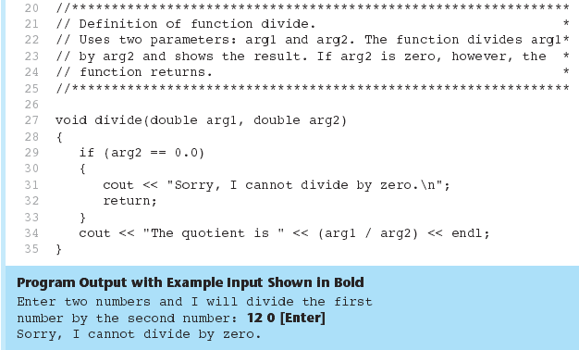
Performing Division in Program 6-11

Slide 35
6.8
Returning a Value From a Function

Slide 36
Returning a Value From a Function
A function can return a value back to the statement that called the function.
You've already seen the pow function, which returns a value:
double x;
x = pow(2.0, 10.0);

Slide 37
Returning a Value From a Function
In a value-returning function, the return statement can be used to return a value from function to the point of call. Example:
int sum(int num1, int num2)
{
double result;
result = num1 + num2;
return result;
}
Return Type
Value Being Returned

Slide 38
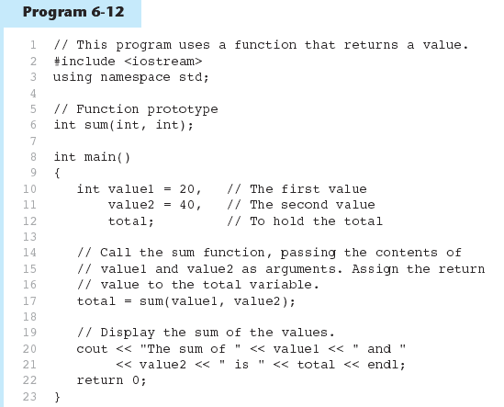
Function Returning a Value in Program 6-12
(Program Continues)

Slide 39
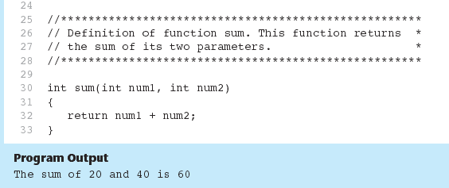
Function Returning a Value in Program 6-12

Slide 40
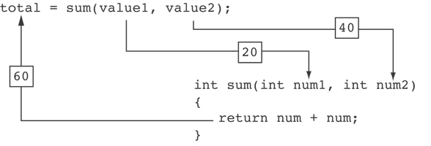
Function Returning a Value in Program 6-12
The statement in line 17 calls the sum function, passing value1 and value2 as arguments. The return value is assigned to the total variable.

Slide 41
6.9
Returning a Boolean Value

Slide 42
Returning a Boolean Value
Function can return true or false
Declare return type in function prototype and heading as bool
Calling function can use return value in a relational expression

Slide 43
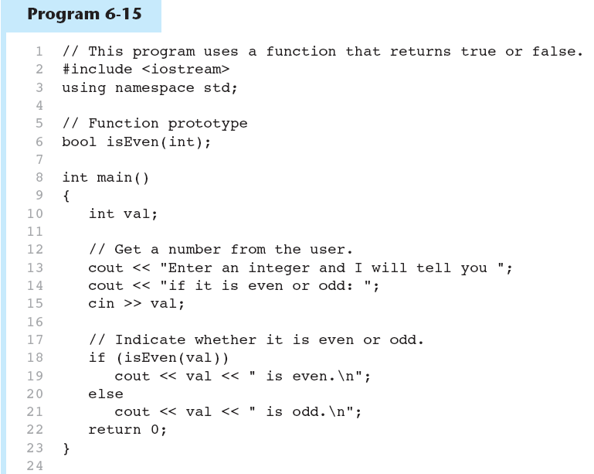
Returning a Boolean Value in Program 6-15
(Program Continues)

Slide 44
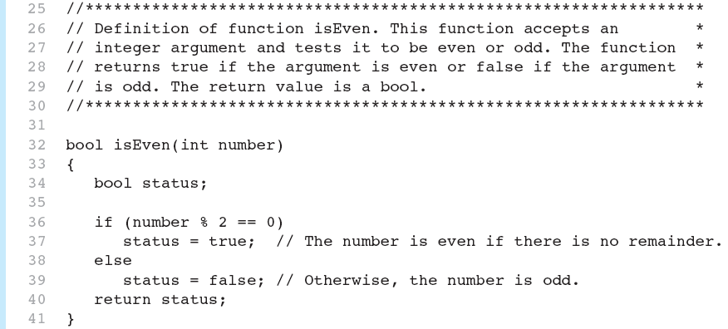

Returning a Boolean Value in Program 6-15

Slide 45
6.10
Local and Global Variables

Slide 46
Local Variables
Variables defined inside a function are local to that function. They are hidden from the statements in other functions, which normally cannot access them.
Because the variables defined in a function are hidden, other functions may have separate, distinct variables with the same name.

Slide 47
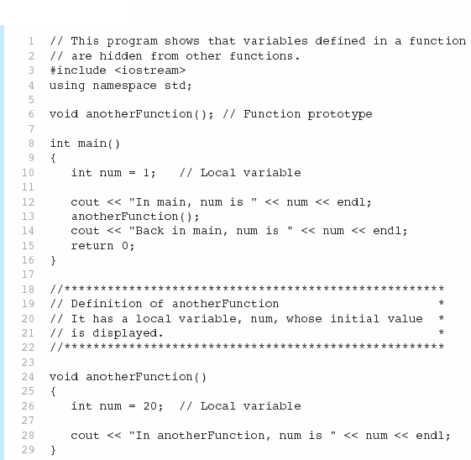

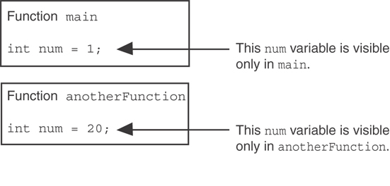

Local Variables in Program 6-16

Slide 48
Local Variable Lifetime
A function’s local variables exist only while the function is executing. This is known as the lifetime of a local variable.
When the function begins, its local variables and its parameter variables are created in memory, and when the function ends, the local variables and parameter variables are destroyed.
This means that any value stored in a local variable is lost between calls to the function in which the variable is declared.

Slide 49
Global Variables and Global Constants
A global variable is any variable defined outside all the functions in a program.
The scope of a global variable is the portion of the program from the variable definition to the end.
This means that a global variable can be accessed by all functions that are defined after the global variable is defined.
You should avoid using global variables because they make programs difficult to debug.
Any global that you create should be global constants.

Slide 50
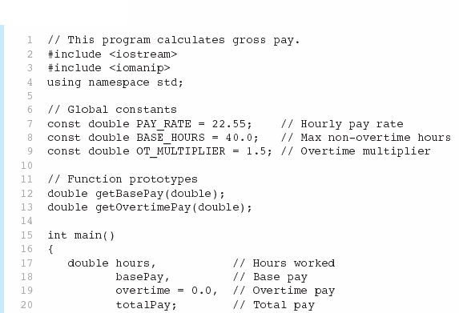

Global Constants in Program 6-19
Global constants defined for values that do not change throughout the program’s execution.

Slide 51



Global Constants in Program 6-19
The constants are then used for those values throughout the program.

Slide 52
Initializing Local and Global Variables
Local variables are not automatically initialized. They must be initialized by programmer.
Global variables (not constants) are automatically initialized to 0 (numeric) or NULL (character) when the variable is defined.

Slide 53
6.11
Static Local Variables

Slide 54
Static Local Variables
Local variables only exist while the function is executing. When the function terminates, the contents of local variables are lost.
static local variables retain their contents between function calls.
static local variables are defined and initialized only the first time the function is executed. 0 is the default initialization value.

Slide 55
Static Local Variables Example
void showLocal()
{
  int a = 0;
  cout << a << endl;
  a++;
}
void showStatic()
{
  static int a;
  cout << a << endl;
  a++;
}
int main()
{
  for (int i = 1; i <= 5; i++)
    showLocal();
  for (int i = 1; i <= 5; i++)
    showStatic();
  return 0;
}

Slide 56
6.12
Default Arguments

Slide 57
Default Arguments
A Default argument is an argument that is passed automatically to a parameter if the argument is missing on the function call.
Must be a constant declared in prototype:
  void evenOrOdd(int = 0);
Can be declared in header if no prototype
Multi-parameter functions may have default arguments for some or all of them:
  int getSum(int, int=0, int=0);

Slide 58
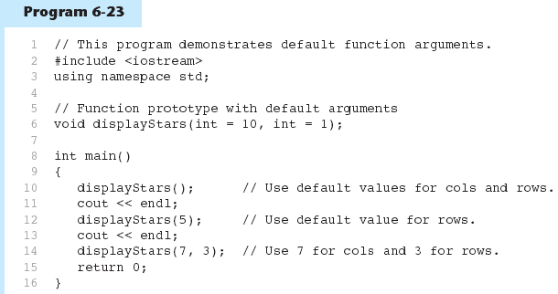

Default Arguments in Program 6-24
Default arguments specified in the prototype
(Program Continues)

Slide 59
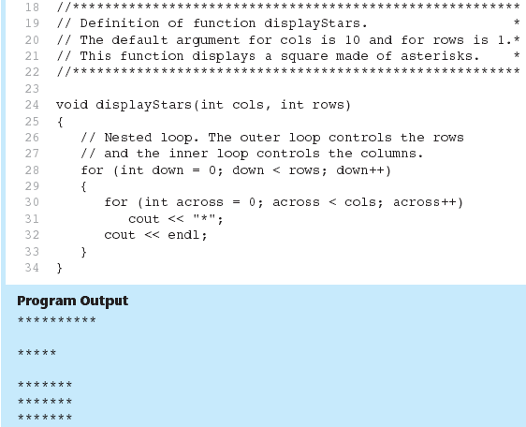
Default Arguments in Program 6-24

Slide 60
Default Arguments
If not all parameters to a function have default values, the defaultless ones are declared first in the parameter list:
  int getSum(int, int=0, int=0);// OK
  int getSum(int, int=0, int); // NO

Slide 61
6.13
Using Reference Variables as Parameters

Slide 62
Passing by Reference
A mechanism that allows a function to work with the original argument from the function call, not a copy of the argument
  Allows the function to modify values stored in the calling environment
A reference variable is an alias for another variable and defined with an ampersand (&)
  void getDimensions(int &a, int &b);
Changes to a reference variable are made to the variable it refers to
Provides a way for the function to ‘return’ more than one value

Slide 63
Passing Data by Value
void change(int a)
{
  a = 10;
  cout << a << endl;
}
int main()
{
  int a = 5;
  change(a);
  cout << a << endl;
  return 0;
}

Slide 64
Passing Data by Reference
void change(int &a)
{
  a = 10;
  cout << a << endl;
}
int main()
{
  int a = 5;
  change(a);
  cout << a << endl;
  return 0;
}

Slide 65
Returning multiple values
Suppose the function getDimensions should get the values of length and bredth from the user and return those two values to the main function.
How would you accomplish that?
void getDimensions()
{
  double a, b;
  cout << "Enter the value of length: ";
  cin >> a;
  cout << "Enter the value of width: ";
  cin >> b;
  return ???
}
Note: Functions can only return one value.

Slide 66
Returning multiple values
void getDimensions(double &a, double &b)
{
  cout << "Enter the value of length: ";
  cin >> a;
  cout << "Enter the value of width: ";
  cin >> b;
}
int main()
{
  double length, width;
  getDimensions(length, width);
  double area = length * width;
  cout << "The area is " << area << endl;
  return 0;
}

Slide 67
6.14
Overloading Functions

Slide 68
Overloading Functions
Overloaded functions have the same name but different parameter lists
Can be used to create functions that perform the same task but take different parameter types or different number of parameters
Compiler will determine which version of function to call by argument and parameter lists

Slide 69
Function Overloading Examples
Using these overloaded functions,
  void getDimensions(int); // 1
  void getDimensions(int, int); // 2
  void getDimensions(int, double); // 3
  void getDimensions(double, double);// 4
the compiler will use them as follows:
  int length, width;
  double base, height;
  getDimensions(length); // 1
  getDimensions(length, width); // 2
  getDimensions(length, height); // 3
  getDimensions(height, base); // 4

Slide 70
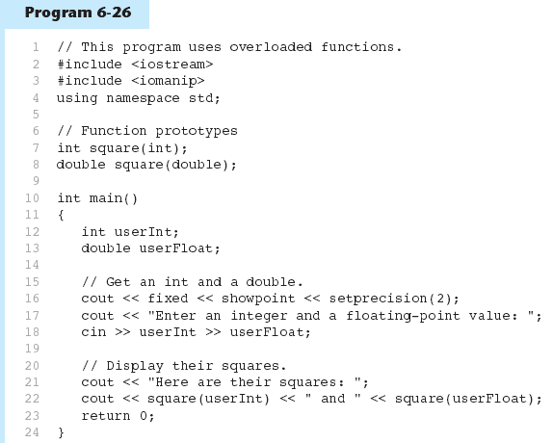

Function Overloading in Program 6-27
The overloaded functions have different parameter lists
Passing a double
Passing an int
(Program Continues)

Slide 71
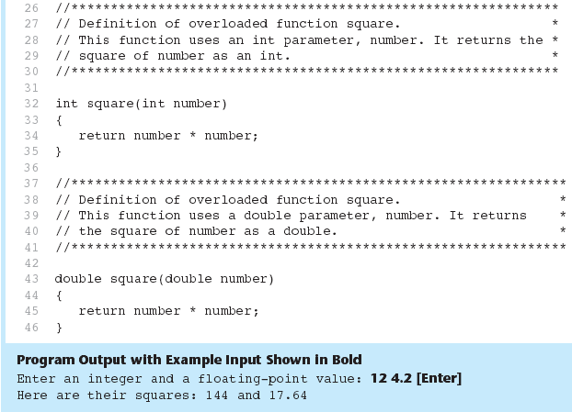
Function Overloading in Program 6-27

Slide 72
6.15
The exit() Function

Slide 73
The exit() Function
Requires cstdlib header file
Terminates the execution of a program
Can be called from any function
Example: exit(0);
Can pass an int value to operating system to indicate status of program termination. 0 indicates a successful exit.
The cstdlib header defines two constants that are commonly passed, to indicate success or failure:
exit(EXIT_SUCCESS);
exit(EXIT_FAILURE);

Slide 74
The exit() Function
void function()
{
  cout << "This program will now exit." << endl;
  exit(0);
  cout << "This line will never execute." << endl;
}
int main()
{
  function();
  return 0;
}

Slide 75
6.16
Stubs and Drivers

Slide 76
Stubs and Drivers
Useful for testing and debugging program and function logic and design
Stub: A dummy function used in place of an actual function
  Usually displays a message indicating it was called. May also display parameters
Driver: A function that tests another function by calling it
  Various arguments are passed and return values are tested

