Slide 1

Chapter 1:
Introduction
to
Computers
and
Programming

Slide 2
1.1
Why Program?

Slide 3
Why Program?
Computer – programmable machine designed to follow instructions
Program – instructions in computer memory to make it do something
Programmer – person who writes instructions (programs) to make computer perform a task
SO, without programmers, no programs; without programs, a computer cannot do anything

Slide 4
1.2
Computer Systems: Hardware and Software

Slide 5
Main Hardware Component Categories:
Central Processing Unit (CPU)
Main Memory
Secondary Memory / Storage
Input Devices
Output Devices

Slide 6
1.3
Programs and Programming Languages

Slide 7

Programs and Programming Languages
A program is a set of instructions that the computer follows to perform a task
We start with an algorithm, which is a set of well-defined steps.

Slide 8
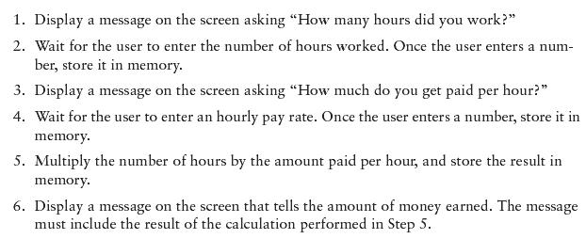
Example Algorithm for Calculating Gross Pay

Slide 9
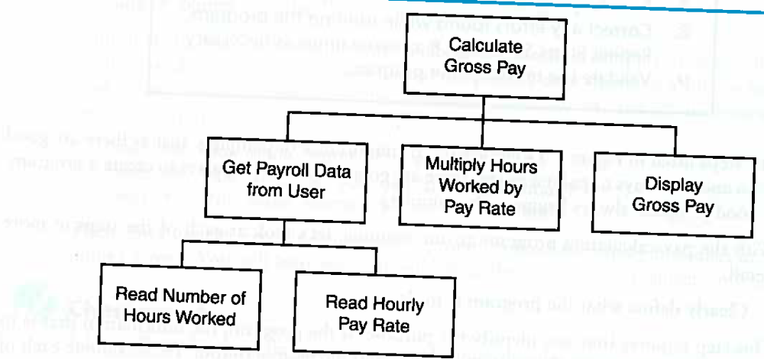
Hierarchy Chart for Calculating Gross Pay
A hierarchy chart begins with the overall task then refines it into smaller subtasks, until each is small enough to be easily performed.

Slide 10
Machine Language
Although the previous algorithm defines the steps for calculating the gross pay, it is not ready to be executed on the computer.
The computer only executes machine language instructions

Slide 11
Machine Language
Machine language instructions are binary numbers, such as
1011010000000101
Rather than writing programs in machine language, programmers use programming languages.

Slide 12
Some Well-Known Programming Languages
C++
BASIC
Ruby
Java
FORTRAN
Visual Basic
C#
COBOL
JavaScript
C
Python

Slide 13
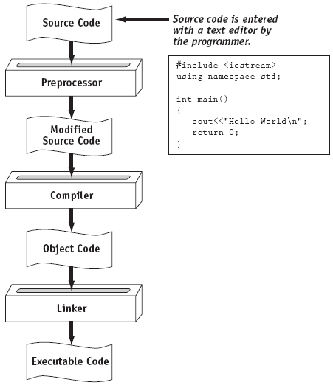
From a High-Level Program to an Executable File

Slide 14
Integrated Development Environments (IDEs)
An integrated development environment, or IDE, combine all the tools needed to write, compile, and debug a program into a single software application.
Examples are Microsoft Visual C++, Xcode, Eclipse, Netbeans, etc.

Slide 15
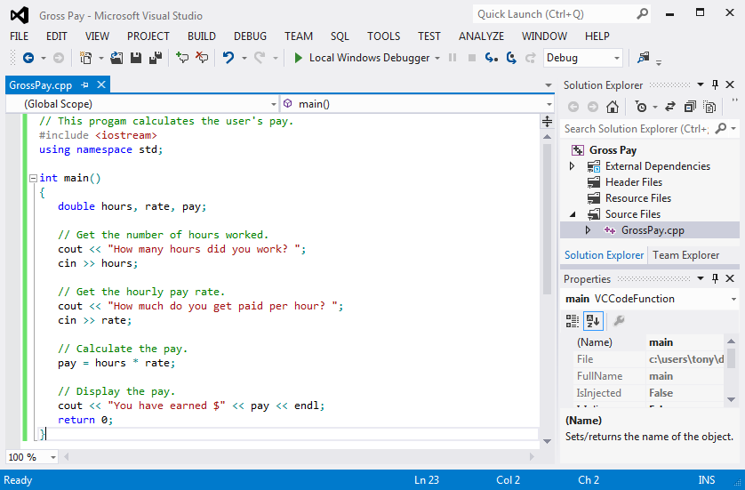
Integrated Development Environments (IDEs)

Slide 16
1.4
What is a Program Made of?

Slide 17
What is a Program Made of?
Common elements in programming languages:
  Key Words
  Programmer-Defined Identifiers
  Operators
  Punctuation
  Syntax

Slide 18
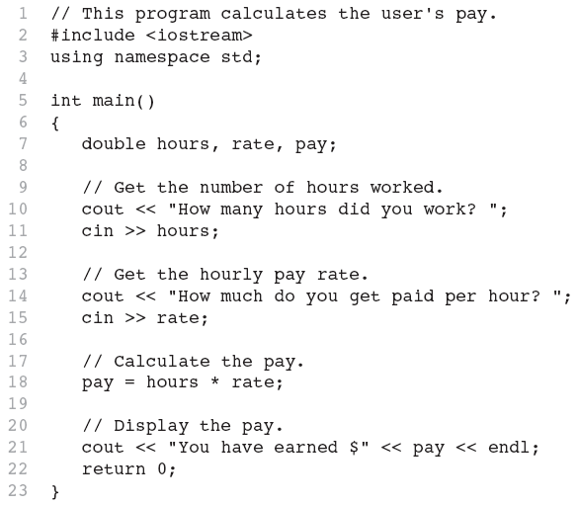
Program 1-1

Slide 19
Key Words
Also known as reserved words
Have a special meaning in C++
Can not be used for any other purpose
Key words in the Program 1-1: using, namespace, int, double, and return

Slide 20
Key Words

Slide 21
Programmer-Defined Identifiers
Names made up by the programmer
Not part of the C++ language
Used to represent various things: variables (memory locations), functions, etc.
In Program 1-1: hours, rate, and pay.

Slide 22
Operators
Used to perform operations on data
Many types of operators:
  Arithmetic - ex: +,-,*,/
  Assignment – ex: =
Some operators in Program1-1:
<< >> = *

Slide 23
Operators

Slide 24
Punctuation
Characters that mark the end of a statement, or that separate items in a list
In Program 1-1: , and ;

Slide 25
Punctuation

Slide 26
Syntax
The rules of grammar that must be followed when writing a program
Controls the use of key words, operators, programmer-defined symbols, and punctuation

Slide 27
Variables
A variable is a named storage location in the computer’s memory for holding a piece of data.
In Program 1-1 we used three variables:
  The hours variable was used to hold the hours worked
  The rate variable was used to hold the pay rate
  The pay variable was used to hold the gross pay

Slide 28
Variable Definitions
To create a variable in a program you must write a variable definition (also called a variable declaration)
Here is the statement from Program 1-1 that defines the variables:
double hours, rate, pay;

Slide 29
1.5
Input, Processing, and Output

Slide 30
Input, Processing, and Output
Three steps that a program typically performs:
  Gather input data:
    from keyboard
    from files on disk drives
  Process the input data
  Display the results as output:
    send it to the screen
    write to a file

Slide 31
1.7
Procedural and Object-Oriented Programming

Slide 32
Procedural and Object-Oriented Programming
Procedural programming: focus is on the process. Functions are written to process data.
Object-Oriented programming: focus is on objects, which contain data and the means to manipulate the data. Messages sent to objects to perform operations.

