Slide 1

Chapter 2:
Introduction
to
C++

Slide 2
2.1
The Parts of a C++ Program

Slide 3
The Parts of a C++ Program
// sample C++ program
#include <iostream>
using namespace std;
int main()
{
cout << "Hello, there!";
return 0;
}
comment
preprocessor directive
which namespace to use
beginning of function named main
beginning of block for main
output statement
string literal
Send 0 to operating system
end of block for main

Slide 4
Special Characters
Character | Name | Meaning
// | Double slash | Beginning of a comment
# | Pound sign | Beginning of preprocessor directive
< > | Open/close brackets | Enclose filename in #include
( ) | Open/close parentheses | Used when naming a function
{ } | Open/close brace | Encloses a group of statements
" " | Open/close quotation marks | Encloses string of characters
; | Semicolon | End of a programming statement

Slide 5
2.2
The cout Object

Slide 6

The cout Object
Displays output on the computer screen
You use the stream insertion operator << to send output to cout:
  cout << "Programming is fun!";

Slide 7
The cout Object
Can be used to send more than one item to cout:
  cout << "Hello " << "there!";
  Or:
  cout << "Hello ";
  cout << "there!";

Slide 8
The cout Object
This produces one line of output:
cout << "Programming is ";
cout << "fun!";

Slide 9
The endl Manipulator
You can use the endl manipulator to start a new line of output. This will produce two lines of output:
cout << "Programming is" << endl;
cout << "fun!";

Slide 10

The endl Manipulator
cout << "Programming is" << endl;
cout << "fun!";
Programming is
fun!

Slide 11
The endl Manipulator
You do NOT put quotation marks around endl
The last character in endl is a lowercase L, not the number 1.
endl
This is a lowercase L

Slide 12
The \n Escape Sequence
You can also use the \n escape sequence to start a new line of output. This will produce two lines of output:
cout << "Programming is\n";
cout << "fun!";
Notice that the \n is INSIDE
the string.

Slide 13
The \n Escape Sequence
cout << "Programming is\n";
cout << "fun!";
Programming is
fun!

Slide 14
2.3
The #include Directive

Slide 15
The #include Directive
Inserts the contents of another file into the program
This is a preprocessor directive, not part of C++ language
Do not place a semicolon at the end of #include line

Slide 16
2.4
Variables and Literals

Slide 17
Variables and Literals
Variable: a storage location in memory
  Has a name and a type of data it can hold
  Must be defined before it can be used:
  int item;

Slide 18
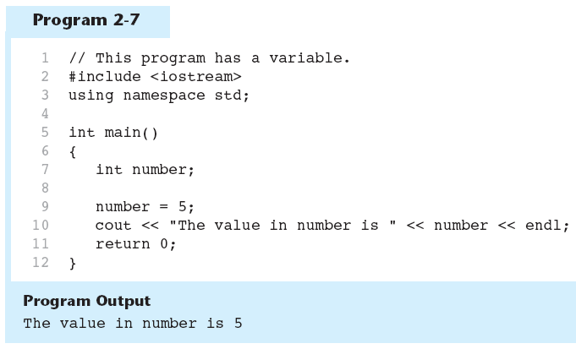
Variable Definition in Program 2-7
Variable Definition

Slide 19
Literals
Literal: a value that is written into a program’s code.
"hello, there" (string literal)
12 (integer literal)

Slide 20
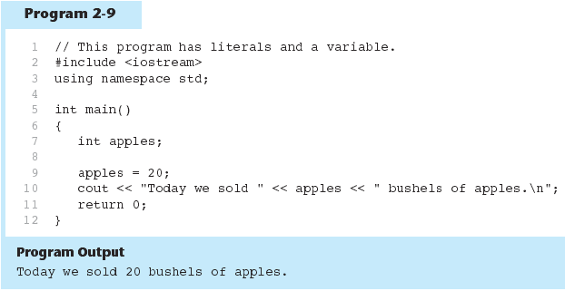
Integer Literal in Program 2-9
20 is an integer literal

Slide 21
String Literals in Program 2-9
These are string literals

Slide 22
2.5
Identifiers

Slide 23
Identifiers
An identifier is a programmer-defined name for some part of a program: variables, functions, etc.

Slide 24
Variable Names
A variable name should represent the purpose of the variable. For example:
itemsOrdered
The purpose of this variable is to hold the number of items ordered.

Slide 25
Identifier Rules
The first character of an identifier must be an alphabetic character or and underscore ( _ ),
After the first character you may use alphabetic characters, numbers, or underscore characters.
Upper- and lowercase characters are distinct

Slide 26
Valid and Invalid Identifiers
IDENTIFIER | VALID? | REASON IF INVALID
totalSales | Yes
total_Sales | Yes
total.Sales | No | Cannot contain .
4thQtrSales | No | Cannot begin with digit
totalSale$ | No | Cannot contain $

Slide 27
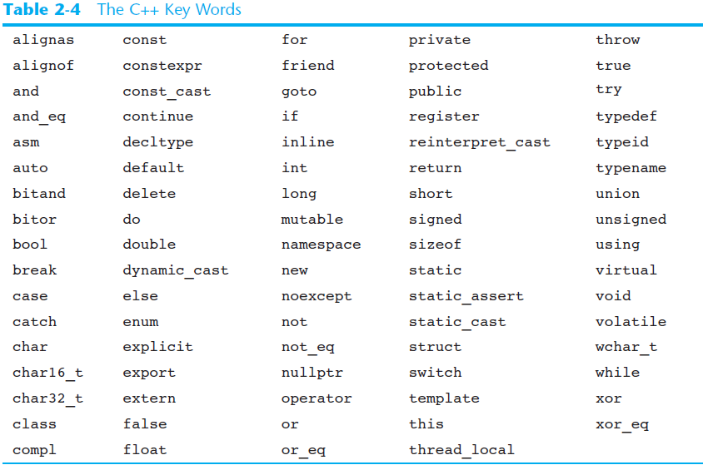
C++ Key Words
You cannot use any of the C++ key words as an identifier. These words have reserved meaning.

Slide 28
2.6
Integer Data Types

Slide 29
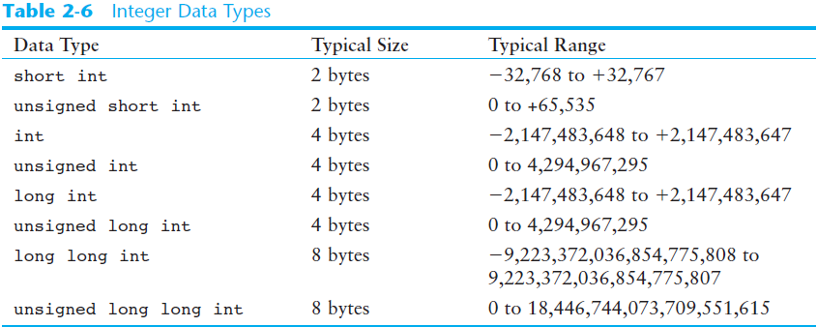
Integer Data Types
Integer variables can hold whole numbers such as 12, 7, and -99.

Slide 30
Defining Variables
Variables of the same type can be defined
  - On separate lines:
  int length;
  int width;
  unsigned int area;
  - On the same line:
  int length, width;
  unsigned int area;
Variables of different types must be in different definitions

Slide 31
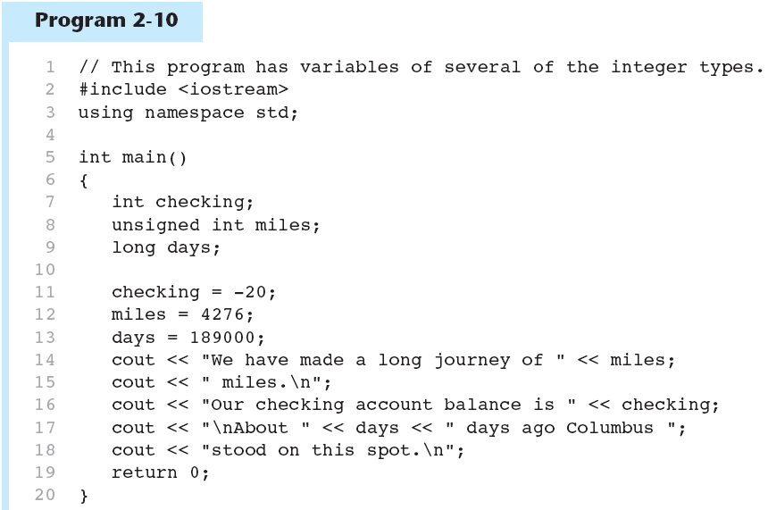
Integer Types in Program 2-10
This program has three variables:
checking, miles, and days

Slide 32
Integer Literals
An integer literal is an integer value that is typed into a program’s code. For example:
int itemsOrdered = 15;
In this code, 15 is an integer literal.

Slide 33
2.7
The char Data Type

Slide 34
The char Data Type
Used to hold characters or very small integer values
Usually 1 byte of memory
Numeric value of character from the character set is stored in memory:
CODE:
char letter;
letter = 'C';
MEMORY:
letter
67

Slide 35
Exercise
Search online for “ASCII table. ” What are the ASCII codes for
F
f
0 (zero)

Slide 36
Character Literals
Character literals must be enclosed in single quote marks. Example:
'A'

Slide 37
Exercise
What is wrong with the following statement?
char letter = “Z”;

Slide 38
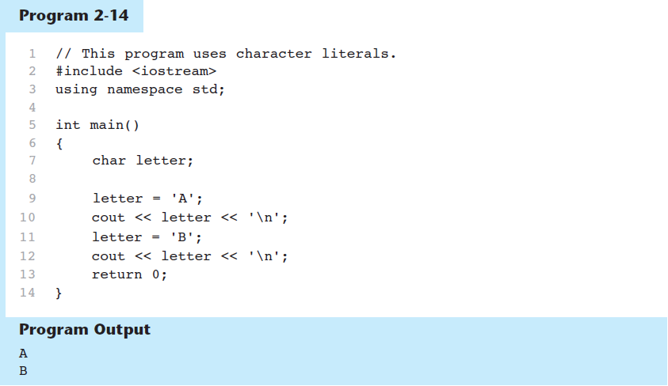
Character Literals in Program 2-14

Slide 39
Character literals and String literals
String literal - A series of characters in consecutive memory locations:
  "Hello"
Stored with the null terminator, \0, at the end:
H | e | l | l | o | \0

Slide 40
Character literals and String literals
Because char variables are only large enough to hold one character, you cannot assign strings to them.
char letter;
letter = ‘A’ // Works
letter = “A” // Doesn’t work

Slide 41
2.8
The C++ string Class

Slide 42
The C++ string Class
Special data type supports working with strings
#include <string>
Can define string variables in programs:
  string firstName, lastName;
Can receive values with assignment operator:
  firstName = "George";
  lastName = "Washington";
Can be displayed via cout
  cout << firstName << " " << lastName;

Slide 43
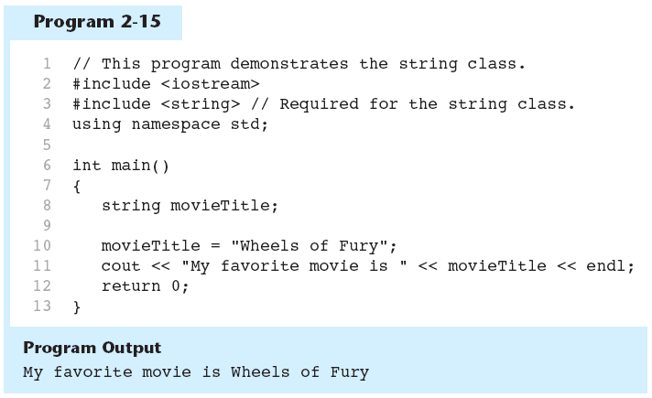
The string class in Program 2-15

Slide 44
Exercise
Write a program that stores your name, address and phone number in three separate string objects. Display the contents of the string objects on the screen.

Slide 45
2.9
Floating-Point Data Types

Slide 46
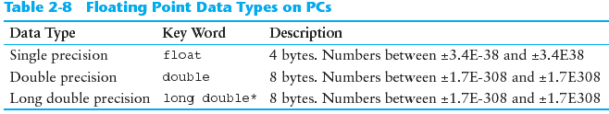
Floating-Point Data Types
Can hold real numbers such as:
  12.45 -3.8
*Some compilers use 10 bytes for long doubles.

Slide 47
Floating-Point Literals
Can be represented in
  Fixed point (decimal) notation:
  31.4159 0.0000625
  E notation:
  3.14159E1 6.25e-5

Slide 48
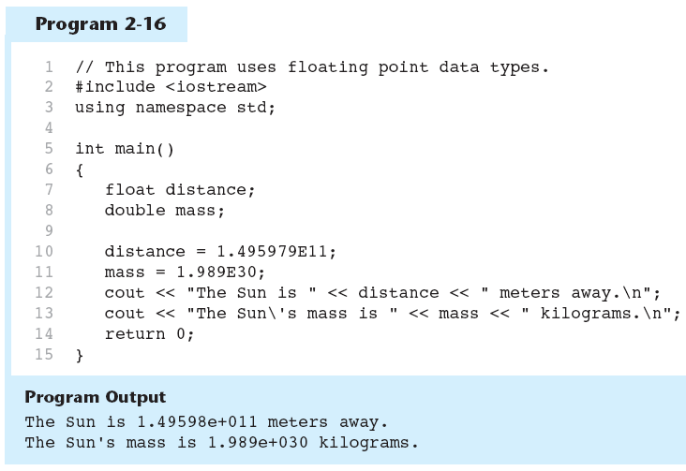
Floating-Point Data Types in Program 2-16

Slide 49
2.10
The bool Data Type

Slide 50
The bool Data Type
Represents values that are true or false
false is represented by 0, true by 1:
  bool allDone = true;
  bool finished = false;
allDone
finished
1
0

Slide 51
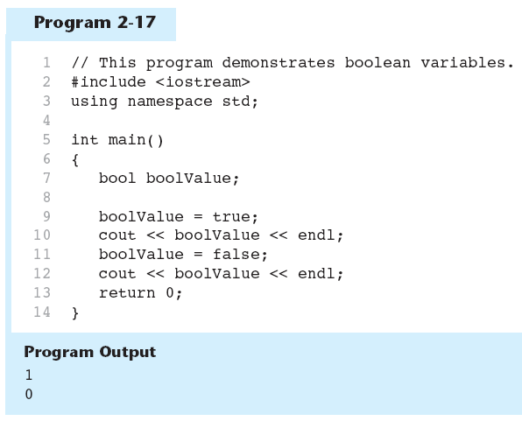
Boolean Variables in Program 2-17

Slide 52
2.11
Determining the Size of a Data Type

Slide 53
Determining the Size of a Data Type
The sizeof operator gives the size of any data type or variable:
double amount;
cout << “Type double takes “ << sizeof(double) << "bytes\n";
cout << "Variable amount takes “ << sizeof(amount) << "bytes\n";

Slide 54
2.12
Variable Assignments and Initialization

Slide 55
Variable Assignments
An assignment statement uses the = operator to store a value in a variable.
item = 12;
The variable receiving the value must appear on the left side of the = operator.
This will NOT work:
  12 = item;

Slide 56
Variable Initialization
To initialize a variable means to assign it a value when it is defined:
  int length = 12;
Can initialize some or all variables:
  int length = 12, width = 5, area;

Slide 57
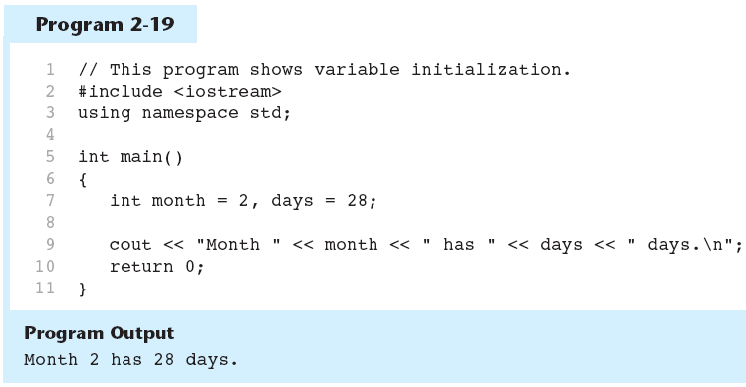
Variable Initialization in Program 2-19

Slide 58
Declaring Variables With the auto Key Word
C++ 11 introduces an alternative way to define variables, using the auto key word and an initialization value. Here is an example:
auto amount = 100;
The auto key word tells the compiler to determine the variable’s data type from the initialization value.
auto interestRate= 12.0;
auto stockCode = 'D';
auto customerNum = 459L;
Do not use the auto keyword for any of your course work related to this course.
int
double
char
long

Slide 59
2.13
Scope

Slide 60
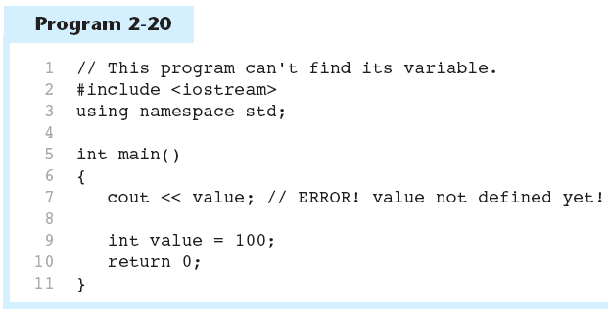
Scope
The scope of a variable: the part of the program in which the variable can be accessed
A variable cannot be used before it is defined

Slide 61
2.14
Arithmetic Operators

Slide 62
Arithmetic Operators
Used for performing numeric calculations
C++ has unary, binary, and ternary operators:
  unary (1 operand) -5
  binary (2 operands) 13 - 7
  ternary (3 operands) exp1 ? exp2 : exp3

Slide 63
Binary Arithmetic Operators
SYMBOL | OPERATION | EXAMPLE | VALUE OF ans
+ | addition | ans = 7 + 3; | 10
- | subtraction | ans = 7 - 3; | 4
* | multiplication | ans = 7 * 3; | 21
/ | division | ans = 7 / 3; | 2
% | modulus | ans = 7 % 3; | 1

Slide 64
A Closer Look at the / Operator
/ (division) operator performs integer division if both operands are integers
  cout << 13 / 5; // displays 2
  cout << 91 / 7; // displays 13
If either operand is floating point, the result is floating point
  cout << 13 / 5.0; // displays 2.6
  cout << 91.0 / 7; // displays 13.0

Slide 65
A Closer Look at the % Operator
% (modulus) operator computes the remainder resulting from integer division
  cout << 13 % 5; // displays 3
% requires integers for both operands
  cout << 13 % 5.0; // error

Slide 66
Arithmetic Operators in Program 2-21
Suppose we need to write a program that calculates and displays an employee’s total wages for the week. The regular hours for the work week are 40, and any hours worked over 40 are considered overtime. The employee earns $18.25 per hour for regular hours and $27.78 per hour for overtime hours. The employee has worked 50 hours this week.
The following pseudocode algorithm shows the program’s logic.
  Regular wages = base pay rate × regular hours
  Overtime wages = overtime pay rate × overtime hours
  Total wages = regular wages + overtime wages
  Display the total wages

Slide 67
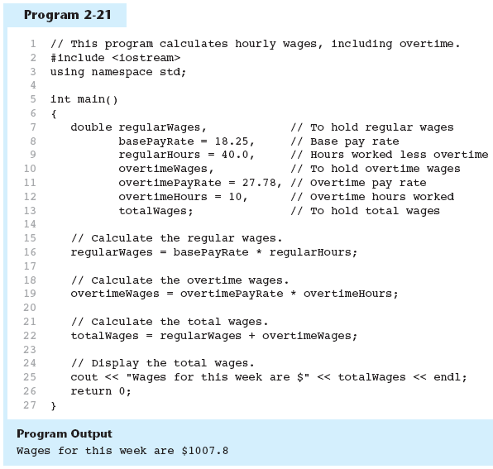
Arithmetic Operators in Program 2-21

Slide 68
2.15
Comments

Slide 69
Comments
Used to document parts of the program
Intended for persons reading the source code of the program:
  Indicate the purpose of the program
  Describe the use of variables
  Explain complex sections of code
Are ignored by the compiler

Slide 70
Single-Line Comments
Begin with // through to the end of line:
  int length = 12; // length in inches
  int width = 15; // width in inches
  int area; // calculated area
  // calculate rectangle area
  area = length * width;

Slide 71
Multi-Line Comments
Begin with /*, end with */
Can span multiple lines:
  /* this is a multi-line
  comment
  */
Can begin and end on the same line:
  int area; /* calculated area */

Slide 72
2.16
Named Constants

Slide 73
Named Constants
Named constant (constant variable): variable whose content cannot be changed during program execution
Used for representing constant values with descriptive names:
  const double TAX_RATE = 0.0675;
  const int NUM_STATES = 50;
Often named in uppercase letters

Slide 74
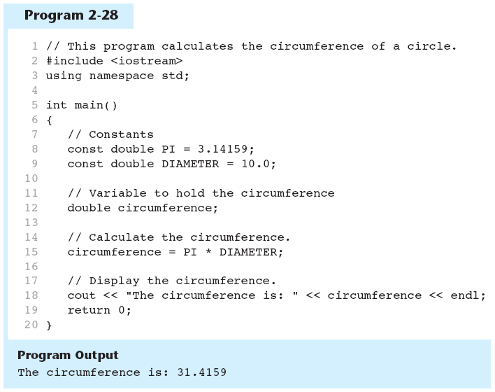
Named Constants in Program 2-28

Slide 75
2.17
Programming Style

Slide 76
Programming Style
The visual organization of the source code
Includes the use of spaces, tabs, and blank lines
Affects the readability of the source code

Slide 77
Summary
Learned about #include and namespace
Variables and literals
Data Types and the String class
Arithmetic Operators
Comments
Named Constants
Programming styles

Slide 78
Programming Challenge 6 Annual Pay
Suppose an employee gets paid every two weeks and earns $2,200 each pay period. In a year the employee gets paid 26 times. Write a program that defines the following variables:
payAmount This variable will hold the amount of pay the employee earns each pay period. Initialize the variable with 2200.0.
payPeriods This variable will hold the number of pay periods in a year. Initialize the variable with 26.
annualPay This variable will hold the employee’s total annual pay, which will be calculated.
The program should calculate the employee’s total annual pay by multiplying the employee’s pay amount by the number of pay periods in a year and store the result in the annualPay variable. Display the total annual pay on the screen.

Slide 79
Programming Challenge 8 Total Purchase
A customer in a store is purchasing five items. The prices of the five items are
Price of item 1 = $15.95
Price of item 2 = $24.95
Price of item 3 = $6.95
Price of item 4 = $12.95
Price of item 5 = $3.95
Write a program that holds the prices of the five items in five variables. Display each item’s price, the subtotal of the sale, the amount of sales tax, and the total. Assume the sales tax is 7%.

Slide 80
Programming Challenge 11 Distance per Tank of Gas
A car with a 20-gallon gas tank averages 23.5 miles per gallon when driven in town and 28.9 miles per gallon when driven on the highway.
Write a program that calculates and displays the distance the car can travel on one tank of gas when driven in town and when driven on the highway.

Slide 81
Programming Challenge 17 Stock Commission
Kathryn bought 750 shares of stock at a price of $35.00 per share. She must pay her stockbroker a 2 percent commission for the transaction.
Write a program that calculates and displays the following:
The amount paid for the stock alone (without the commission)
The amount of the commission
The total amount paid (for the stock plus the commission)

Slide 82
Programming Challenge 14 Personal Information
Write a program that displays the following pieces of information, each on a separate line:
Your name
Your address, with city, state, and ZIP code
Your telephone number
Your college major
Use only a single cout statement to display all of this information.

Slide 83
Programming Challenge 15 Triangle Pattern
Write a program that displays the following pattern on the screen:
*
***
*****
*******

