Slide 1

Chapter 5:
Loops and Files

Slide 2

The Increment and Decrement
Operators
++ is the increment operator.
It adds one to a variable.
  val++; is the same as val = val + 1;
++ can be used before (prefix) or after (postfix) a variable:
  ++val; val++;

Slide 3
The Increment and Decrement
Operators
-- is the decrement operator.
It subtracts one from a variable.
  val--; is the same as val = val - 1;
-- can be also used before (prefix) or after (postfix) a variable:
  --val; val--;

Slide 4
Prefix vs. Postfix - Examples
int num, val = 12;
cout << val++; // displays 12,
// val is now 13;
cout << ++val; // sets val to 14,
// then displays it
num = --val; // sets val to 13,
// stores 13 in num
num = val--; // stores 13 in num,
// sets val to 12

Slide 5
5.2
Introduction to Loops: The while Loop

Slide 6
Introduction to Loops:
The while Loop
Loop: a control structure that causes a statement or statements to repeat
General format of the while loop:
  while (expression)
  statement;
statement; can also be a block of statements enclosed in { }

Slide 7
The while Loop – How It Works
  while (expression)
  statement;
expression is evaluated
  if true, then statement is executed, and expression is evaluated again
  if false, then the loop is finished and program statements following statement execute

Slide 8
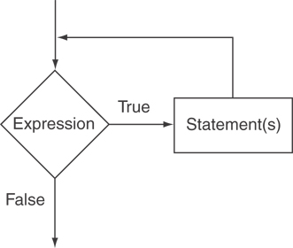
The Logic of a while Loop

Slide 9
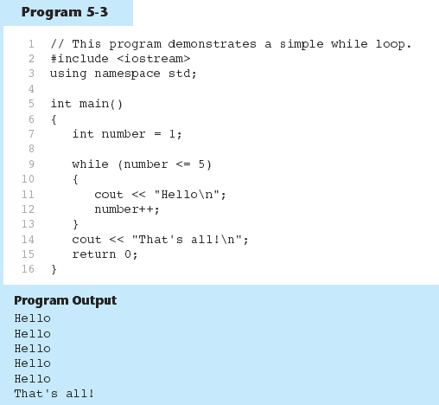
The while loop in Program 5-3

Slide 10
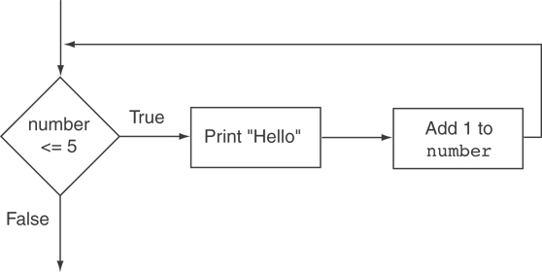
Flowchart of the while Loop in Program 5-3

Slide 11
The while Loop is a Pretest Loop
expression is evaluated before the loop executes. The following loop will never execute:
int number = 6;
while (number <= 5)
{
cout << "Hello\n";
number++;
}

Slide 12
Watch Out for Infinite Loops
The loop must contain code to make expression become false
Otherwise, the loop will have no way of stopping
Such a loop is called an infinite loop, because it will repeat an infinite number of times

Slide 13
Example of an Infinite Loop
int number = 1;
while (number <= 5)
{
cout << "Hello\n";
}

Slide 14
5.3
Using the while Loop for Input Validation

Slide 15
Using the while Loop for Input Validation
Input validation is the process of inspecting data that is given to the program as input and determining whether it is valid.
The while loop can be used to create input routines that reject invalid data, and repeat until valid data is entered.

Slide 16
Using the while Loop for Input Validation
Here's the general approach, in pseudocode:
Read an item of input.
While the input is invalid
Display an error message.
Read the input again.
End While

Slide 17
Input Validation Example
cout << "Enter a number less than 10: ";
cin >> number;
while (number >= 10)
{
cout << "Invalid Entry!"
<< "Enter a number less than 10: ";
cin >> number;
}

Slide 18
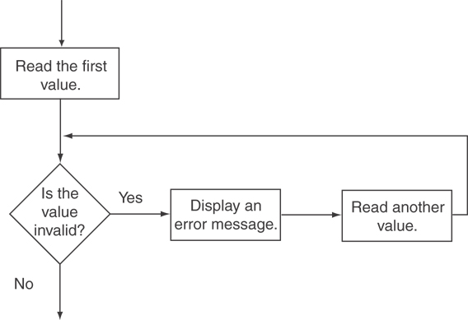
Flowchart for Input Validation

Slide 19
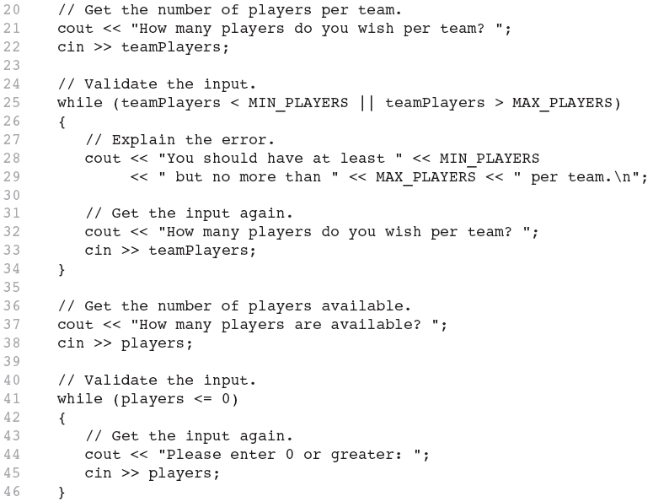
Input Validation in Program 5-5

Slide 20
5.4
Counters

Slide 21
Counters
Counter: a variable that is incremented or decremented each time a loop repeats
Can be used to control execution of the loop (also known as the loop control variable)
Must be initialized before entering loop

Slide 22
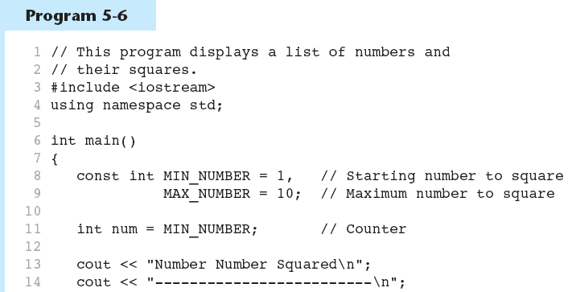
A Counter Variable Controls the Loop in Program 5-6
Continued…

Slide 23
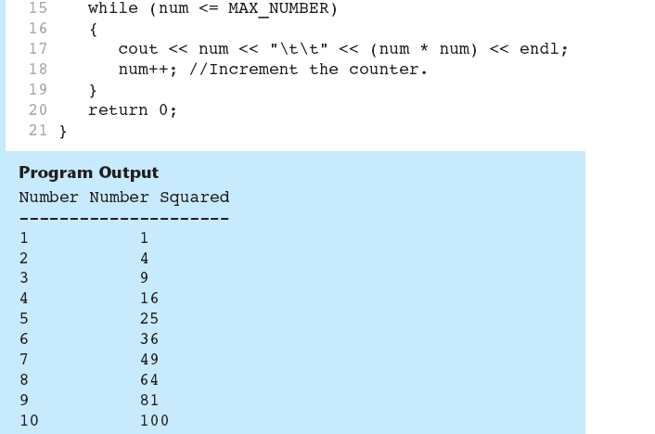
A Counter Variable Controls the Loop in Program 5-6

Slide 24
Example
Write a program that will ask the user to enter two numbers. Your program will display the sum of the two numbers. Your program will then ask the user if they would like to add another pair of numbers. If the user enters yes, ask the user to enter two numbers and then display the sum. Repeat the process until the user enters no.

Slide 25
Solution using while loop
double num1, num2;
char choice;
cout << "Enter two numbers: ";
cin >> num1 >> num2;
cout << "The sum is " << num1 + num2 << endl;
cout << "Would you like to add another pair of numbers? Enter y or n: ";
cin >> choice;
while (choice == 'y')
{
cout << "Enter two numbers: ";
cin >> num1 >> num2;
cout << "The sum is " << num1 + num2 << endl;
cout << "Would you like to add another pair of numbers? Enter y or n: ";
cin >> choice;
}

Slide 26
Solution using do-while loop
double num1, num2;
char choice;
do {
cout << "Enter two numbers: ";
cin >> num1 >> num2;
cout << "The sum is " << num1 + num2 << endl;
cout << "Would you like to add another pair of numbers? Enter y or n: ";
cin >> choice;
} while (choice == 'y');

Slide 27
5.5
The do-while Loop

Slide 28
The do-while Loop
do-while: a posttest loop – execute the loop, then test the expression
General Format:
  do
  statement; // or block in { }
  while (expression);
Note that a semicolon is required after (expression)

Slide 29
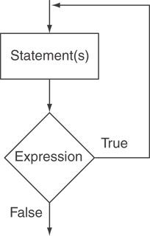
The Logic of a do-while Loop

Slide 30
An Example do-while Loop
int x = 1;
do
{
cout << x << endl;
} while(x < 0);
Although the test expression is false, this loop will execute one time because do-while is a posttest loop.

Slide 31
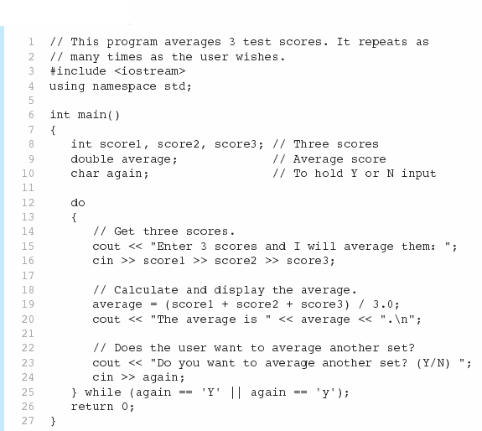

A do-while Loop in Program 5-7
Continued…

Slide 32
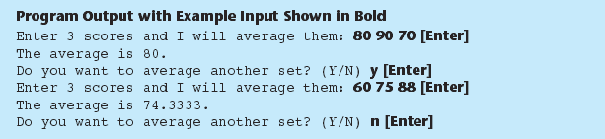
A do-while Loop in Program 5-7

Slide 33
do-while Loop Notes
Loop always executes at least once
Execution continues as long as expression is true, stops repetition when expression becomes false
Useful in menu-driven programs to bring user back to menu to make another choice (see Program 5-8 on pages 245-246)

Slide 34
while vs. do-while Loop
// Password validation using while loop
string input, password = "jaspers";
cout << "Enter the password: " << endl;
getline(cin, input);
while (input != password)
{
cout << "Enter the password: " << endl;
getline(cin, input);
}
cout << "Login Successful!!" << endl;

Slide 35
while vs. do-while Loop
// Password validation using do-while loop
string input, password = "jaspers";
do
{
cout << "Enter the password: " << endl;
getline(cin, input);
} while (input != password);
cout << "Login Successful!!" << endl;

Slide 36
Exercise
In the previous code, the user gets unlimited attempts to enter the correct password.
Modify the code so that the user only gets three attempts. After three attempts, the program displays “Login Unsuccessful!”

Slide 37
Solution
// Password validation using do-while loop with a maximum of three attempts
string input, password = "jaspers";
int attempts = 0;
do
{
cout << "Enter the password: " << endl;
getline(cin, input);
attempts++;
} while (input != password && attempts != 3);
if (input == password)
cout << "Login Successful!!" << endl;
else
cout << "Login Unsuccessful!!" << endl;

Slide 38
5.6
The for Loop

Slide 39
The for Loop
General Format:
for(initialization; test; update)
  statement; // or block in { }
How it works:
Perform initialization
Evaluate test expression
  If true, execute statement
  If false, terminate loop execution
Execute update, then re-evaluate test expression
Note: No semicolon after the update expression or after the )

Slide 40
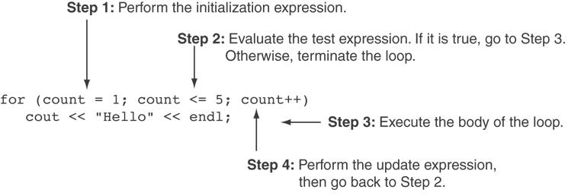
for Loop - Example
int count;
for (count = 1; count <= 5; count++)
  cout << "Hello" << endl;

Slide 41
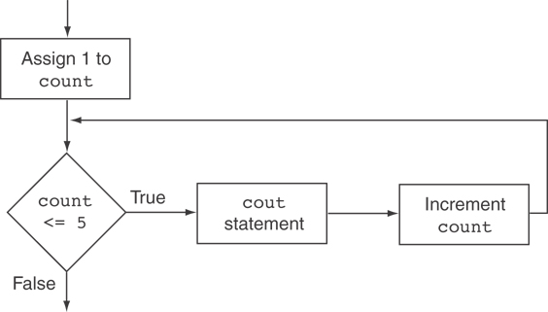
Flowchart for the Previous Example

Slide 42
for Loop - Modifications
You can declare variables in the initialization expression:
  int sum = 0;
  for (int num = 0; num <= 10; num++)
  {
  sum += num;
  }
  The scope of the variable num is the for loop.

Slide 43
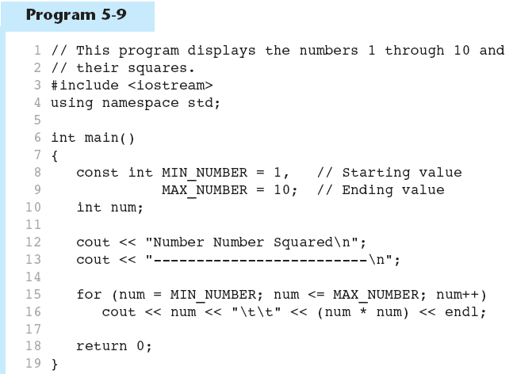
A for Loop in Program 5-9
Continued…

Slide 44
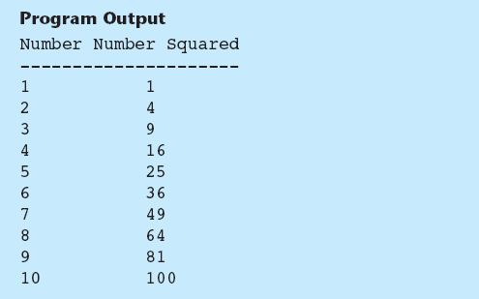
A for Loop in Program 5-9

Slide 45
5.7
Keeping a Running Total

Slide 46
Keeping a Running Total
running total: accumulated sum of numbers from each repetition of loop
accumulator: variable that holds running total
  int sum=0, num=1; // sum is the
  while (num <= 5) // accumulator
  { sum += num;
  num++;
  }
  cout << "Sum of numbers 1 – 5 is"
  << sum << endl;

Slide 47
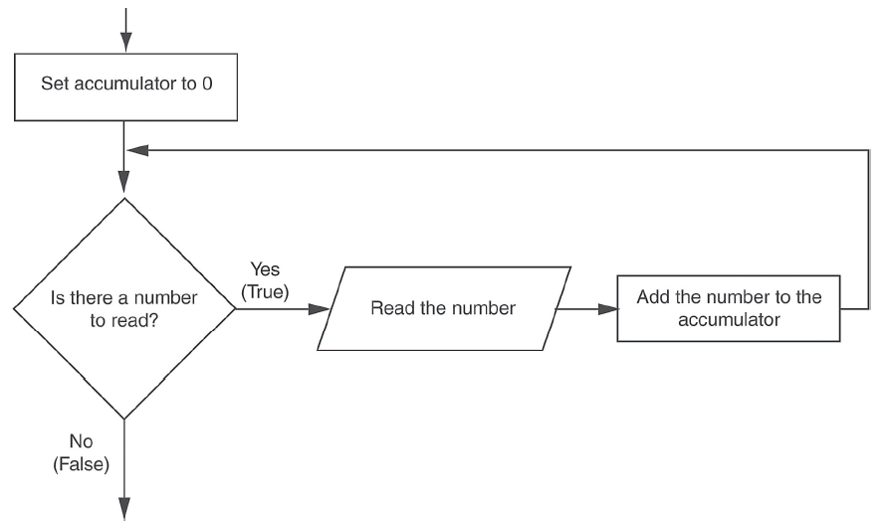
Logic for Keeping a Running Total

Slide 48

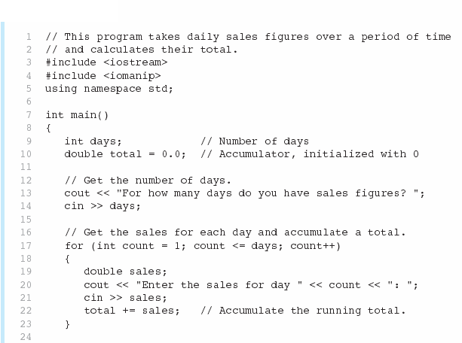
A Running Total in Program 5-12
Continued…

Slide 49
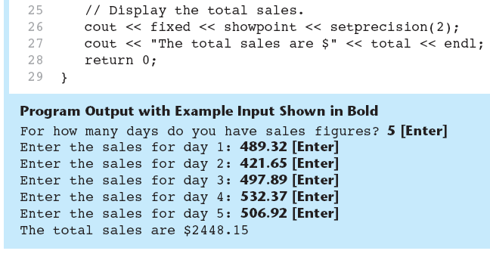
A Running Total in Program 5-12

Slide 50
5.8
Sentinels

Slide 51
Sentinels
sentinel: value in a list of values that indicates end of data
Special value that cannot be confused with a valid value, e.g., -999 for a test score
Used to terminate input when user may not know how many values will be entered

Slide 52
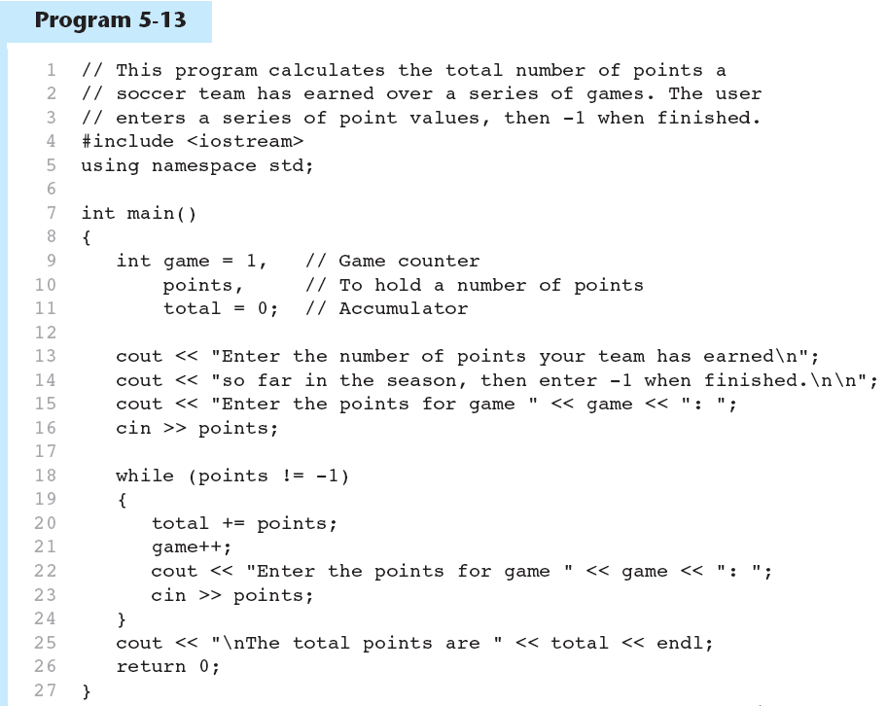
A Sentinel in Program 5-13
Continued…

Slide 53
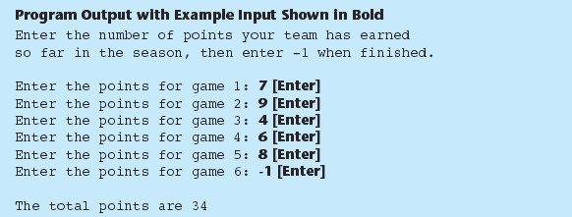
A Sentinel in Program 5-13

Slide 54
5.9
Deciding Which Loop to Use

Slide 55
Deciding Which Loop to Use
The while loop is a conditional pretest loop
  Iterates as long as a certain condition exits
  Validating input
  Reading lists of data terminated by a sentinel
The do-while loop is a conditional posttest loop
  Always iterates at least once
  Repeating a menu
The for loop is a pretest loop
  Built-in expressions for initializing, testing, and updating
  Situations where the exact number of iterations is known

Slide 56
5.10
Nested Loops

Slide 57
Nested Loops
A nested loop is a loop inside the body of another loop
Inner (inside), outer (outside) loops:

Slide 58
What will be the output?
int i, j;
for (i=1; i<=5; i++)
{
for (j=1; j<=i; j++)
{
cout << "*";
}
cout << endl;
}

Slide 59
What will be the output?
int i, j;
for (i=1; i<=5; i++)
{
for (j=i; j<=5; j++)
{
cout << "*";
}
cout << endl;
}

Slide 60
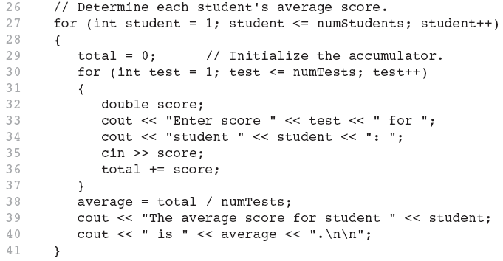
Nested for Loop in Program 5-14
Inner Loop
Outer Loop

Slide 61
5.12
Breaking and Continuing a Loop

Slide 62
Breaking Out of a Loop
Can use break to terminate execution of a loop
Can use continue to go to end of loop and prepare for next repetition
Use sparingly – can make program logic hard to follow

Slide 63
5.11
Using Files for Data Storage

Slide 64
Using Files for Data Storage
Can use files instead of keyboard, monitor screen for program input, output
Allows data to be retained between program runs
Steps:
  Open the file
  Use the file (read from, write to, or both)
  Close the file

Slide 65
Files: What is Needed
Use fstream header file for file access
File stream types:
  ifstream for input from a file
  ofstream for output to a file
  fstream for input from or output to a file
Define file stream objects:
  ifstream infile;
  ofstream outfile;

Slide 66
Opening Files
Create a link between file name (outside the program) and file stream object (inside the program)
Use the open member function:
  infile.open("inventory.dat");
  outfile.open("report.txt");
Filename may include drive, path info.
Output file will be created if necessary; existing file will be erased first
Input file must exist for open to work

Slide 67
Testing for File Open Errors
Can test a file stream object to detect if an open operation failed:
  infile.open("test.txt");
  if (!infile)
  {
  cout << "File open failure!";
  }

Slide 68
Closing Files
Use the close member function:
  infile.close();
  outfile.close();
Don’t wait for operating system to close files at program end:
  may be limit on number of open files
  may be buffered output data waiting to send to file

Slide 69
Program 5-17: Writing to a file
ofstream outputFile;
outputFile.open("C:\\Users\\AA\\Desktop\\Numbers.txt");
int number1, number2, number3;
cout << "Enter a number: ";
cin >> number1;
cout << "Enter another number: ";
cin >> number2;
cout << "One more time. Enter a number: ";
cin >> number3;
// Write the numbers to the file.
outputFile << number1 << endl;
outputFile << number2 << endl;
outputFile << number3 << endl;
// Close the file
outputFile.close();

Slide 70
Program 5-20: Reading from a file
ifstream inFile;
inFile.open(" C:\\Users\\AA\\Desktop\\Numbers.txt");
int value1, value2, value3, sum;
// Read the three numbers from the file.
inFile >> value1;
inFile >> value2;
inFile >> value3;
// Close the file.
inFile.close();
// Calculate the sum of the numbers.
sum = value1 + value2 + value3;
// Display the three numbers.
cout << "Here are the numbers:\n" << value1 << " " << value2 << " " << value3 << endl;
// Display the sum of the numbers.
cout << "Their sum is: " << sum << endl;

Slide 71
Program 5-22: Detecting the end of the file
ifstream inFile;
int value, sum = 0;
string fileName = "Numbers.txt";
inFile.open(fileName);
while (inFile >> value)
{
cout << value <<endl;
sum = sum + value;
}
// Close the file.
inFile.close();
// Display the sum of the numbers.
cout << "The sum is: " << sum << endl;

Slide 72
Class Exercise 1
Write a program that generates 20 random numbers between 10 and 15 and stores them in a text file called “Numbers.txt” on your desktop.

Slide 73
Class Exercise 2
Read the text file that you created in the previous example. Count the number of values less than equal to 12 and the number of values greater than 12. Display these two counts.

