Slide 1
鄉
ARXIV 2606.24093 · COMPUTATIONAL LITERARY HISTORY
音
Predicting Poets' Origins from Verse
無
改
Regional linguistic fingerprints in the Complete Tang Poems 全唐詩
鬢
Chi-Sheng Chen Harvard University
Hung-Yun Liu University of Washington
毛
衰
10-minute version
詩
Notes:
Good morning. Today I'd like to ask a very old question with a very new instrument: can you tell where a poet came from, just by reading their poems? We take the Complete Tang Poems — 49,000 of them — and treat this as a prediction problem. (~30s)

Slide 2
THE QUESTION
詩
Can a poem betray where its poet came from?
An accent survives a lifetime away from home. Does home also survive on the page?
We treat it as a measurement problem: read ~49,000 poems and predict each poet's home circuit 道 from text alone.
少小離家老大回
鄉音無改鬢毛衰
“I left home young and return an old man; my native accent is unchanged, though my temple-hair has thinned.”
— He Zhizhang 賀知章, “On Returning Home” 回鄉偶書
RQ1 · Prediction
RQ2 · Signal
RQ3 · Persistence
Can a model recover a poet's circuit of origin from their collected work alone?
Which features carry it — lexical choice, imagery, tonal patterns, themes?
Does the fingerprint hold steady across the dynasty's poetic eras?
Chen & Liu · Regional Fingerprints in the Complete Tang Poems
2 / 12
Notes:
He Zhizhang: accent unchanged after a lifetime at court. Our question: does HOME survive on the page? Three RQs: prediction, signal, persistence. Design principle: interpretability — features a literary historian can read and contest. Keep He Zhizhang in mind; he returns at the end. (~60s)

Slide 3
DATA
詩
49,000 poems, 357 poets, ten circuits 道
900
≈49,000
357
242
volumes, aggregated end-to-end
poems parsed into poet-level corpora
poets located via CBDB · ≥5 poems each
poets in the South/North subset
Pipeline. Texts from the Chinese Text Project 中國哲學書電子化計劃; birthplaces linked via the China Biographical Database (CBDB); poets mapped to the ten early-Tang administrative circuits 道.
Heavily imbalanced. Jiangnan 江南 alone has 126 poets; Longyou 隴右 has 6 — so: balanced class weights throughout, macro-F1 reported alongside accuracy.
Chen & Liu · Regional Fingerprints in the Complete Tang Poems
3 / 12
Notes:
Complete Tang Poems, 900 volumes, ~49k poems into poet-level corpora. Birthplaces via CBDB; filter to >=5 poems, unambiguous attribution: 357 poets across ten circuits, 242 South/North. Flag now: heavy imbalance — Jiangnan 126, Longyou 6 — hence balanced weights + macro-F1. (~55s)

Slide 4
METHOD
詩
Readable features, one fair test
Character n-gram TF-IDF. 空山新雨後 → 空·山·新·雨·後 + 空山·山新·新雨·雨後. 1–2 grams, ≤8,000 features. No word segmentation, no modern assumptions — characters are the native unit.
Plus features a historian can read: imagery classes (山·水·草木·鳥獸·天體), seasonal markers, allusion density, lexical richness, tonal patterns 平仄 (approximated).
The fair test
Five models — LogReg · Linear SVM · Random Forest · MLP · GuwenBERT 古文BERT
Stratified 5-fold CV — every poet held out exactly once
Balanced class weights — small circuits not drowned out by Jiangnan
Baseline — “always guess the biggest region” — 0.53 on South/North
Chen & Liu · Regional Fingerprints in the Complete Tang Poems
4 / 12
Notes:
Workhorse: character n-gram TF-IDF — no segmentation, no modern linguistic assumptions. On top, readable features: imagery, seasons, allusion, lexical richness, approximate tone. Five models, stratified 5-fold CV, balanced weights; baseline 0.53. (~55s)

Slide 5
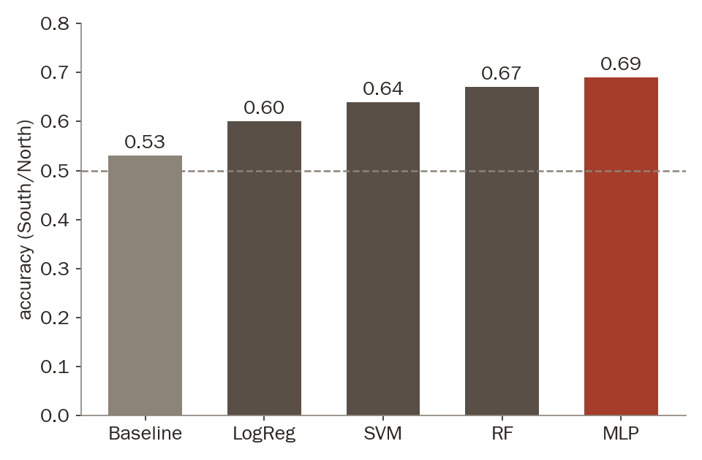
RESULT · RQ1
詩
Geography is legible from verse alone
0.69
accuracy on South vs North — against a 0.53 most-frequent baseline
Macro-F1 0.69 vs 0.35 — not an artefact of class imbalance.
A poet's origin is readable, well above chance, from text alone.
South vs North · stratified 5-fold CV · 242 poets
Chen & Liu · Regional Fingerprints in the Complete Tang Poems
5 / 12
Notes:
Can it be done? Yes. Baseline 0.53 -> LogReg 0.60, SVM 0.64, RF 0.67, MLP 0.69. Macro-F1 0.35 -> 0.69, so not an imbalance artefact. Origin is readable from text alone. (~45s)

Slide 6
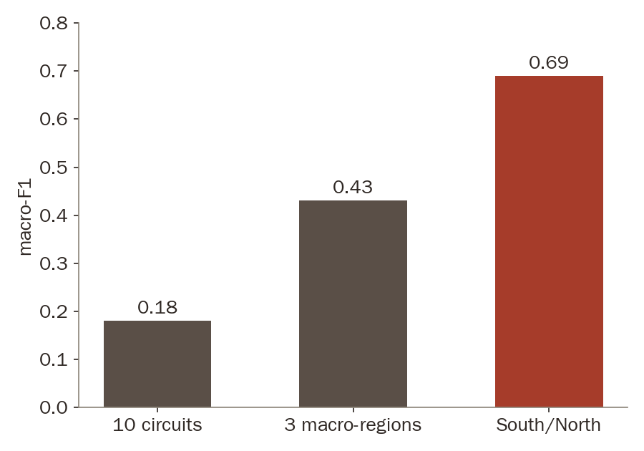
RESULT
詩
The signal survives at every grain
Coarse maps are sharper — but even the hardest map is readable
0.69 South/North — the axis of the historical debate
0.43 3 macro-regions — regional structure persists
0.18 10 circuits — ≈2× baseline despite six-poet classes
macro-F1 by task granularity · each ≈2× its most-frequent baseline
Chen & Liu · Regional Fingerprints in the Complete Tang Poems
6 / 12
Notes:
Harder maps: South/North 0.69, three macro-regions 0.43, full ten-circuit task 0.18 — each roughly TWICE its own baseline. Ten-way with six-poet classes is brutal; doubling baseline there is the surprise. (~40s)

Slide 7
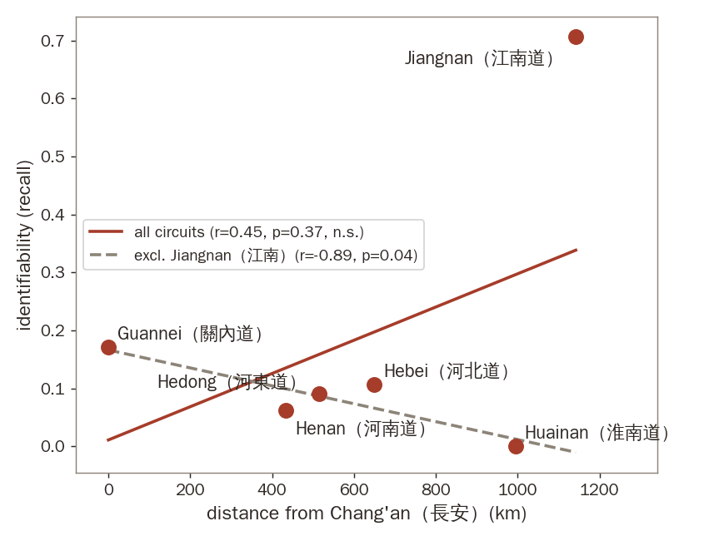
RESULT
詩
The centre blurs; Jiangnan stands apart
Near the court, one idiom. Circuits around Chang'an and Luoyang are heavily confused — the shared court language erases local difference.
Far from it, a voice of one's own. Jiangnan 江南 is by far the most separable region — recall 0.71 on the ten-way task.
Not a distance law. All six circuits: non-significant (r = 0.45, p = 0.37); drop Jiangnan and the slope reverses (r = −0.89). Two facts, not one gradient.
Per-circuit identifiability (recall) vs. distance from Chang'an — the apparent rise is carried by Jiangnan alone.
Chen & Liu · Regional Fingerprints in the Complete Tang Poems
7 / 12
Notes:
Where is the signal on the map? Two facts: capitals blur into one court idiom; Jiangnan stands apart at recall 0.71. Careful: NOT a distance law — full fit non-significant, slope reverses without Jiangnan. Two facts, not one gradient. (~55s)

Slide 8
RESULT · RQ2
詩
Imagery carries the region
南 The South writes landscape
北 The North writes the court
Mountain & water imagery 山水 — markedly more than in the north
Buddhist & recluse vocabulary — temples, retreat, withdrawal
Landscape diction — the discriminative characters of the south
Palace diction — the built world of the capitals
Gongti 宮體 motifs — courtly “boudoir” poetry
Court-idiom characters — the discriminative characters of the north
Tonal patterns 平仄 carry comparatively weak signal — the fingerprint lives in what poets see, not in how their verses scan.
Chen & Liu · Regional Fingerprints in the Complete Tang Poems
8 / 12
Notes:
RQ2: the South writes landscape — mountain/water imagery, Buddhist and recluse vocabulary. The North writes the court — palace diction, gongti motifs. Tone is weak. The fingerprint lives in what poets SEE, not how verses scan. (~45s)

Slide 9
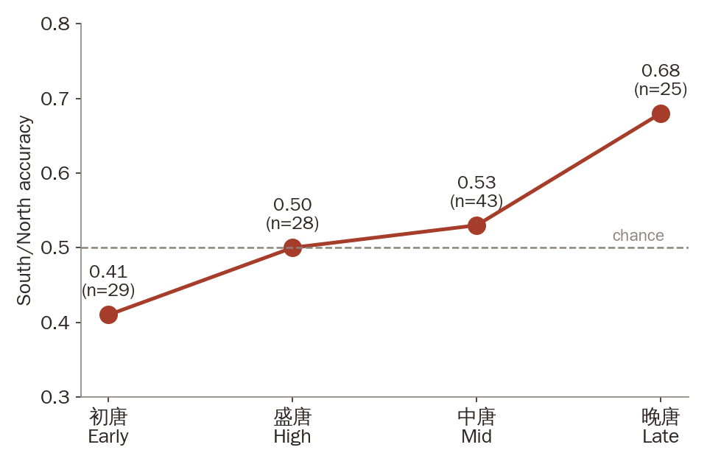
RESULT · RQ3
詩
The fingerprint waxes and wanes with the dynasty
初唐 0.41 southern poets assimilate — all 7 full-model errors run south → north
盛唐 0.50 at chance — maximum integration at the empire's height
中唐 0.53 after the An Lushan rebellion, regional voices begin to return
晚唐 0.68 as central authority weakens, separability peaks
Regional distinctiveness waxes and wanes with the political integration of the dynasty.
Chen & Liu · Regional Fingerprints in the Complete Tang Poems
9 / 12
Notes:
RQ3: 0.41 early Tang (southerners write the northern court idiom — all 7 errors run S->N), 0.50 at chance at the empire's height, 0.53 after An Lushan, 0.68 late Tang. Distinctiveness moves with political integration — now with numbers. (~55s)

Slide 10
RESULT · READING THE ERRORS
詩
When the model errs, it errs like a historian
7 / 7
鄉音無改？
Early-Tang misclassifications read a southern poet as northern — none err the other way.
“My native accent is unchanged …”
He Zhizhang swore the accent of home never left him. On the page, the classifier reads him as northern.
The “error” is the court's gravity, measured. Misclassification here is not noise — it encodes the prestige of the early-Tang court style.
虞世南
褚亮
賀知章
Yu Shinan
Chu Liang
He Zhizhang
Southern-born, court-trained — all three wrote in the dominant northern court idiom.
Chen & Liu · Regional Fingerprints in the Complete Tang Poems
10 / 12
Notes:
He Zhizhang returns. Early Tang errors: 7/7 southerners read as northern, none the other way. Yu Shinan, Chu Liang, He Zhizhang — southern-born, court-trained. He swore the accent never left him; the classifier reads him as northern. The error is the court's gravity, measured. [slow down here] (~55s)

Slide 11
STRESS TEST & CAVEATS
詩
Do transformers read anything more?
0.62
0.674
+ 0
Naive fine-tuning
Hierarchical frozen encoder
Hybrid BERT + TF-IDF
GuwenBERT per fragment — below the n-gram models
pool fragments over a poet's corpus — ties the best classical models
combining the two adds nothing
Character n-grams already capture the available regional signal — interpretability costs nothing.
Read with care: small samples (357 / 242 / era subsets 25–43) · labels inherit CTP + CBDB noise · tone approximated · distance decay suggestive (r = 0.40, Mantel p ≈ 0.09). All four point the same way: more data would sharpen, not overturn.
Chen & Liu · Regional Fingerprints in the Complete Tang Poems
11 / 12
Notes:
Wouldn't a transformer see more? Naive fine-tuning 0.62 — below n-grams. Hierarchical frozen encoder 0.674 — ties classical. Hybrid adds nothing. N-grams already capture the signal; interpretability costs nothing. Caveats in one breath: small samples, inherited label noise, approximate tone, suggestive geography — all point the same way. (~55s)

Slide 12
CONCLUSION
A Tang poet's origin leaves a computationally detectable trace in their verse.
文
如
其
Carried chiefly by imagery and lexical choice — mountains and waters in the south; palace and gongti diction in the north
地
Not a simple distance law — the capitals blur into one court idiom — Jiangnan alone keeps a voice of its own
Modulated by history — at chance amid High-Tang integration; strongest (0.68) as Late-Tang authority wanes
詩
Next: stylistic similarity networks — does textual proximity track geography, or transcend it through literary influence?
謝謝 Thank you · arXiv:2606.24093 · Chen & Liu
Notes:
Conclusion: origin leaves a detectable trace — carried by imagery and lexical choice, not a simple distance law, modulated by history. Next: stylistic similarity networks. 鄉音無改 — the accent never left the page either. Thank you. (~40s)

