Slide 1
文
ARXIV 2606.24093 · COMPUTATIONAL LITERARY HISTORY
Predicting Poets' Origins from Verse
如
其
Regional linguistic fingerprints in the Complete Tang Poems 全唐詩
地
Chi-Sheng Chen Harvard University
Hung-Yun Liu University of Washington
詩
10-minute version
Notes:
Good morning. Today I'd like to ask a very old question with a very new instrument: can you tell where a poet came from, just by reading their poems? We take the Complete Tang Poems — 49,000 of them — and treat this as a prediction problem. (~30s)

Slide 2
THE QUESTION
詩
Can a poem betray where its poet came from?
Literary historians have long debated regional schools 地域流派 in Tang poetry — yet whether geographic origin shows up as quantifiable patterns in poetic language has resisted systematic study.
We treat it as a measurement problem: read ~49,000 poems and predict each poet's home circuit 道 from text alone.
RQ1 · Prediction
RQ2 · Signal
RQ3 · Persistence
Can a model recover a poet's circuit of origin from their collected work alone?
Which features carry it — lexical choice, imagery, tonal patterns, themes?
Does the fingerprint hold steady across the dynasty's poetic eras?
Framed for interpretability throughout — features a literary historian can read and contest.
Chen & Liu · Regional Fingerprints in the Complete Tang Poems
2 / 12
Notes:
The regional-schools debate is old; what's been missing is quantification. We treat it as a measurement problem: predict each poet's home circuit from text alone. Three RQs: prediction, signal, persistence. Design principle: interpretability — features a literary historian can read and contest. (~55s)

Slide 3
DATA
詩
49,000 poems, 357 poets, ten circuits 道
900
≈49,000
357
242
volumes, aggregated end-to-end
poems parsed into poet-level corpora
poets located via CBDB · ≥5 poems each
poets in the South/North subset
Pipeline. Texts from the Chinese Text Project 中國哲學書電子化計劃; birthplaces linked via the China Biographical Database (CBDB); poets mapped to the ten early-Tang administrative circuits 道.
Heavily imbalanced. Jiangnan 江南 alone has 126 poets; Longyou 隴右 has 6 — so: balanced class weights throughout, macro-F1 reported alongside accuracy.
Chen & Liu · Regional Fingerprints in the Complete Tang Poems
3 / 12
Notes:
Complete Tang Poems, 900 volumes, ~49k poems into poet-level corpora. Birthplaces via CBDB; filter to >=5 poems, unambiguous attribution: 357 poets across ten circuits, 242 South/North. Flag now: heavy imbalance — Jiangnan 126, Longyou 6 — hence balanced weights + macro-F1. (~50s)

Slide 4
SETUP
詩
Three tasks, three grains of geography
South 南 vs North 北
3 macro-regions
10 circuits 道
the headline task · 242 poets
core vs periphery axis
the full administrative map · hardest
南 江南 · 淮南 · 劍南 · 嶺南 · 山南
北 河北 · 河南 · 河東 · 關內 · 隴右
The axis the literary-historical debate cares about.
東南 Southeast 江南 · 淮南
中原 Central Plains 河北 · 河南 · 河東 · 關內
邊陲 Frontier 劍南 · 嶺南 · 山南 · 隴右
關內 · 河南 · 河北 · 河東 · 江南 · 淮南 · 山南 · 劍南 · 嶺南 · 隴右
Many small classes — six poets in the smallest; classes with < 5 poets are dropped from CV.
Two different geographic hypotheses, not one nested hierarchy — 山南·劍南·嶺南 are “south” on the S/N axis but “frontier” on the core–periphery axis.
Chen & Liu · Regional Fingerprints in the Complete Tang Poems
4 / 12
Notes:
Three grains. South/North — the headline: five southern vs five northern circuits, 242 poets. Three macro-regions — a different axis: Southeast (Jiangnan+Huainan), Central Plains, Frontier. Ten circuits — the full map, hardest. Note: S/N and macro are two different hypotheses, not a nested hierarchy — Shannan, Jiannan, Lingnan are 'south' on one axis, 'frontier' on the other. (~55s)

Slide 5
METHOD
詩
Readable features, one fair test
Character n-gram TF-IDF. 空山新雨後 → 空·山·新·雨·後 + 空山·山新·新雨·雨後. 1–2 grams, ≤8,000 features. No word segmentation, no modern assumptions — characters are the native unit.
Plus features a historian can read: imagery classes (山·水·草木·鳥獸·天體), seasonal markers, allusion density, lexical richness, tonal patterns 平仄 (approximated).
The fair test
Five models — LogReg · Linear SVM · Random Forest · MLP · GuwenBERT 古文BERT
Stratified 5-fold CV — every poet held out exactly once
Balanced class weights — small circuits not drowned out by Jiangnan
Baseline — “always guess the biggest region” — 0.53 on South/North
Chen & Liu · Regional Fingerprints in the Complete Tang Poems
5 / 12
Notes:
Workhorse: character n-gram TF-IDF — no segmentation, no modern linguistic assumptions. On top, readable features: imagery, seasons, allusion, lexical richness, approximate tone. Five models incl. GuwenBERT, stratified 5-fold CV, balanced weights; baseline 0.53. (~50s)

Slide 6
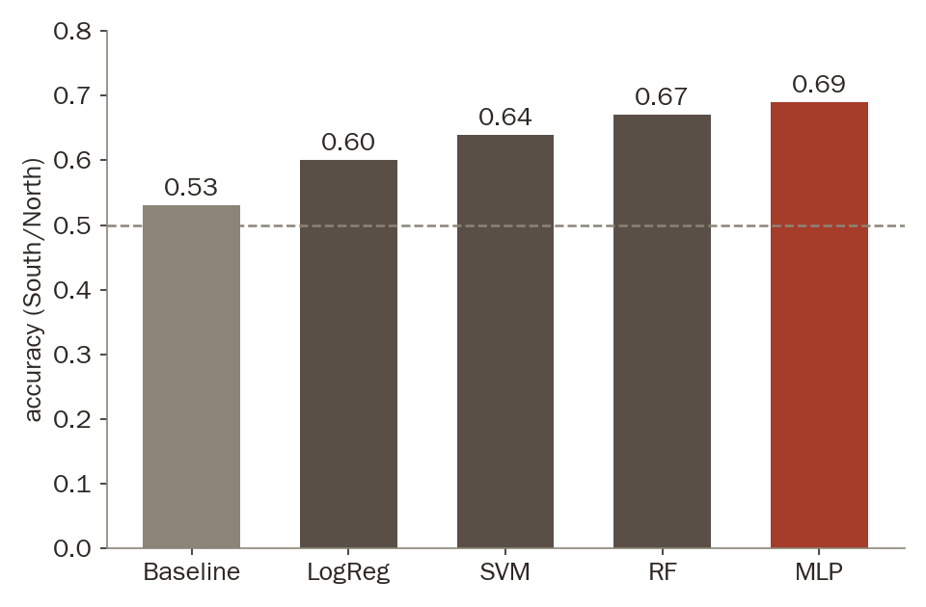
RESULT · RQ1
詩
Geography is legible from verse alone
0.69
accuracy on South vs North — against a 0.53 most-frequent baseline
Macro-F1 0.69 vs 0.35 — not an artefact of class imbalance.
A poet's origin is readable, well above chance, from text alone.
South vs North · stratified 5-fold CV · 242 poets
Chen & Liu · Regional Fingerprints in the Complete Tang Poems
6 / 12
Notes:
Can it be done? Yes. Baseline 0.53 -> LogReg 0.60, SVM 0.64, RF 0.67, MLP 0.69. Macro-F1 0.35 -> 0.69, so not an imbalance artefact. Origin is readable from text alone. (~45s)

Slide 7
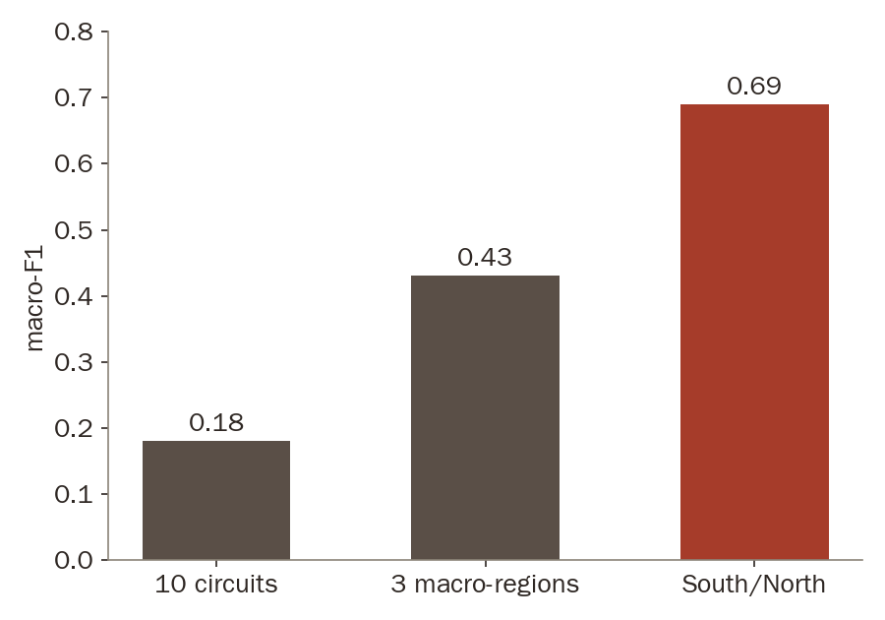
RESULT
詩
The signal survives at every grain
Coarse maps are sharper — but even the hardest map is readable
0.69 South/North — the axis of the historical debate
0.43 3 macro-regions — regional structure persists
0.18 10 circuits — ≈2× baseline despite six-poet classes
macro-F1 by task granularity · each ≈2× its most-frequent baseline
Chen & Liu · Regional Fingerprints in the Complete Tang Poems
7 / 12
Notes:
Harder maps: South/North 0.69, three macro-regions 0.43, full ten-circuit task 0.18 — each roughly TWICE its own baseline. Ten-way with six-poet classes is brutal; doubling baseline there is the surprise. (~40s)

Slide 8
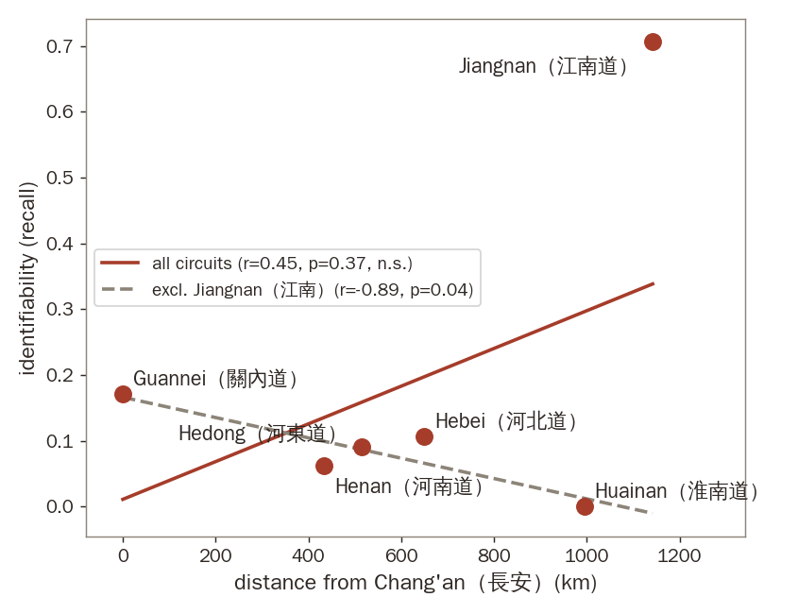
RESULT
詩
The centre blurs; Jiangnan stands apart
Near the court, one idiom. Circuits around Chang'an and Luoyang are heavily confused — the shared court language erases local difference.
Far from it, a voice of one's own. Jiangnan 江南 is by far the most separable region — recall 0.71 on the ten-way task.
Not a distance law. All six circuits: non-significant (r = 0.45, p = 0.37); drop Jiangnan and the slope reverses (r = −0.89). Two facts, not one gradient.
Per-circuit identifiability (recall) vs. distance from Chang'an — the apparent rise is carried by Jiangnan alone.
Chen & Liu · Regional Fingerprints in the Complete Tang Poems
8 / 12
Notes:
Where is the signal on the map? Two facts: capitals blur into one court idiom; Jiangnan stands apart at recall 0.71. Careful: NOT a distance law — full fit non-significant, slope reverses without Jiangnan. Two facts, not one gradient. (~55s)

Slide 9
RESULT · RQ2
詩
Imagery carries the region
南 The South writes landscape
北 The North writes the court
Mountain & water imagery 山水 — markedly more than in the north
Buddhist & recluse vocabulary — temples, retreat, withdrawal
Landscape diction — the discriminative characters of the south
Palace diction — the built world of the capitals
Gongti 宮體 motifs — courtly “boudoir” poetry
Court-idiom characters — the discriminative characters of the north
Tonal patterns 平仄 carry comparatively weak signal — the fingerprint lives in what poets see, not in how their verses scan.
Chen & Liu · Regional Fingerprints in the Complete Tang Poems
9 / 12
Notes:
RQ2: the South writes landscape — mountain/water imagery, Buddhist and recluse vocabulary. The North writes the court — palace diction, gongti motifs. Tone is weak. The fingerprint lives in what poets SEE, not how verses scan. (~45s)

Slide 10
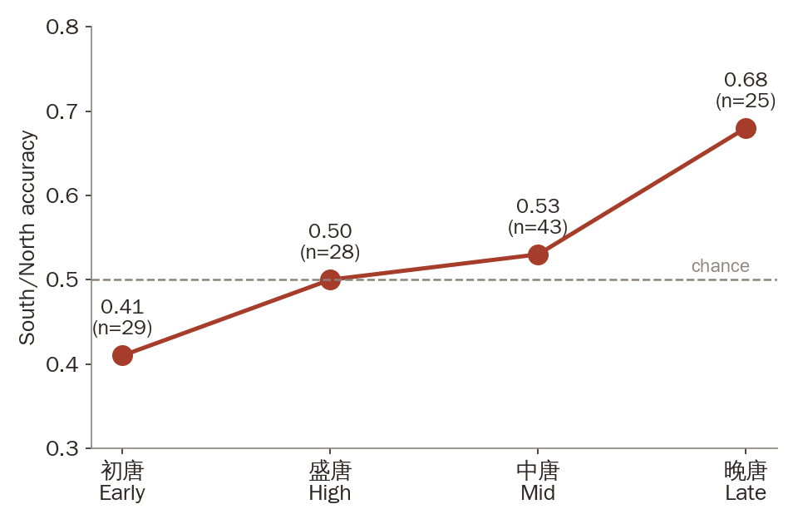
RESULT · RQ3
詩
The fingerprint waxes and wanes with the dynasty
初唐 0.41 southern poets assimilate — all 7 full-model errors run south → north
盛唐 0.50 at chance — maximum integration at the empire's height
中唐 0.53 after the An Lushan rebellion, regional voices begin to return
晚唐 0.68 as central authority weakens, separability peaks
Regional distinctiveness waxes and wanes with the political integration of the dynasty.
Chen & Liu · Regional Fingerprints in the Complete Tang Poems
10 / 12
Notes:
RQ3: 0.41 early Tang — southerners wrote the northern court idiom, and all 7 full-model errors in that era run S->N. 0.50 at chance at the empire's height, 0.53 after An Lushan, 0.68 late Tang. Distinctiveness moves with political integration — now with numbers. (~55s)

Slide 11
STRESS TEST & CAVEATS
詩
Do transformers read anything more?
0.62
0.674
+ 0
Naive fine-tuning
Hierarchical frozen encoder
Hybrid BERT + TF-IDF
GuwenBERT per fragment — below the n-gram models
pool fragments over a poet's corpus — ties the best classical models
combining the two adds nothing
Character n-grams already capture the available regional signal — interpretability costs nothing.
Read with care: small samples (357 / 242 / era subsets 25–43) · labels inherit CTP + CBDB noise · tone approximated · distance decay suggestive (r = 0.40, Mantel p ≈ 0.09). All four point the same way: more data would sharpen, not overturn.
Chen & Liu · Regional Fingerprints in the Complete Tang Poems
11 / 12
Notes:
Wouldn't a transformer see more? Naive fine-tuning 0.62 — below n-grams. Hierarchical frozen encoder 0.674 — ties classical. Hybrid adds nothing. N-grams already capture the signal; interpretability costs nothing. Caveats in one breath: small samples, inherited label noise, approximate tone, suggestive geography — all point the same way. (~55s)

Slide 12
CONCLUSION
A Tang poet's origin leaves a computationally detectable trace in their verse.
文
如
其
Carried chiefly by imagery and lexical choice — mountains and waters in the south; palace and gongti diction in the north
地
Not a simple distance law — the capitals blur into one court idiom — Jiangnan alone keeps a voice of its own
Modulated by history — at chance amid High-Tang integration; strongest (0.68) as Late-Tang authority wanes
詩
Next: stylistic similarity networks — does textual proximity track geography, or transcend it through literary influence?
謝謝 Thank you · arXiv:2606.24093 · Chen & Liu
Notes:
Conclusion: origin leaves a detectable trace — carried by imagery and lexical choice, not a simple distance law, modulated by history. Next: stylistic similarity networks. 文如其地 — the text is like its land. Thank you. (~40s)

