Slide 1
LMZ Data Analyzer
TEAM A3 PPT
TEAM A3
Dept. of Photonics & Nanoelectronics
장희령, 지요섭, 김건우

Slide 2
What is the problem?
How to solve?
How to use?
Results
INDEX
LMZ Data Analyzer

Slide 3


What does the client want?
What is the problem?
Black Box

Slide 4






Module
How to solve?
csv_maker.py
project
data
1.xml
n.xml
filter.py
fitting.py
src
get_start.py
Run.py
results
csvs
.csv
graph.py
parsing.py
jpgs
.jpg
rsq.py
Jupyter notebook
doc

Slide 5
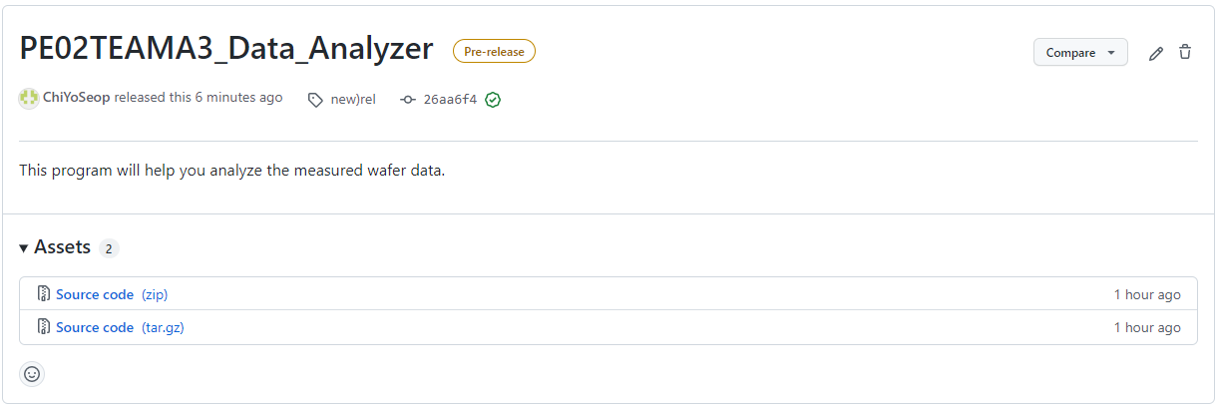

How can the client use it?
How to use?

Slide 6


Put the data you want to analyze into the 'dat' folder.
How to use?
dat

Slide 7
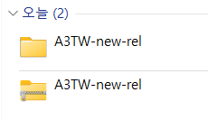
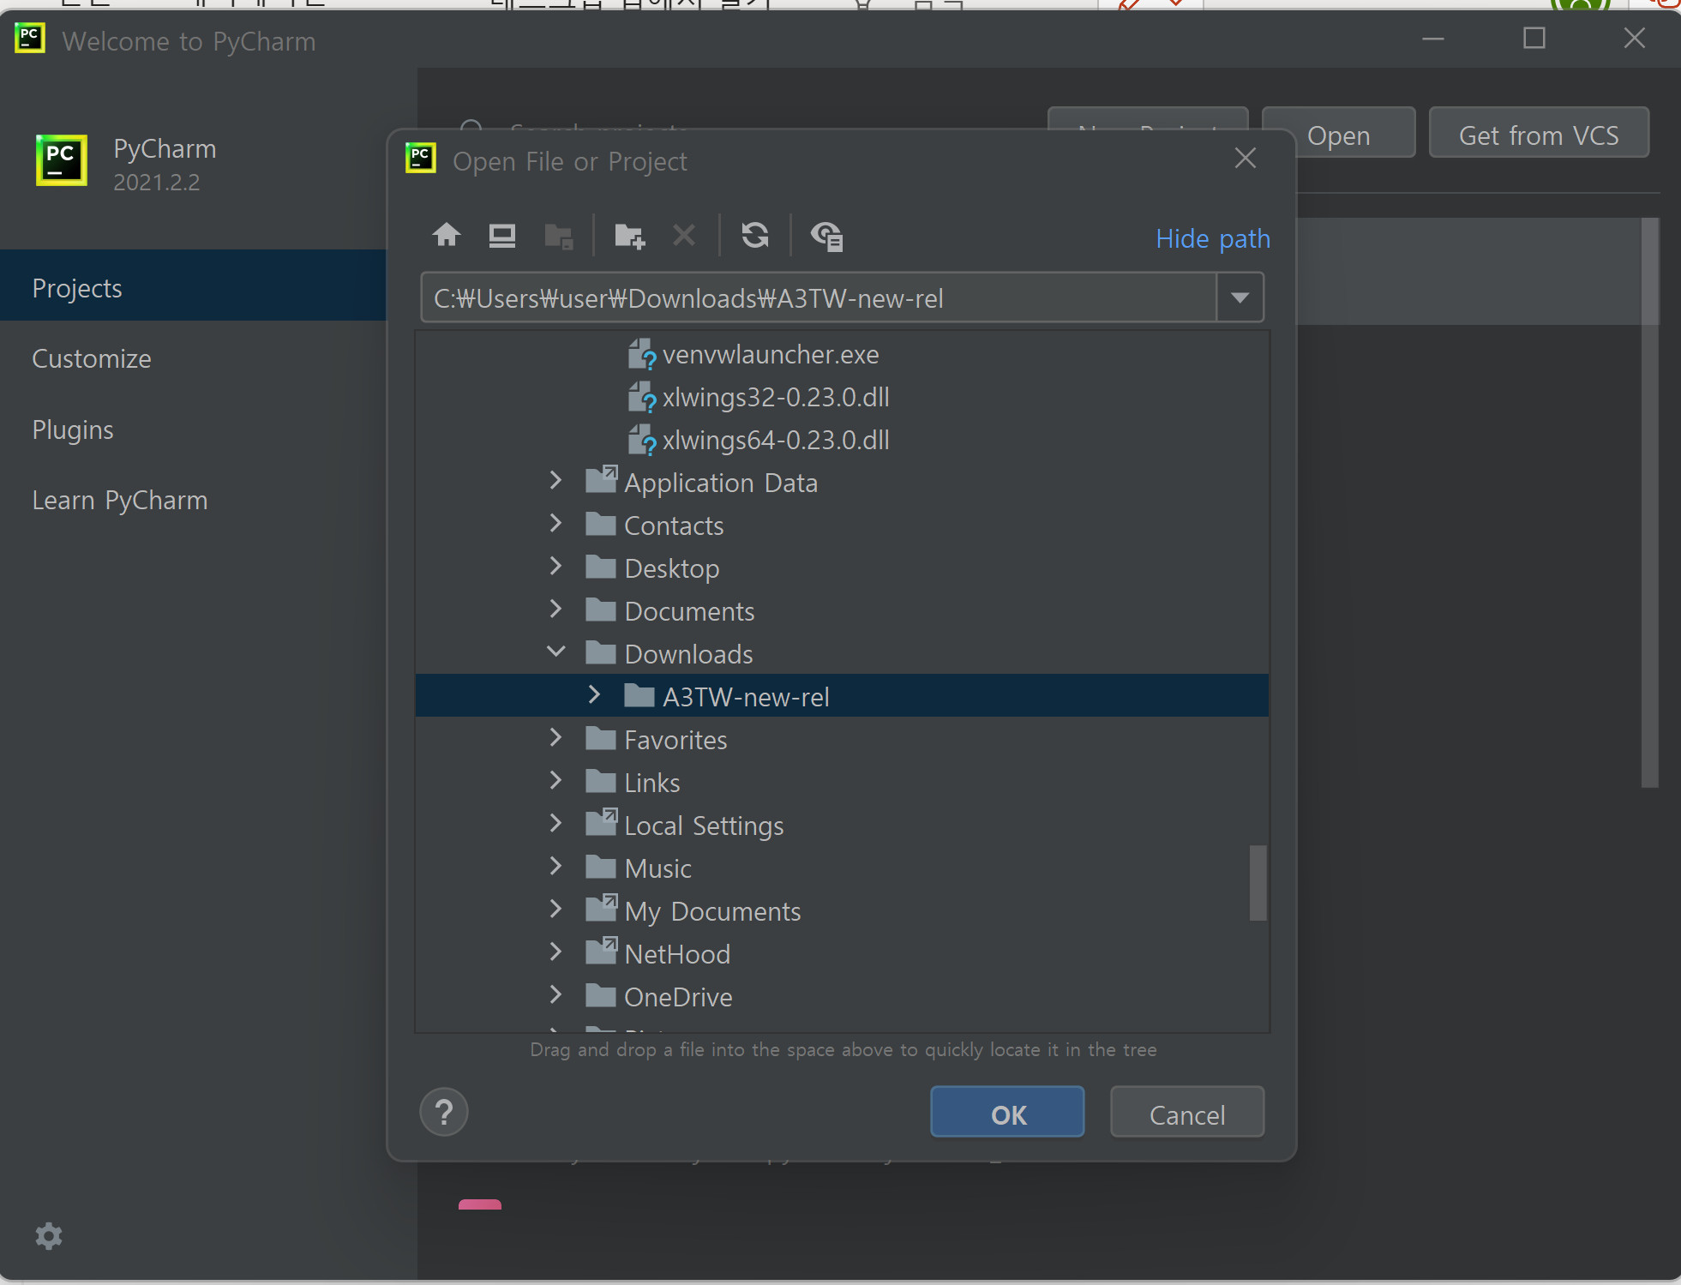
Open the file using PyCharm
How to use?

Slide 8
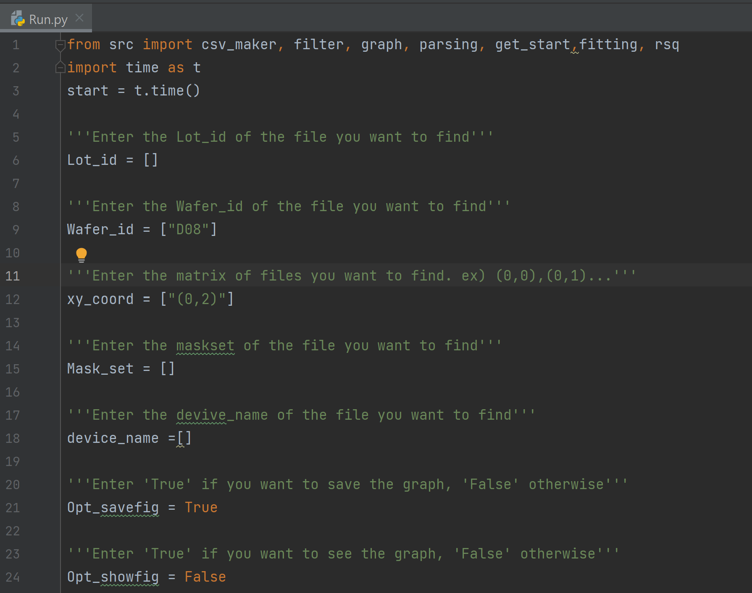
Enter the values in Run.py
How to use?

Slide 9
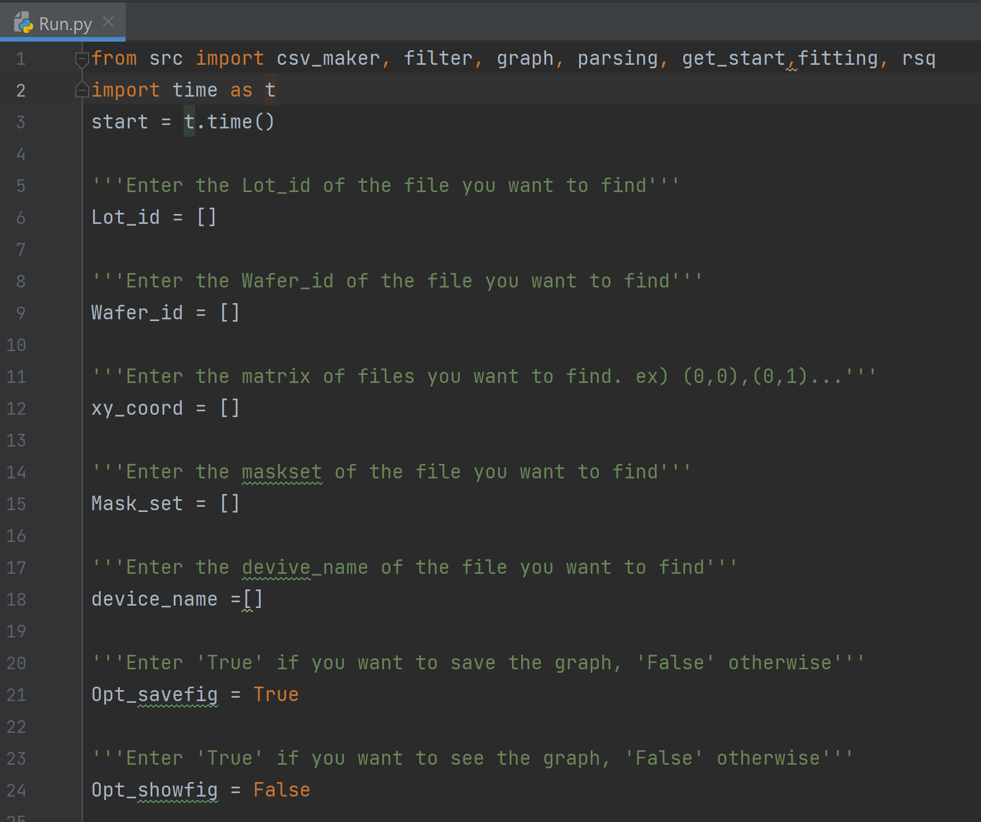
EX) Analyze all 'LMZ' data
How to use?
Run.py

Slide 10
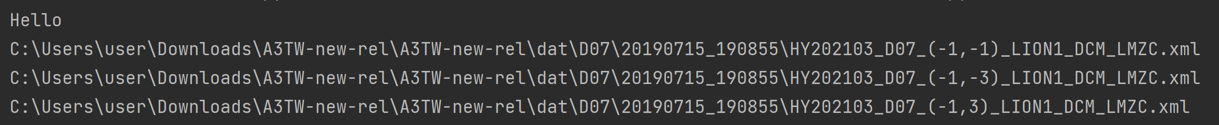
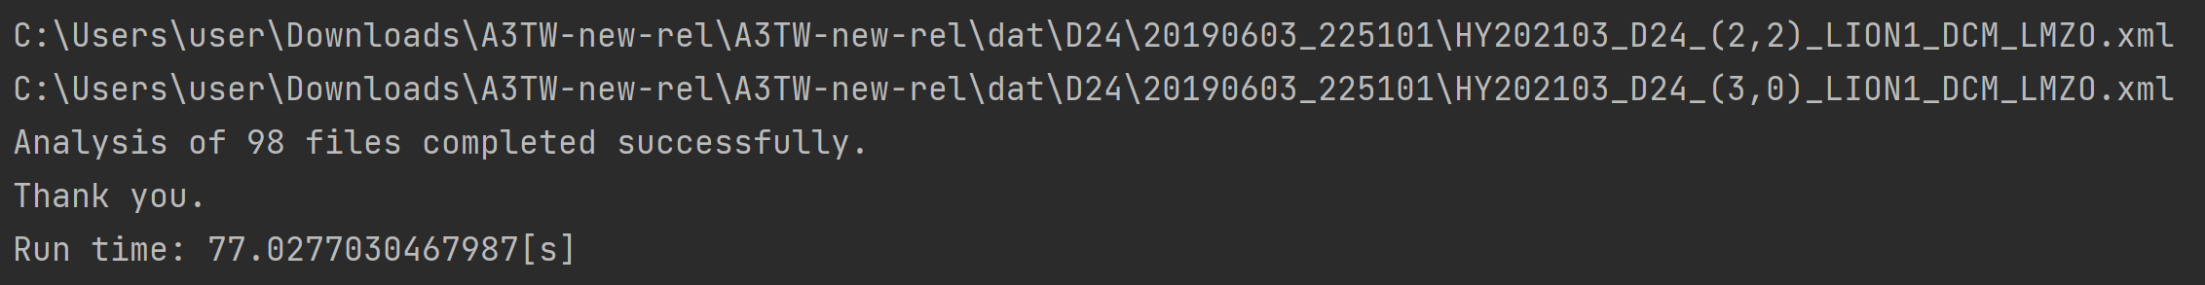
EX) Analyze all 'LMZ' data
How to use?
Results
.
.
.

Slide 11
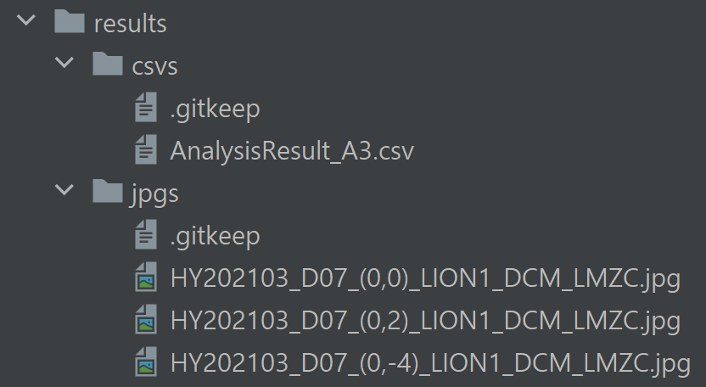
Check the results
How to use?

Slide 12
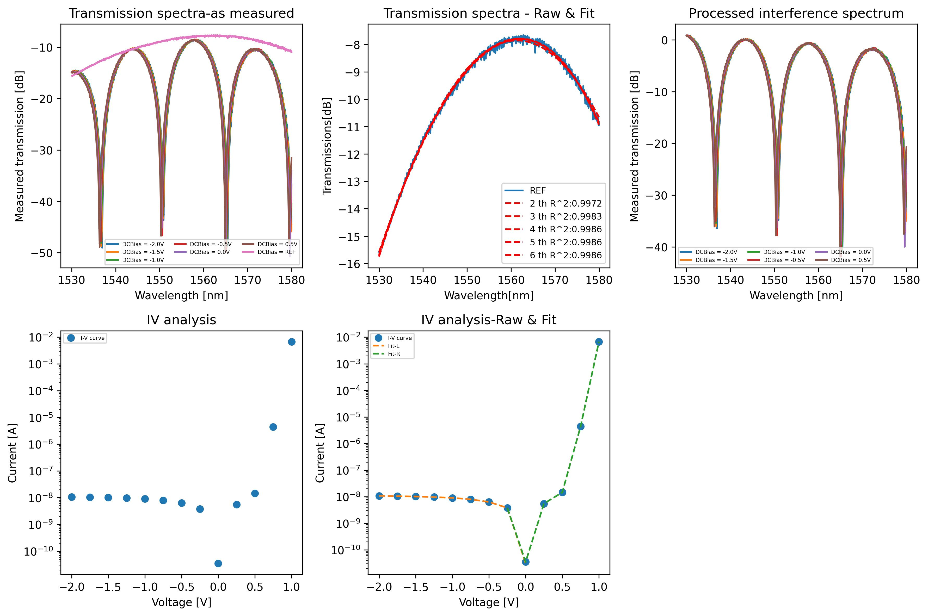
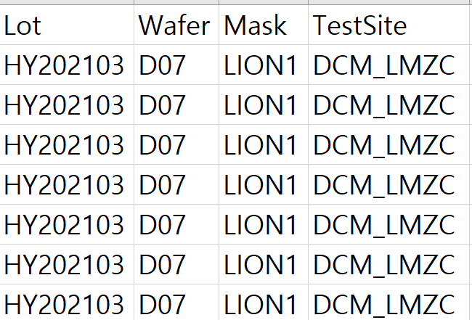
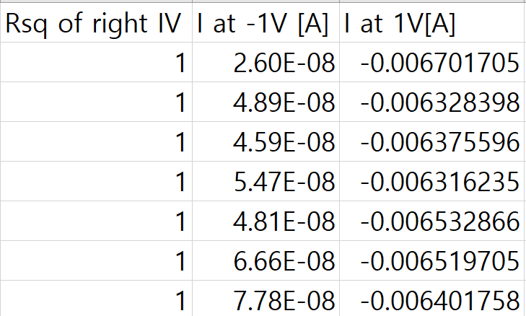
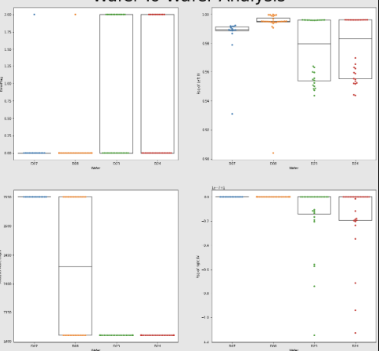
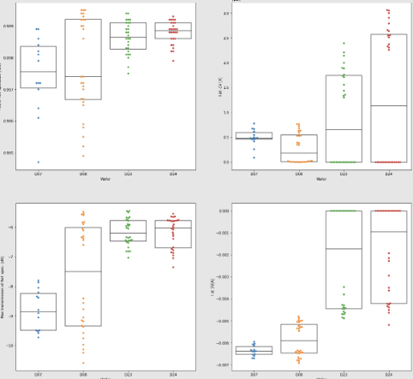
Results
Results
jpg
csv
...
Jupyter notebook

Slide 13
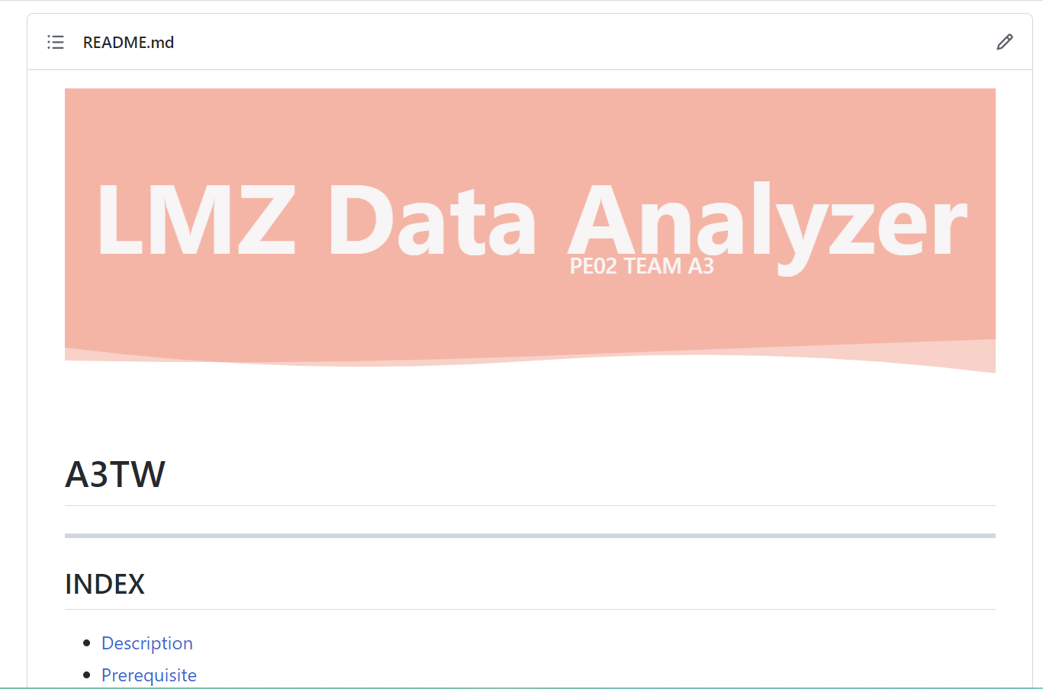
README
How to solve?
https://github.com/PE02TEAMA3/A3TW#readme

Slide 14

Thank you
TEAM A3 PPT
Source: https://img1.daumcdn.net/thumb/R1280x0/?scode=mtistory2&fname=https%3A%2F%2Fblog.kakaocdn.net%2Fdn%2FmvI0C%2Fbtq57oVfCGM%2FPqiCigr0LNOsZDpdgcRLY0%2Fimg.jpg

