Slide 2

RUN
PiX

Slide 3
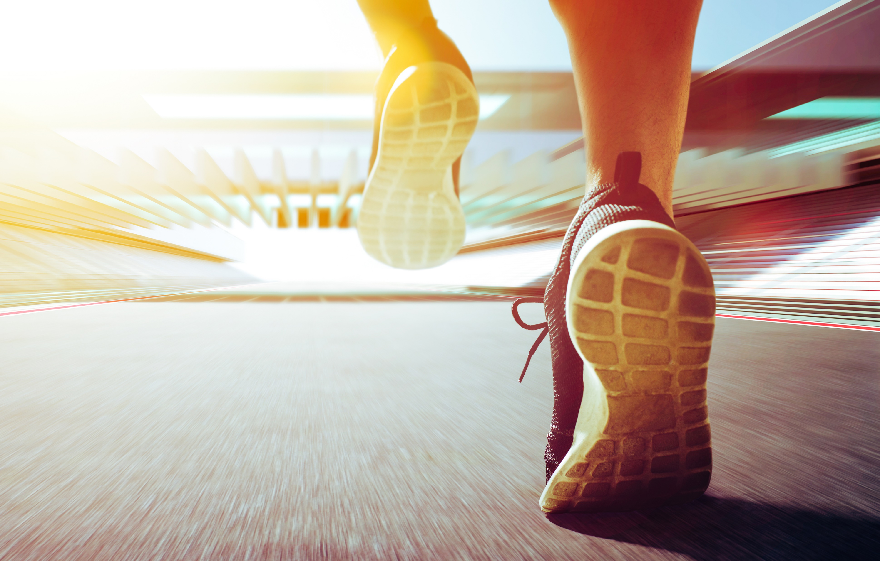
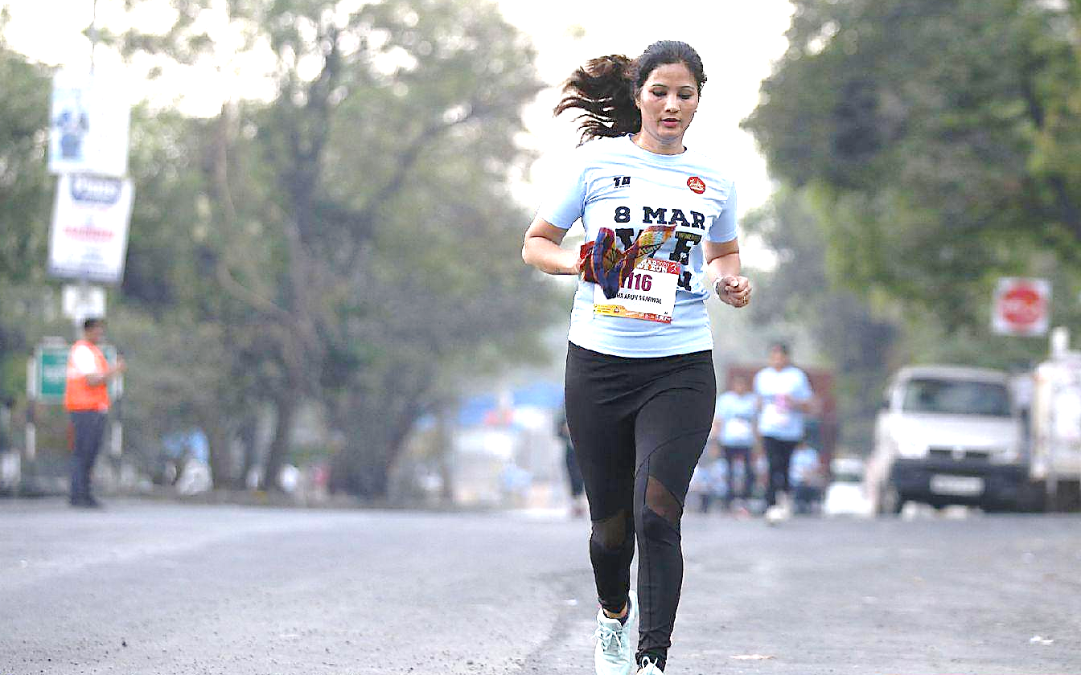

Menu
RESULTS
PHOTOS
EVENTS

