Slide 1


Big Data Project
GirlGenerations

Slide 2
Issue - How to define the “System Loading”
We thought system loading is associated with “The amount of requests in a period of time”.
So, we could find how many requests the users made,
Assume each data represent one ticket, and after every user order the ticket, would be added the data in system dataset.
We can define system loading with the formula below :
△ amount of tickets addition / △ hour
△ amount of people addition / △ hour
Because it is difficult to observe the variance in minute, we calculated in hour.

Slide 3
Case 1 △ amount of tickets addition / △ hr
_{ˮ}

Slide 4
Data Preprocessing & Feature Engineering
Data Selection:
"IDENTITY", "CREATE_DATE” , "PRICE” , "T_STANDARD_TICKET_TYPE_NAME” , "SEAT_REGION_NAME” , "SEX”
Feature conversion:
Convert “CREATE_DATE” to comparable object like panda’s DatetimeIndex
Convert “T_STANDARD_TICKET_TYPE_NAME” to category type
Feature Splition：
Split “SEAT_REGION_NAME” to FloorNo to represent the seat’s floor (ex floorB1, Floor2, Floor3)
Feature Combination: Assume the total tickets is the same as sample size (n=7069)
Compute the existing tickets that each kind of FloorNo
Compute the existing tickets that each kind of SEAT_REGION_NAME

Slide 5
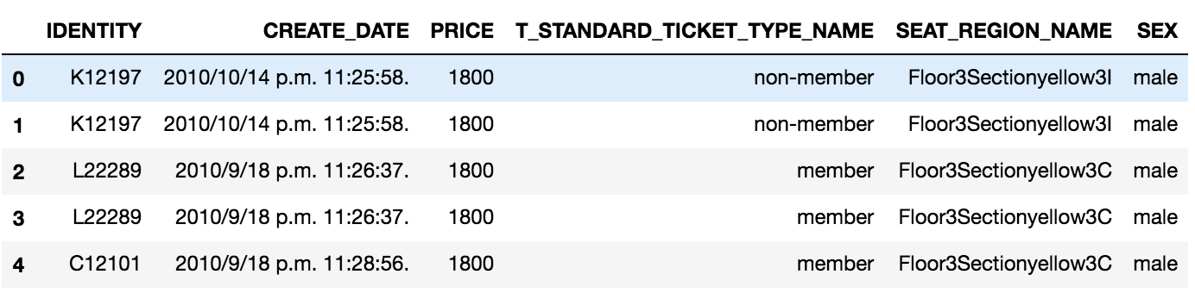

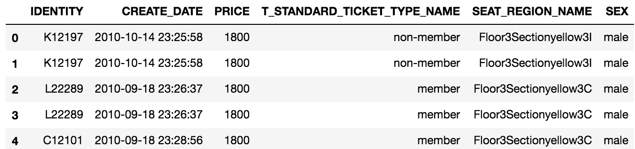
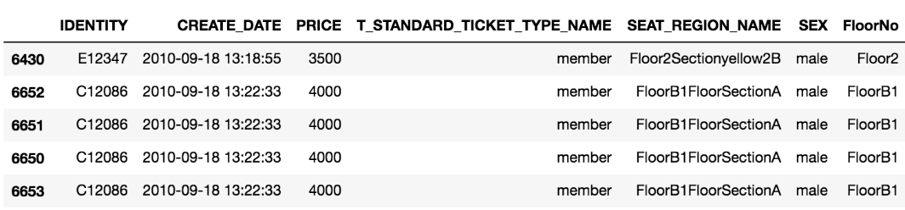
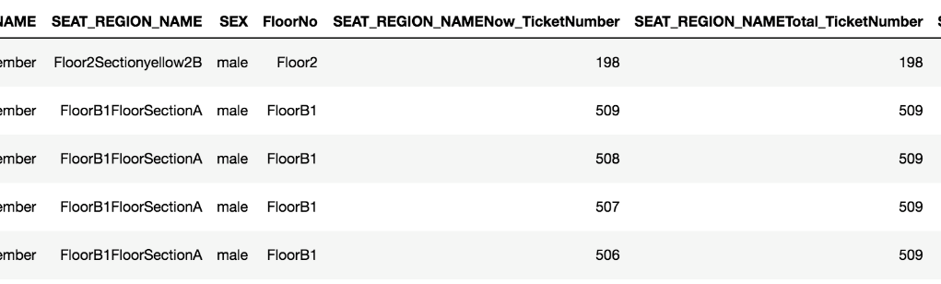
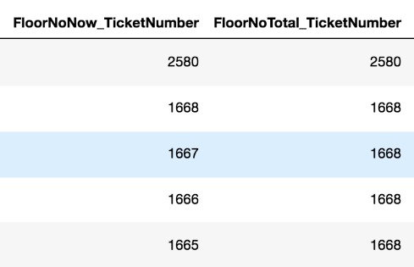
Read
Feature
Selection
Convert TimeObject
Split to FloorNo
Compute existing tickets on two situations
Data
Analysis

Slide 6
Analyze Process – 3 Phase
We found the tickets were sell in different period of time, member could buy the ticket previously. So when we analyzed the system loading divide in member and non-member two groups.
There are three phases to discuss System Loading Performance :
Member / non-member average tickets addition
Average tickets addition of The matrix of 「 (member, non-member) 」 and「 FloorNo(FloorB1,Floor2,Floor3) 」
Average tickets addition of The matrix of 「(member, non-member) 」 and 「 SEAT_REIGON_NAME 」

Slide 7
Phase 1 – Discuss member & non-member
All Tickets = 7069 tickets
Member System Loading: 551.75 ( △ amount of ticket addition / △ hr )
( member | All Tickets ) = 6307 tickets
Timedelta = 11.43 hr
6307 / 11.43 = 551.75
Member System Loading = 66.66 ( △ amount of ticket addition / △ hr )
( member | All Tickets ) = 762 tickets
Timedelta = 11.34 hr
762 / 11.34 = 67.18
Represent System can afford “551 tickets additions” per hour
Member System Loading > non-member System Loading

Slide 8
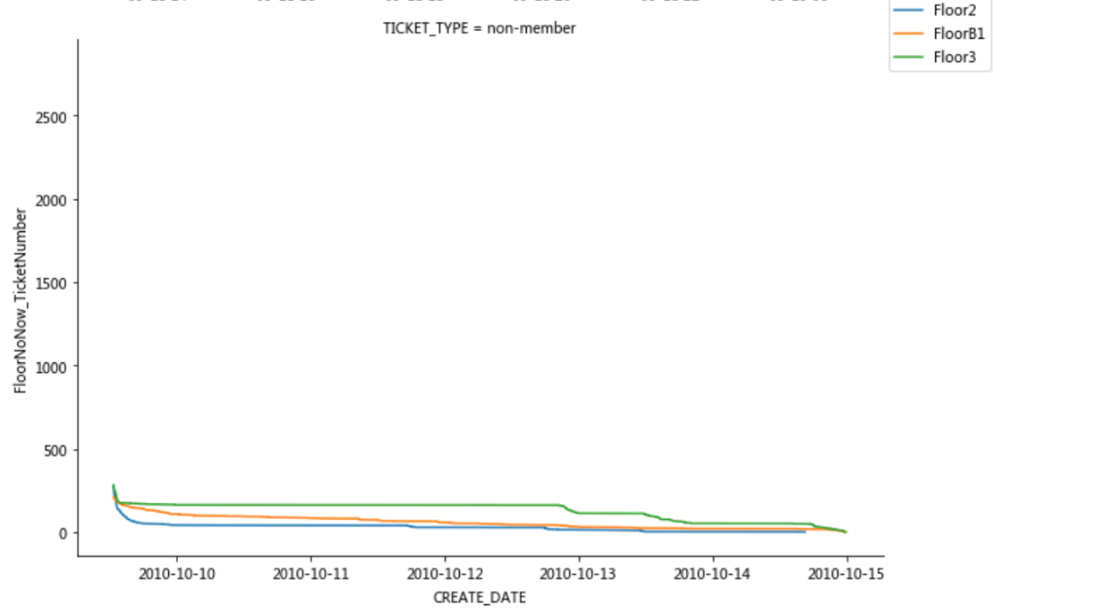

Phase 2 – Discuss matrix of NMe& FloorNo
member
FloorB1 System Loading = 1460 / 11.37 = 128.4
Floor2 System Loading = 2311/9.96 = 231.94
Floor3 System Loading = 2536 / 11.24 = 225.59
non-member
FloorB1 System Loading = 209 / 11.29 = 18.51
Floor2 System Loading = 270 / 3.94 = 68.56
Floor3 System Loading = 283 / 11.08 = 25.55
System Loading’s Rank of each floor
1st : Floor2 ( average price of this floor is 3598 )
2nd: Floor3 ( average price of this floor is 1854 )
3rd: FloorB1 ( average price of this floor is 4000 )
Why Floor2 > Floor3 : we guess this is because Floor2 amount of Tickets < Floor3’s
Ps. NMe : Non-member, Member | FloorNo : (FloorB1,Floor2,Floor3)

Slide 9
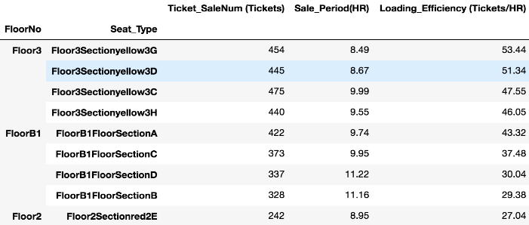
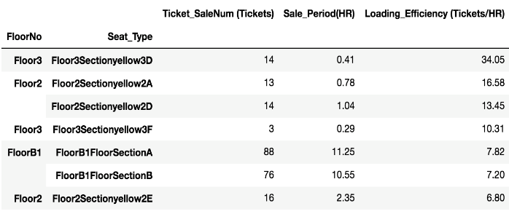
Phase 3 – Discuss matrix of NMe & SEAT_REGION_NAME
This related data ouput is saved in Result.xlsx.
According to right data we analyze, we can found some characteristics in the data :
Member :
The Floor3Sectionyellow3G, 3D,3C,3H is the four highest area that system loading perform very well, we can guess because this area’s price (800, or 1800) is the cheapest of all tickets.
After four highest the area, following area is FloorB1’s all sections => maybe it mean there always some people who want to experience the “Rock Zone.”
Member and Non-member:
According to the System loading, we find out that people tend to book the “center seat” of the concert, maybe because it has more wide view
After Sorting
Member
Non-member

Slide 10
Result-1
System can afford “551 tickets additions” per hour in Member
The maximum of affordance is 551
Member System Loading > non-member System Loading
System Loading’s Rank of each floor :
Floo2 > Floo3 > FloorB1
System Loading about each area:
Floor3YellowSection{CenterArea} is the highest, maybe because the price is cheap
“Rock Zone” is always popular
No matter member or non-member, every body always like cheap ticket

Slide 11
Case 2 △ amount of people addition / △ hr
_{ˮ}

Slide 12
Data Preprocessing & Feature Engineering
Data Selection:
"IDENTITY", "CREATE_DATE” , "T_STANDARD_TICKET_TYPE_NAME”
conversion:
convert “CREATE_DATE” to “newDate” & “newTIme”
“newDate” & “newTIme” convert to String
Feature Splition：
Split "T_STANDARD_TICKET_TYPE_NAME” to “member” & “non-member”
Split “CREATE_DATE” to represent the different date(ex 0918, 0918, 1009,1010)
Feature Combination:
Assume the people is the same as sample size (member = 2421 , non-member = 438)
Compute the at member purchase time & non-member purchase time
Compute the existing buy request that each kind of different date

Slide 13
Analyze Process
We found every one can order four ticket in one time, but not limit the order time. So there are some people order the ticket in both period of time for member and non-member. In this case, we just wanted to discuss how many people had requests in per hour.
Because the interval of date sold ticket, we split the data in date. We would analyzed with steps below :
Split the data in date, there were 2010-09-18 , 2010-09-19 , 2010-10-09~ 2010-10-14.
And delete the repeated “IDENTITY” data , and divided into member and non-member.
Calculate the total requests per day and average requests per hour.

Slide 14
Result-2
 | Member | Non-member
Date | 09/18 , 09/19 | 10/09 , 10/10 , 10/11 10/12 , 10/13 , 10/14
number of people request | 2421 people | 438 people
Purchase time | 12 hr | 69 hr
Request per hour | 201.75 requests | 6.35 requests
Purchase time : If there hour has not any request, it would not calculate in purchase time.

