Slide 1
SQL Presentation -
Entertainment
Core C: Alizeh Sultan, Yutong Gao, Xiaoyu Ma, Maria Chen, Chia-Chun Hung, Shao-Chueh Liu, Jiajun Ma, Joshua Zhang
Notes:
Joshua

Slide 2
Presentation
overview
Our Analysis
Our Visualizations
AI Analysis
AI Visualization
Comparative Analysis
Individual Contributions
Notes:
Joshua

Slide 3
Agent Performance Analysis
Matrix:
Total Net Revenue by Agent
Average Net Revenue per Contract
ROI: Revenue Generated per Dollar of Commission
What We Found:
Carol Viescas: drives the highest total net revenue because she signs the most contracts
John Kennedy: leads in deal quality with the highest net revenue per contract, showing strong pricing and negotiation skills
Caleb: the most efficient overall. He ranks near the top in both per-contract value and ROI
Maria and Karen: underperform across all three metrics and need targeted support.
Recommendations:
Continue to route strong opportunities to Carol and John
Expand opportunities for Caleb
Provide pricing and negotiation coaching for Maria and Karen.
Notes:
Tony

Slide 4
Entertainers Revenue Analysis
A small group of entertainers drive most of the company’s reach, loyalty, and revenue, while underpricing and portfolio imbalance limit overall profitability.
Customer Reach (Diversity)
Customer Loyalty (Repeat Bookings ≥ 2)
Profitability (Avg Revenue per Engagement)
Recommendations:
Double down on top performers (marketing, pricing, priority access)
Increase prices for high-volume entertainers with low revenue (Carol Peacock Trio)
Protect premium niche acts (Coldwater Cattle Company)
Intervene or phase out consistently weak performers
Rebalance talent portfolio toward high-performing styles (60’s Music, Country, Standards)
Notes:
Maria

Slide 5
Revenue & Customer Preferences by Musical Style
Key Insights:
High-value customers demonstrate broad and diverse musical tastes
Spending differences are driven by entertainer pricing, not booking frequency
Several styles show strong revenue per entertainer (60’s Music, Country), while others underperform despite similar talent counts
Recommendations:
Expand talent in high-ROI styles such as 60’s Music and Country
Reassess low-demand styles (Classical, Folk, Chamber Music) through pricing review, marketing repositioning, or selective downsizing
Implement a premium pricing strategy for high-value clients, who tend to choose high-priced entertainers rather than more events
Notes:
Xiaoyu

Slide 6
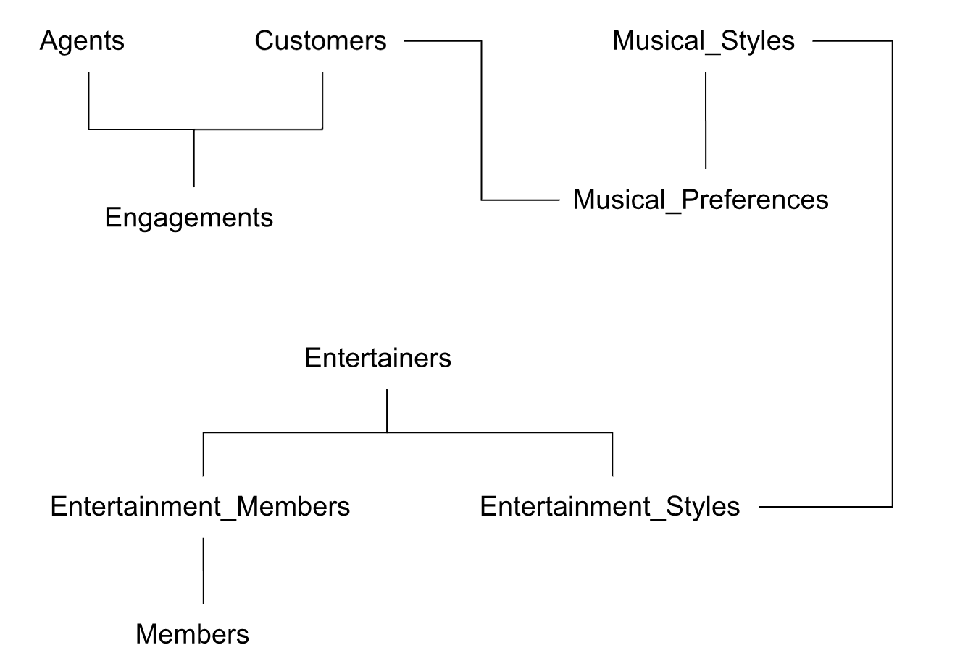
Flow Chart Diagram
Notes:
Joshua

Slide 7
AI Analysis
Data Quality: Some records (e.g., test agents, extreme revenues) may require cleaning.
Contract Pricing:Right-skewed distribution; most bookings fall between $500–$1,500.
Genre Demand vs. Supply: High demand for Contemporary and Jazz, but limited entertainer coverage.
Top Performer: Country Feeling accounts for 11% of all engagements.
Agent Performance: William Thompson leads with $18,485 in revenue; performance varies across agents.
Market Gap: Contemporary is highly requested but only two entertainers offer it.
Price Distribution: Median price ($1,130) is more representative; most bookings fall under $1,000.
Notes:
Gina

Slide 8
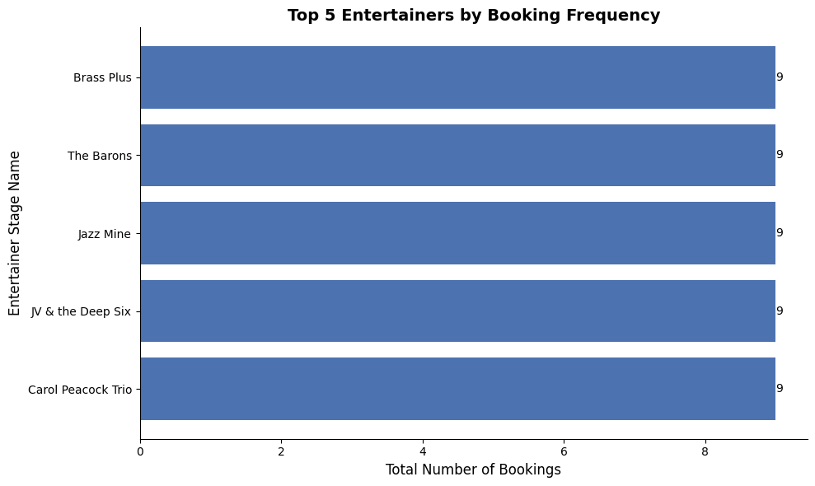
AI Visualizations
Notes:
Alizeh

Slide 9
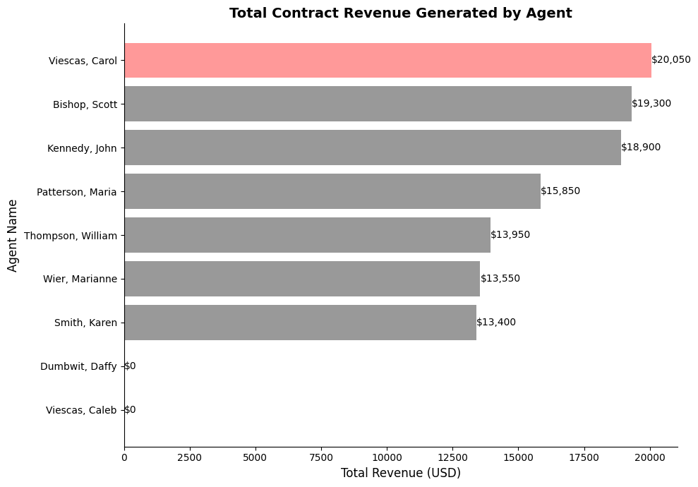
AI Visualizations
Notes:
Alizeh

Slide 10
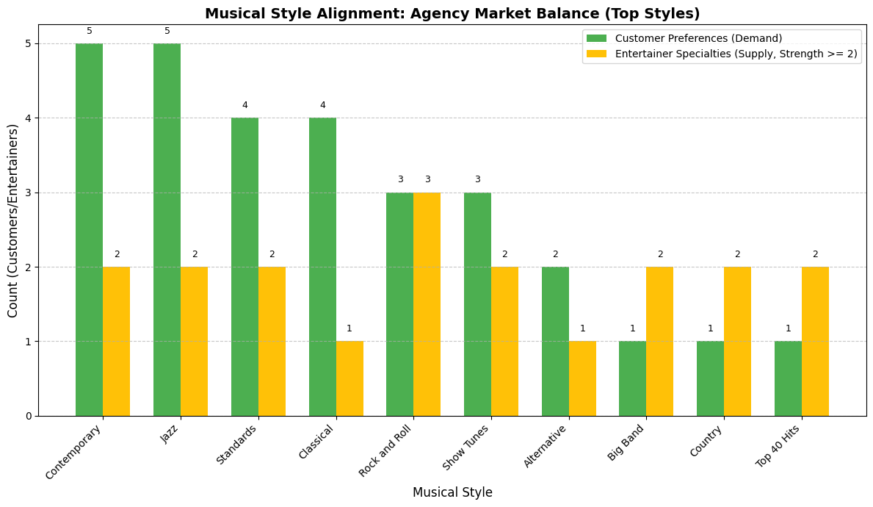
AI Visualizations
Notes:
Alizeh

Slide 11
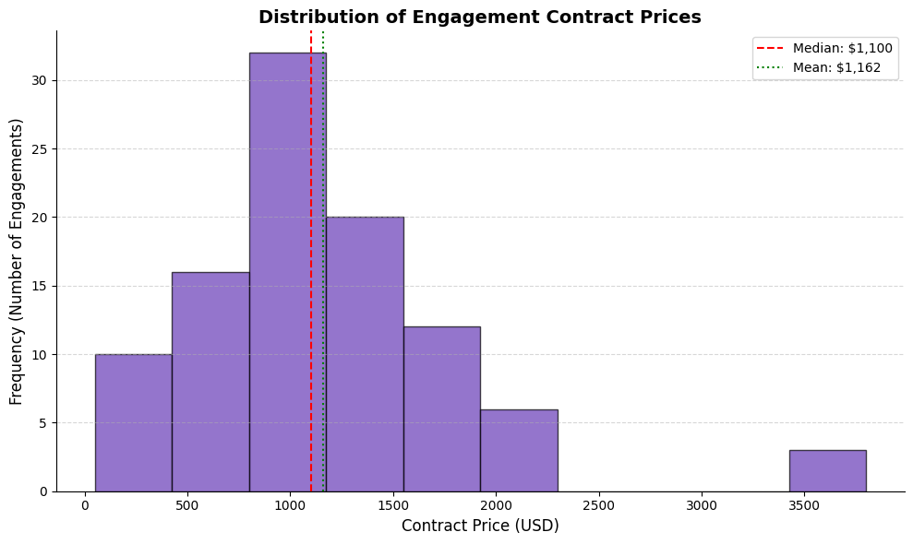
AI Visualizations
Notes:
Alizeh

Slide 12
Comparative Analysis - Team
Strengths (3):
Strong, detailed SQL analysis with accurate data cleaning
Deep business insights on entertainers, customers, and agents
Multi-metric agent evaluation (net revenue, ROI, revenue per contract)
Weaknesses (2):
Visualizations were limited compared to Python
Analysis required more time and manual effort
Notes:
Jeff –
For our team’s analysis, our main strengths were the depth and accuracy of our SQL work. We carefully cleaned the data, checked for inconsistencies, and produced strong business insights across entertainers, customers, and agents. We also evaluated agent performance using multiple metrics like net revenue, ROI, and revenue per contract, which gave us a clearer picture of their true effectiveness.
The weaknesses were mainly related to time and tools. Our visualizations were more limited compared to what Python can generate, and our work required more manual effort to explore patterns.

Slide 13
Comparative Analysis - AI
Strengths (3):
Fast and automated EDA with strong Python visualizations
Quickly surfaced major trends and high-level insights
Generated reusable SQL and Python code
Weaknesses (2):
Analysis was more surface-level and missed deeper context
Didn’t detect data issues or anomalies that the team identified
Notes:
Mitchell–
For the AI analysis, its main strengths were speed and automation. It generated Python visualizations quickly, highlighted major trends immediately, and produced reusable SQL and Python code that made the process very efficient.
However, the AI analysis had limitations. It tended to stay at a surface level, missing the deeper business context we found, and it didn’t catch data issues or anomalies that we identified manually.

Slide 14
Individual Contributions
Alizeh Sultan
Yutong Gao
Maria Chen
Xiaoyu Ma
Completed phase 2 of Individual report (missing values, inconsistencies)
Complete AI report with python code
AI Analysis for Slides
Completed phase 2 data cleaning
(missing values,inconsistencies, duplicates)
Completed the AI analysis slide based on AI EDA analysis
Completed phase 3 (Exploratory Analysis & Insight Generation)
Complete phase 4 (Synthesis & Recommendations)
Completed phase 3 (Exploratory Analysis & Insight Generation)
Complete phase 4 (Synthesis & Recommendations)
Chia-Chun Hung
Shao-Chueh Liu
Jiajun Ma
Joshua Zhang
Performed data validation and integrity checks, wrote SQL queries to identify missing or inconsistent records.
Completed phase 3 (Exploratory Analysis & Insight Generation)
Complete phase 4 (Synthesis & Recommendations)
Think about how each target audience or segment relates to your product or service, why they need it, and how they’ll use it.
Flow chart diagram
Data dictionary table
Individual report Phase 1
Notes:
Mitchell

Slide 15
Thank you
Notes:
Mitchell

