Slide 1
Outline
Introduction
Background
O-RAN architecture
A1 interface
E2 interface
ML Workflow with RIC: Non-RT RIC
ML Workflow with RIC: Near-RT RIC
AI/ML Models in O-RAN Use Cases
O-RAN implementation guide on ubuntu 20.04
Install k8s, helm, and docker
Install Near-RT RIC
Install Non-RT RIC
Anomaly Detection Use Case
Reference

Slide 2
Outline
Introduction
Background
O-RAN architecture
A1 interface
E2 interface
ML Workflow with RIC: Non-RT RIC
ML Workflow with RIC: Near-RT RIC
AI/ML Models in O-RAN Use Cases
O-RAN implementation guide on ubuntu 20.04
Install k8s, helm, and docker
Install Near-RT RIC
Install Non-RT RIC
Anomaly Detection Use Case
Reference

Slide 3
Introduction (1/14)
Background
Today, radio access network (RAN) components are monolithic units, all-in-one solutions that implement each and every layer of the cellular protocol stack.
They are provided by a limited number of vendors and seen by the operators as black-boxes.
Reliance on black-box solutions has resulted in:
Limited reconfigurability of the RAN, with equipment whose operations cannot be fine-tuned to support diverse deployments and different traffic profiles.
Limited coordination among network nodes, preventing joint optimization and control of RAN components.
Vendor lock-in, with limited options for operators to deploy and interface RAN equipment from multiple vendors.
To overcome these limitations, in the last decade several research and standardization efforts have promoted the Open RAN (O-RAN) as the new paradigm for the RAN of the future.
O-RAN deployments are based on disaggregated, virtualized and software-based components, connected through open and well-defined interfaces, and interoperable across different vendors.
Disaggregation and virtualization enable flexible deployments.
Open and interoperable interfaces also allow operators to onboard different equipment vendors.
Open interfaces and software-defined protocol stacks enable the integration of intelligent, data-driven closed-loop control for the RAN.
Notes:
在現今，radio access network 是屬於 all-in-one 的結構, 就是一個基地台包含了大部分的網路功能。
這些基地台是由少數的供應商所提供，像是華為, nokia, 或是 ericsson，這些廠商占了大部分的基地台市場。
所以像這種 all-in-one 的基地台，它可能帶來一些影響，較難重新配置網路，網路節點之間的合作較有限，網路供應商的選擇有限,成本難控制。
這些原因,促使一些學者開始提倡開放式的 radio access network。
而 open ran 的架構是基於 分解、虛擬化和軟體定義網路的這些概念所建立的。這使得網路的部屬可以更靈活，另外網路供應商有更多的產品選擇，而不同網路裝置之間透過開放式的介面，可以獲得更多其他網路的資訊，已做出更好的決策。

Slide 4

Introduction (2/14)
Background
O-RAN ALLIANCE
Who we are
O-RAN ALLIANCE is a world-wide community of mobile operators, vendors, and research & academic institutions with the mission to re-shape Radio Access Networks to be more intelligent, open, virtualized and fully interoperable.
Membership: AT&T, NTT DOCOMO, SK telecom, 中華電信, ….
What We Do
Specification Effort
O-RAN specifications define individual parts of the O-RAN Architecture.
Open Software for the RAN
The O-RAN Software Community aims to create open software for Radio Access Network (RAN), aligning it with O-RAN Architecture and specs.
The goal is to unify and speed up RAN evolution and deployment.
Testing & Integration of O-RAN Implementations
O-RAN ALLIANCE aids members in testing and integrating their O-RAN implementations.
Open Testing and Integration Centres (OTIC) provide a collaborative, open, and impartial testing environment.
O-RAN Demonstrations
O-RAN Virtual Exhibition allows companies to demonstrate their O-RAN based implementations.
Notes:
Oran alliance 是一個類似於 3GPP 的組織，由一些學術機構或是私人公司所組成的聯盟，他們致力於提供 ORAN 的解決方案。
會員包含了各國知名的電信公司。
以下是他們主要的貢獻:
提供 O-ran 的相關文件。
提供開源軟體，讓大家可以嘗試部屬自己的 Oran。
還有協助整合不同會員所提出的解決方案，並測試運作的狀況。
此外，提供平台，讓大家可以展示自己的 oran 系統。

Slide 5
Introduction (3/14)
O-RAN architecture
The gNB is split into a Central Unit (CU), a Distributed Unit (DU), and a Radio Unit (RU) (called O-CU, O-DU, and O-RU in O-RAN specifications).
The O-RU performs time-domain functionalities, with precoding, Fast Fourier Transform (FFT), cyclic prefix addition/removal, and Radio Frequency (RF) operations.
The O-DU then takes care of the remaining functionalities of the physical (PHY) layer, and of the Medium Access Control (MAC) and Radio Link Control (RLC) layers.
scrambling, modulation, layer mapping, part of precoding, and mapping into physical resource blocks
The O-CU units (CP and UP) implement the higher layers of the 3GPP stack.
Radio Resource Control (RRC) layer: manages the life cycle of the connection
Service Data Adaptation Protocol (SDAP) layer: manages the Quality of Service (QoS) of the traffic flows
Packet Data Convergence Protocol (PDCP) layer: takes care of reordering, packet duplication, and encryption for the air interface
RRC
PDCP
RLC
MAC
PHY-high
PHY-low
RF
RAN black-box
O-CU
O-DU
O-RU
Notes:
接著就開始介紹 oran 的架構。
傳統基地台，屬於 all in one 的架構，像 cu,du,ru這些裝置都是和在一起的，oran 較不同的是….並且使他們可以在一般伺服器上運行

Slide 6
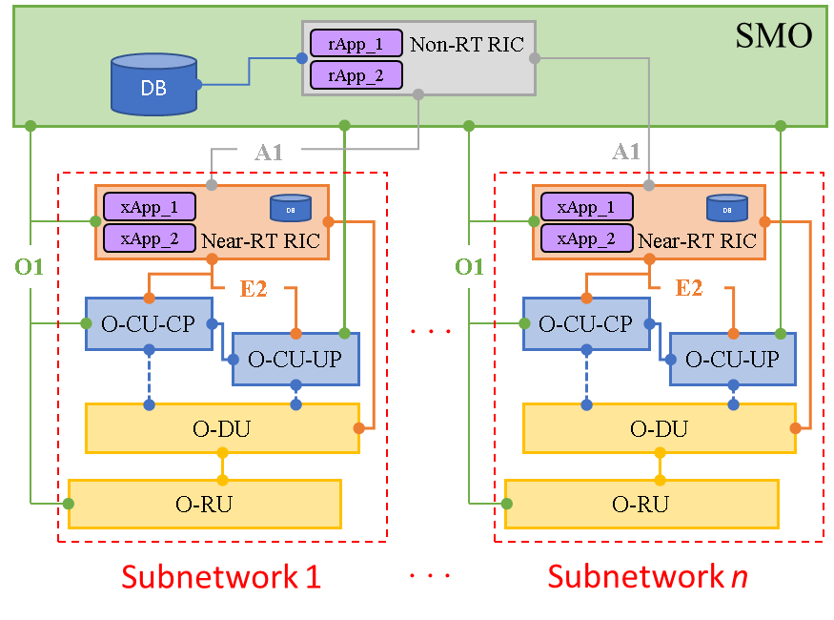
Introduction (4/14)
O-RAN architecture
The second innovation is represented by the RAN intelligent controllers (RICs), which introduce programmable components that can run closed-loop control and orchestrate the RAN.
Non-real-time RIC:
Provides guidance, enrichment information, and management of machine learning (ML) models for the Near-RT RIC.
The AI algorithms run as rApps on a time scale larger than 1 second.
It has been designed to derive control policies that operate at a higher level and affect a larger number of users and network nodes.
Near-real-time RIC:
Deliver specific services such as radio resource management (RRM) and handover controlling for network.
AI algorithms are implemented as external applications (i.e., xApps) and operate control loops with a periodicity between 10 ms and 1 s.
The O-RAN Alliance has also introduced technical specifications that describe open interfaces connecting a number of different components of the O-RAN architecture.
O1: SMO to each O-RAN component
A1: Non-RT RIC to Near-RT RIC
E2: Near-RT RIC to each E2 nodes (O-CU, O-DU)
Fig. O-RAN architecture
SMO: Service Management and Orchestration
Notes:
O-ran 的第二個創新是 ran intelligent controller，這個功能可以對網路進行 closed-loop 控制。
Non-real-time RIC:
為 near-rt ric 提供 ML 模型豐富的訊息和管理。
AI 的演算法是以 rapp 的形式運行，控制迴路的 dealy 大於 1 秒。
因為 non-rt ric 是屬於比較高的網路層級，因此他可控制多個 oran 的子網路，像右邊的圖顯示一樣。
Near-real-time RIC:
離網路下層比較靠近，適合用來控制對環境變化敏感的應用，像是 radio resource management。
和 non-rt ric 不同，演算法是以 xapp 運行，控制迴路的 dealy 較 rapp 小
O-RAN 聯盟還提出了不同規範的開放式介面，使得網路不同裝置可以互相溝通。

Slide 7
Introduction (5/14)
A1 interface
The A1AP (A1 application protocol) has three services for near-RT RIC including A1 Policy management, A1 ML model management and A1 Enrichment Information.
A1 Policy management:
To drive the functionalities of the near-RT RIC to achieve high level intent for the RAN.
This intent is generally defined through QoS or KPI goals for all users or subsets of users and monitored using the O1 interface and feedback over A1 to near-RT RIC.
Policies, formulated by the non-RT RIC, are deployed via A1, which also enables policy lifecycle management, including deletion, updates, and queries, by the non-RT RIC.
A1 ML model management: Be considered as further study.
A1 Enrichment Information (EI):
Aims at improving RAN performance by providing information that is generally not available to the RAN itself (e.g., capacity forecasts, information elements from sources outside the RAN, aggregate analytics).
The non-RT RIC and SMO possess a network-wide view and external data access, and can share the data with near-RT RIC xApps via A1 EI.
The flow of information can also bypass the non-RT RIC, which can instruct the near-RT RIC (over A1) to connect directly to sources of EI.
rApp_1
Non-RT RIC
rApp_2
A1
xApp_1
DB
xApp_2
Near-RT RIC
QoS: quality of service
Notes:
接下來介紹其中兩個比較重要的 interface。
首先是連接 non-rt ric 與 near-rt ric 的 A1 interface，
A1 interface 包含 3 個 service, A1 Policy management, A1 ML model management, A1 Enrichment Information。
A1 Policy management
由於 non-rt ric 可連接多個 network 所以較能全面了解整個網路, 因此他可以制定更完整的 policy
此外，服務項目也包含 刪除, 更新, 訪問 near rt ric 的 policy
A1 Enrichment Information:
如前一頁所提到的, non-rt ric 可連接多個子網路, 所以能夠獲得更豐富的資訊或是 data，這樣更有利於 xapp ai model 的訓練。

Slide 8
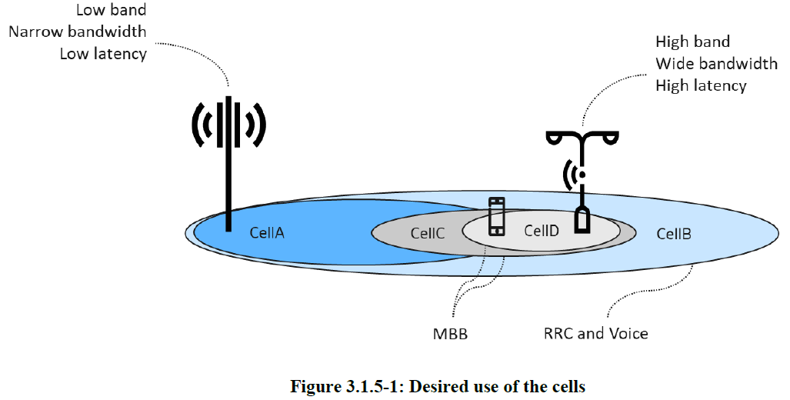
Introduction (6/14)
A1 interface
An example scenario used to describe the use of A1 for traffic management.
In this scenario, an UE with UE_ID = 1, belonging to a subnet slice identified by S-NSSAI = 1, having a Voice (5QI = 1) and an MBB (5QI = 9) connection established, enters an area covered by four frequency bands.
MBB: Mobile broadband
S-NSSAI: Single Network Slice Selection Assistance Information
Notes:
這邊給出了一個 A1 interface 的 use case。
在此 use case 的場景下，有一個 ID為１的使用者，屬於子網路 １，需要 voice 和行動寬頻的服務，並且處於四個頻段的覆蓋之下的區域。

Slide 9
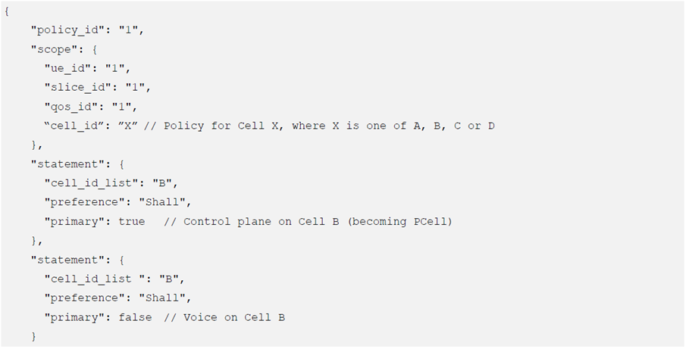
Introduction (7/14)
A1 interface
The Non-RT RIC understands the requirements and characteristics of the services and decides to let the Voice and RRC connection reside on the low band (CellB: narrow bandwidth).
RRC: Radio Resource Control
Notes:
Non-rt ric 得知使用者所需的服務的需求和特性，讓 voice 和 control data 的傳送的服務以頻寬較低的基地台服務。

Slide 10
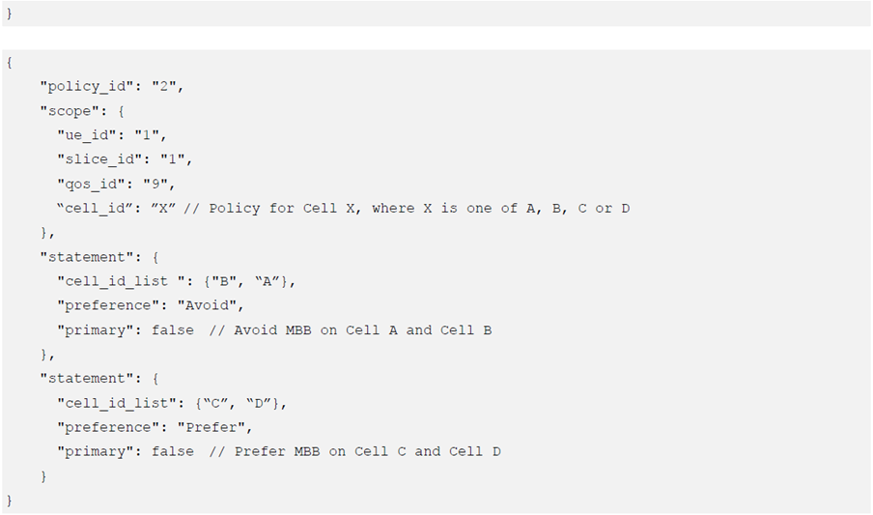
Introduction (8/14)
A1 interface
While the MBB connection should preferably use the higher band (CellC, CellD: wide bandwidth) and avoid the low band (CellA, CellB) if possible.
CellA is used for MBB if required for coverage reasons.
Notes:
行動寬頻需要較即時的服務，因此分配給頻寬較高的基地台負責。
若 cellC 與 cellC 無法連線或過載時，考慮以 cellA 負責。

Slide 11
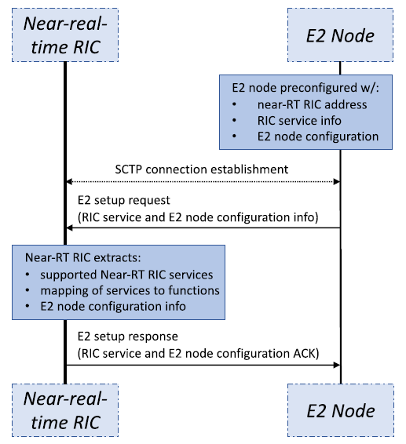
Introduction (9/14)
E2 interface
At first, the SCTP connection is established.
Then, the E2 node transmits an E2 setup request, in which it lists the RAN functions and configuration it supports, together with the identifiers for the node.
Finally, the near-RT RIC processes this information and replies with an E2 setup response.
Fig. The procedure of setting up an E2 session between the near-RT RIC and an E2 node.
SCTP: Stream Control Transmission Protocol
Notes:
這部分要來介紹 near-rt ric 是如何透過 e2 interface 進行控制及溝通。
因此，需建立起 ric 和 E2 node 的溝通橋樑。
再建立完 sctp 的連線後，E2 node 發送 setup request, 並同時附帶 node 的位置及需要的服務項目資訊。
Near-rt ric 確認是哪個 e2 node 並配置node需要的服務，最後發送 response 告知 E2 node 已完成設定。

Slide 12
Introduction (10/14)
E2 interface
After the connection is established, the E2AP (E2 Application Protocol) provides four services,
E2 Report:
The E2 report service sends data from an E2 node to an xApp in the near-RT RIC.
Subscription triggers or periodicity determine when the E2 node sends report messages containing telemetry data.
E2 Insert:
The insert service notifies the near-RT RIC xApp about specific E2 node events, such as a potential handover signaled by a UE (user equipment).
Upon the E2 node sending the insert message, a wait timer also begins, and if the RIC doesn't respond before it ends, the E2 node procedure can resume or be definitively halted.
E2 Control:
The control service can be initiated by the RIC or triggered by receiving an insert message at the near-RT RIC.
It involves two messages: a RIC Control Request from RIC to E2 nodes, and a reverse RIC Control Acknowledge.
E2 Policy:
This service involves a subscription procedure that specifies: (i) an event trigger; and (ii) a policy that the E2 node should autonomously follow to perform radio resource management.
These services are then combined to create a service model.
Notes:
在建立完連線後， E2 可以進行相關服務。
E2 服務包含以下 4 個，E2 Report, E2 Insert, E2 Control, E2 Policy。
E2 report 屬於例行式的傳送資料，通常會以週期性方式或是設立 trigger condition 來啟動 。
與上面較不同，E2 insert 屬於突發性，當特定事件觸發時, 就會啟動 E2 insert 的服務，同時，在 E2 node 的部分會設立 一個 timer，當 ric 沒有回應時，可以選擇重新傳送 insert message 或是中止。
當 near rt ric 收到 insert message 時，即會在 near rt ric 啟動此服務，near rt ric 可以選擇是否要發送控制訊息給 E2 node。
此服務主要工作為， near rt ric 對 E2 node 的 policy 進行管理，設定 trigger 的 condition 或是修改 E2 node 需自動執行的流程。
由這些服務可以組成一個 service model.

Slide 13
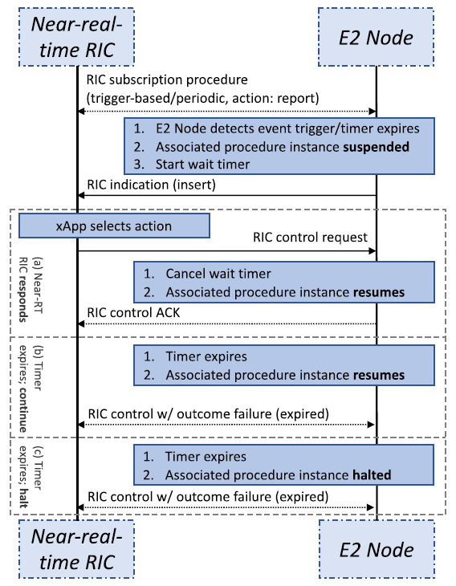
Introduction (11/14)
E2 interface
An example of E2 message exchange between an E2 node and a near-RT RIC xApp in a standard control procedure.
First, the xApp subscribes to the E2 node, which needs to expose a specific RAN function called RAN control.
During the subscription phase, the xApp can specify a triggering event or a timer.
Then, if the timer expires or the condition defined in the trigger is verified, the E2 node sends an E2 control request insert message to the RIC.
At the same time, the E2 node suspends the radio resource management procedure, and starts a timer.
Three different outcomes will follow:
The RIC can reply with an E2 control message that denies the control request or accepts it and replies with a control action.
If the E2 node timer expires before the reception of a message from the RIC, the procedure may continue autonomously, or it may be halted.
E2 report
E2 insert
E2 control
Notes:
這部分是一個 service model 的例子。
首先，E2 node 會持續發送 E2 report 給 Ric，告知 ric 一些基本資訊，xapp 也會指定 trigger event 或是 timer 在 E2 node 上。
在 E2 node 上，一旦 timer 到期或是trigger condition 滿足時，E2 node 發送 e2 insert message，同時 E2 中止目前動作，並開始計時。
接下來的動作，分兩個情況，E2 收到control message ，可能是 control accept 或是 control deny ，另一個情況，當時間到期時，E2 沒收到 ric 的 response 時，可以選擇重新傳送 insert message 或是中止。

Slide 14
Introduction (12/14)
ML Workflow with RIC: Non-RT RIC
SMO
Database
Continuous Operation
Near-RT RIC
E2 nodes
Non-RT RIC
1. <A1> Deploy MLB xApp.
2. <O1> Data collection.
3. Retrieve data for monitoring.
4. <A1>Trigger ML inference.
5. Retrieve data for ML inference.
6. Decision of optimized action.
7. <A1> Policy create message.
8. <E2> Action enforcement.
Database
Continuous Operation
Near-RT RIC
E2 nodes
Non-RT RIC
Notes:
透過開放式介面，

Slide 15
Introduction (13/14)
ML Workflow with RIC: Near-RT RIC
SMO
Database
Continuous Operation
Near-RT RIC
E2 nodes
Non-RT RIC
1. <A1> Deploy MLB xApp.
2. <O1> Data collection.
3. Retrieve data for monitoring.
4. <A1>Trigger ML inference.
5. <E2> Data collection.
6. ML inference.
7. Decision of optimized action.
8. <E2> Action enforcement.
Database
Continuous Operation
Near-RT RIC
E2 nodes
Non-RT RIC

Slide 16
Introduction (14/14)
AI/ML Models in O-RAN Use Cases
Use Case | AI/ML models functionality description | AI/ML algorithms types (example) | Data Input | Data Output
Traffic steering | Cell load prediction/user traffic volume prediction | Supervised learning (time series prediction, e.g., SVR, DNN) | UL/DL PRB occupation | Same to input
 | Radio finger print prediction | Supervised learning (e.g., SVR, GBDT) | Intra-frequency MR data and PM counters, e.g., RSRP, RSRQ, MCS, CQI, etc. | Inter-frequency MR data, e.g., RSRP, RSRQ, MCS, CQI, etc.
V2X handover management | Prediction / detection HO anomalies Discovery of preferred HO sequences | Supervised learning | Cam Radio cell IDs Connection IDs Basic radio measurements (RSRP, RSPQ etc.) GPS Direction Velocity | HO anomalies probability Preferred HO sequences
MR: measurement report
RSRP: reference Symbol Received Power
RSRQ: reference Signal Received Quality
CQI: channel Quality Indicator
MCS: modulation and Coding Scheme
DNN: deep neural network
UL/DL: uplink/downlink
HO: handover
PRB: physical Resource Block
Notes:
Oran spec 提供了一些 ai 應用的 use case, 這邊列出兩個做為參考。

Slide 17
Outline
Introduction
Background
O-RAN architecture
A1 interface
E2 interface
ML Workflow with RIC: Non-RT RIC
ML Workflow with RIC: Near-RT RIC
AI/ML Models in O-RAN Use Cases
O-RAN implementation guide on ubuntu 20.04
Install k8s, helm, and docker
Install Near-RT RIC
Install Non-RT RIC
Anomaly Detection Use Case
Reference

Slide 18
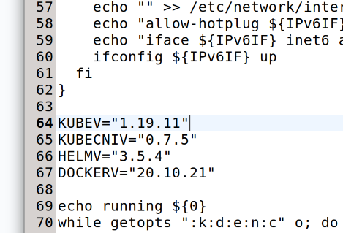
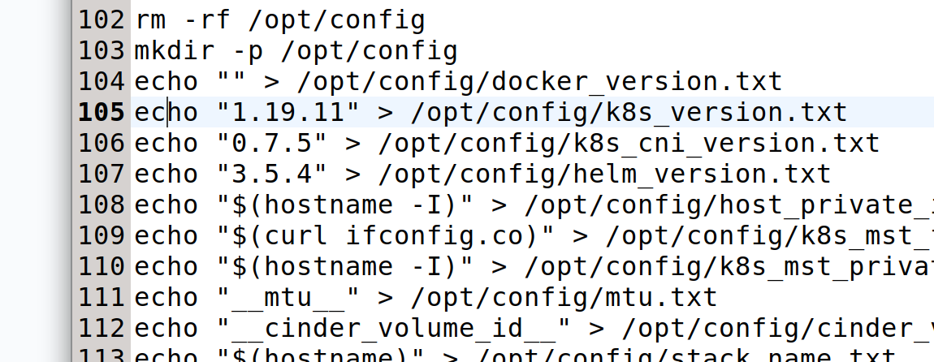
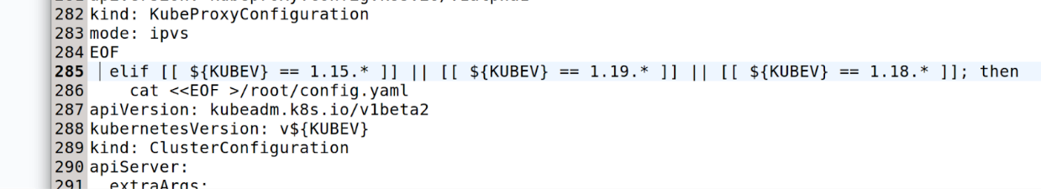
Install k8s, helm, and docker (1/2)
首先 clone 兩個不同版本的 ric-dep 資料夾至不同路徑
git clone --branch f-release https://gerrit.o-ran-sc.org/r/ric-plt/ric-dep 至路徑 1: /Home/ric-dep
git clone https://gerrit.o-ran-sc.org/r/ric-plt/ric-dep 至路徑 2: /root/ric-dep
再將路徑 2 的 install_k8s_and_helm.sh 檔案取代路徑 1 內同名的檔案
之後我們利用路徑 1 的資料夾安裝 k8s (1.19.11), helm (3.5.4), docker and Near-RT RIC (f-release)
進入 /root/ric-dep/bin/install_k8s_and_helm.sh 修改 .sh 檔
修改 k8s 的版本至 1.19.11

Slide 19
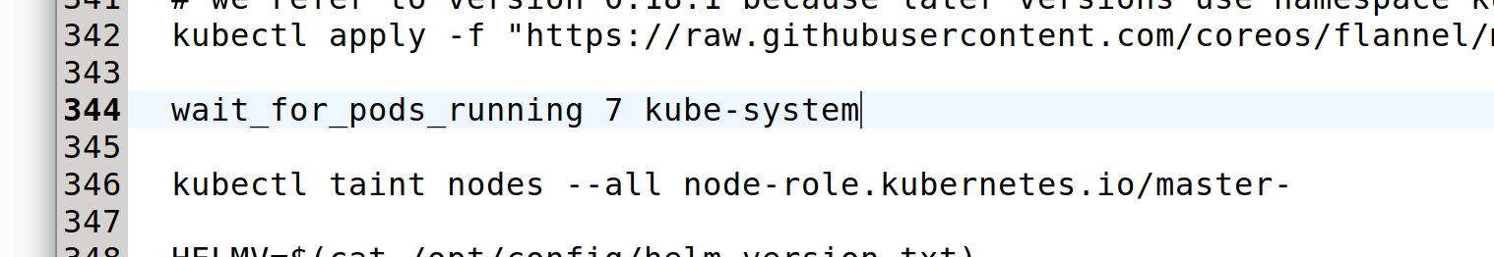
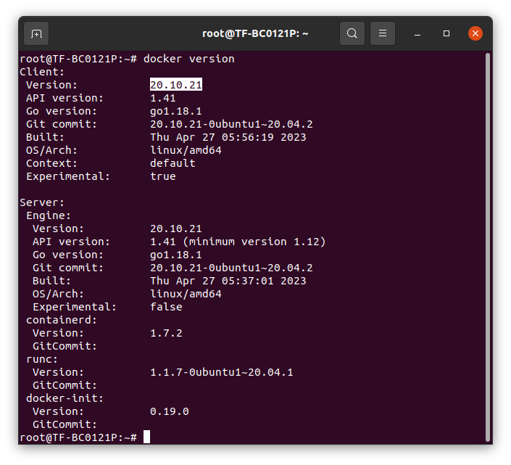
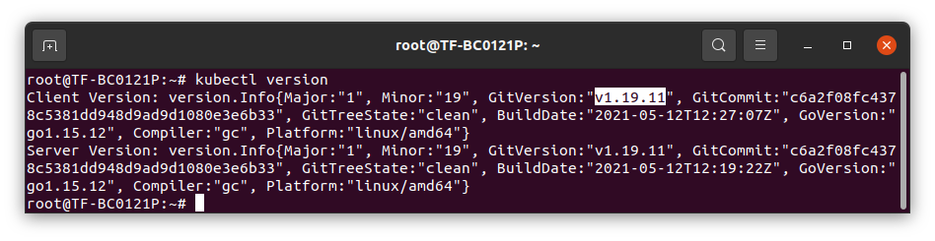
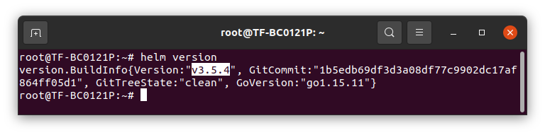
Install k8s, helm, and docker (2/2)
將網址改成如圖
將 pods 的數量改為 7 個
cd /root/ric-dep/bin
./install_k8s_and_helm.sh
./install_common_templates_to_helm.sh
./setup-ric-common-template
Check version:

Slide 20
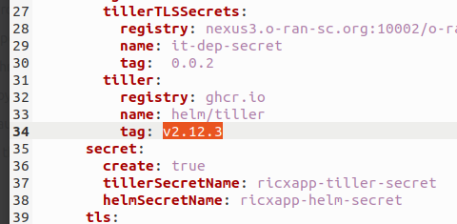
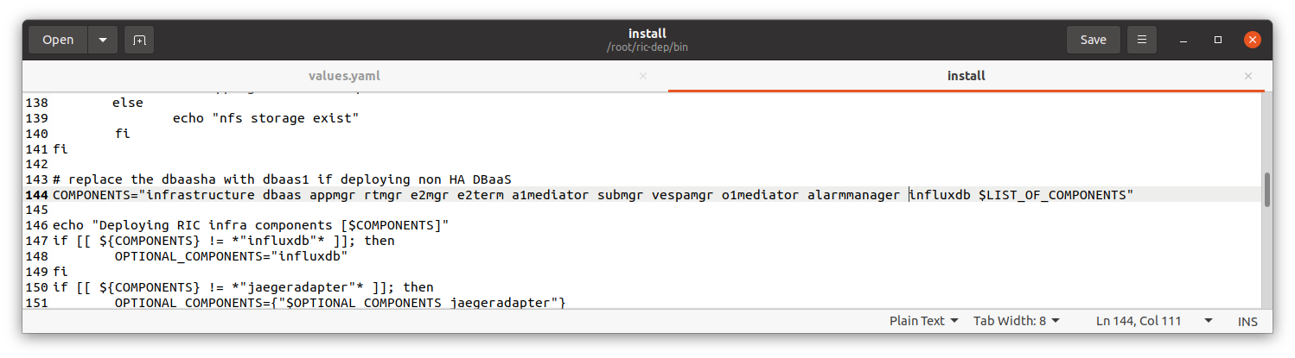
Install Near-RT RIC (1/2)
修改兩個檔案內 tiller 的 tag version (如右圖) [2]:
檔案1路徑: ric-dep/helm/appmgr/values.yaml
檔案2路徑: ric-dep/helm/infrastructure/values.yaml
kubectl create ns ricinfra
helm repo add stable https://charts.helm.sh/stable
helm install nfs-release-1 stable/nfs-server-provisioner --namespace ricinfra
kubectl patch storageclass nfs -p '{"metadata": {"annotations":{"storageclass.kubernetes.io/is-default-class":"true"}}}’
apt install nfs-common
add influxdb component into the line "COMPONENTS" in the file dep/ric-dep/bin/install

Slide 21
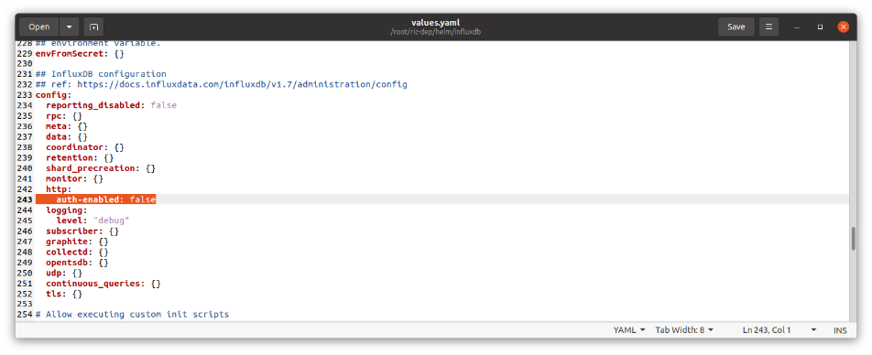
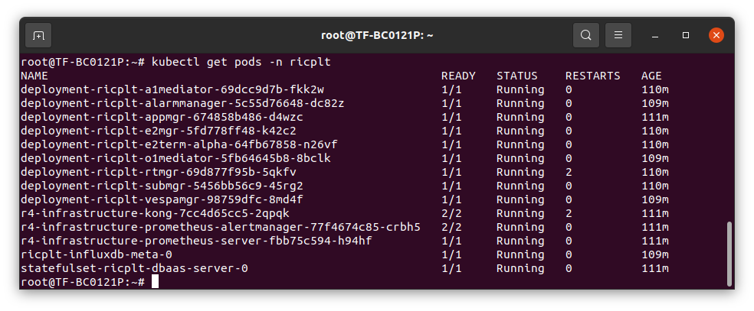
Install Near-RT RIC (2/2)
當 xApp 欲利用 influxDB 的資源時，若未設定授權選項，會出現以下字樣，
因此需進入 ric- dep/helm/influxdb/values.yaml, 修改 auth-enabled：true 至 false 以排除問題
安裝 RIC platform (Near-RT RIC)
./install -f ../RECIPE_EXAMPLE/example_recipe_latest_stable.yaml
kubectl get pods -n ricplt % 查看 pods 狀態

Slide 22
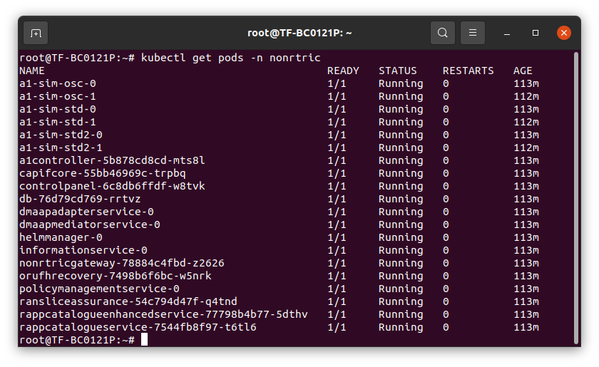
Install Non-RT RIC
git clone https://gerrit.o-ran-sc.org/r/it/dep
dep/bin/deploy-nonrtric -f dep/nonrtric/RECIPE_EXAMPLE/example_recipe.yaml % 安裝 Non-RT RIC
kubectl get pods -n nonrtric % 查看 pods 狀態

Slide 23
Anomaly Detection Use Case (1/9)
AD xApp
QP xApp
Step 3. Anomaly detection (send UEID)
Step 4. Prediction request (send UEID)
Step 5. Prediction (UEID,cell1,tp1,cell2,tp2)
Step 2. Fetch UE data
influx DB
AD: Anomaly Detection
QP: QoE Predictor
TS: Traffic Steering
DB: Database
xApp deployment sequence: AD→TS→QP
xApp 佈署 3 步驟:
取得 xApp
上架 xApp
安裝 xApp
TS xApp
UE handover decision
Step 1. Write UE data
KPIMON xApp
Step 6. REST(handover(UEID,cell1))
E2 – KPM 2.0 SM
Near-RT RIC
E2 simulator (O-CUs, O-DUs, O-RUs)
QoE: quality of experience
Notes:
當 AD xapp 啟動時，會先將資料夾裡的 static 資料輸入至 influxdb…….

Slide 24
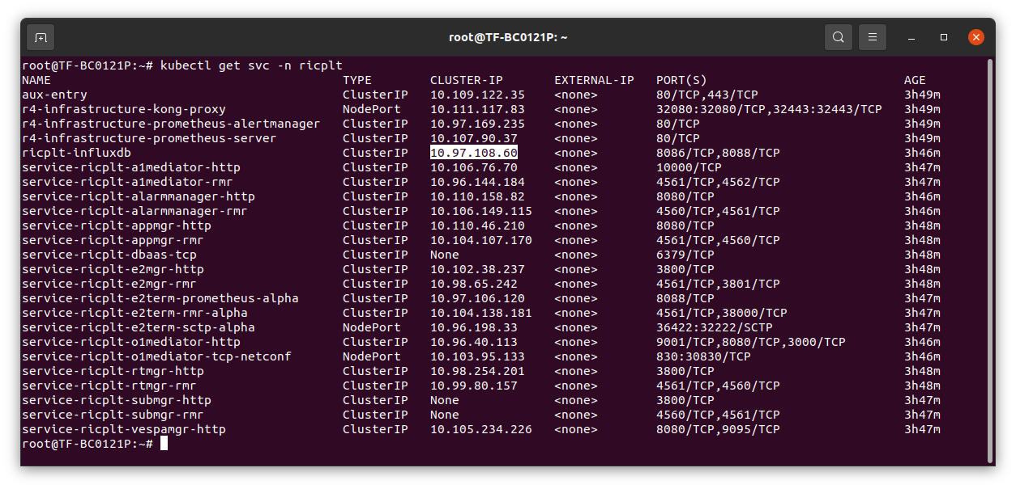
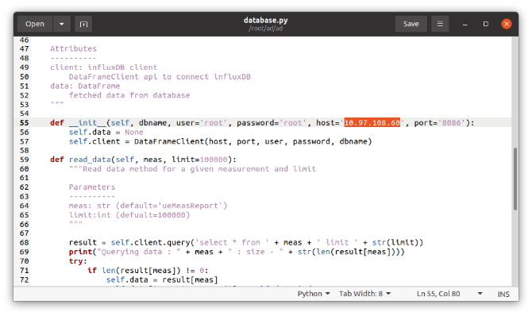
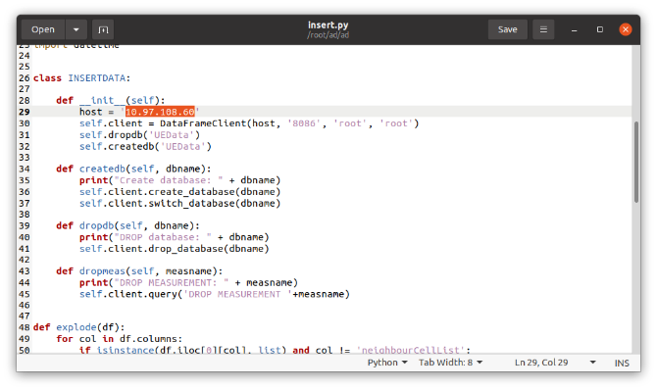
Anomaly Detection Use Case (2/9)
Install dms_cli tool:
git clone "https://gerrit.o-ran-sc.org/r/ric-plt/appmgr"
cd appmgr/xapp_orchestrater/dev/xapp_onboarder
apt install -y python3-pip
pip3 uninstall xapp_onboarder
pip3 install ./
export CHART_REPO_URL=http://0.0.0.0:8090
dms_cli health % check dms health
docker run --rm -u 0 -it -d -p 8090:8080 -e DEBUG=1 -e STORAGE=local -e STORAGE_LOCAL_ROOTDIR=/charts -v $(pwd)/charts:/charts chartmuseum/chartmuseum:latest
Install ad xApp:
git clone --branch f-release https://gerrit.o-ran-sc.org/r/ric-app/ad
modify the host IP (influxdb service IP) in database.py and insert.py file

Slide 25
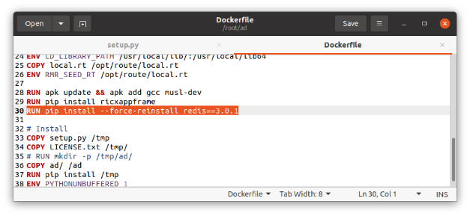

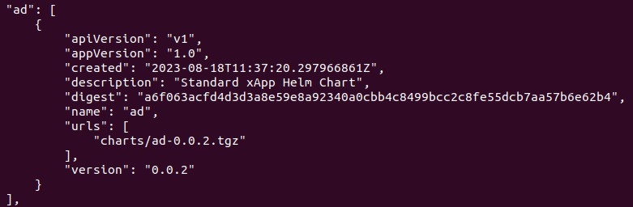
Anomaly Detection Use Case (3/9)
add RUN pip install --force-reinstall redis==3.0.1 into ad/Dockerfile file
git clone https://github.com/ToriRobert/ad.git -b master 後, 並從資料夾取得 schema.json file, 再儲存至 ad/xapp-descriptor 路徑
cd ad
docker build -t nexus3.o-ran-sc.org:10002/o-ran-sc/ric-app-ad:0.0.2 .
cd xapp-descriptor
export CHART_REPO_URL=http://0.0.0.0:8090
dms_cli onboard config.json schema.json % 上架 xApp
dms_cli get_charts_list % 檢查xApp是否成功上架
dms_cli install ad 0.0.2 ricxapp % 安裝 xApp
點不能遺漏!

Slide 26
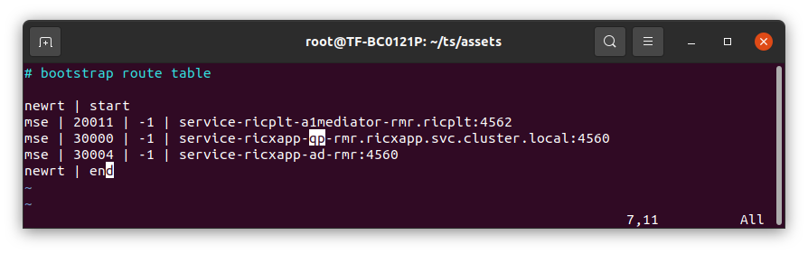
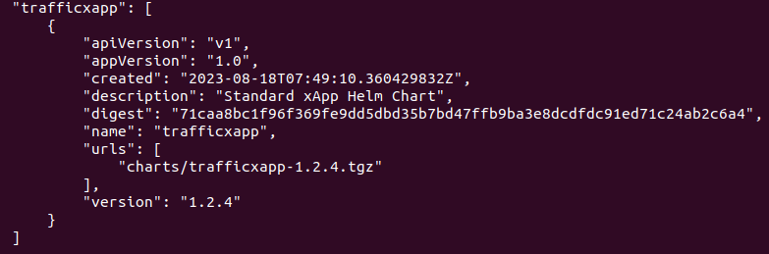
Anomaly Detection Use Case (4/9)
Install ts xApp:
git clone --branch f-release https://gerrit.o-ran-sc.org/r/ric-app/ts
進入 assets/bootstrap.rt 檔, 修改 qpdrive 至 qp
cd ts
docker build -t nexus3.o-ran-sc.org:10002/o-ran-sc/ric-app-ts:1.2.4 .
cd xapp-descriptor
export CHART_REPO_URL=http://0.0.0.0:8090
dms_cli onboard config-file.json schema.json
dms_cli get_charts_list
dms_cli install trafficxapp 1.2.4 ricxapp

Slide 27
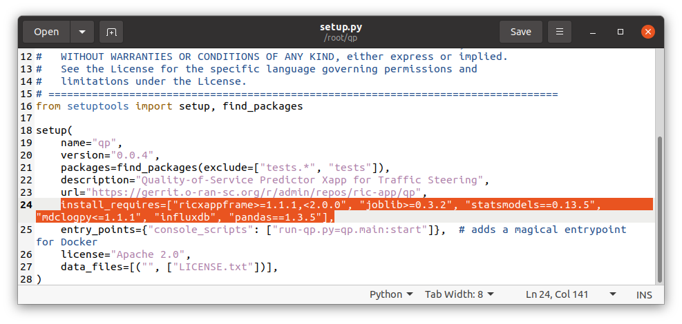
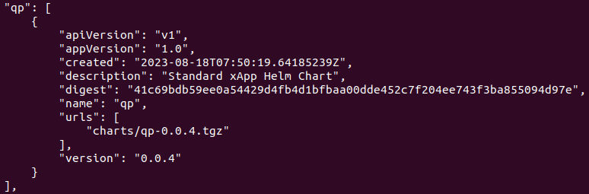
Anomaly Detection Use Case (5/9)
Install qp xApp:
git clone --branch f-release https://gerrit.o-ran-sc.org/r/ric-app/qp
Same as ad xApp installation, modify the host IP (influxdb service IP) in database.py and insert.py file
Also, add RUN pip install --force-reinstall redis==3.0.1 into ad/Dockerfile file
assign 0.13.5 version for statsmodels and 1.3.5 for pandas in qp/setup.py file % 如右下圖
git clone https://github.com/ToriRobert/qp.git -b e-release 後, 並從資料夾取得 schema.json file, 再儲存至 qp/xapp-descriptor 路徑
cd qp
docker build -t nexus3.o-ran-sc.org:10002/o-ran-sc/ric-app-qp:0.0.4 .
cd xapp-descriptor
export CHART_REPO_URL=http://0.0.0.0:8090
dms_cli onboard config.json schema.json
dms_cli get_charts_list
dms_cli install qp 0.0.4 ricxapp

Slide 28
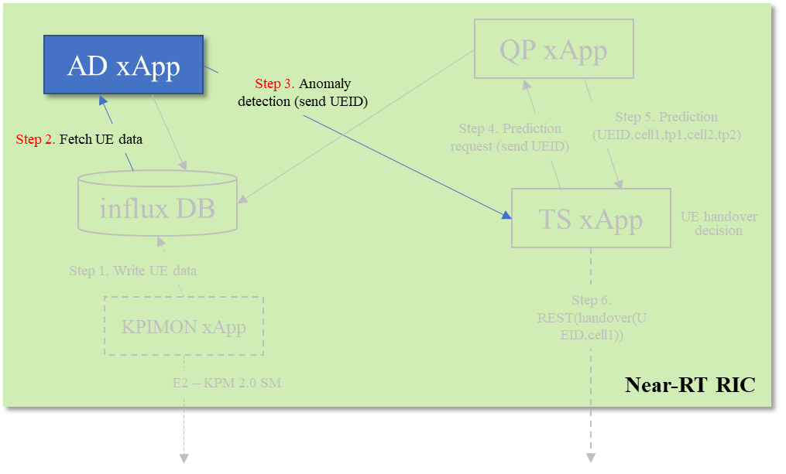
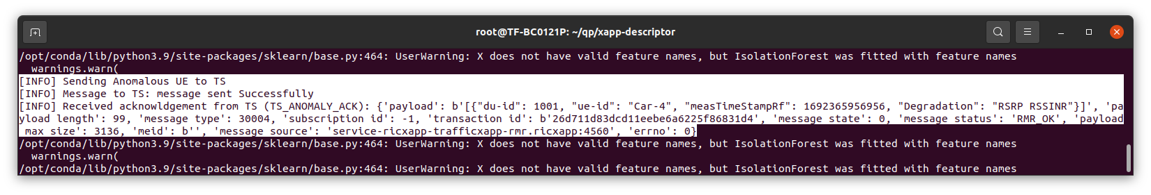
Anomaly Detection Use Case (6/9)
Check for logs in xApp:
kubectl logs -f <xApp pod name> -n ricxapp
kubectl get pods -n ricxapp % check xApp status and pod name
AD xApp logs:
AD xApp 成功將異常 UE 的資訊傳送給 TS xApp。

Slide 29
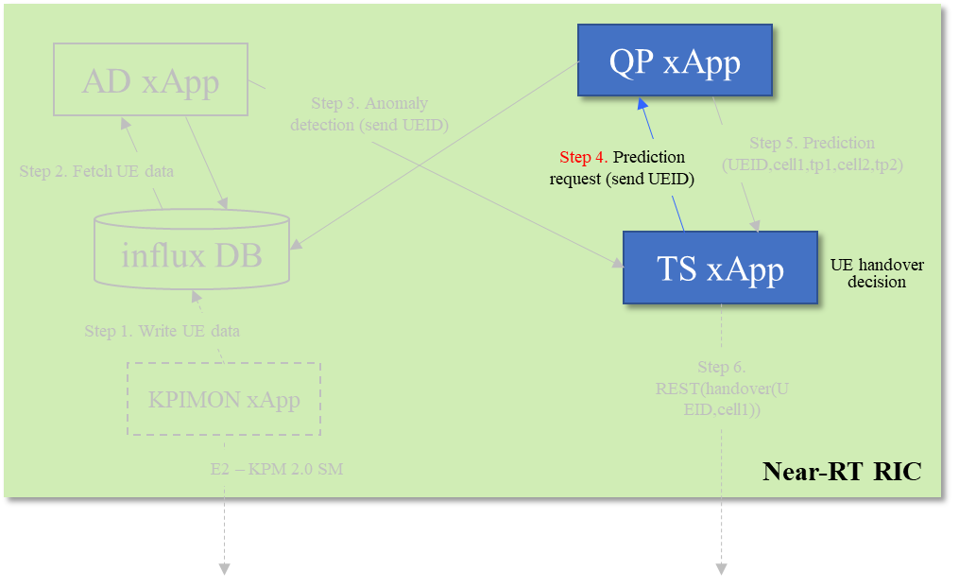
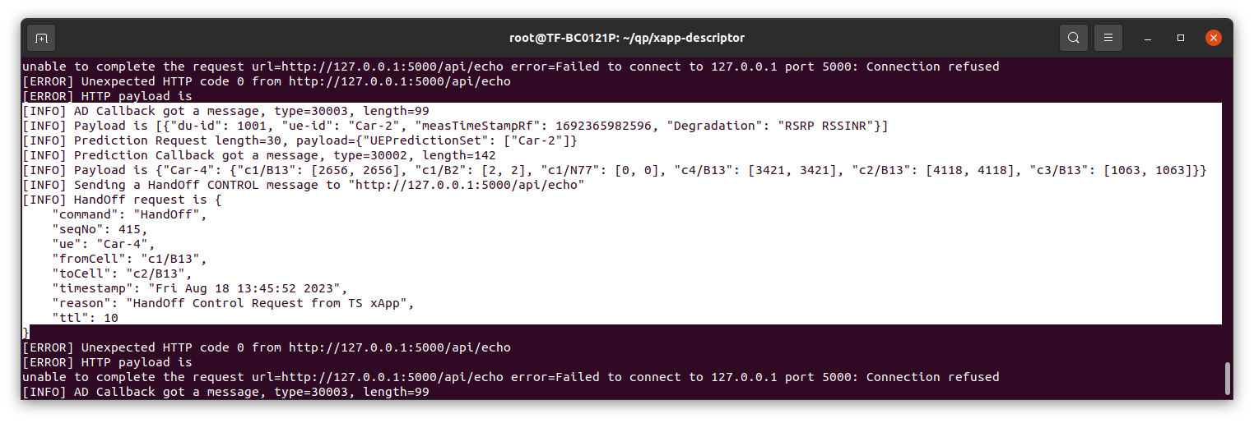
Anomaly Detection Use Case (7/9)
TS xApp logs:
TS xApp 收到 AD xApp 傳回的異常 UE 資訊。
TS xApp 向 QP xApp 要求對 UE 進行 QoE 的預測。

Slide 30
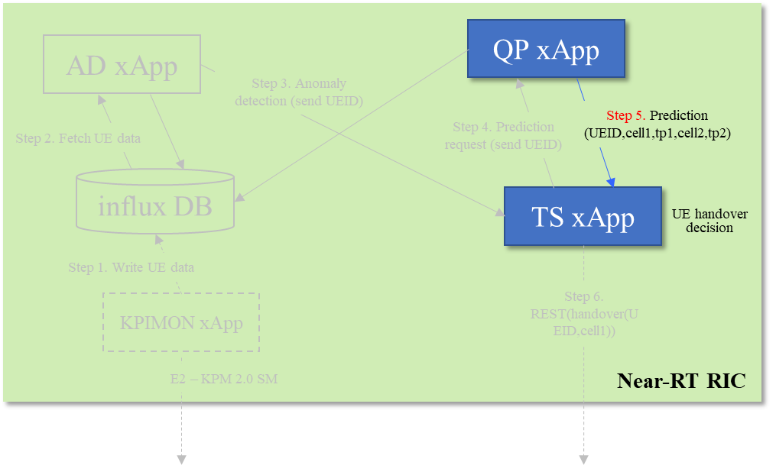
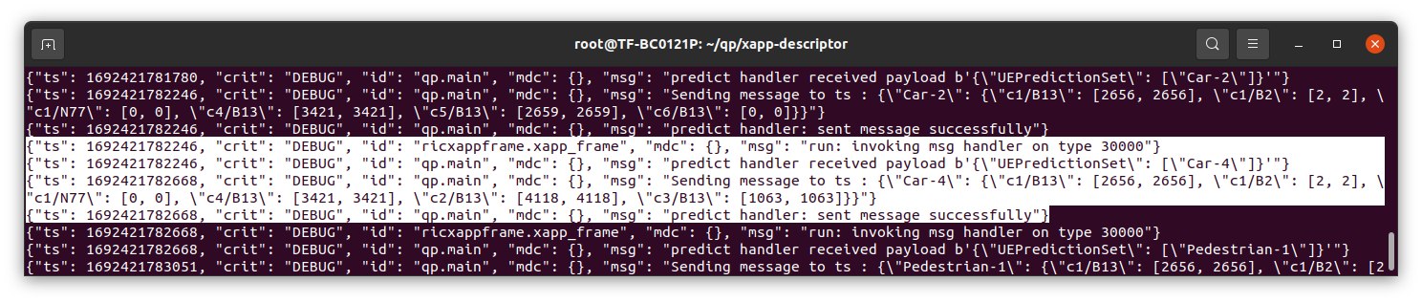
Anomaly Detection Use Case (8/9)
QP xApp logs:
QP xApp 接收到來自 TS xApp 的異常 UE 資訊。
QP xApp 成功將異常 UE 的 QoE 預測資訊回傳給 TS xApp。

Slide 31
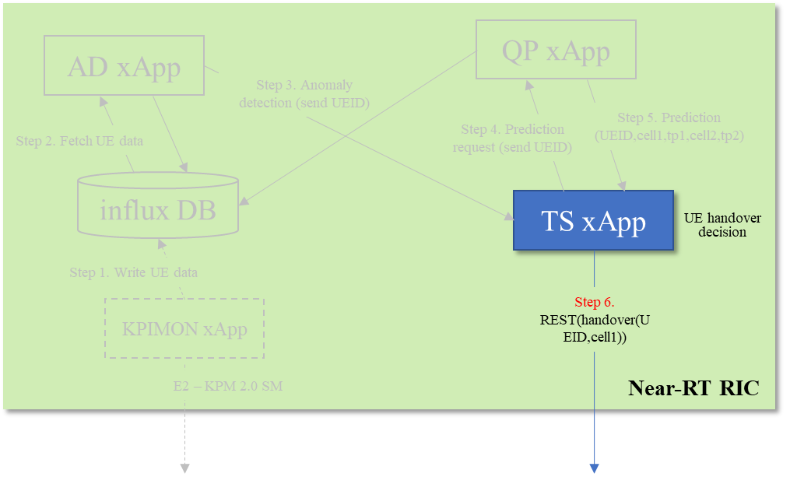
Anomaly Detection Use Case (9/9)
TS xApp logs:
TS xApp 收到 QP xApp 傳回的 UE QoE 預測資訊。
TS xApp 進行 UE handoff 決策，並將 handoff 要求訊息傳送至指定的位置。

Slide 32
Outline
Introduction
Background
O-RAN architecture
A1 interface
E2 interface
ML Workflow with RIC: Non-RT RIC
ML Workflow with RIC: Near-RT RIC
AI/ML Models in O-RAN Use Cases
O-RAN implementation guide on ubuntu 20.04
Install k8s, helm, and docker
Install Near-RT RIC
Install Non-RT RIC
Anomaly Detection Use Case
Reference

Slide 33
Reference
[1] https://docs.o-ran-sc.org/projects/o-ran-sc-ric-plt-ric-dep/en/latest/installation-guides.html
[2] https://wiki.o-ran-sc.org/display/SIM/Near-RT+RIC+Deployment
[3] https://wiki.o-ran-sc.org/pages/viewpage.action?pageId=82706560
[4] https://blog.51cto.com/gcherforever/4812069
[5] https://docs.o-ran-sc.org/projects/o-ran-sc-ric-plt-ric-dep/en/latest/installation-guides.html#installing-near-realtime-ric-in-ric-cluster
[6] https://zenn.dev/sandship/articles/a82add3764467a
[7] https://www.cxyzjd.com/article/jeffyko/107975572
[8] M. Polese, L. Bonati, S. D’Oro, S. Basagni and T. Melodia, "Understanding O-RAN: Architecture, Interfaces, Algorithms, Security, and Research Challenges," in IEEE Communications Surveys & Tutorials, vol. 25, no. 2, pp. 1376-1411, Secondquarter 2023, doi: 10.1109/COMST.2023.3239220.
[9] O-RAN Working Group 2, “O-RAN AI/ML workflow description and requirements 1.03,” O-RAN, Alfter, Germany, document O-RAN.WG2.AIML-v01.03 Technical Specification, Jul. 2021.
[10] https://hackmd.io/@Min-xiang/SJD9Xh5c9
[11] https://wiki.o-ran-sc.org/display/GS/Near+Realtime+RIC+Installation
[12] https://hackmd.io/@mwnl-pre-6g-team/SJPEE-6a9
[13] https://hackmd.io/@Min-xiang/HJZF3-xgt#75-Check-the-xApp-statuses-of-AD-Use-Case
[14] https://wiki.o-ran-sc.org/display/GS/SMO+Installation
[15] https://wiki.o-ran-sc.org/display/IAT/Traffic+Steering+Flows
[16] https://wiki.o-ran-sc.org/display/RICP/Anomaly+Detection+Use+Case
[17] https://wiki.o-ran-sc.org/display/IAT/AD+xApp+Flows
[18] https://www.o-ran.org/

