Slide 1
6
6
6
5
5
5
4
4
4
3
3
3
2
2
2
1
1
1
0
1
2
3
4
5
6
0
1
2
3
4
5
6
0
1
2
3
4
5
6
6
6
6
5
5
5
4
4
4
3
3
3
2
2
2
1
1
1
0
1
2
3
4
5
6
0
1
2
3
4
5
6
0
1
2
3
4
5
6

Slide 2
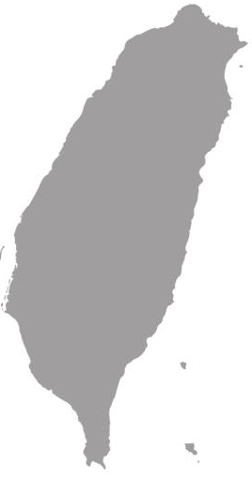
False Northing
6
NCTU
5
4
3
2
1
False Origin
False Easting (Equator)
0
1
2
3
4
5
6
250 km
EPSG:3826
(249964.105, 2742415.017)
east of the
False Northing
north of the False Easting
EPSG:4326
121°E
(120.999645, 24.789071)
Standard Line
longitude
latitude

Slide 3
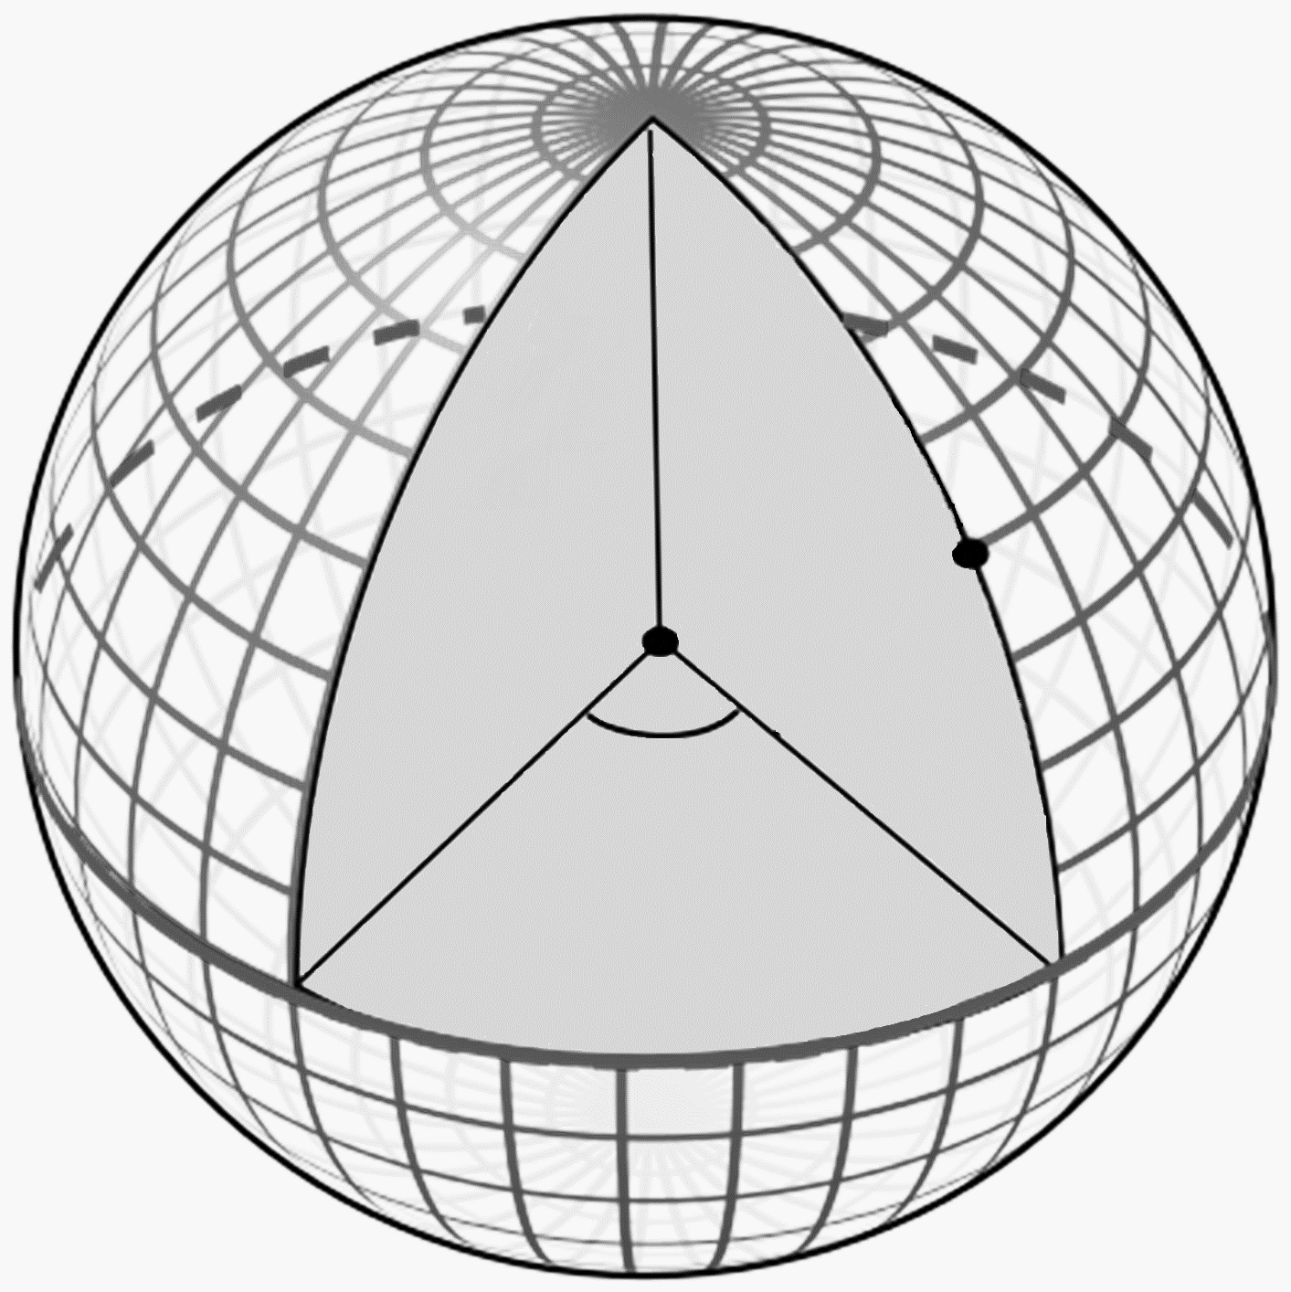
橢球
平面
Y
角度
(λ, φ)
座標
(x, y)
φ
λ
X

Slide 4
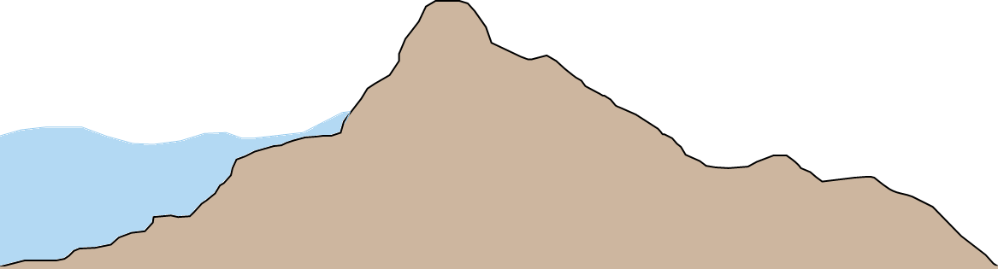
地球表面
參考橢球面
大地基準面

Slide 5
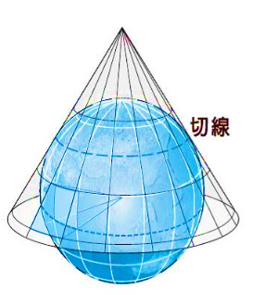
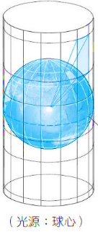
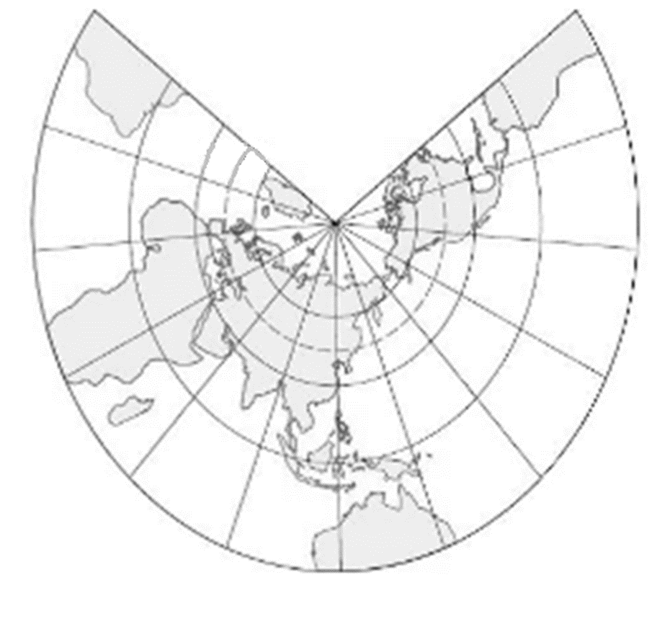
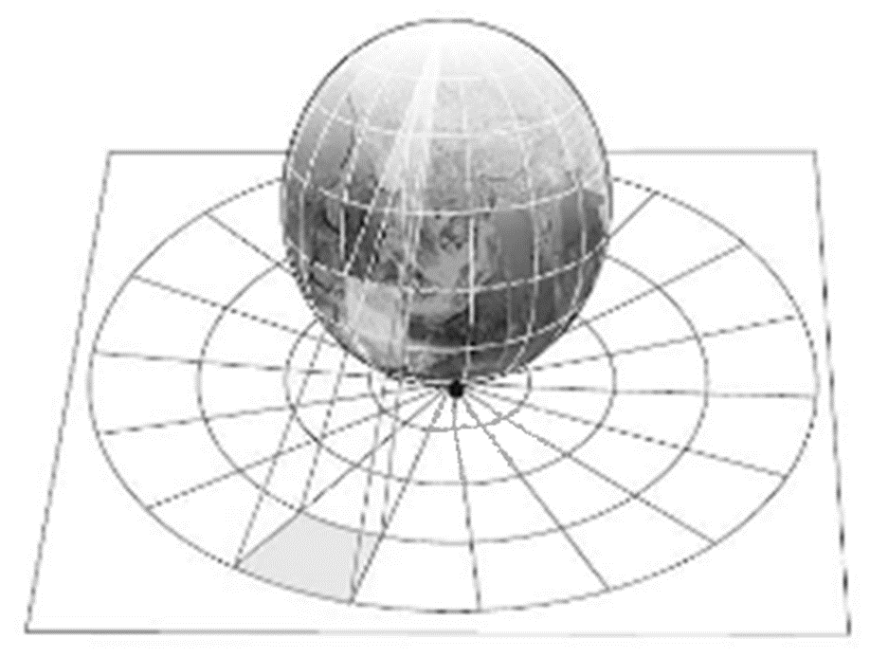
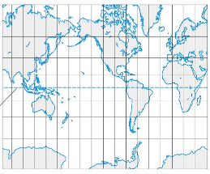
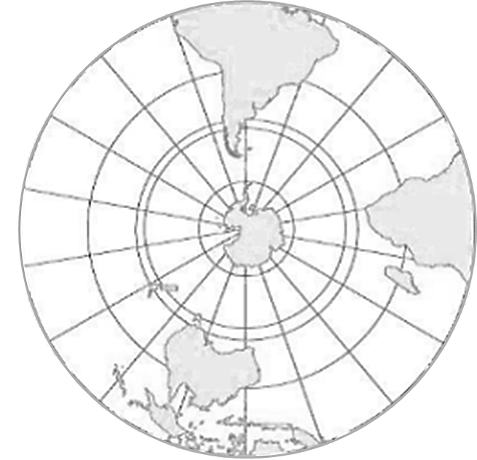

Slide 6
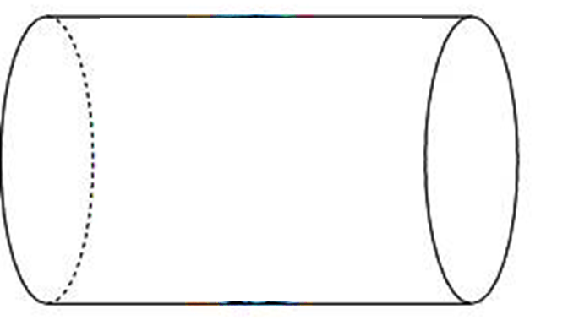
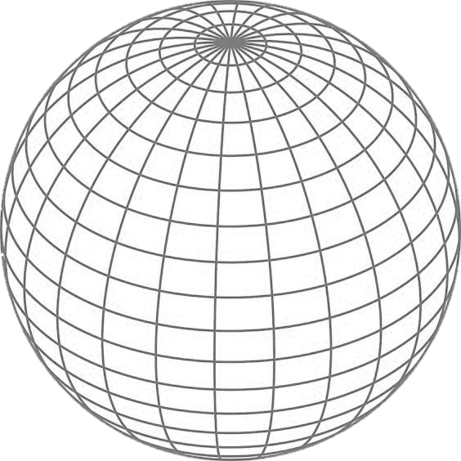
A
B
B
A

Slide 7
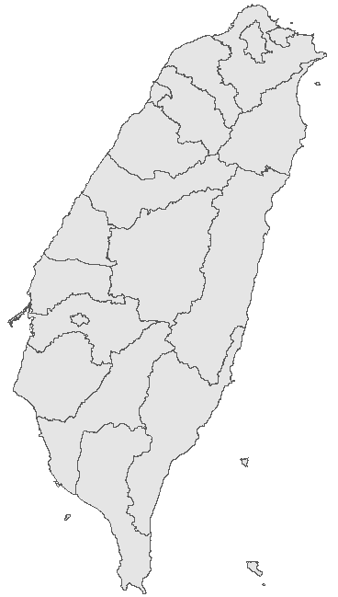
中央經線
中央經線
假想 Y 軸
120°E
121°E
122°E
Y
Y
121°E
平移250,000公尺
X
X
赤道
赤道

Slide 8
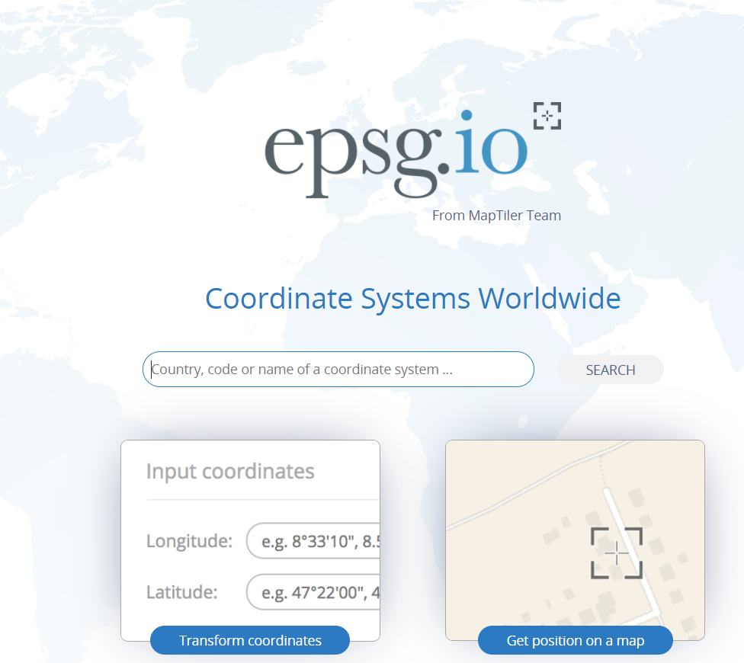
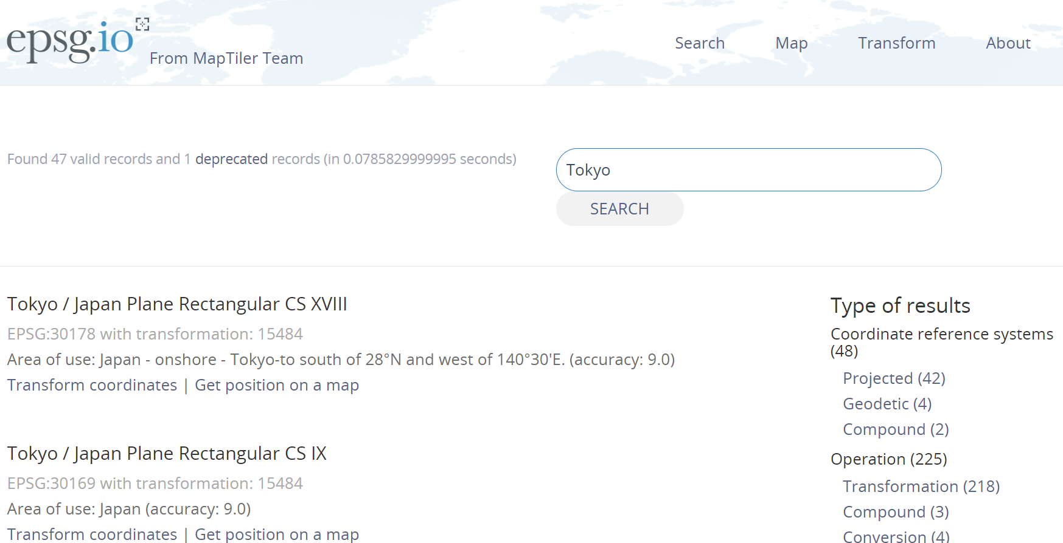
EPSG 官網（https://epsg.io/）
查詢結果（以東京為例）

Slide 9
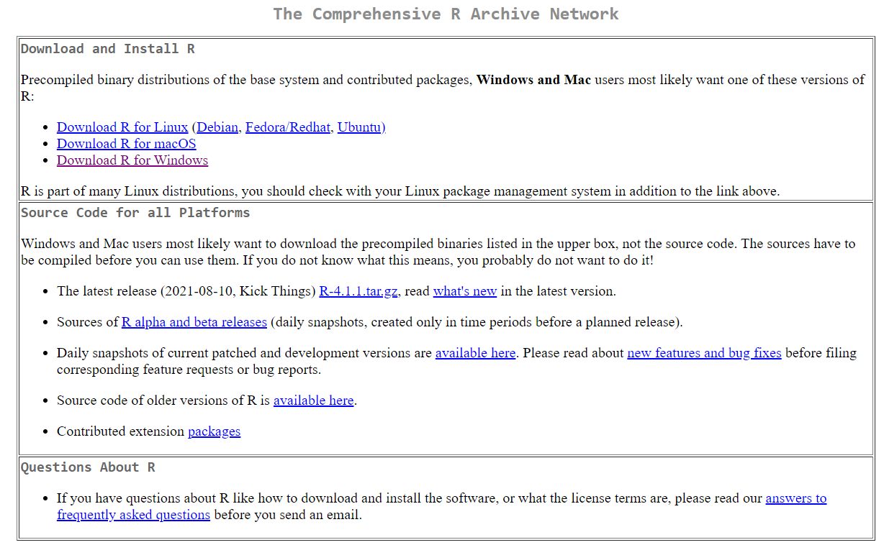
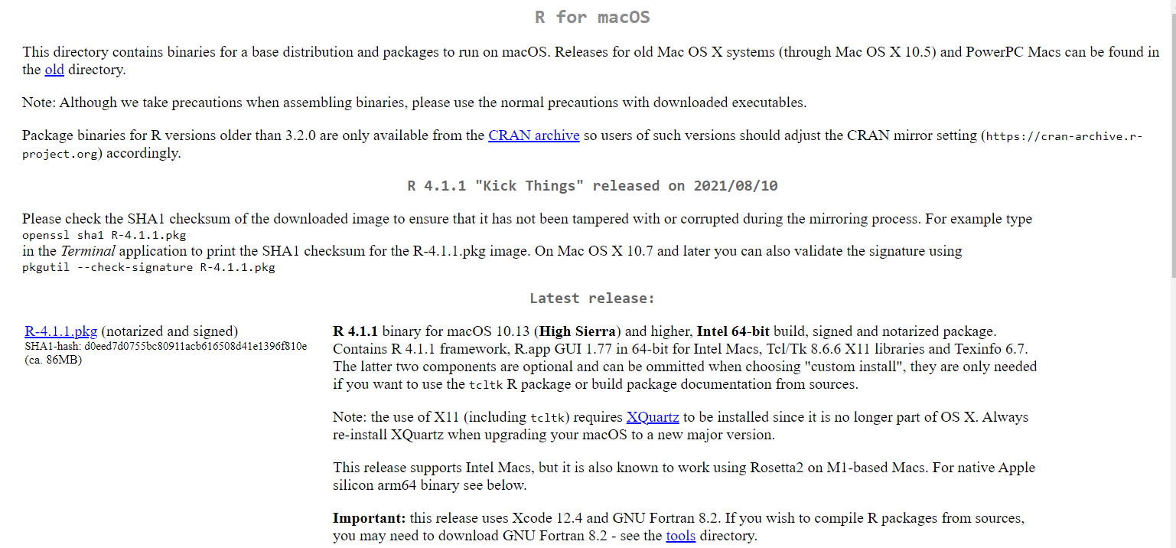
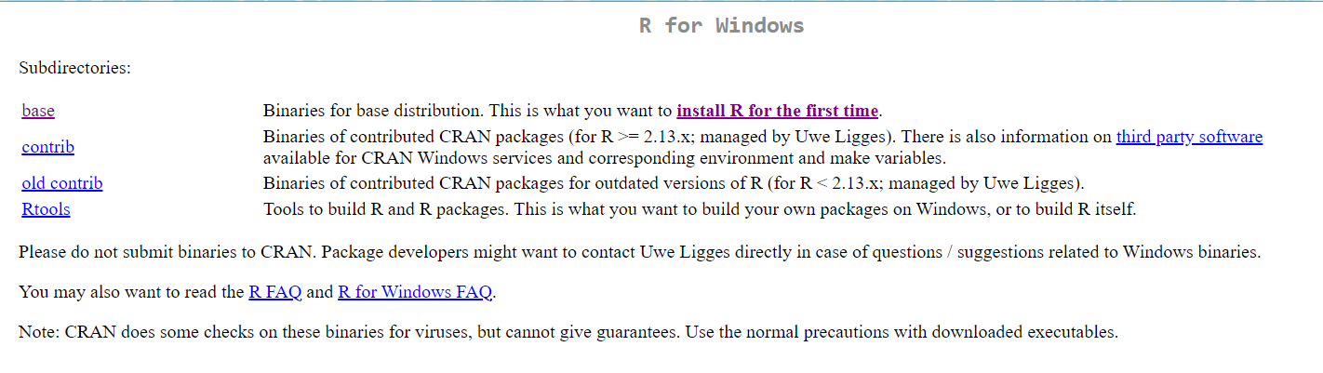
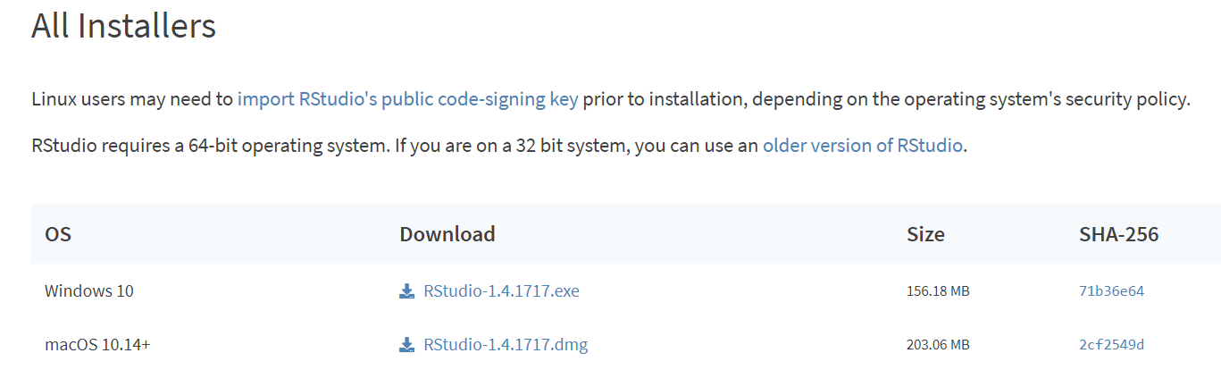
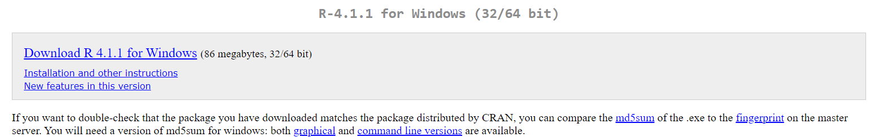

Slide 10
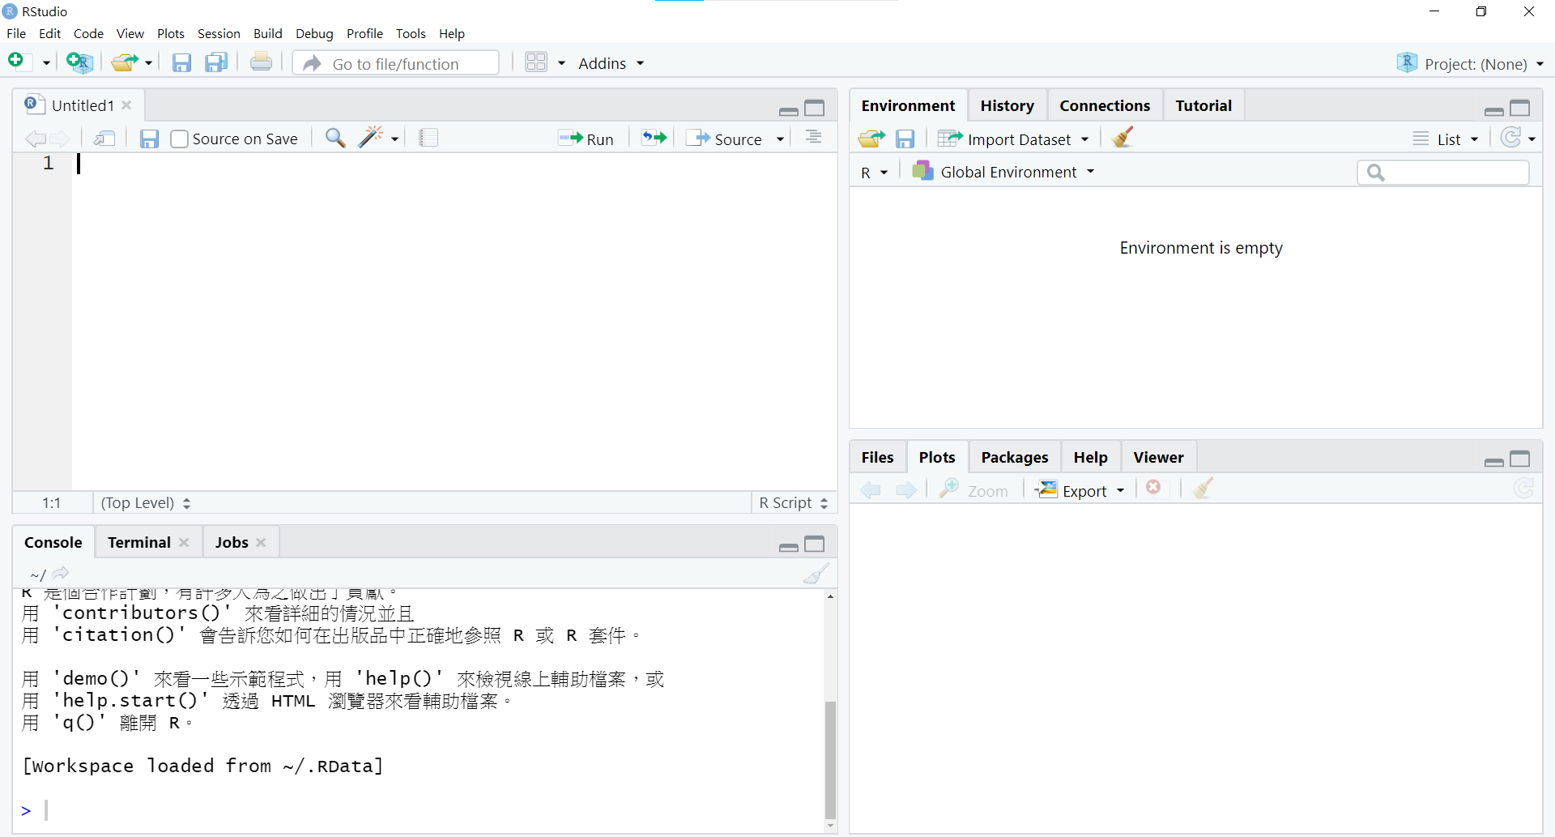

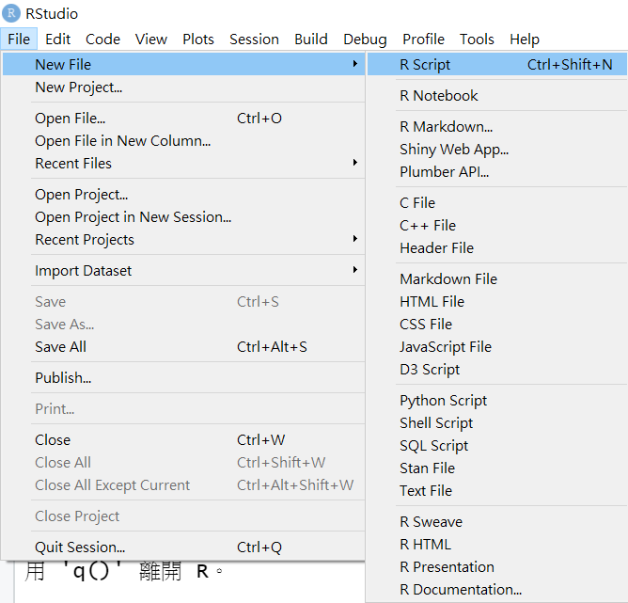

Slide 11
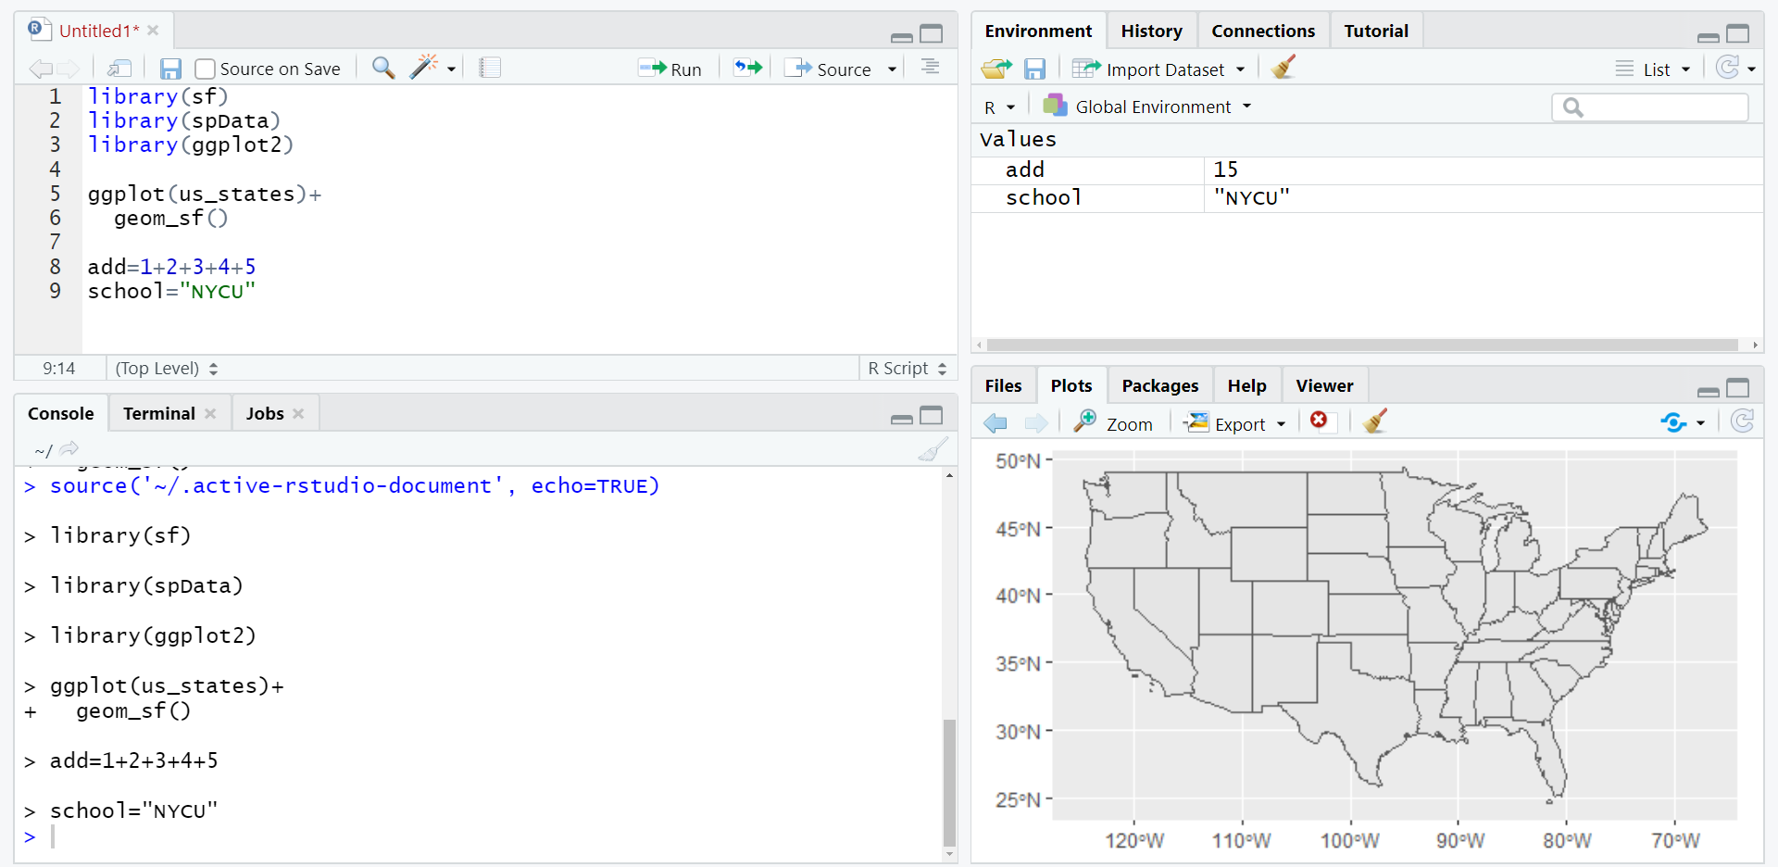
程式編寫
變數儲存
程式執行結果
顯示圖表（主要功能）

Slide 12
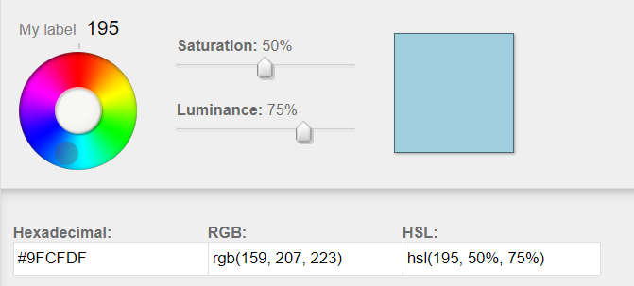

Slide 13
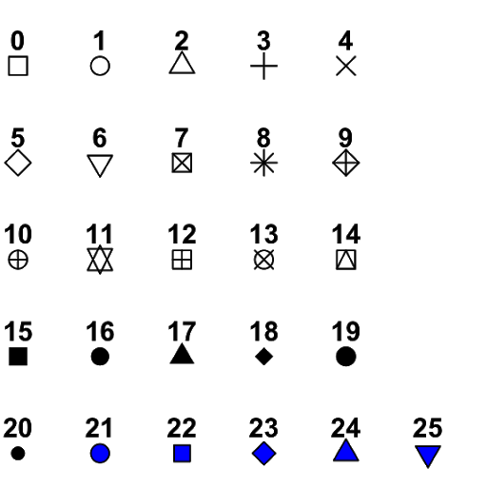
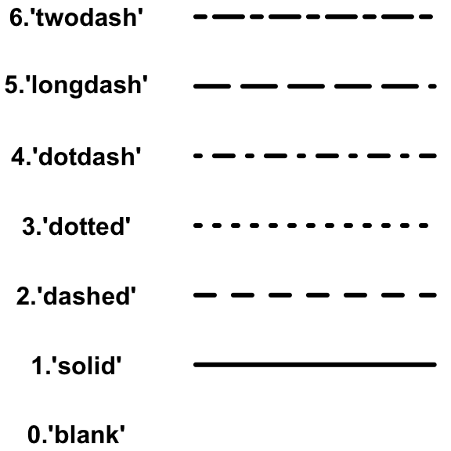
Linetype in R
Shape in R

Slide 14
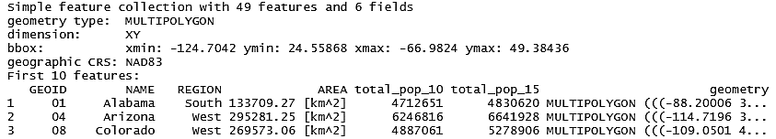
Simple feature (sf)
Simple feature geometries (sfg)
Simple feature columns (sfc)

Slide 15
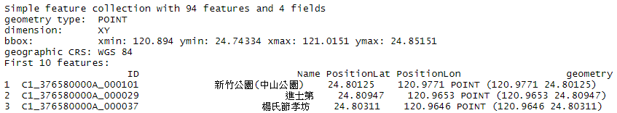
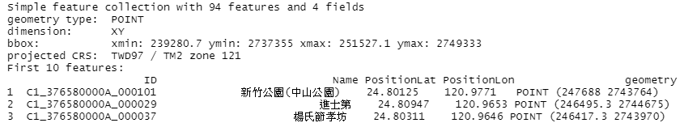
EPSG:4326 (Origin)
POINT(longitude latitude)
EPSG:3826 (New)
POINT(X Y)

Slide 16
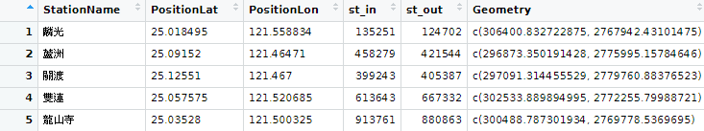
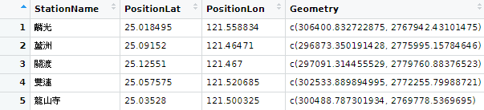
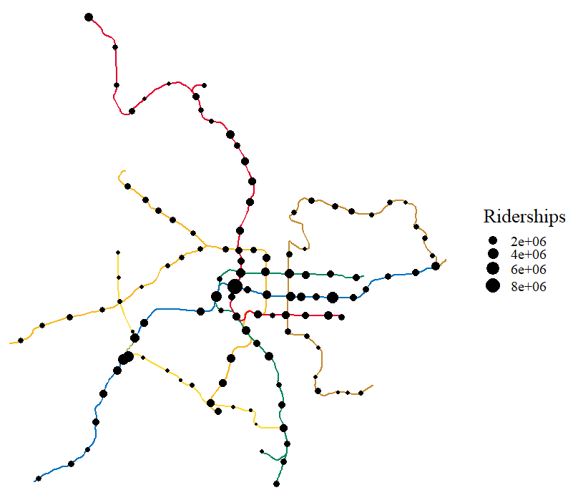
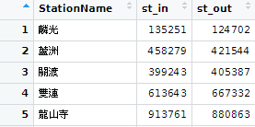
Spatial Data
Location
Plot
Primary Key
Join
Attribute Data
Ridership

Slide 17


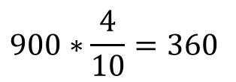

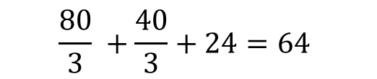

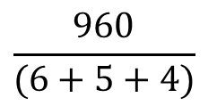

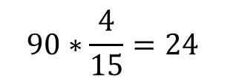
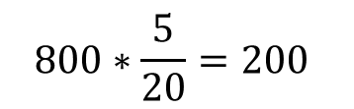

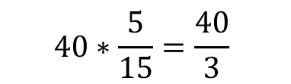
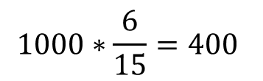
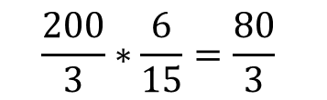

Population
$$1000∗\frac{6}{15}=400$$
$$800∗\frac{5}{20}=200$$
$$\frac{6 \text{km}\text{2}}{15 \text{km}\text{2}}$$
$$\frac{5 \text{km}\text{2}}{\text{20 }\text{km}\text{2}}$$
$$\frac{4 \text{km}\text{2}}{\text{10 }\text{km}\text{2}}$$
Area 2
Area 1
20 km²
800 residents
$$900∗\frac{4}{10}=360$$
15 km²
1000 residents
Sum
Extensive=T
Density: 200/3
Density: 40
$$400+200+360=960$$
6 km²
Interpolation
5 km²
$$\frac{200}{3}∗\frac{6}{15}=\frac{80}{3}$$
Extensive=F
Study Area
4 km²
Average
$$40∗\frac{5}{15}=\frac{40}{3}$$
10 km²
900 residents
Area 3
$$\frac{6 \text{km}\text{2}}{15 \text{km}\text{2}}$$
Density: 90
$$\frac{5 \text{km}\text{2}}{\text{15 }\text{km}\text{2}}$$
$$\frac{960}{(6+5+4)}$$
$$\frac{4 \text{km}\text{2}}{\text{15 }\text{km}\text{2}}$$
$$90∗\frac{4}{15}=24$$
$$\frac{80}{3} +\frac{40}{3}+24=64$$
Density

Slide 18
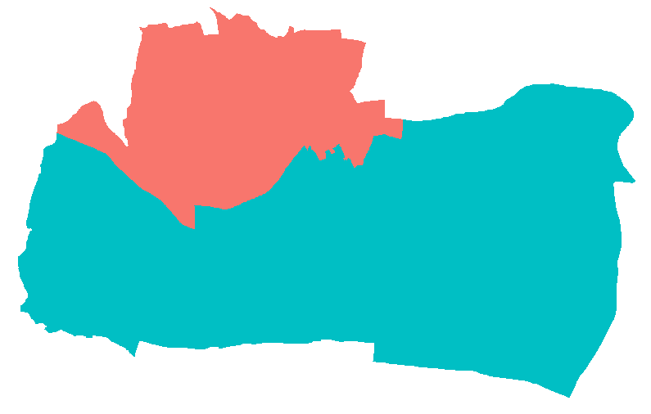
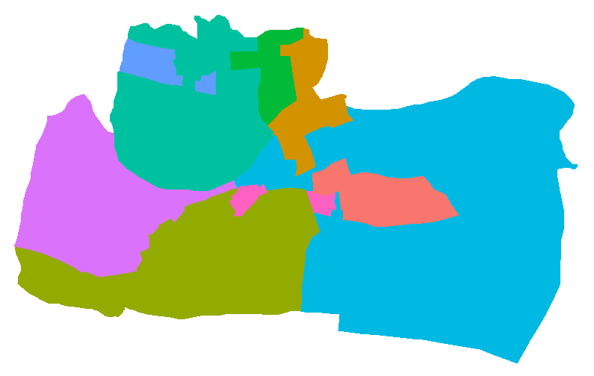
aggregating_zones
incongruent

Slide 19
ONLY Point Attribute
Point
Point | Type | Value
A | big | 2
B | small | 5
C | small | 7
D | small | 3
E | big | 6
F | big | 1
Point | Type | Value
B | small | 5
D | small | 3
E | big | 6
A
F
Clip
B
E
P
Point Attribute
Polygon Attribute
D
Intersection
Polygon
Point | Type | Value | Polygon | Number | Area
B | small | 5 | P | 15 | 10
D | small | 3 | P | 15 | 10
E | big | 6 | P | 15 | 10
Polygon | Number | Area
P | 15 | 10
C

Slide 20
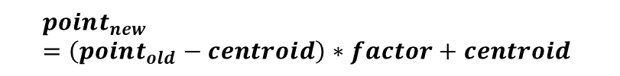
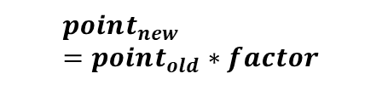
Global Scaling
Local Scaling
9
9
8
8
7
7
=
6
6
=
(9,6)
5
5
4
÷2
4
=
3
(4.5,3)
3
=
2
÷2
(2,2)
2
1
1
(1,1)
0
1
2
3
4
5
6
7
8
9
0
1
2
3
4
5
6
7
8
9
$$point_{new}=point_{old}∗factor$$
$$point_{new}=\left(point_{old}−centroid\right)∗factor+centroid$$

Slide 22
Point Set
Delaunay Triangulation
Find Cicumcircle
Voronoi Polygon

Slide 23


$$d_{s}$$
$$\overline{x}$$

Slide 24
Case A
Case B

Slide 25
Case A
Case B
0 | 0 | 0 | 1 | 0 | 0 | 0
0 | 0 | 0 | 1 | 0 | 0 | 0
0 | 1 | 4 | 3 | 3 | 0 | 0
0 | 0 | 3 | 5 | 4 | 0 | 0
0 | 1 | 1 | 2 | 0 | 1 | 0
0 | 0 | 0 | 0 | 0 | 0 | 0
0 | 1 | 0 | 1 | 1 | 0 | 0
0 | 1 | 1 | 1 | 1 | 1 | 0
0 | 1 | 2 | 1 | 2 | 1 | 0
1 | 1 | 1 | 1 | 1 | 2 | 1
0 | 1 | 1 | 1 | 1 | 1 | 0
1 | 0 | 1 | 0 | 0 | 0 | 0

Slide 26



$$VMR=0$$
$$VMR=1$$
$$VMR>1$$
Uniform Distribution
Poisson Distribution
Clustering
[dispersed]
[random]
[dense]

