Slide 1


Electric Vehicle Registration In Californisa
Chia Wei Tu-300289967

Slide 2


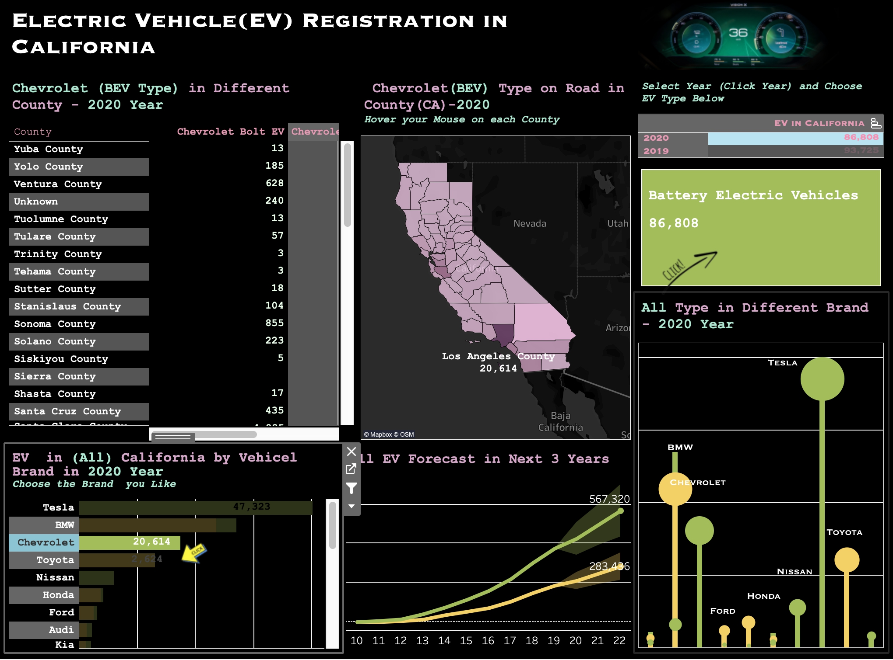
Why I choose the type

Slide 3
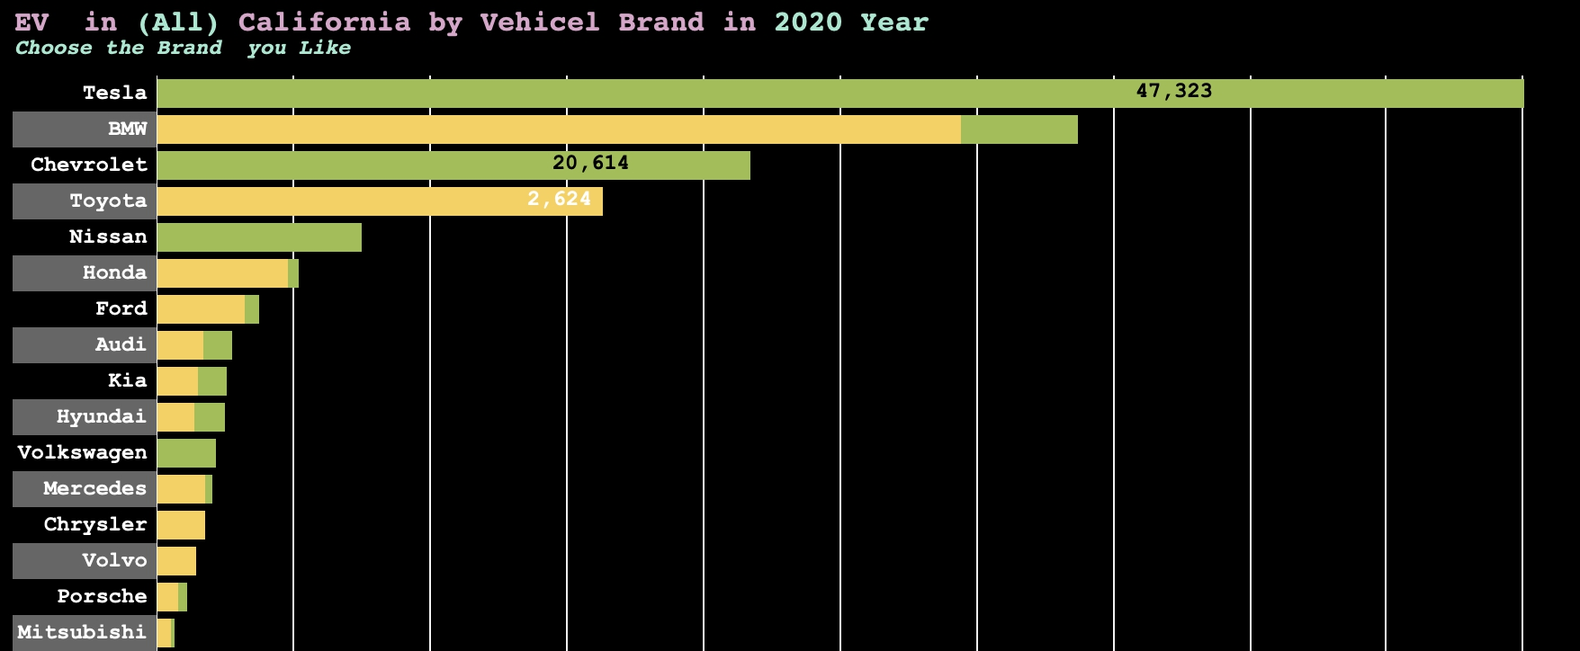
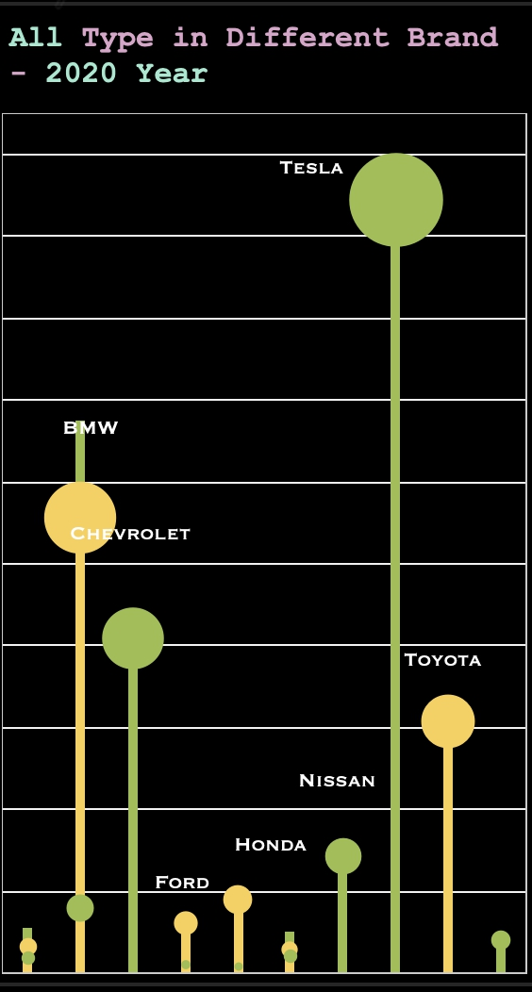
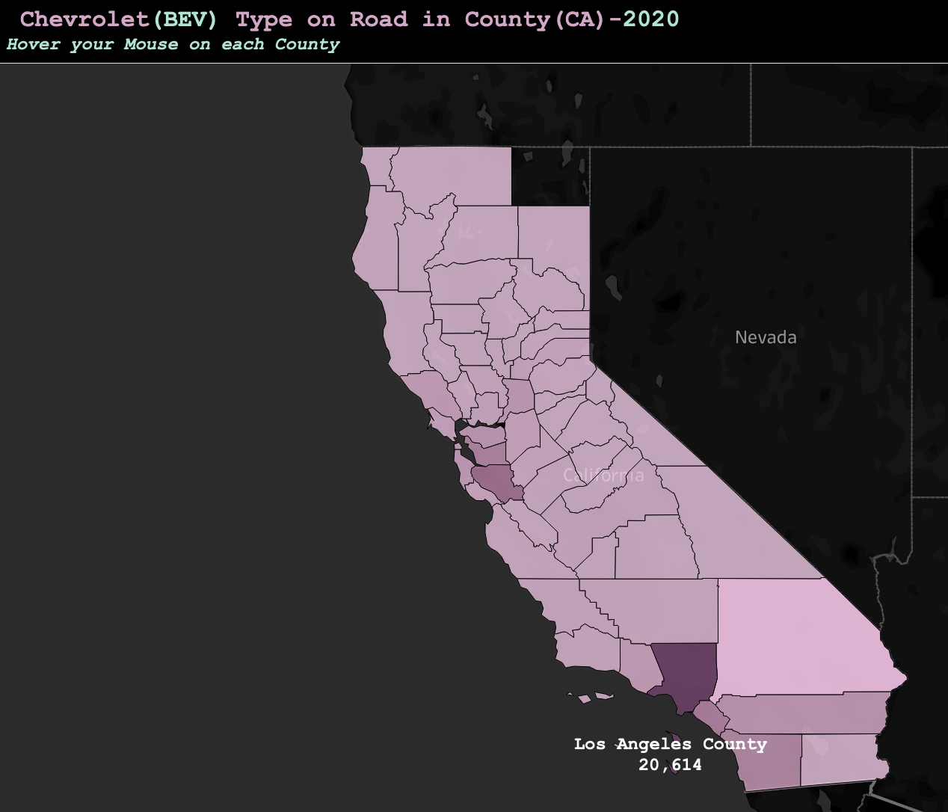
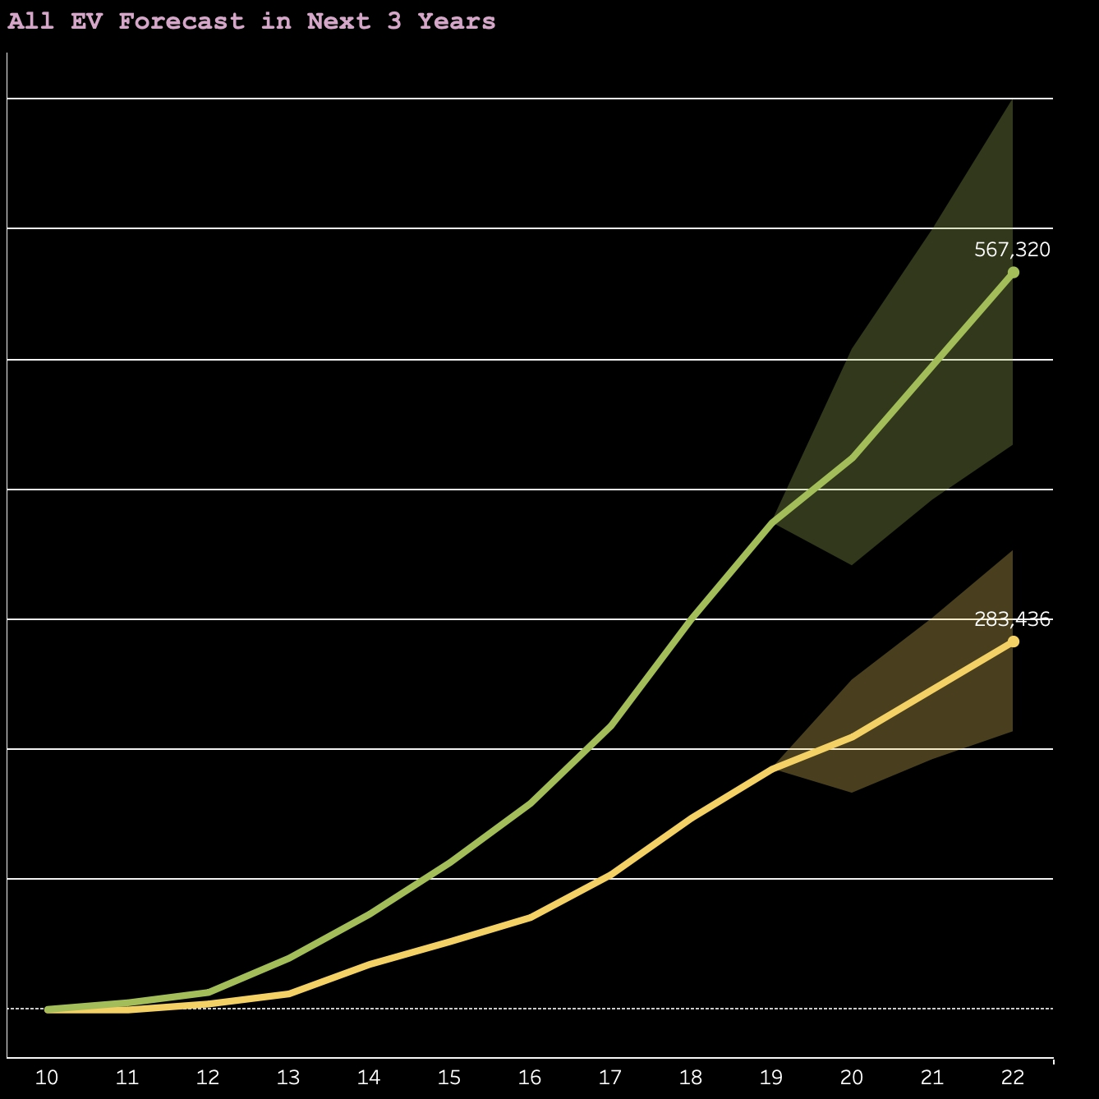
Pre-attentive Attributes
Line Length
Colour
Line Length
Size
Colour
Orientation & Curvature
Colour-Intensity

Slide 4

Challenging Features
The Action links to each sheets
The Lollipop chart fit nicely in dashboard
How to accurately present the plot togheter

Slide 5

Something I’m Proud of..
The Data and Ideas

Slide 6

What I learn from class

Slide 7
Thank You So Much!

