Slide 1
SB_STR & PAB_PSD report program instruction
2018-05-17
Yujin.Wang

Slide 2
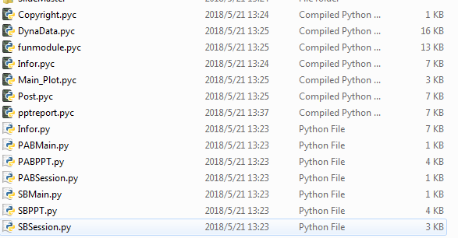
Rundir
Y:\doc\08_Personal\Yujin\0508\YokingPy\Howtouse
PAB
SB

Slide 3
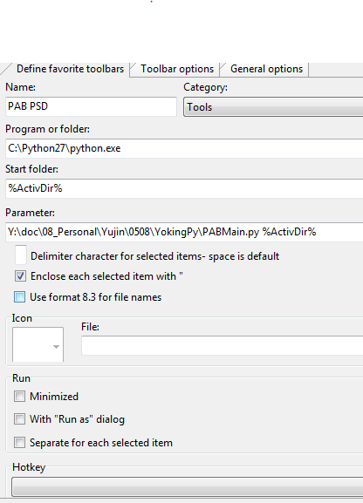
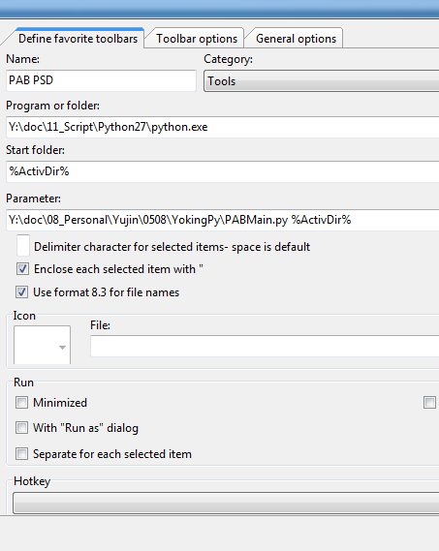

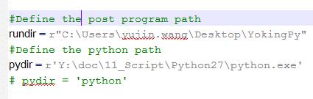
Local Setup
Confirm Python : C:\Python27\python.exe.
Run Setup.bat , and copy these files(YokingPy) to users’ PC.
Configure the FreeCommander.
Note: User can don’t setup in personal PC, and run python with server Y (ignore 1~2 step), but it will take more time for creating PPT.
Local C:
Server Y:

Slide 4

PAB(PSD) USAGE
PABMAIN: Main program, user shouldn’t modify.
PABPPT : PPT frame program, user can modify.
PABSession: Create a new session file and tcl file in work directory, user shouldn’t modify.
Note: Hyperview session and tcl file shoudn’t be modified.
Script files:Y:\doc\08_Personal\Yujin\0508\YokingPy\SessionFiles
HyperView Tcl script
HyperView Session

Slide 5

SB USAGE
SBMAIN: Main program, user shouldn’t modify.
SBPPT : PPT frame program, user can modify.
SBSession: Creat a new session file in work directory, user shouldn’t modify.
Note: Animator session and tcl file shoudn’t be modified.
Script files:Y:\doc\08_Personal\Yujin\0508\YokingPy\SessionFiles
Stress-strain curve ID
Animator script

Slide 6

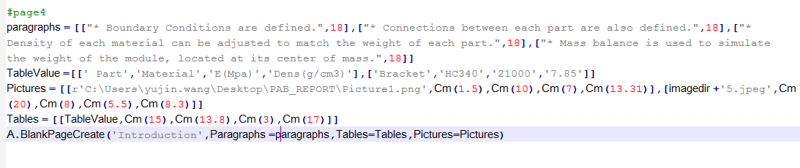

SBPPT&PABPPT FRAME USAGE
Three layouts in the slidemaster
CoverPage : User shoud define “Title”, “Date” and “Author “
BlankPage : User shoud define “Title”(first arg.), “Paragraphs”, “Tables”, “Pictures”.
EndPage : No arguments need to be defined.

Slide 7
ADD Paragraphs
Example:
[["Fatigue Life with vibration in each of three main axes.",24,’b’,’I’,’r’]]
Note: double list
[content,Font size(18), Bold(“b”), Italic(“I”), color(“b”,”r”, default = theme color)]

Slide 8
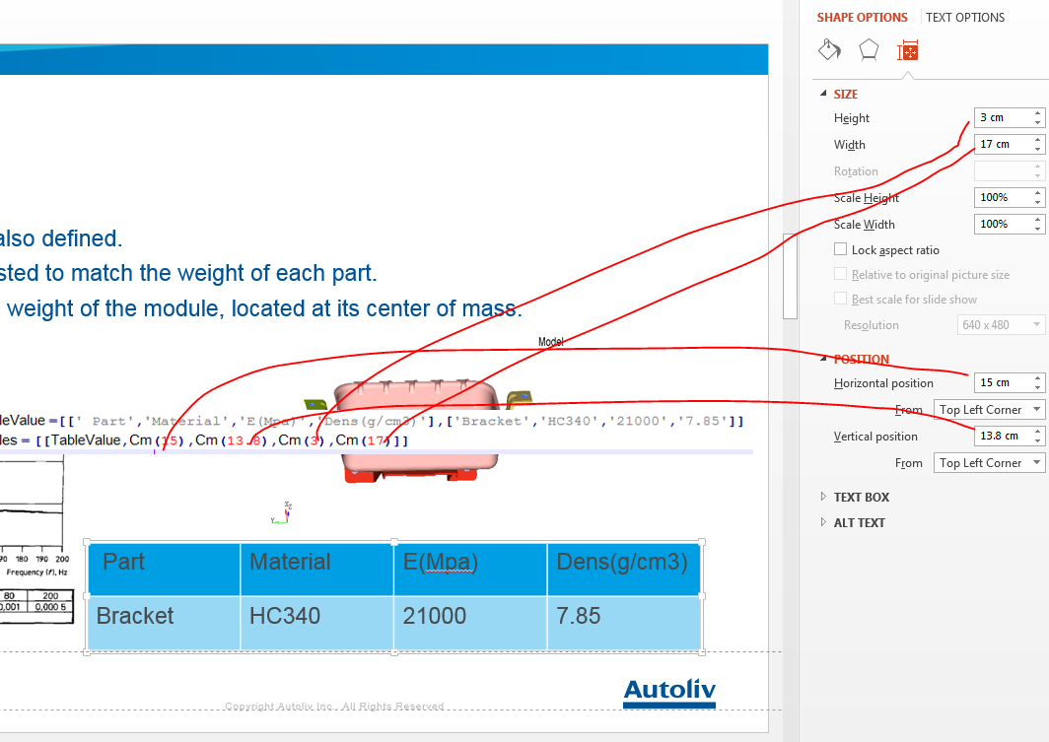
ADD Tables
Example:
[tabelvalue, horizontal position, vertical position, height, width]
Note:One table in “Tables” should be a list contains “TableValue”, position and size parameter.
Double list.

Slide 9
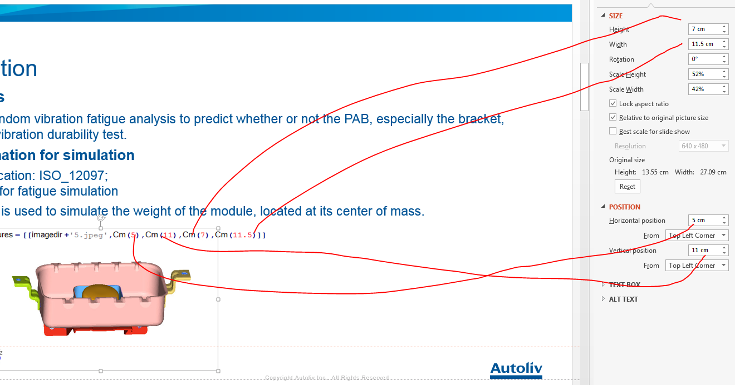
Add Pictures
[picture_dir, horizontal position, vertical position, height, width]

Slide 10
Tips:
XXXPPT.py can be run directly.
YokingPy can be copied in user’s PC, and maybe user should define the “rundir” and “pydir” in XXXMain.py.
If PPT can't be created, user should check if the ppt file is open.
If user want to use l2a to extract the result from binout , user should confirm ASG_HPC_DYN_l2a last row(“Press enter to continue”) must be commented out.

Slide 11
RUN TIME
PAB（PSD）
SB

Slide 12
Version Log
20180518
import getpass to get user name
Import time to get date
Automatic achieve title for directory
20180606
SBSession check coord -> spring（discrete element）
Seession（Animator）sta set fma -> sta set tim <time>; insert ‘sta set pre’ after sta set las to avoid strange deformed element
201806011
PAB add mode shape slide
20180613
SB automatic fill material table
20180622
SB automatic fill force in the conclusion.

