Slide 1
Avito
Training programme wrap-up

Slide 2
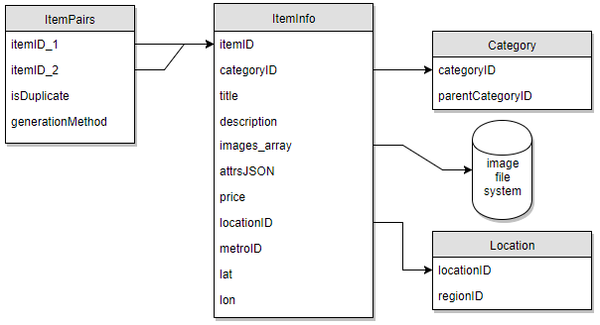
Background of dataset
Objective: To determine if a given pair of items are duplicates.

Slide 3
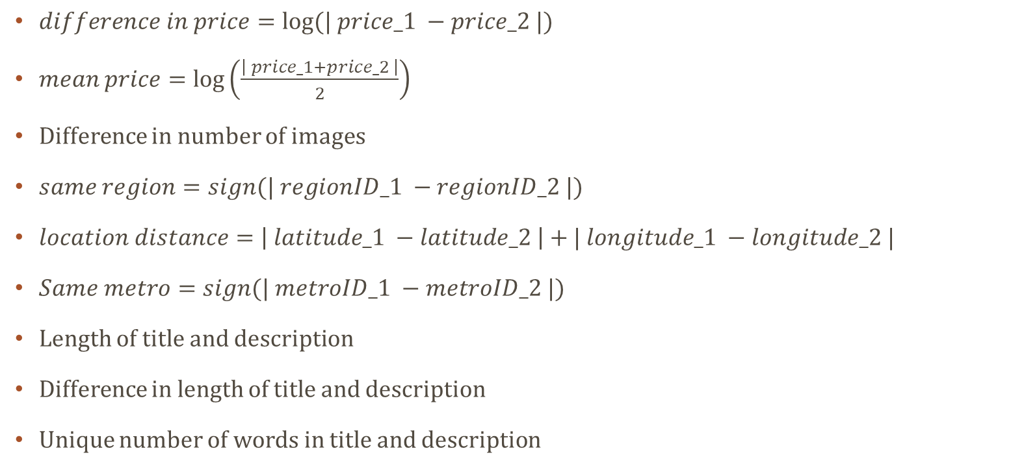
ying ying Feature engineering
$difference in price=log⁡(| price_1 −price_2 |)$
$mean price=\log\left(\frac{\left| price_1+price_2 \right|}{2}\right)$
Difference in number of images
$same region=sign(| regionID_1 −regionID_2 |)$
$location distance=\left| latitude_1 −latitude_2 \right|+| longitude_1 −longitude_2 |$
$Same metro=sign(| metroID_1 −metroID_2 |)$
Length of title and description
Difference in length of title and description
Unique number of words in title and description

Slide 4
ying ying Model and results
1-gram and 2-gram Term Frequency on title + description
Model | Train Accuracy | Test Accuracy (On Kaggle)
Logistic Regression | 78.23% | 76.85%
XGBoost | 74.83% | 78.46%

Slide 5
Ying ying thoughts on dataset
Similarity between title, similarity between description
Clustering latitude and longitude

