Slide 1

CHIAMAKA UKWUOMA
ALT/SOD/023/1017

Slide 2
Chinook Database

Slide 3
The Chinook Database was used for this project. This database was Modeled after a digital media store.
It contained Facts and Dimension tables where we could summarize columns in the fact table and then categorize them based on various groups in the dimension table
PowerBI was used for extraction, cleaning, analysis and visualization of the records in these database.
Primary keys and foreign keys were used to form relationships in the semantic layer of the tool.
Project Overview

Slide 4
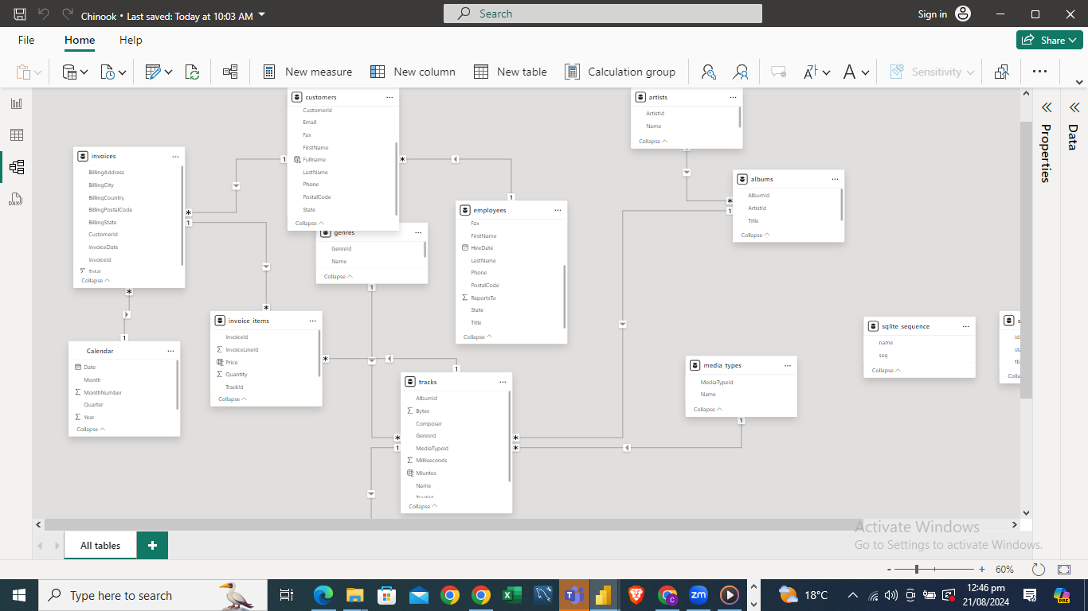
Semantic Layer Showing the relationships

Slide 5
Methodology and steps taken for data exploration and analysis.
For effective exploration and analysis, I had to do some data cleaning and modification using the power query editor in Power BI. Nulls were replaced, data types changed for tables that needed the improvement – The applied steps pane would speak to that.
1
In the front-end view, Calculated columns were created to get row-level data and Measures were created to give summarized data.
2
A main calendar table was also created in the table view, which helps to synchronise all the reports as well as do better time-intelligence analysis and modifications to the calendar table. With the date hierarchy created, we would have the flexibility to drill up and down (Year - Quarter – Month – Day) for date related charts.
3
In the semantic model, a relationship was then formed between the date columns in one of the chinook tables and the newly formed calendar table.
4
With the measures, calculated columns and date hierarchy created, visuals were then built to answer the various use cases.
5

Slide 6
Key insights derived from the analytics
Iron Maiden had the highest number of albums released in the stipulated time this data was collected and also made the highest sales.
Though it is correct for Iron maiden that his album and sales were the highest, the analysis showed that the higher the amount of albums you release does not necessarily mean you'll make more sales than artists with fewer albums.
The most sales were made in the year 2010. January had the most sales as well.
The highest selling genre of music is Rock and MPEG audio file is the most used media type for the streaming of these tracks.
The distribution of customers in a country has an effect on the purchase frequency of that country. Using USA as a sample, They had the highest number of customers as well as highest purchase frequency.
There was no significant difference in purchase frequency when plotted again the different date metrics – years, quarters and months.

Slide 7
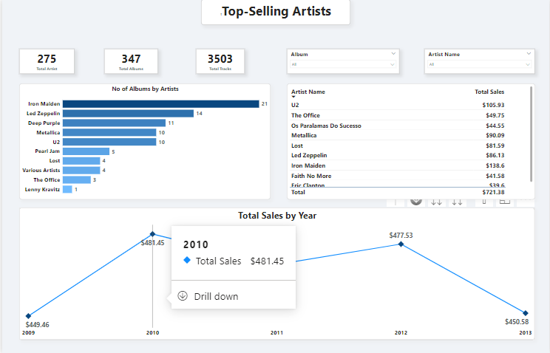
Visualizations to support the findings

Slide 8
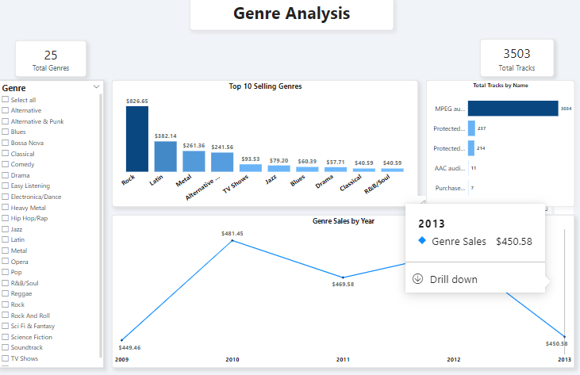
Visualizations to support the findings

Slide 9
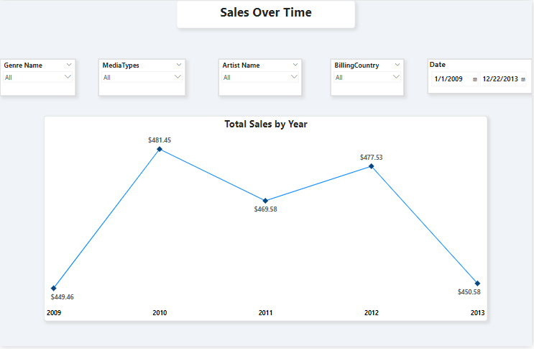
Visualizations to support the findings

Slide 10
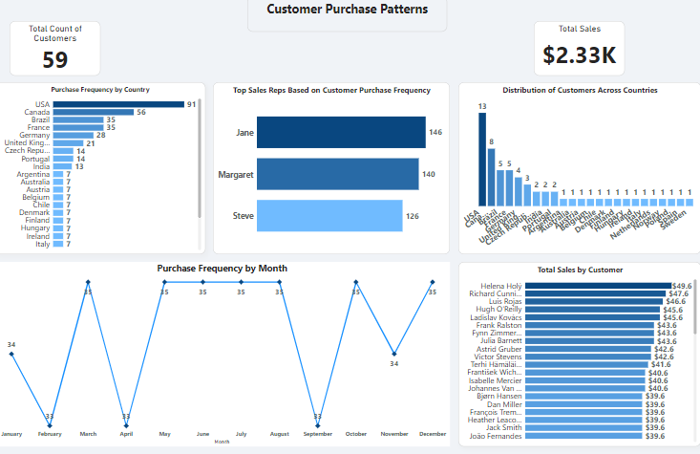
Visualizations to support the findings

Slide 11
Recommendations based on the analytics.
If the customer aspect is tackled, it would have an effect on the purchase frequency as well as Total sales.
01
We can try to improve our customer reach, since sales and purchase frequency is related the distribution of customers across the country.
02
Since many of the customers have interest in Rock music, we can invest more in stocking up the store with top selling genre's and albums to improve sales
03

Slide 12
World Population
Database

Slide 13
Project Overview
This world population data set was gotten from Kaggle and was in a .csv format.
This report was cleaned and modelled to give insights on the comparism between the world population in 2023 and 2024.
I was intrigued and decided to do an easy-to-go exploratory analysis as well as visualise my findings by countries and cities in the world.

Slide 14
Methodology and steps taken for data exploration and analysis.
This dataset didn't need a lot of modifications and cleaning, however I included some measures to give us more insights into the comparism between the two years.
I also applied some advanced conditional formatting to show icons pointing to either an increase or decrease in population from 2023 to 2024. That way users can easy see countries above or below.
I made sure to use a matrix to visualize in the overview page. This gives somewhat of the same effect as a drill through feature. You get to see categories and sub categories speaking to the same fact.

Slide 15
Key insights derived from the analytics
China is the highest populated country and has a growth rate of above 500% between 2023 and 2024.
Tokyo is the most populated city in the world as of 2024
Palestine and Qatar are rated the least populated countries in 2024.
Huambo and Amara are rated the least populated countries in 2024.
Though Nigeria is rated number Number 7 in the ranking, their growth rate is above 80% and are Number 3 in the List of highest growth rate from 2023 and 2024.

Slide 16
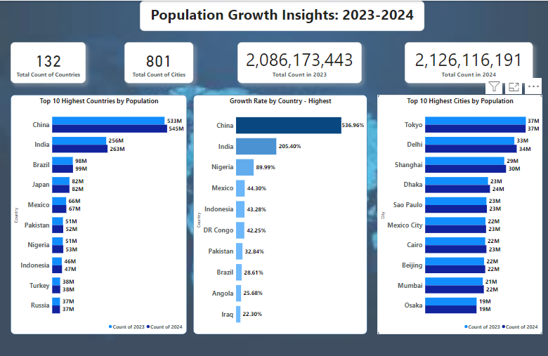
Visualizations to support the findings

Slide 17
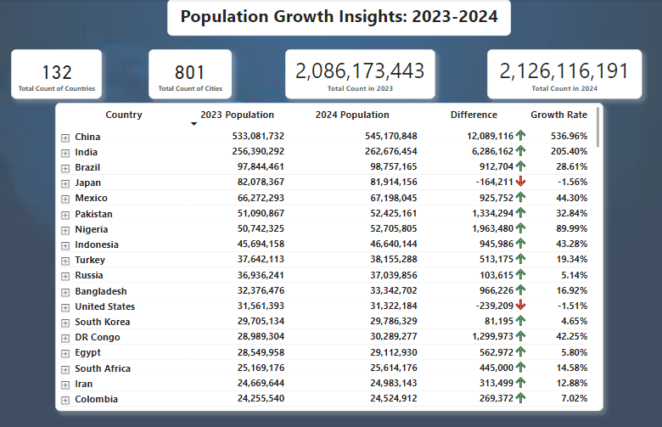
Visualizations to support the findings

Slide 18
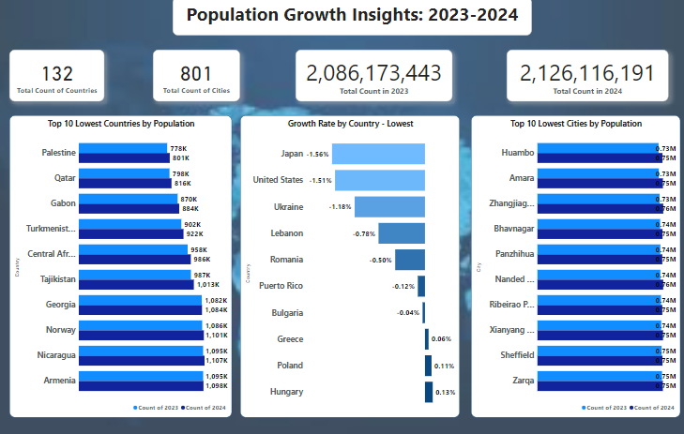
Visualizations to support the findings

Slide 19
Thank you!

