Slide 1
Project status
08 September 2026
Do text-serialized EHR models use longitudinal time?
Controlled history and timestamp stress tests on EHRSHOT
William Delery · Jeff Chiang Lab
DSBMED 220 · Summer 2026
ML4H 2026 proceedings-track working draft
M1 held-out evaluation complete · M3 validation complete · M2 incomplete future work
TEMPORAL EHR · ML4H 2026 WORKING DRAFT
1

Slide 2
Motivation
What the study isolates
Why this is difficult
Four questions
Longitudinal EHRs combine clinical content, event order, recurrence, and irregular elapsed time.
A long context window does not demonstrate that a model uses timestamp information correctly.
Many comparisons change several information sources at once, making temporal effects difficult to identify.
This project changes time labels while holding clinical events and their order fixed.
History
Does earlier history add signal beyond the latest window?
Elapsed time
Does correct prediction-relative time improve on event order alone?
Alignment
Does falsifying earlier time labels change predictions?
Interface
Do flat, compressed, and sequential representations behave differently?
Contribution: content-matched temporal stress tests with strict pre-prediction censoring, patient-balanced sampling, and patient-level uncertainty.
TEMPORAL EHR · ML4H 2026 WORKING DRAFT
2

Slide 3
Cohort construction
Aggregate counts only
EHRSHOT
Locked task panel
Prediction-time audit
Patient balancing
Final locked cohort
6,739 patients
41,661,637 events
31,252 codes
15 tasks
150,892 official
train/validation
label rows
149,769 unique
patient/task/time groups
935 duplicate groups excluded
At most one official
instance per patient/task
deterministic SHA-256 rank
13,172 instances
4,471 train
4,358 validation
4,343 held-out
Every retained event is strictly before the official prediction time T. Exact seven-field duplicates are removed, and official patient splits are preserved.
30-day windows: laboratory, imaging, and operational tasks
90-day windows: incident diagnosis
The final four-task panel was frozen before pilot embedding performance could influence task selection.
TEMPORAL EHR · ML4H 2026 WORKING DRAFT
3

Slide 4
Prediction tasks
One official label instance per patient and task
Task
Outcome predicted
Train / validation / held-out
Held-out % +
History window
Lab anemia
Next qualifying hemoglobin result is abnormal
2,092 / 1,991 / 2,002
46.4%
30 days
Readmission
Readmission within 30 days; future admission evidence excluded
1,337 / 1,191 / 1,190
5.3%
30 days
New hypertension
First/new hypertension diagnosis within one year
792 / 781 / 755
15.9%
90 days
CheXpert
Upcoming chest-radiograph finding vs No Finding; prediction precedes report
250 / 395 / 396
67.4%
30 days
CheXpert input is structured pre-T EHR history—not the target X-ray image or radiology report. The target report/finding at or after T is excluded.
TEMPORAL EHR · ML4H 2026 WORKING DRAFT
4

Slide 5
Conditions and baselines
Clinical event arrays never move
C0–C3: matched temporal stress tests
B1–B4: information-removal baselines
B1
Latest nonempty window
earlier
middle
recent
T
C0
Order only
No elapsed-time labels
B2
Latest occurrence of each code
C1
Correct time
Correct prediction-relative window labels
B3
Log code counts + logistic regression
C2
Reversed earlier gaps
Earlier gaps reversed; final window remains correct
B4
Training prevalence only
C3
Shuffled earlier labels
Three fixed seeds; final window remains correct
C2/C3 alter label indices only. They do not rearrange the clinical events, add future information, or change the prediction task.
TEMPORAL EHR · ML4H 2026 WORKING DRAFT
5

Slide 6
Modeling interfaces (M1–M3)
Same development cohort; different history representation
M1 · Flat history
M2 · One-pass compression
M3 · Window sequence
Status: frozen primary; held-out complete
Status: incomplete future work; no test access
Status: validation-only secondary analysis
Complete 8,192-token serialized history
Frozen Qwen3-Embedding-0.6B encoder
Full 1,024-dimensional FP32 L2-normalized embedding
Task-specific penalized logistic regression
Designed to compress the same content-matched source evidence
On-premise Qwen3.6-35B endpoint
Deterministic decoding and strict retention checks
Versioned attempts did not meet fidelity/runtime gates
Partial caches were excluded from analysis
Up to 64 recent nonempty windows
512 tokens per window with frozen 0.6B embeddings
Fixed 256-dimensional projection
Mean-pool logistic comparator
One-layer unidirectional GRU; three fixed seeds
Validation AUROC early stopping
The 0.6B encoder supports the complete prespecified comparison matrix. The downloaded 8B model is reserved for prespecified runtime-gated M1 confirmation cells, not outcome-driven expansion.
TEMPORAL EHR · ML4H 2026 WORKING DRAFT
6

Slide 7
Study workflow and decision gates
Frozen one-time test complete
1
2
3
4
5
Protocol and
serialization
Pilot and
panel lock
Foundation
and M1
M1/M3
selection
One-time
held-out test
Complete
Complete
Complete
Complete
Complete
Approach selection uses validation only
M1 completed the required matrix and had validation macro-AUROC 0.694. M3 reached 0.622 and remained secondary. M2 did not pass its fidelity/runtime gate. M1 was therefore frozen before test access.
The held-out split was evaluated once from a hash-pinned manifest. No post-access design changes were made, and every job has an exit-0 COMPLETE sentinel.
TEMPORAL EHR · ML4H 2026 WORKING DRAFT
7

Slide 8
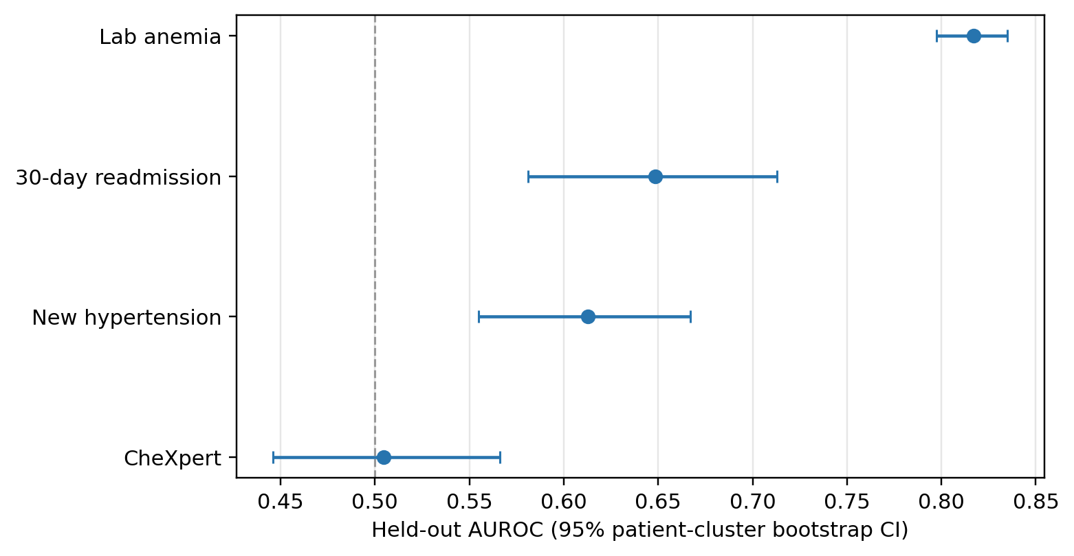
Frozen M1 held-out performance
Correct-time condition C1 · 4,343 instances
Interpretation
Anemia showed strong discrimination (AUROC 0.817).
Readmission and hypertension were moderate (0.649 and 0.613).
CheXpert AUROC was near chance (0.505).
CheXpert AUPRC was 0.695 at 67.4% prevalence.
Equal-weight macro values give each task the same influence.
These values come from the single frozen held-out evaluation. The protocol was not changed after test access.
M1 C1 held-out macro: AUROC 0.646 · AUPRC 0.442 · Brier 0.146 · log loss 0.452
TEMPORAL EHR · ML4H 2026 WORKING DRAFT
8

Slide 9
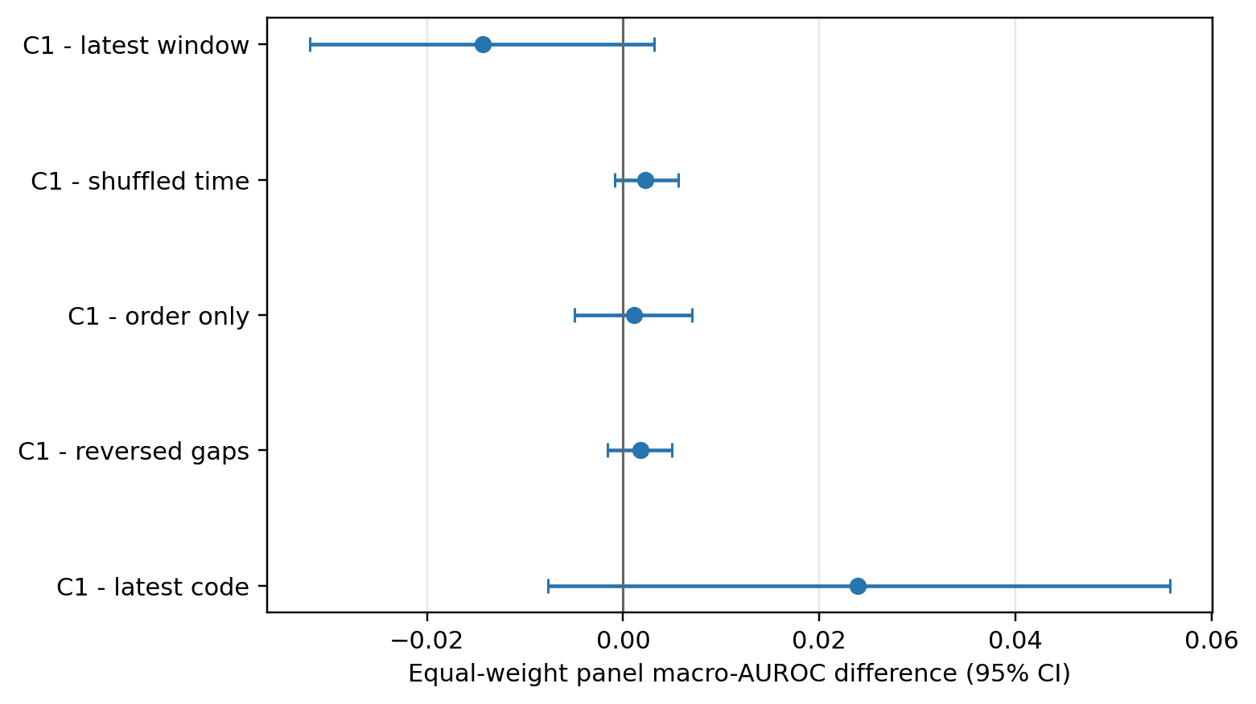
M1 temporal stress-test result
Equal-weight held-out macro-AUROC
Paired patient-bootstrap contrasts
C1 − latest window: −0.014 [−0.032, +0.003]
C1 − shuffled time: +0.002 [−0.001, +0.006]
C1 − order only: +0.001 [−0.005, +0.007]
C1 − reversed gaps: +0.002 [−0.002, +0.005]
C1 − latest code: +0.024 [−0.008, +0.056]
Correct textual time was not detectably better than recent history, order alone, or falsified earlier labels at the panel level. Anemia showed a modest task-specific C1−C0 effect.
Co-primary Holm-adjusted p=0.224 for C1−B1 and C1−C3. Bootstrap: 2,000 patient-cluster replicates.
TEMPORAL EHR · ML4H 2026 WORKING DRAFT
9

Slide 10
Current state and next steps
Scientific analysis complete · 08 September 2026
Completed and verified
Remaining work
Protocol, privacy boundaries, and final four-task panel are locked.
Cohort construction, strict censoring, duplicate-time handling, and shortcut audits passed.
M1 validation, one-time held-out evaluation, baselines, and bootstrap contrasts are complete.
M3 reference validation is complete and remained secondary.
M2 was frozen as incomplete future work; partial caches were excluded.
Confirm authorship and contribution statements with collaborators.
Insert the institutionally supported IRB/ethics wording.
Finalize code and data availability language.
Compile in the official ML4H 2026 Proceedings template and enforce the eight-page content limit.
Cross-check every manuscript number against the frozen aggregate JSON and CSV tables.
Run final anonymity, reference, and submission-package QA.
Main conclusion: textual timing did not add reliable panel-level signal to this frozen flat embedding, although anemia showed a modest task-specific effect.
TEMPORAL EHR · ML4H 2026 WORKING DRAFT
10

