Slide 1
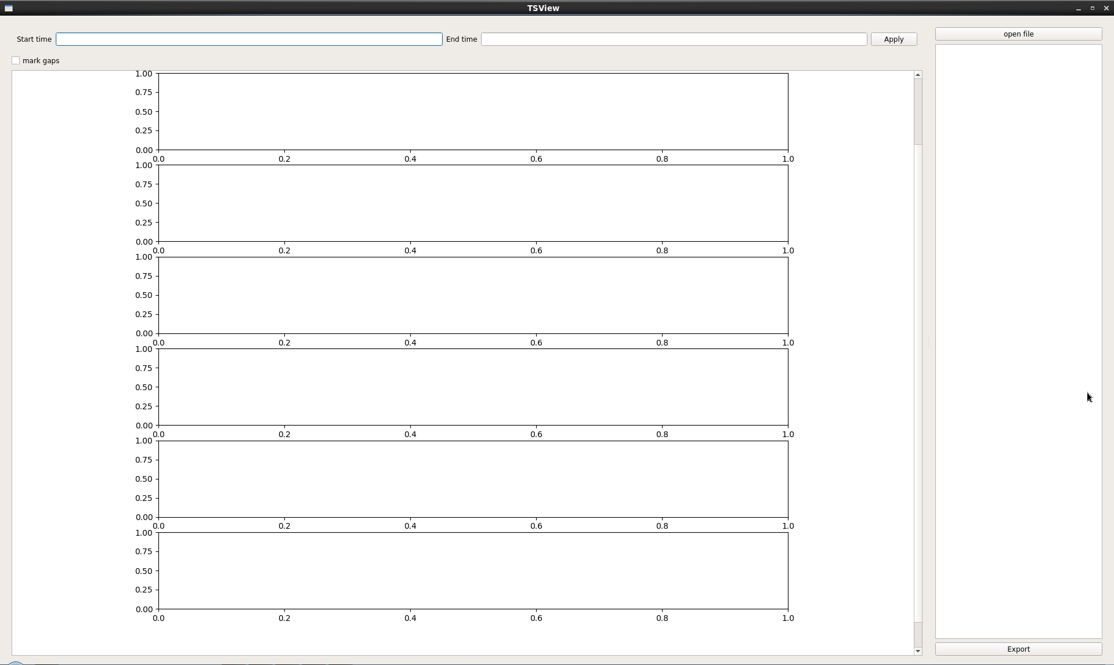
Open asdf file

Slide 2
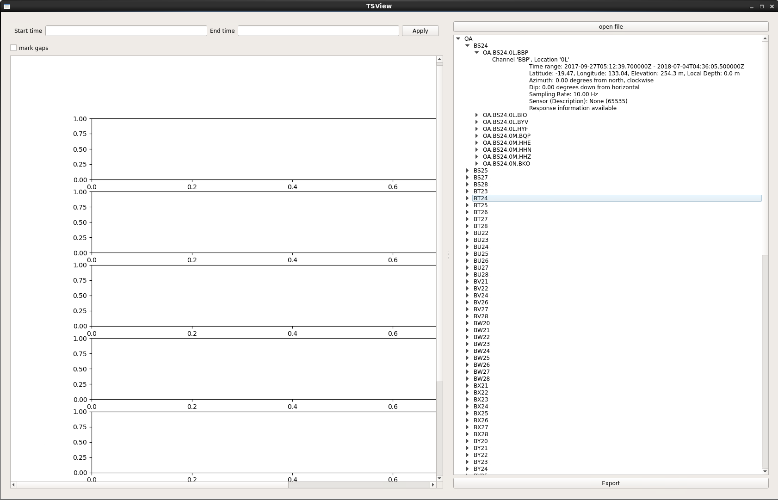
network
station
location
channel
Meta data

Slide 3
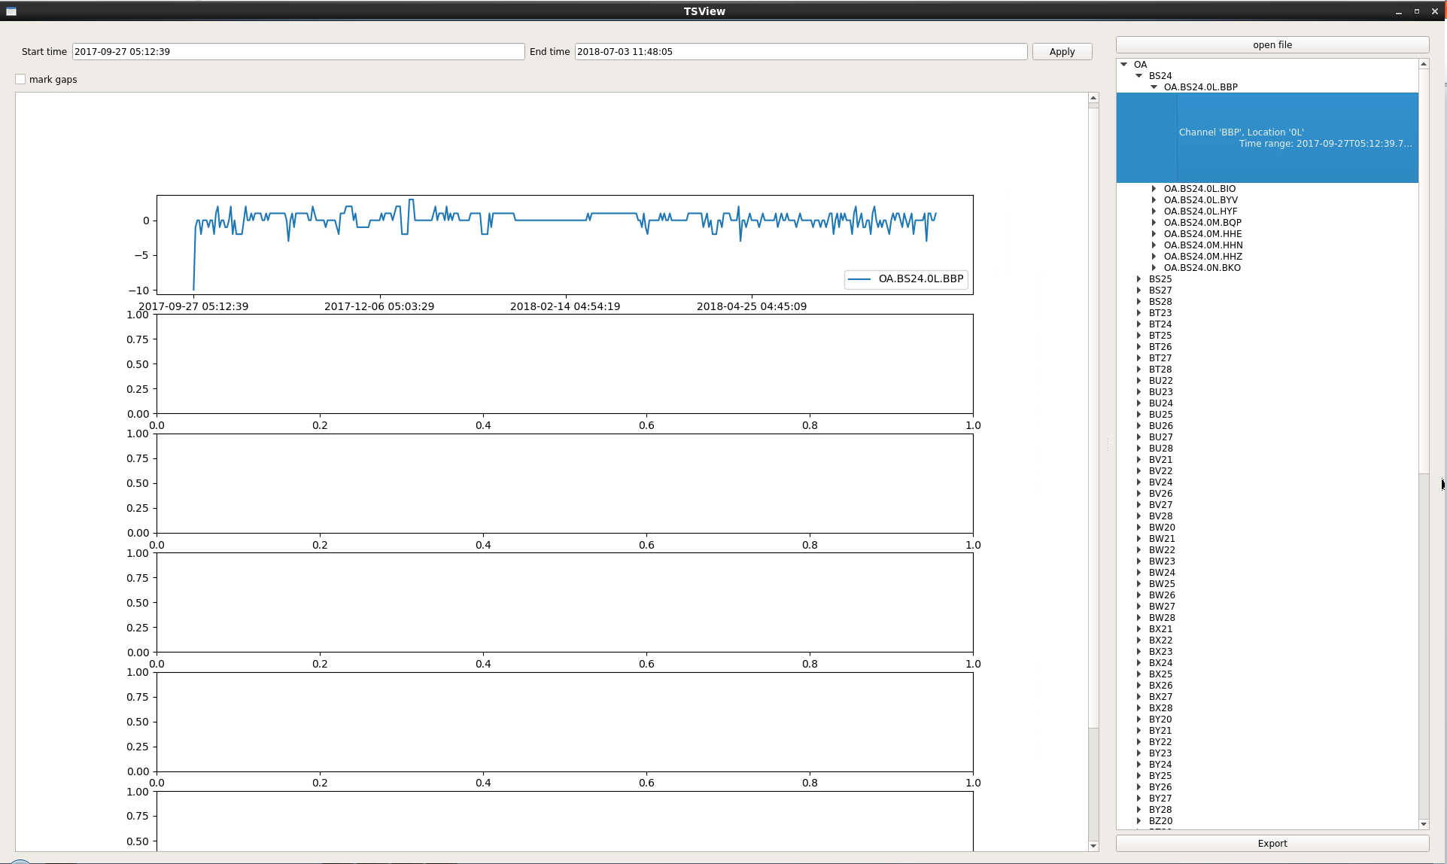
Can be adjusted
Can be adjusted
Apply adjustment
Can be moved
drag the plot with left/right mouse to see the effects, respectively
Scrolling the mouse wheel will increase/decrease the scope of plot

Slide 4
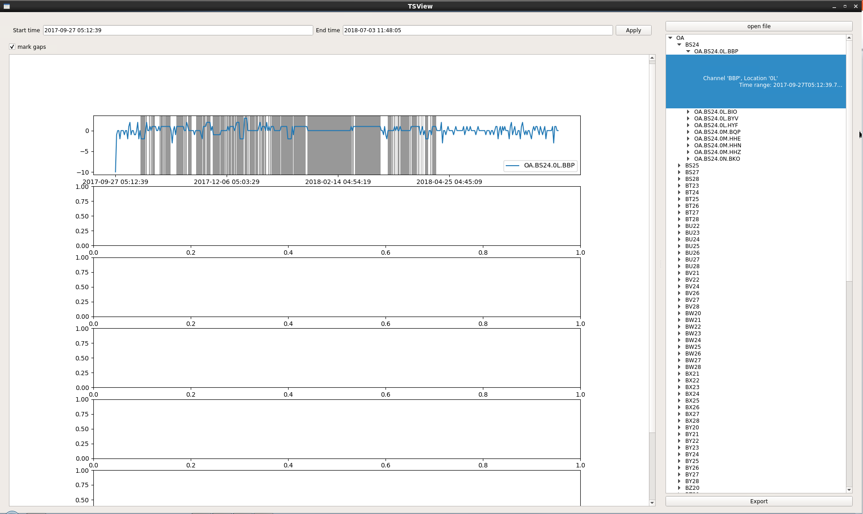
Gaps in the input data are shown as grey spans
For display purpose, we fill in gaps with the last values

Slide 5
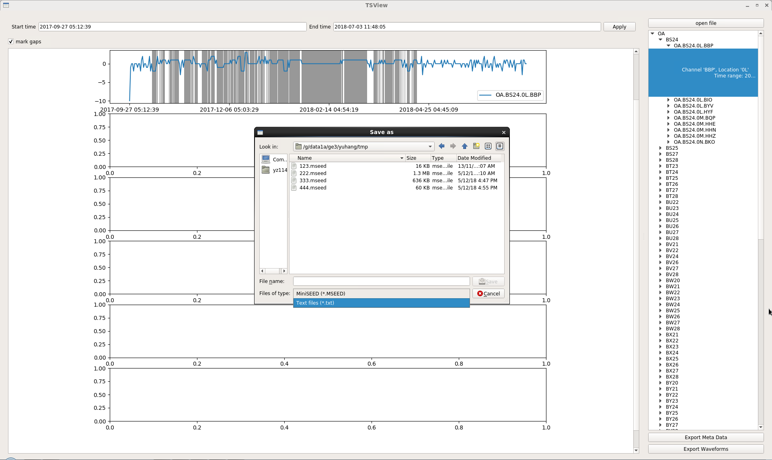
MiniSEED
Text file
Export meta data of all waveforms on the list above
Export all waveforms being displayed between the start/end time above
at the original sample rate

