Slide 1
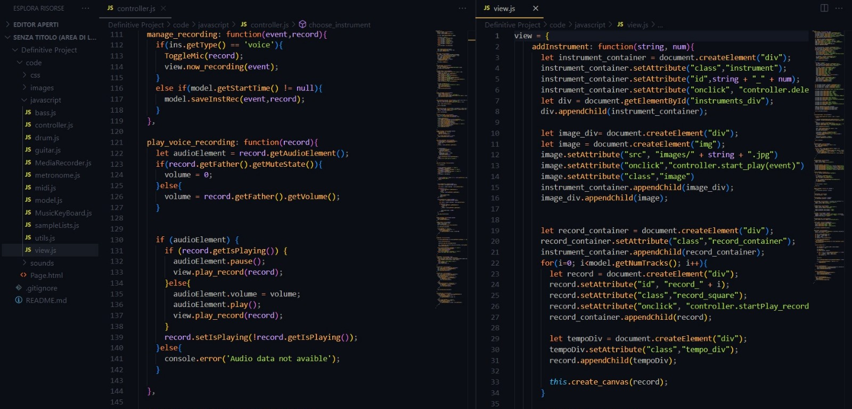

IT’S NOT GARAGE BAND
ISPIRAZIONI

Slide 2
IT’S NOT GARAGE BAND
ISPIRAZIONI

Slide 3
IT’S NOT GARAGE BAND
ISPIRATION

Slide 4

ISPIRATION

Slide 5
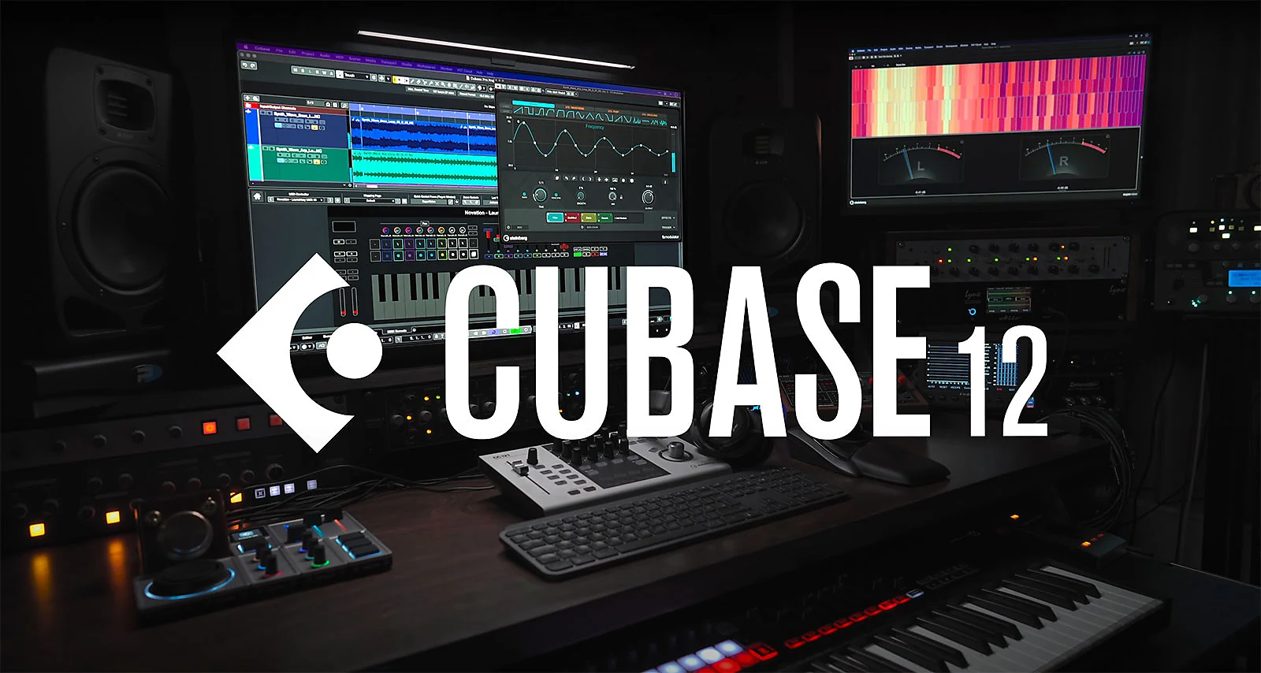

Slide 6
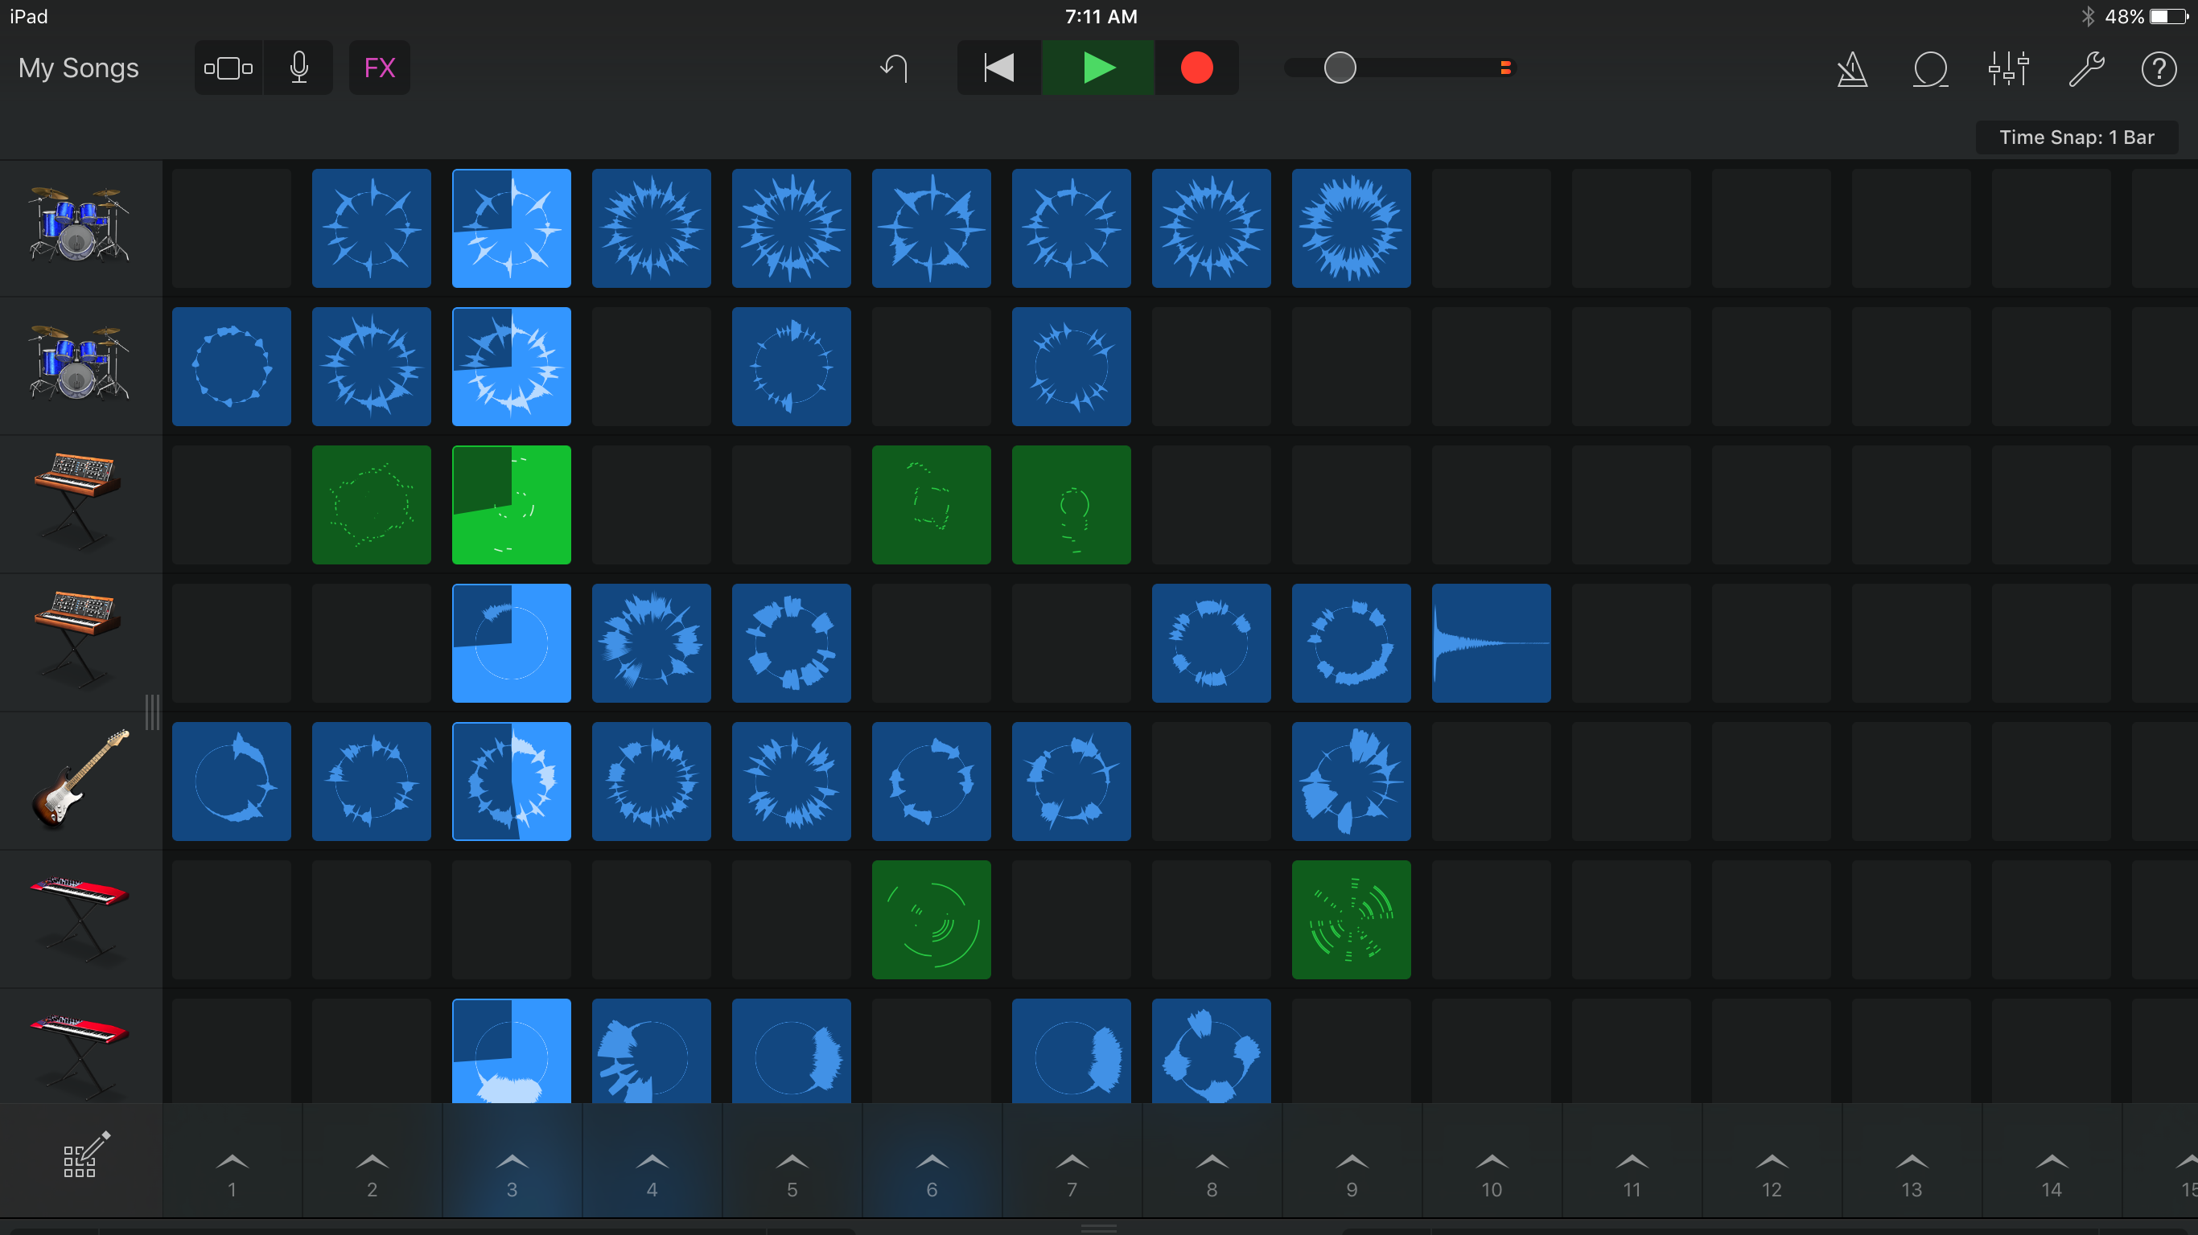

Slide 7

GARAGE BAND

Slide 8
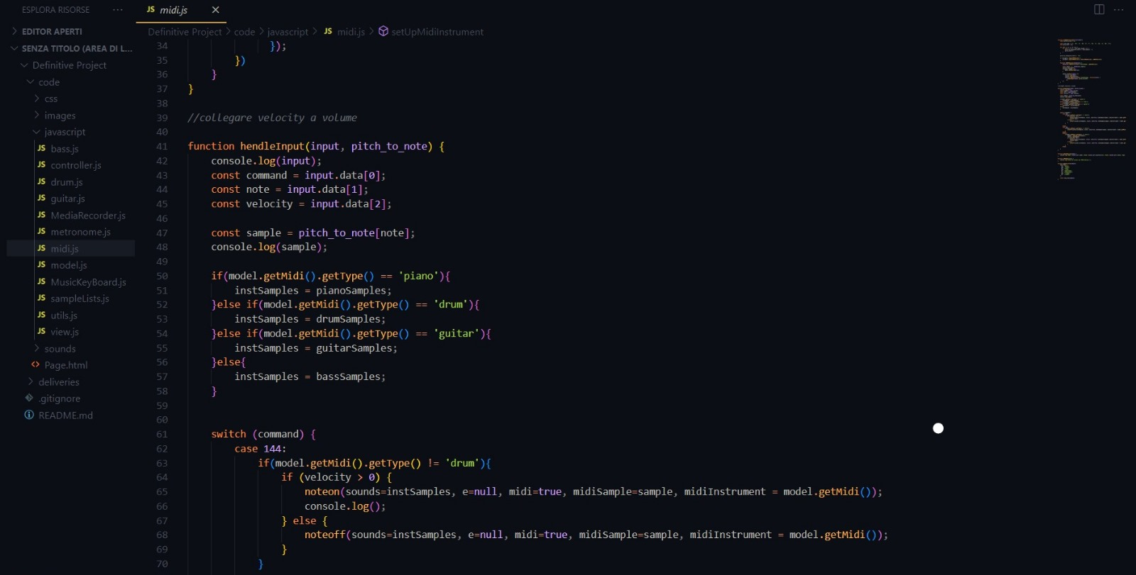
FEATURE
GARAGE BAND

Slide 9
FEATURE
MIDI ITERFACE

Slide 10
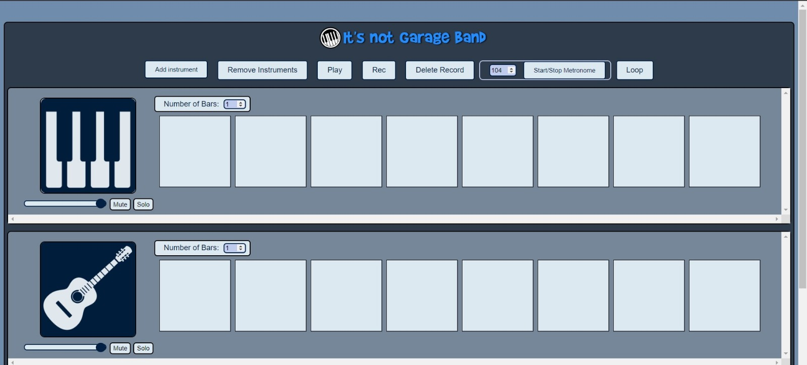
MIDI ITERFACE
ITERFACE

Slide 11
MIDI ITERFACE

Slide 13
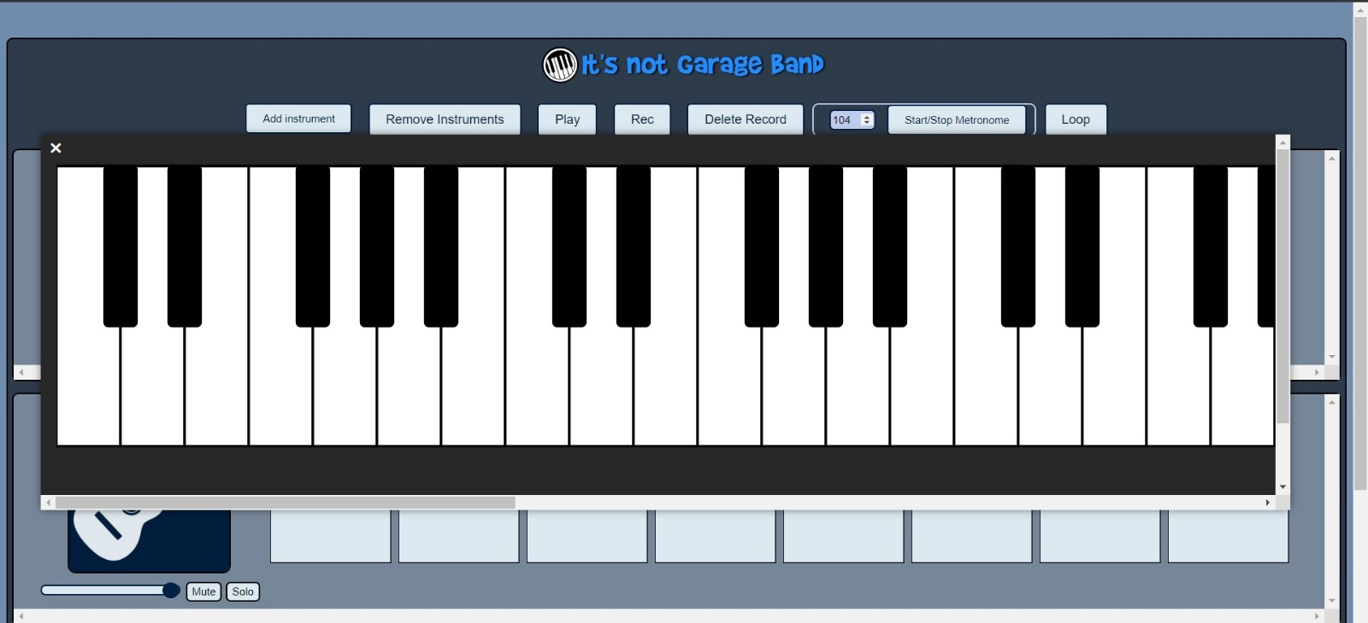
PIANO

Slide 14
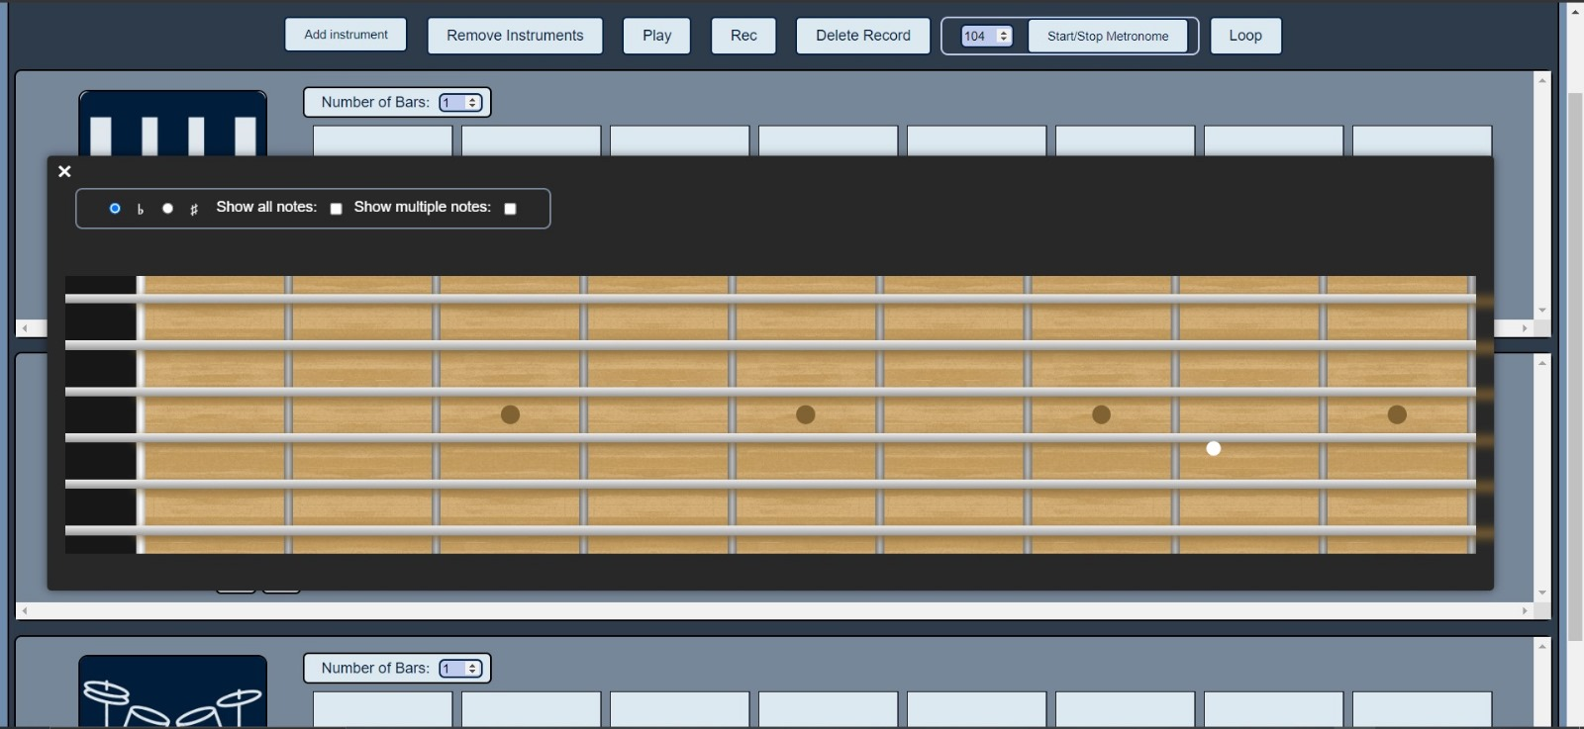
PIANO

Slide 15
GUITAR

Slide 16
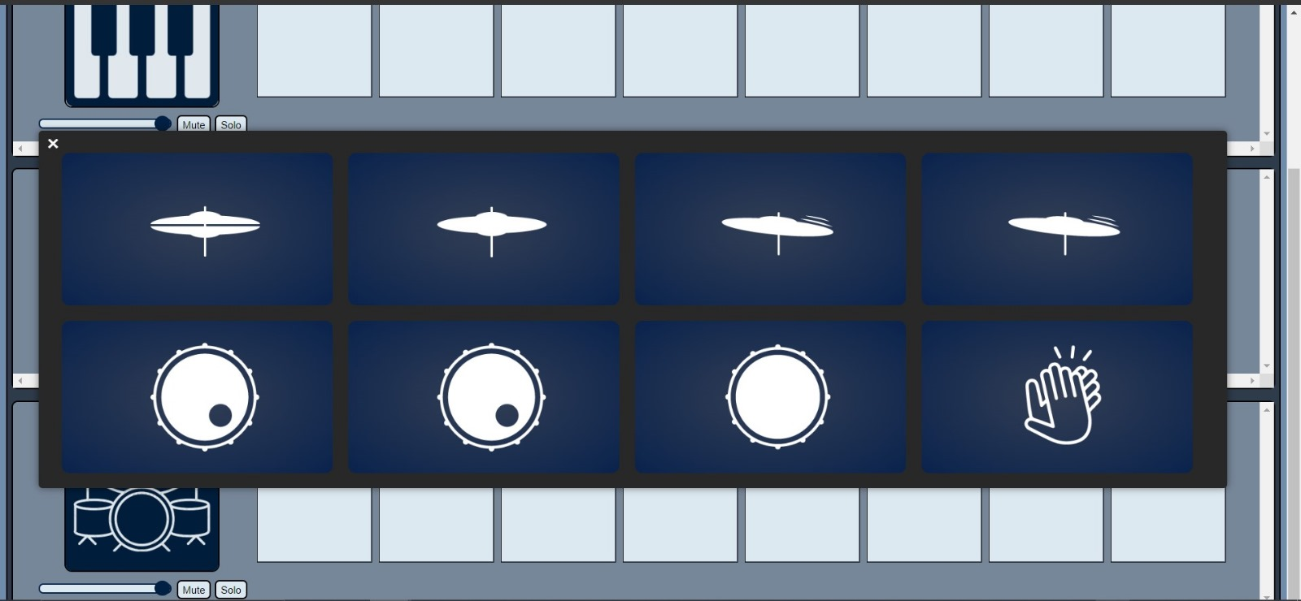
GUITAR

Slide 17
DRUM

Slide 18
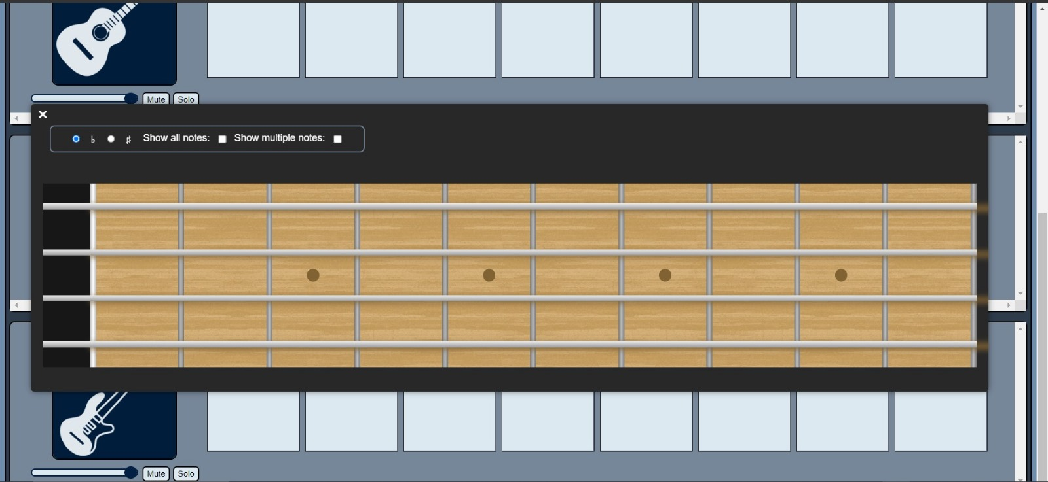
DRUM

Slide 19
BASS

Slide 20
BASS

Slide 21
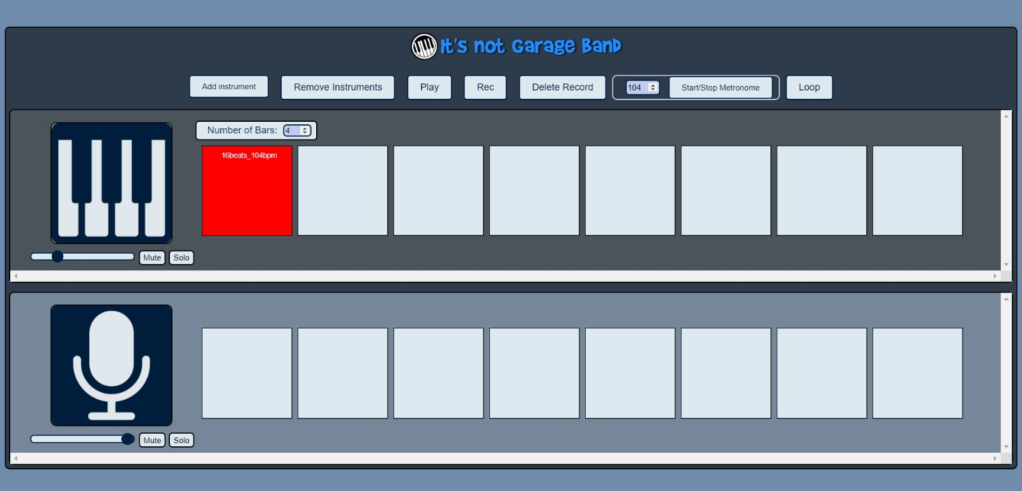
VOICE

Slide 22
VOICE

