Slide 1
EveSense
Catching an eavesdropper on a BB84 link that is already noisy
Chiara De Venuto
Qiskit Fall Fest 2026 @ MPSTME, IBM Quantum
Quantum Secure Communication track

Slide 2
The question
BB84 security rests on one fact: measuring a qubit in the wrong basis
disturbs it. An intercept-resend attacker inserts errors, the two ends
read those errors as QBER, and above roughly 11% QBER the link stops
producing usable key.
Deployed fiber is never clean. Raman scattering, dark counts and
polarization drift put real links at a few percent QBER with nobody
listening. So the receiver is not comparing a measurement against
zero. It is comparing against a baseline that moves.
Eve knows the baseline. A patient attacker keeps her interception
rate under the noise floor. The receiver has one number and one
threshold, and has to decide whether a rise in QBER is Eve or the
weather.

Slide 3
What we built
A BB84 link in Qiskit with a tunable attacker and a tunable channel,
then a detection study across nine conditions.
One round is one qubit: Alice prepares |0>, |1>, |+> or |->, Eve
intercept-measures and resends when she is active, the channel adds
depolarizing and readout noise, Bob measures in the basis he picked.
Rounds are packed into batches of 64 qubits in a single stabilizer
circuit, so 30000 rounds cost milliseconds. Eve's outcome is drawn
from the Born rule, which is what a mid-circuit measure-and-resend
gives.
Four experiments: interception sweep, channel noise sweep, detection
study with 12 repeats per condition, and the secure key rate curve.

Slide 4
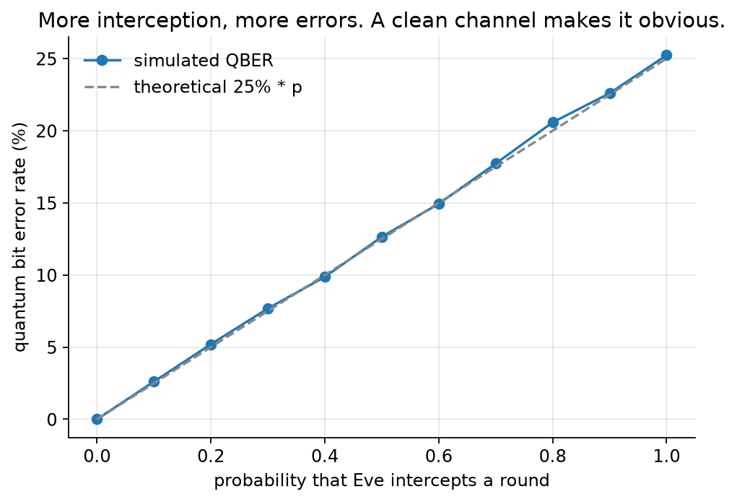
Clean channel, tunable attacker
Interception sweep. The simulated points fall on the analytical 25% * p line, which is the sanity check every QKD demo should pass before claiming anything.

Slide 5
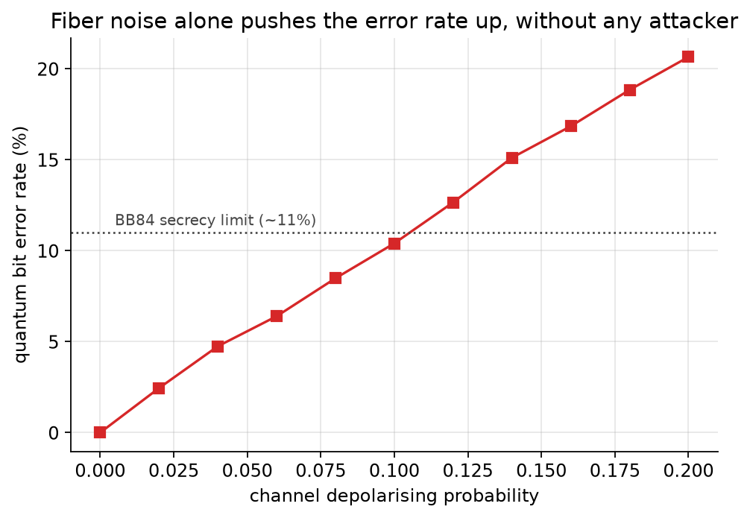
The baseline she hides in
Channel noise with no attacker. By 12% depolarising probability the link crosses the 11% secrecy limit on its own.

Slide 6
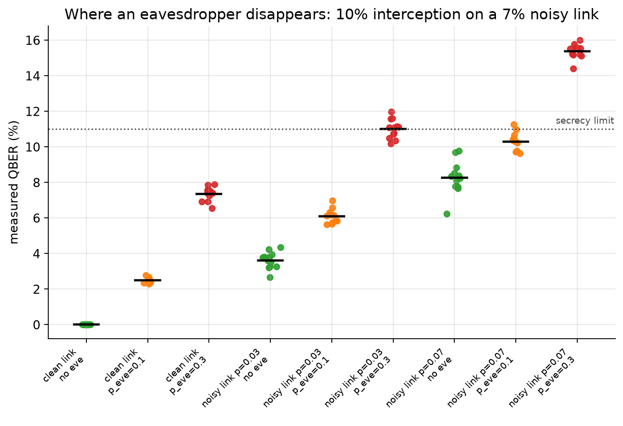
Nine conditions, twelve runs each
QBER distributions per condition. The overlap between a tapped noisy link and an untapped noisy link is the whole problem.

Slide 7
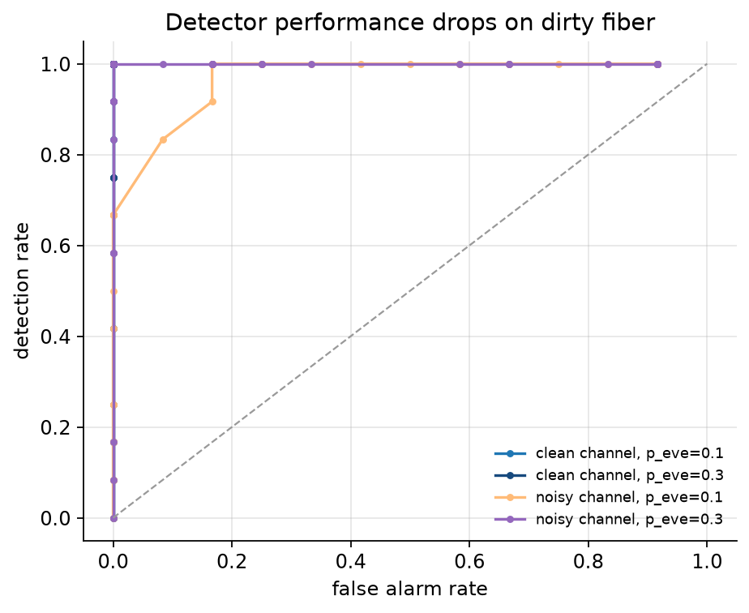
Detection cost
Hit rate against false alarm rate. The noisy-channel curves fall toward the diagonal exactly where the attacker is quietest.

Slide 8
What the numbers say
On a clean link the protocol behaves exactly as theory predicts: QBER
tracks 25% of the interception probability, and the measured curve
sits on the analytical one.
A 7% depolarizing channel on its own produces about 7% QBER. That
is the same order of magnitude as a 10% interception rate on clean
fiber. The receiver cannot tell those two apart from a single
measurement.
The ROC curves show the tradeoff. On clean fiber almost any
threshold separates tapped from untapped. On dirty fiber the curve
collapses toward the diagonal at low interception rates, which is
where a patient attacker works.
Past about 11% QBER error correction and privacy amplification take
everything. The link stays up and stops being worth anything.

Slide 9
Limits and next steps
Eve here is a textbook intercept-resend attacker. Photon-number-
splitting and coherent attacks are not in the model, and nothing in
this work is a security proof.
The channel is depolarizing plus symmetric readout noise. Real fiber
drifts in polarization and loses differently per wavelength.
The detector is a single threshold. A real receiver discloses part of
the key, estimates QBER on that subset and adapts the threshold
against a measured baseline instead of a fixed number.
The next version of this work would estimate the baseline online and
run the detection on the residual, which is the version that would
survive contact with a real link.

