Slide 1
HEART FAILURE DETECTION
Chiara Esposito 1716809

Slide 2
TABLE OF CONTENTS
00.
Introduction
01.
Idea
02.
Dataset
03.
Related works
04.
Implementation
05.
Conclusions
User and goal
Analysis of the used dataset
Analysis of studies already done on the topic
Of preprocessing and visualization

Slide 3
INTRODUCTION
Cardiovascular diseases (CVDs) are the number 1 cause of death globally, that occur prematurely in people under 70 years of age.
Most of diseases are being diagnosed at later stages at which it is very difficult to control. So, people who are at high cardiovascular risk need early detection and management.

Slide 4
01.
The idea
To create an interactive dashboard that allows doctors, especially cardiologists see the elements contributing to a heart failure.
It will be possible to monitor different elements, such as cholesterol, blood pressure, chest pain, maximum heart rate, etc... according to age and sex of the different people, to detect and prevent possible diseases.

Slide 5
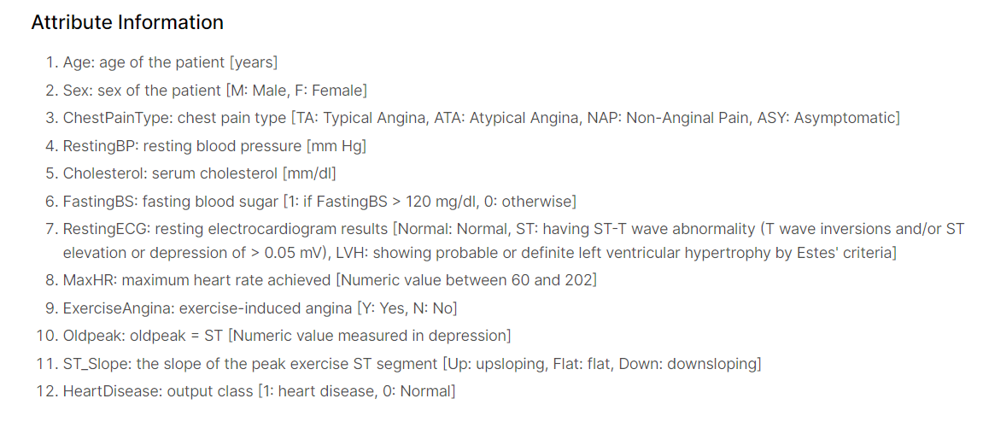
02.
Dataset
The dataset is from Kraggle.

Slide 6
03.
Related works
1
V. Gupta, V. Aggarwal, S. Gupta, N. Sharma, K. Sharma and N. Sharma, "Visualization and Prediction of Heart Diseases Using Data Science Framework," 2021 Second International Conference on Electronics and Sustainable Communication Systems (ICESC), 2021, pp. 1199-1202, doi: 10.1109/ICESC51422.2021.9532790.
Rami Lehtinen, Harri Sievänen, Jari Viik, Väinö Turjanmaa, Kari Niemelä, Jaakko Malmivuo, “Accurate detection of coronary artery disease by integrated analysis of the ST-segment depression/heart rate patterns during the exercise and recovery phases of the exercise electrocardiography test”, The American Journal of Cardiology, Volume 78, Issue 9, 1996, Pages 1002-1006, ISSN 0002-9149, https://doi.org/10.1016/S0002-9149(96)00524-3.
G. Dangi, T. Choudhury and P. Kumar, "A smart approach to diagnose Heart disease through machine learning and Springleaf Marketing Response," 2016 International Conference on Recent Advances and Innovations in Engineering (ICRAIE), 2016, pp. 1-6, doi: 10.1109/ICRAIE.2016.7939547.
2
3

Slide 7
APPROACH
BARCHARTS
HEATMAP
A. Data Collection
B. Data Cleaning
C. Data Explore
D. Parameter Selection
To check the distribution of all parameters in order to explore the dataset and the interdependence between attributes.
To better know the association between the parameters or attributes.
V. Gupta, V. Aggarwal, S. Gupta, N. Sharma, K. Sharma and N. Sharma, "Visualization and Prediction of Heart Diseases Using Data Science Framework," 2021 Second International Conference on Electronics and Sustainable Communication Systems (ICESC), 2021, pp. 1199-1202, doi: 10.1109/ICESC51422.2021.9532790.
1

Slide 8
04.
Implementation
Firstly, we made our dataset fully quantitative.
We also implemented the possibility for the user to check only the cases in which the probability for the heart disease is high.
We also wanted to have some of the values divided into ranges. We then implemented the PCA noticing that there were no correlation among the features.
We analyze some of the features and decided to drop them, such as FastingBP, ExerciseAngina and Oldpeak finding them not so relevant for our purposes.

Slide 9
VISUALIZATION

Slide 10
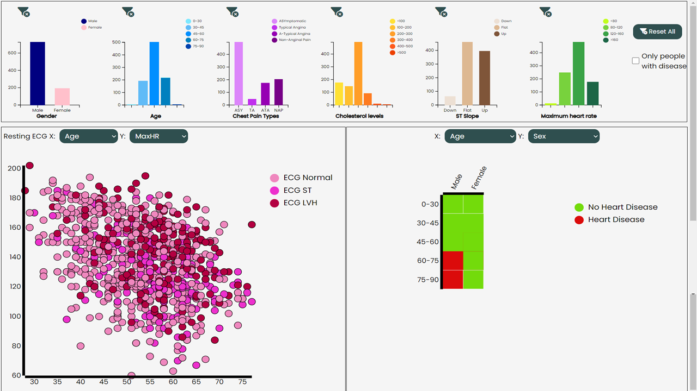
Insights:
Most common risk factors
Comparison among ranges

Slide 11
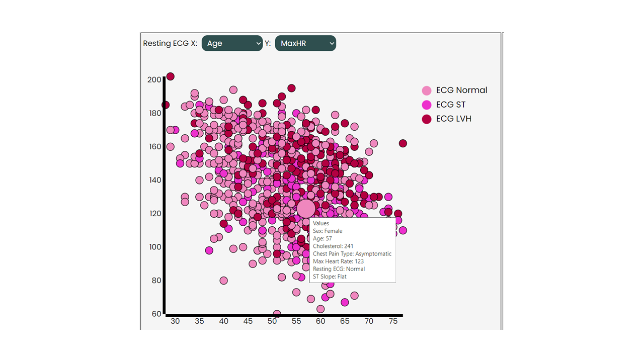
Insights:
Most common ECG in relation to different factors
Analysis of cholesterol levels

Slide 12
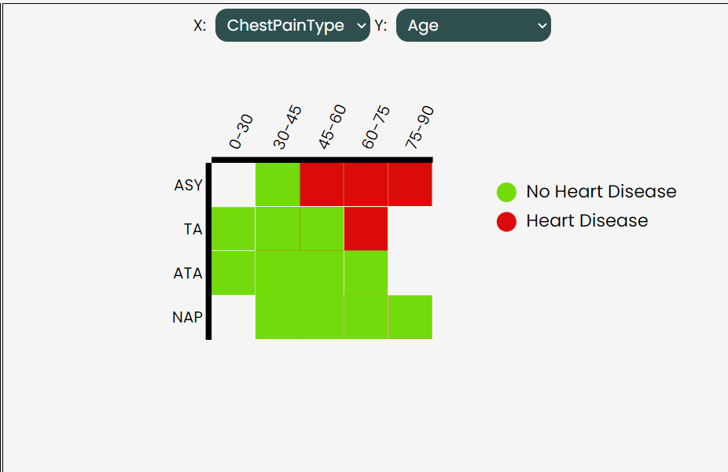
Insights:
Immediately see ranges with disease
Analysis of chest pain type

Slide 13

06.
Conclusions
Better risk allocation : you can check which are the most common risk factors that contribute to an heart failure;
More eﬀective targeted analysis, focused on patients grouped with similar characteristics, such as age, sex or levels of cholesterol;
Improved prevention: in further works, this study could be useful for helping patients in preventing heart failures, by for example addressing them to special medical checkings before synthomps appear.

Slide 14
THANKS
FOR THE ATTENTION!
https://github.com/ChiaraEsposito/VisualAnalytics

