Slide 1

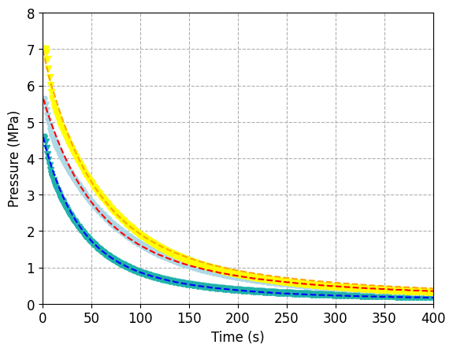
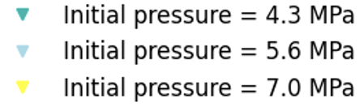
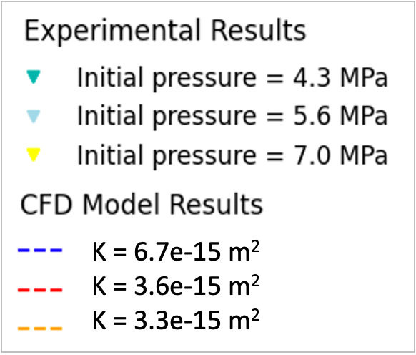

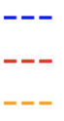
K = 6.7e-15 m²
K = 3.6e-15 m²
K = 3.3e-15 m²

Slide 2
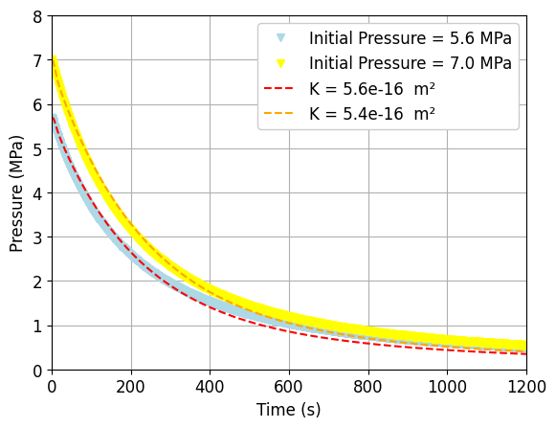
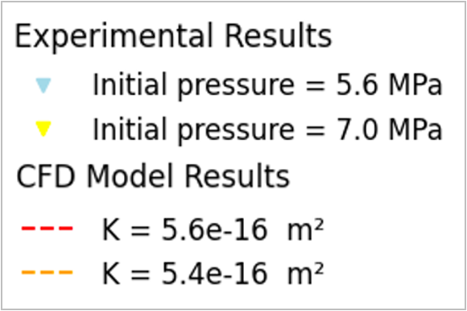
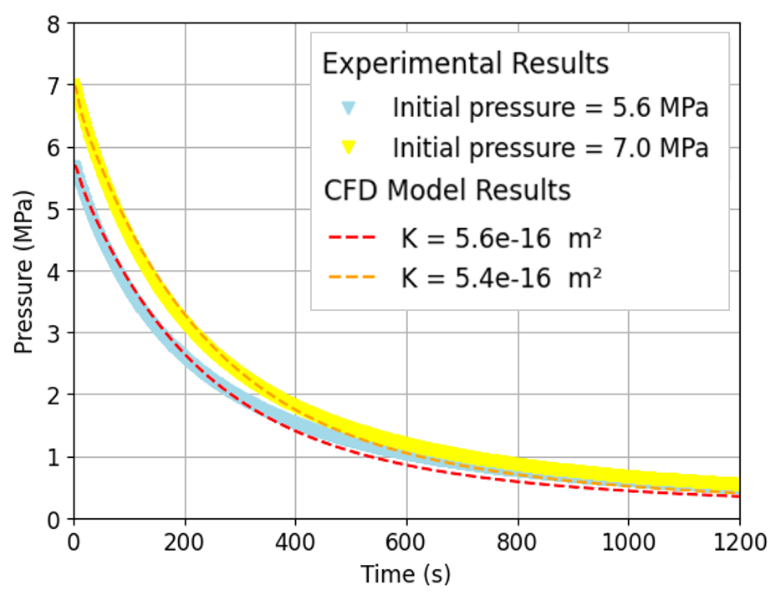


Slide 3
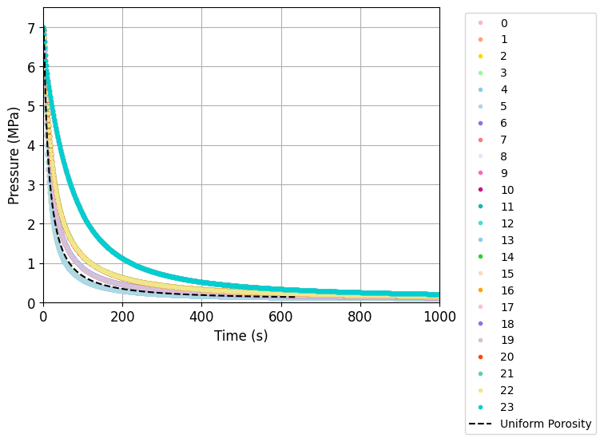

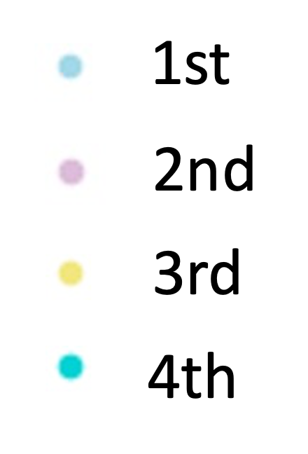

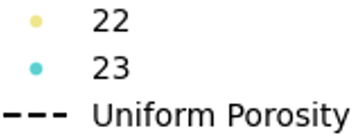
Position of the Lowest Porosity Pellet
1st
2nd
3rd
4th
Uniform Porosity

Slide 4

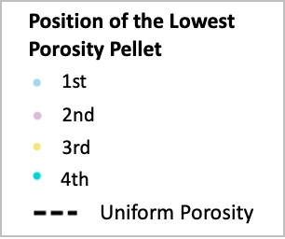

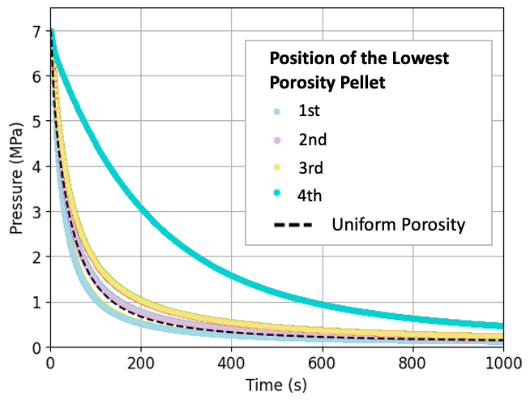
Inlet
1st
2nd
3rd
4th
Outlet
Position of the Lowest Porosity Pellet
Uniform Porosity

Slide 5
Inlet
1st
2nd
3rd
4th
Outlet
Uniform Porosity

Slide 6
