Slide 1
Advanced Deep Learning Team Project
Fakultät 7
Anna Reiter, Chiara Perocco

Slide 2
Overview
Introduction
1.1 Architecture of the system
1.2 Object Detector
1.3 Image Classifier
1.4 Article Agent
1.5 Article Assembler
1.6 Diffusion Model
Results
Conclusion
Outlook

Slide 3
Domain

Slide 4

Domain
Domain: informative text about American Sign Language (ASL)
Article Structure:
Introduction
The letter in written language
The letter in sign language
Conclusion
Dataset: ASL(American Sign Language) Alphabet Dataset → consists of 29 classes (only 26 used)
Source: Kaggle (ASL(American Sign Language) Alphabet Dataset)
Each paragraph is followed by an image

Slide 5
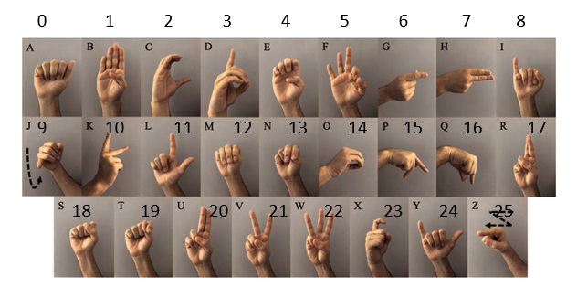
Domain

Slide 6
Architecture of the system

Slide 7
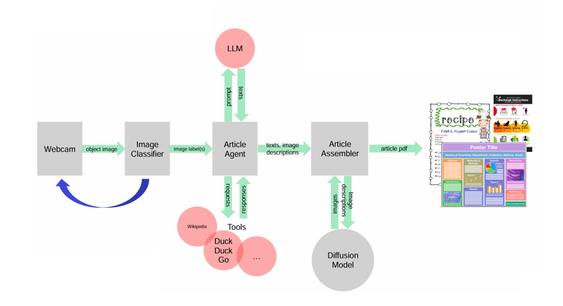
Architecture of the system

Slide 8
Object Detector

Slide 9
Object Detector
Laptop camera
Opencv-python
Takes a photo by triggering the „y“ (yes) on keyboard
Takes no photo by triggering the „n“ (no) on keyboard

Slide 10
Image Classifier

Slide 11
Image Classifier
AlexNet from scratch
VisionTransformer pretrained on ImageNet
ResNet50 pretrained on ImageNet

Slide 12
Article Agent, Artcile Assembler, Diffusion Model

Slide 13
Article Agent, Artcile Assembler, Diffusion Model
Tools: Wikipedia, DuckDuckGo
LLM: Llama3.1 von Ollama
Markdown and Pandoc
HuggingFace Model: kakaobrain/karlo-v1-alpha

Slide 14
Results
Ds1
1.1 AlexNet
1.2 ResNet50
1.3 VisionTransformer
2. Ds2
2.1 AlexNet
2.2 ResNet50
2.3 VisionTransformer

Slide 15
Definition Ds1, Ds2
Ds1
300 images per class (80% train, 10% val, 10% test) → computing power
Data augmentation:
horizontal flip
crop (padding n = 4)
Hyperparameter tuning with optuna
Ds2
Adjustment of ds1 with mediapipe; 1300 images per class (80% train, 10% val, 10% test)
Data augmentation:
horizontal flip
crop (padding n = 4)
Data augmentation:
Rotation
Colour properties
Affine transformations
Grayscale conversion

Slide 16
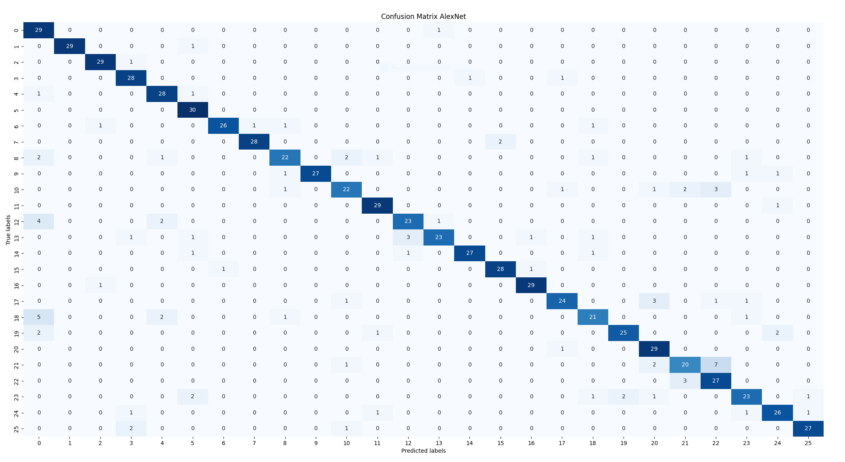
Ds1 – AlexNet
Learning rate: 3.99e-05; Batch size: 64; Epochs: 35

Slide 17
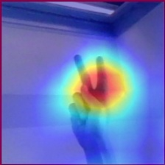
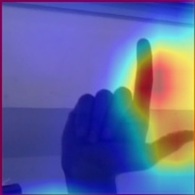
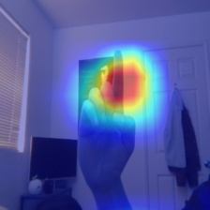
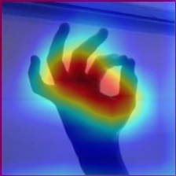
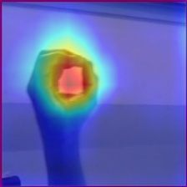
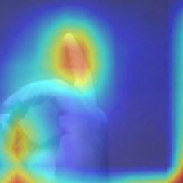
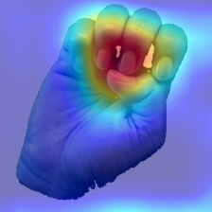
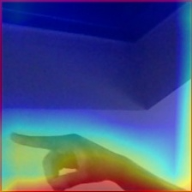
Ds1 - AlexNet

Slide 18
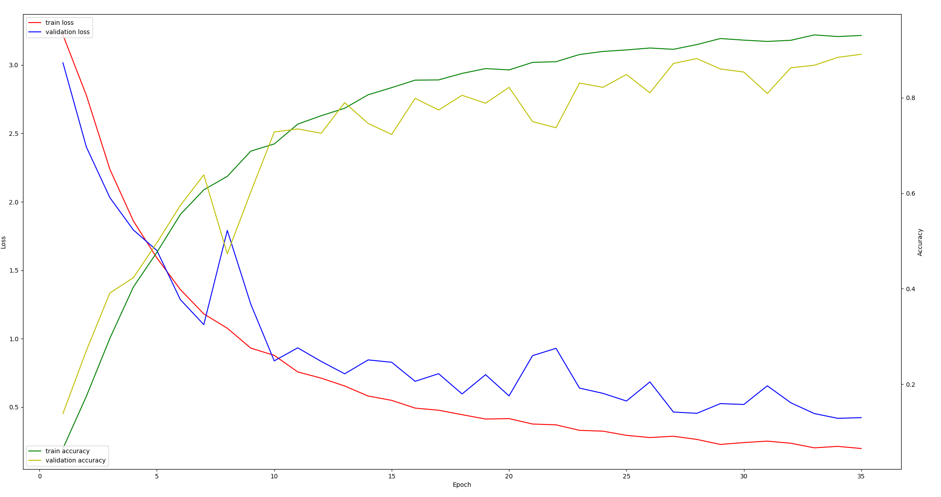
Ds1 - AlexNet

Slide 19
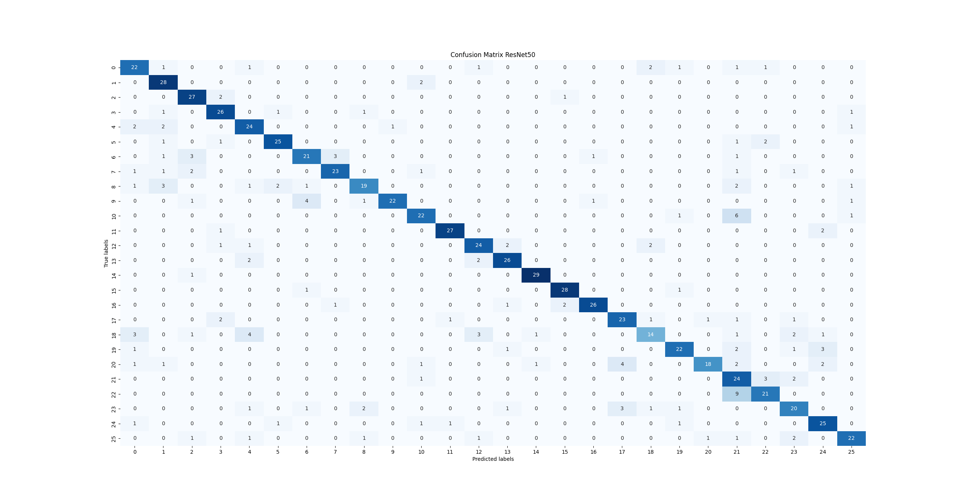
Ds1 – ResNet50
Learning rate: 0.0008; Batch size: 64; Epochs: 10

Slide 20
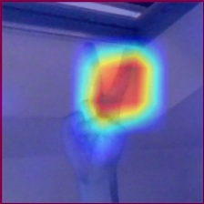
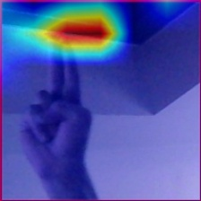
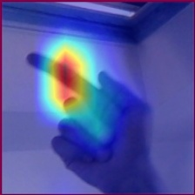
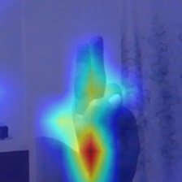
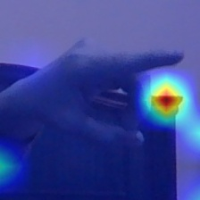
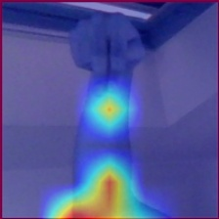
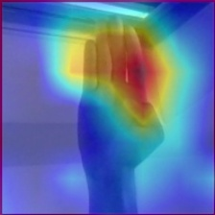
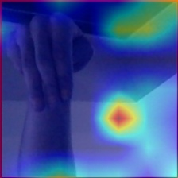
Ds1 – ResNet50

Slide 21
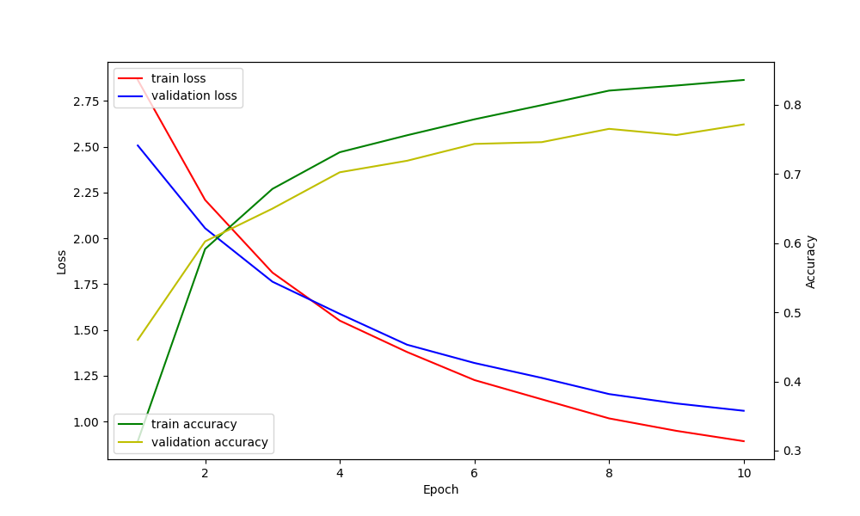
Ds1 – ResNet50

Slide 22
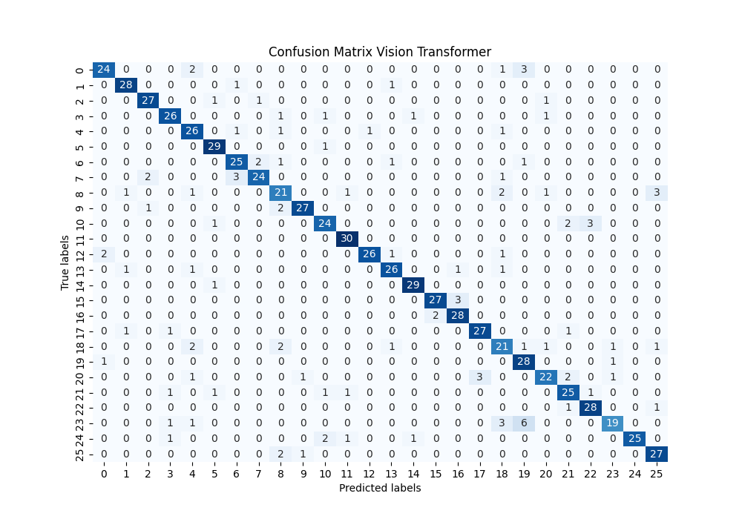
Ds1 – VisionTransformer
Learning rate: 0.0008; Batch size: 64; Epochs: 10

Slide 23
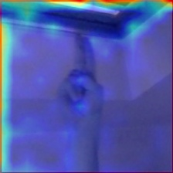
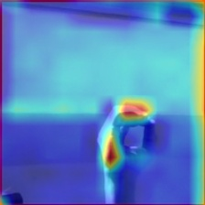
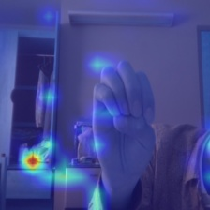
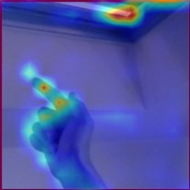
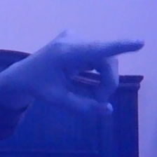
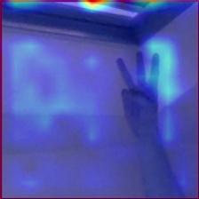
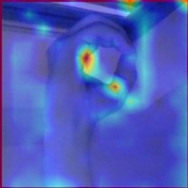
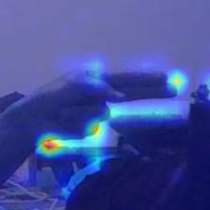
Ds1 – VisionTransformer

Slide 24
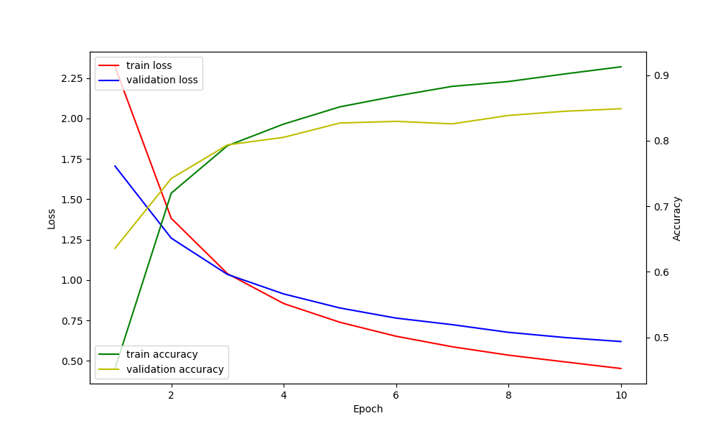
Ds1 – VisionTransformer

Slide 25
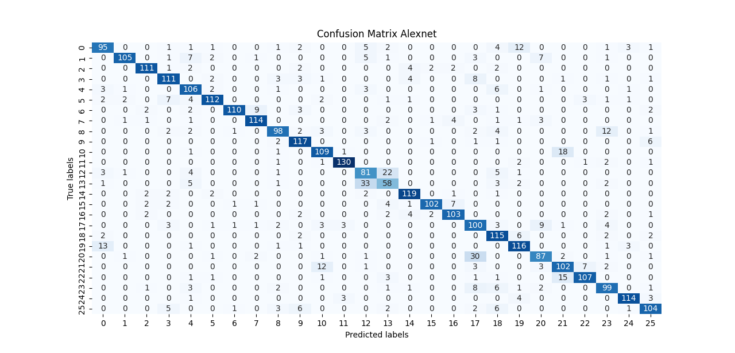
Ds2 – AlexNet
Batch size: 64, Drop out: 0.5, Learning rate: 0.0008, Epochs: 50 (early stopping)

Slide 26
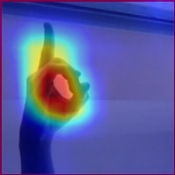
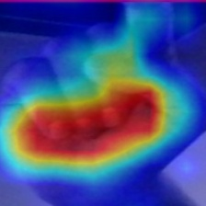
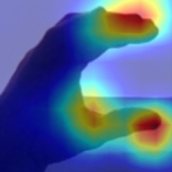
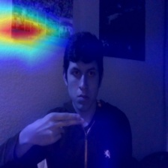
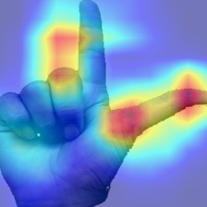
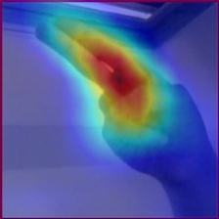
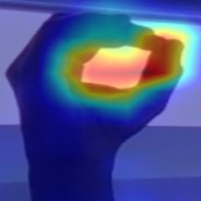
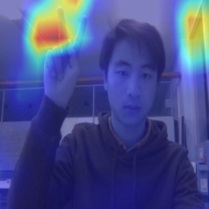
Ds2 – AlexNet

Slide 27
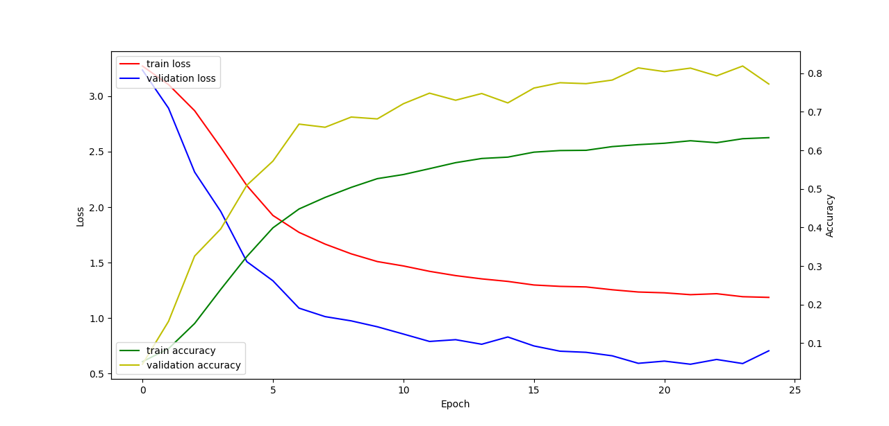
Ds2 – AlexNet

Slide 28
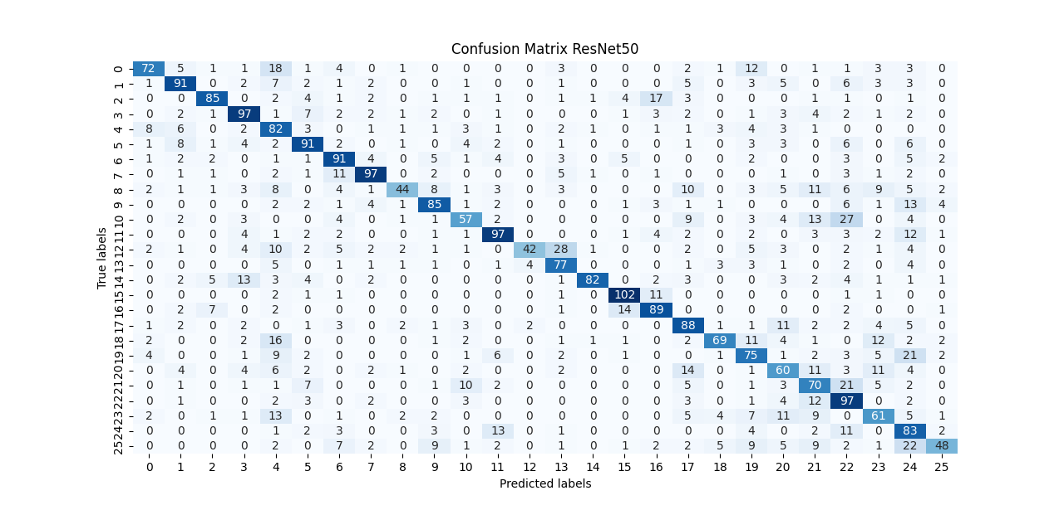
Ds2 – ResNet50
Batch size: 64, Drop out: 0.2, Learning rate: 0.001, Epochs: 50 (early stopping)

Slide 29
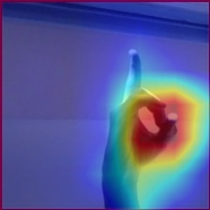
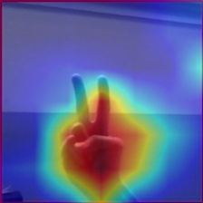
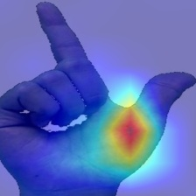
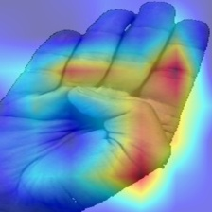
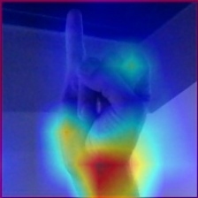
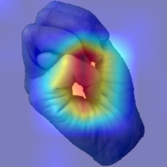
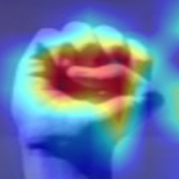

Ds2 – ResNet50

Slide 30

Ds2 – ResNet50

Slide 31

Ds2 – VisionTransformer
Batch size: 64, Drop out: 0.3, Learning rate: 0.0001, Epochs: 50

Slide 32








Ds2 – VisionTransformer

Slide 33

Ds2 – VisionTransformer

Slide 34
Conclusion

Slide 35
Conclusion
Best Models: Vision Transformer, AlexNet
Data Augmentation: More images and augmentation improve model performance
Early Stopping: Adjusting patience prevents overfitting and enhances generalization
Optimization: Dropout, weight decay, (learning rate scheduling) improve robustness

Slide 36
Outlook

Slide 37
Outlook
Fine-tuning Diffusion model
Optimize Prompt Engineering
Improve data quality
More experiments with hyperparameters

