Slide 1
Advanced Deep Learning Team Project
Fakultät 7
Anna Reiter, Chiara Perocco

Slide 2
OVERVIEW
Domain
Architecture of the system
Modules
Object Detector
Image Classifier
Article Agent
Article Assembler
Diffusion Model
Outlook

Slide 3
Domain

Slide 4
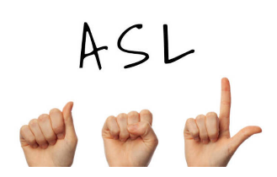
Domain
Domain: informative text about American Sign Language (ASL)
Article Structure:
Introduction
The letter in written language
The letter in sign language
Conclusion
Dataset: ASL(American Sign Language) Alphabet Dataset → consists of 29 classes (only 26 used)
Source: Kaggle (ASL(American Sign Language) Alphabet Dataset)
Each paragraph is followed by an image

Slide 5
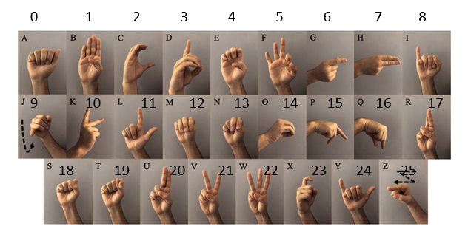
Domain

Slide 6
Architecture of the system

Slide 7
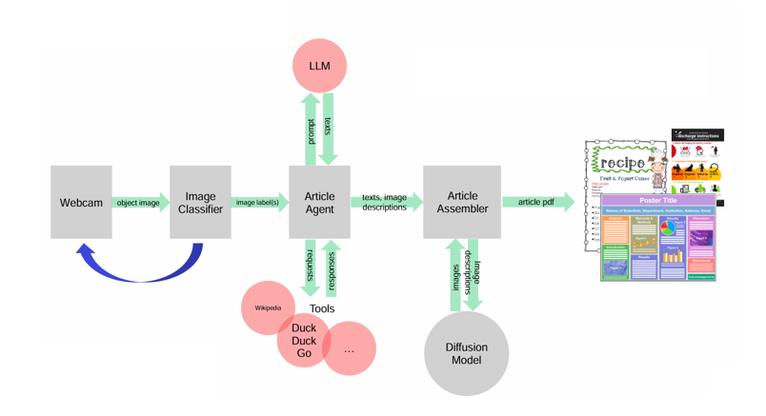
Architecture of the system

Slide 8
Modules

Slide 9
Object Detector

Slide 10
Object Detector
Laptop camera
Opencv-python
Takes a photo by triggering the „y“ (yes) on keyboard
Takes no photo by triggering the „n“ (no) on keyboard

Slide 11
Image Classifier

Slide 12
Image Classifier
AlexNet from scratch
VisionTransformer pretrained on ImageNet
ResNet50 pretrained on ImageNet

Slide 13
Image Classifier - AlexNet

Slide 14
Image Classifier - VisionTransformer

Slide 15
Image Classifier – ResNet50

Slide 16
Article Agent, Artcile Assembler, Diffusion Model

Slide 17
Article Agent, Artcile Assembler, Diffusion Model
Tools: Wikipedia, DuckDuckGo
used Markdown and Pandoc
HuggingFace Model: kakaobrain/karlo-v1-alpha

Slide 18
Outlook

Slide 19
Outlook

