Slide 1
Stochastic modeling of the transmission of respiratory syncytial virus (RSV) in the region of Valencia, Spain
Abraham J. Arenas, Gilberto González-Parra, Jose-A. Morano˜ c
Nicola Perotti, Chiara Rosati, Thomas Sirchi

Slide 2
INTRODUCTION 1/2
Respiratory Syncytial Virus (RSV) → spread through respiratory secretions
Two vaccines available
Syncytia are created thanks to the virus envelope proteins
RhoA has a role in syncytia formation
Off-season cases
Covid-19 → putative role in RSV diffusion
Increased age at infection
Downregulation of CD19

Slide 3
INTRODUCTION 2/2
15,000-20,000 cases in Spain
High costs for the Spanish public health system
THUS
Crucial role of mathematical models in studying diseases
Role of environmental factors and other diseases
Assess the role of external factors in RSV dynamics
Deterministic (Weber et al., 2001) and stochastic strategies

Slide 4
MODELS
Deterministic strategy
Balance between simplicity and power
Noise in real data
Stochastic strategy
Better to handle noisy data and complex system unpredictability
Demographic data show inherited variability
DETERMINISTIC MODEL
STOCHASTIC MODEL: perturbations on birth rate and transmission rate

Slide 5
Deterministic Model 1/3
SIRS model:
Susceptibles
Infected
Recovered
Assumptions:
Temporary immunity
Birth and death rates are equal → constant population
ν → recovery rate, γ → immunization rate
Function β(t) models the transmission rate

Slide 6

Deterministic Model 2/3
Model fitted to hospitalization data of children (<4 yo) of Valencia

Slide 7









Deterministic Model 3/3 - Parameters and Initial values
= 36.4
= 0.009
= 0.9988
= 0.38
= 36
= 0.0012
= 1.07
= 1.8
s = 0.38
= 0
Literature
Paper
Paper/Inferred by us

Slide 8


Stochastic models
Itô system
Wiener process
It’s a continuous time process where each increment is independent of the past values and follows a normal distribution N(0,dt)

Slide 9

System with perturbation on the birth rate

Slide 10

System with perturbation on the transmission rate (b₀)

Slide 11
Solve_ivp (ODE simulation)
Function within the scipy.integrate module;
Takes in input a function describing the ODE system, the time span, the initial values and a specified method of integration (RK45);
Runge-Kutta 45 is a method of fifth order in which the error is estimated using a fourth order method (looks like this function works in the opposite way with respect to the standard RK45);
Allows for an adaptive stepsize.

Slide 12
Euler Maruyama method (stochastic simulations)
Returns approximate solutions for a system of SDEs;
Lower order method than Milstein, but comparable results;
We decided to perform 10 simulations rounds for each SDE system.
Define N subintervals of length dt
Define the Wiener process dW
Update the system state (forward method) and time

Slide 13
RESULTS

Slide 14
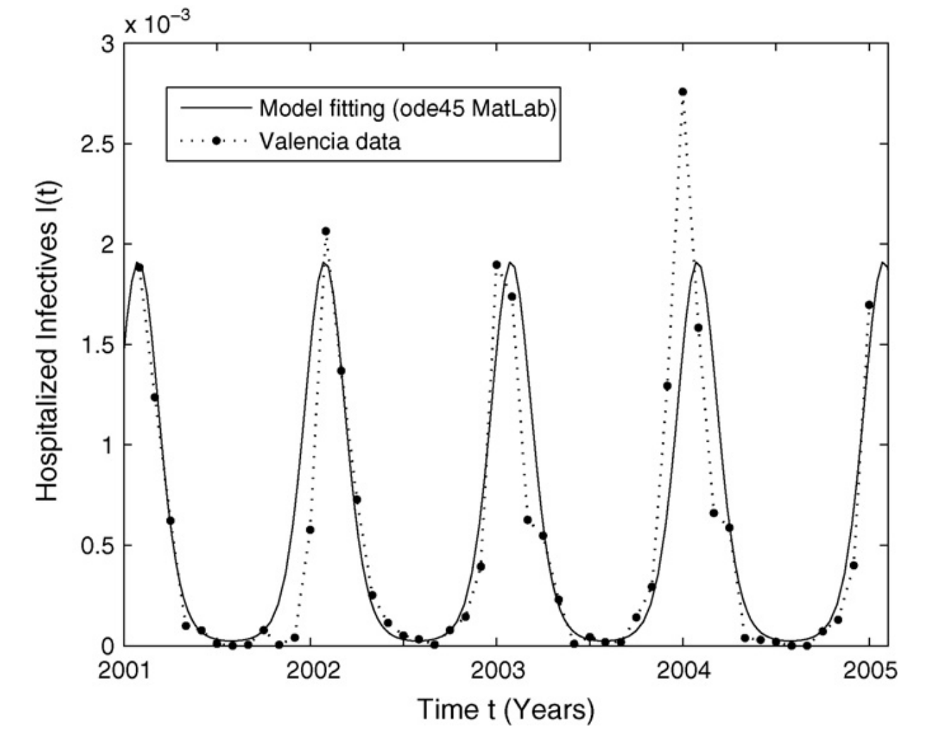
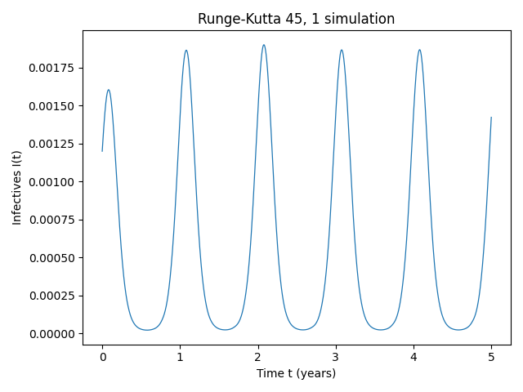
Deterministic Model

Slide 15
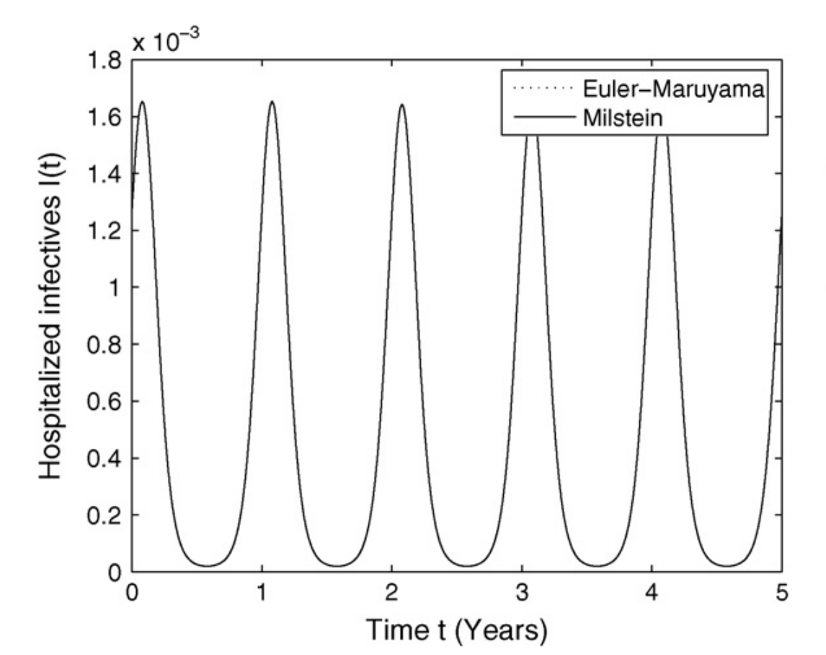
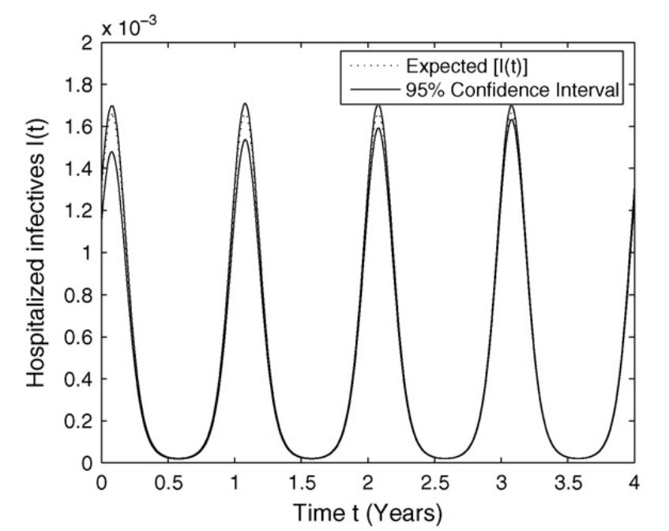
Stochastic Model with perturbation on the birth rate

Slide 16
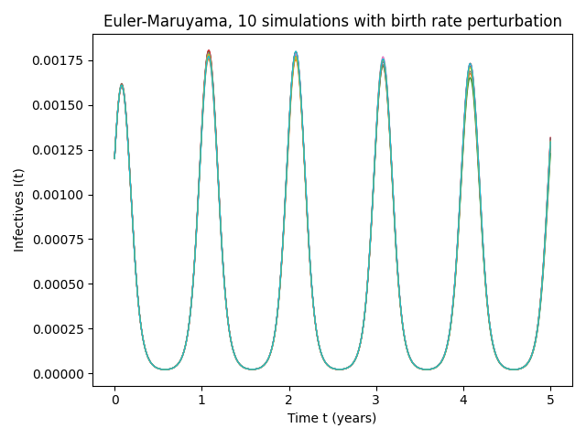
Our stochastic implementation for Infected I(t)

Slide 17
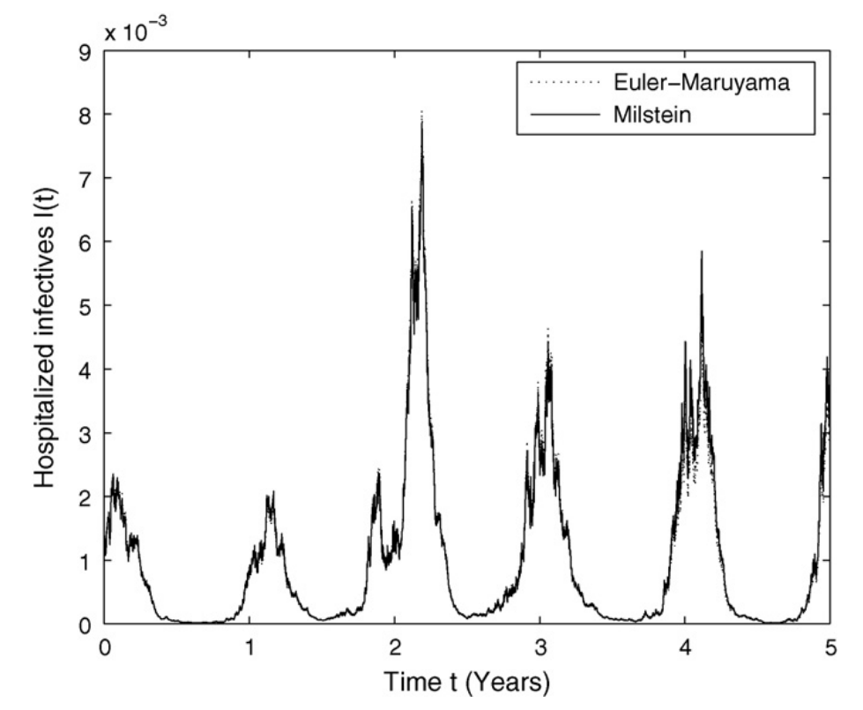
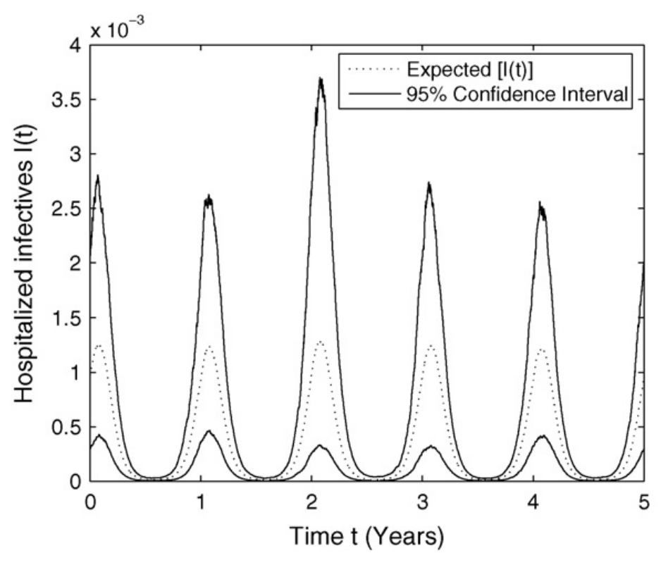
Stochastic Model with perturbation on the transmission rate

Slide 18
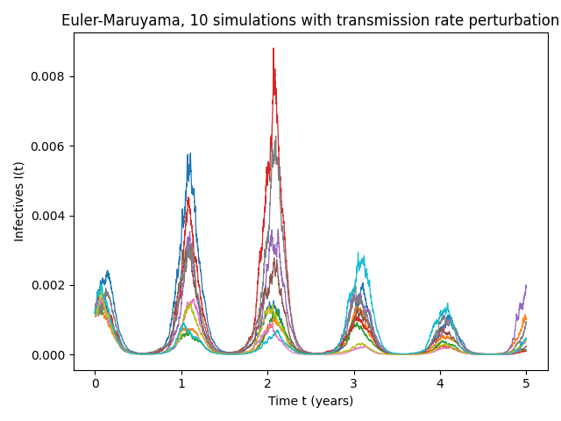
Our stochastic implementation for Infected I(t)

Slide 19
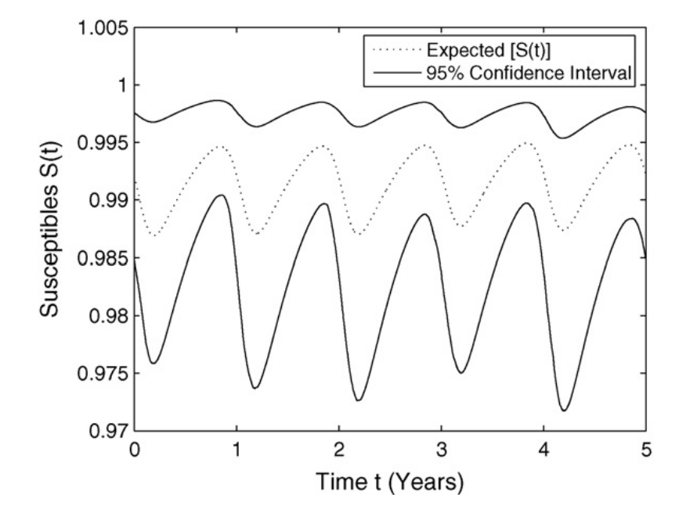
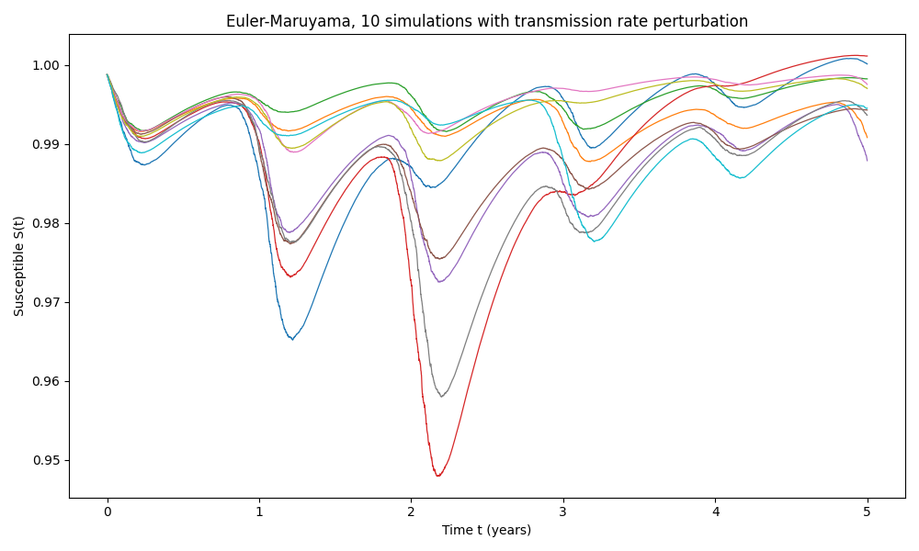
About the Susceptible S(t)

Slide 20
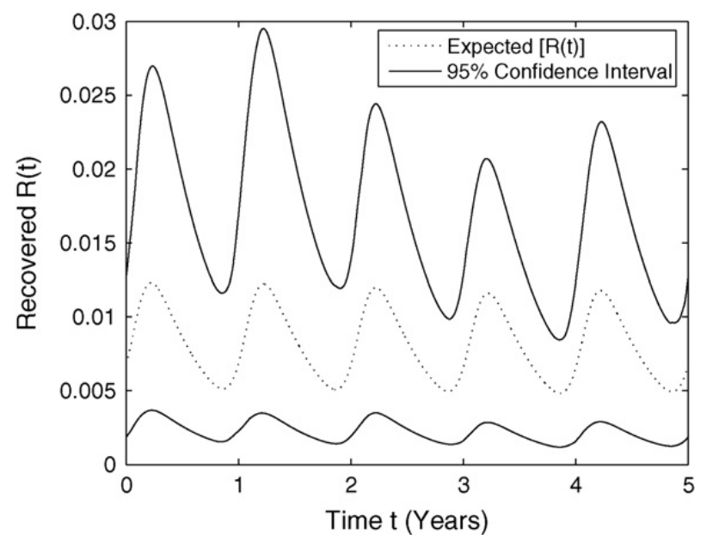
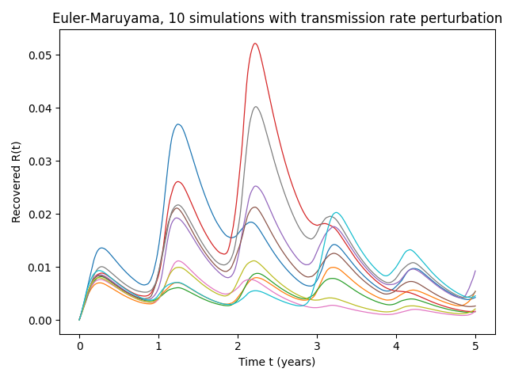
About the Recovered R(t)

Slide 21
About the Recovered R(t) and Susceptible S(t)
The variation in the R(t) and S(t) subpopulations increases with higher transmission rate perturbations.
This increase in variation occurs despite the absence of explicitly included noisy seasonally forced co-sinusoidal functions in the SDEs governing the variables.
Introducing a noise term in the equations reveals the fundamental oscillatory nature of these subpopulations.

Slide 22
CONCLUSIONS

Slide 23
Deterministic vs. Stochastic Approaches
Serve different purposes in understanding biological systems through mathematical models.
Stochastic models better capture intrinsic variability and environmental factors
Deterministic models may be suitable when the environment has minimal impact on simulations.
Parameters in Stochastic Simulation
Value of α provided only for perturbation on the birth rate, missing for perturbation on the transmission rate.
Hypothesizes that α represents a fraction defining fluctuations above and below the reference parameter value.
Other parameters had to be implemented from literature

Slide 24
Perturbation Ranges
Authors experimented with perturbation ranges without explaining the rationale behind these values.
Small perturbations of transmission led to a significant change in the populations
Recommends a sensitivity analysis to better understand the role of perturbations for effective healthcare policy decisions.
Importance of Transmission Rate Perturbations in SIR
Transmission rate highly sensitive to perturbations.
Notes the influence of global movement and changing meteorological conditions on diseases spread, emphasizing the significance of modeling studies.

Slide 25
Thank you for your attention!

