Slide 1

ARTICLE PROPOSED
CHIARA SAVOLDI 5014502
“AN ALGORITHM FOR IMPROVING THE QUALITY OF COMPACTED JPEG IMAGE BY MINIMIZES THE BLOCKING ARTIFACTS”

Slide 2
What is the purpose of the article?
Nowadays, we need efficient ways for storing large amounts of data. The amount of space required for storing images can be large in terms of cost;
Several methods for image compression are available today;
The purpose of this work is to study some techniques for the reduction of images distortions;
The JPEG is an example of image compression standard, which is preferable over other standards because of its low complexity, efficient utilization of memory and reasonable coding efficiency.

Slide 3
KEYWORDS & SUMMARIES OF THEORY
Image processing
Compression
JPEG and DCT
Blocking artifacts

Slide 4
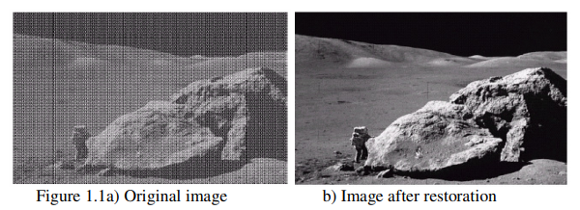
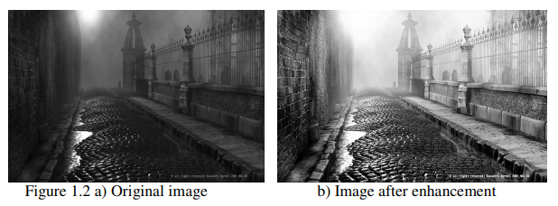
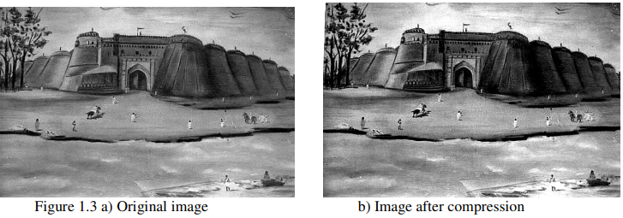
Image processing operations
Image Restoration takes a corrupted image and attempts to recreate a clean original;
Image Enhancement alters an image to makes its meaning clearer to human observers. It allows the observer to see details in images that may not be immediately observable in the original image;
Image Compression is the process that helps to represent image data with as few bits as possible through exploiting redundancies in the data.
LET’S FOCUS ON IMAGE COMPRESSION.

Slide 5
COMPRESSION
Compression is the process of transforming the data description into a more succinct and condensed form. Thus improves the storage efficiency, communication speed, and security.
A common characteristic of images is that the neighboring pixels are correlated and contain redundant information.
Three types of redundancy can be identified:
Coding Redundancy: If the gray levels of an image are coded in a way that uses more code symbols than absolutely necessary to represent each gray level.
Interpixel Redundancy: the value of any given pixel can be reasonably predicted from the value of its neighbours.
Psychvisual Redundancy: It is associated with real or quantifiable visual information. Since the reduction of psychovisual redundancy results in quantitative loss of information, this type of reduction is referred to as quantisation.

Slide 6
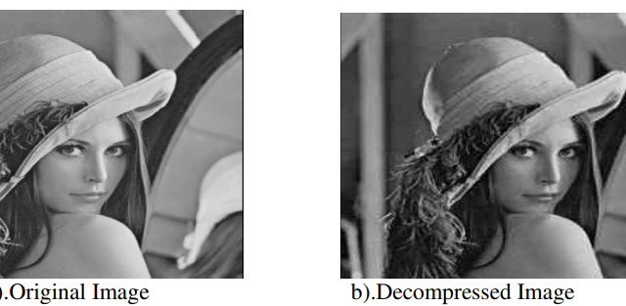
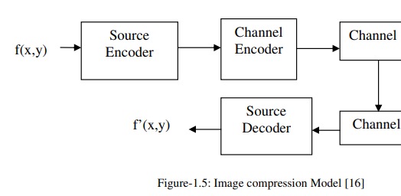
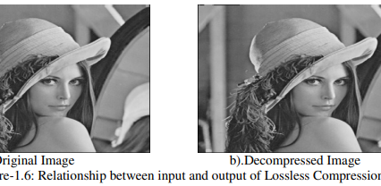
COMRPESSION MODEL AND TECHNIQUES
A compression system consists of two distinct blocks: an encoder, where an input image f(x,y) is fed and the decoder where the output image f’(x,y) is generated.
There are two different ways to compress :
IMAGES-LOSSLESS
The restored data file is identical to the original explained;
Loss of information is unacceptable;
LOSSY COMPRESSION
Decompressed image is as close to the original as we wish;
It’s based on the concept that all real world measurements inherently contain a certain amount of noise;
It’s a reversible technique.
It’s irreversible.

Slide 7
JPEG AND DCT
JPEG is an image compression mechanism designed for compressing full-color or gray-scale images of natural, real-world scenes;
The JPEG standard defines basic compression method based on the use of the discrete cosine transform (DCT-Discrete Cosine Transform) with "lossy type compression“;
JPEG has become the practical standard for storing realistic still images using lossy compression.JPEG ;
The usage of JPEG (DCT) compression method is motivated because of the compression ratio and it exploits known limitations of the human eye;
The DCT can be used to convert the signal (spatial information) into numeric data so that the image’s information exists in a quantitative form that can be manipulated for compression. Image is divided into a blocks of 8x8, DCT is applied on each block →Quantization

Slide 8
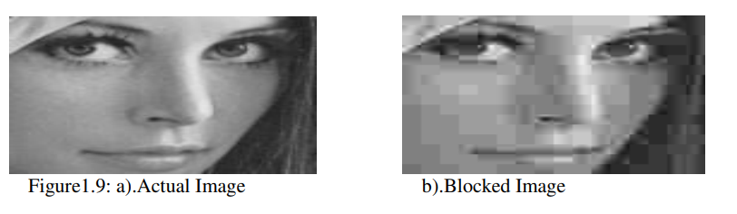
BLOCKING ARTIFACTS
It is observable how, as the level of compression increases, artifacts appear more and more evident from a visual point of view. Among these, the most typical for the JPEG format and for all formats based on the DCT, is the grid, or "blocking";
These artifacts appear as a regular pattern of visible block boundaries. This degradation is a direct result of the coarse quantization of the coefficients and the independent processing of the blocks which does not consider the existing correlations among adjacent block pixels;
The deblocking algorithm that I will present has been successful in reducing blocky artifacts in an image and therefore increases the subjective as well as objective quality of the reconstructed image.

Slide 9
Algorithm for the reduction of blocking artifacts in JPEG
The algorithm tried to fulfill the following criteria’s too :
Reduce the extent of blocking artifacts ;
Make efficient utilization of resources ;
Preserves the edges;
Do not result in other type of artifacts.

Slide 10
Design and Implementation This algorithm is implemented in MatLab 7.There are mainly three segments.
Segment-1
As difference exists between each block, an attempt is made (spatially) to smooth out this difference.
There are many smoothing filters that can easily smoothes the difference, but it results in blurring (which is another artifact).
Due to low quality, edges are quite visible in the image (blocked). Smoothening is done by gradually decreasing the difference between the block edges. The point is also considered that the blocking artifact should not move inside the block, that’s why neighboring pixels are also manipulated, to reduce the difference.
The key idea behind smoothing the blocked image is to reduce the extent of blockiness without blurring the image.
The algorithm used in this segment is described:
Input: Preprocessed Image
Output: Uniformly deblocked Image

Slide 11
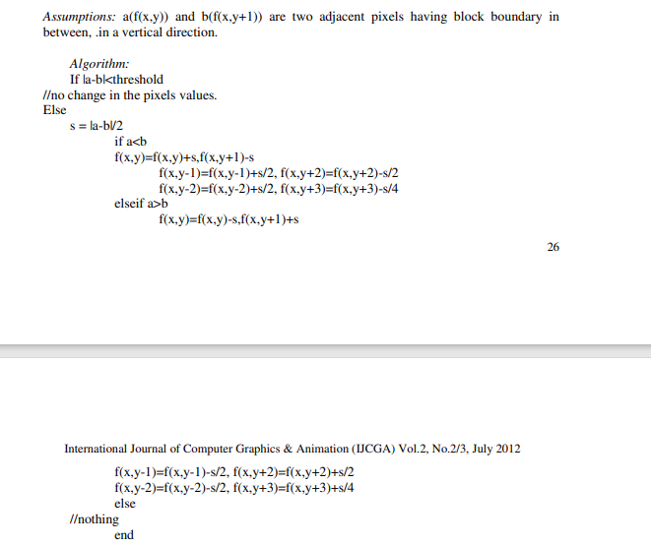

Slide 12
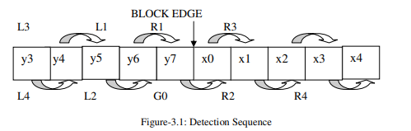
SEGMENT-2 In the previous segment, blocking artifacts are dealt in a uniform manner. In this segment, the blocked edges are first detected and then deblocked by using Gaussian formula. Here detection and deblocking are interlinked.
Input: Eight rows of ten pixels having the edge in the center, which is being detected against blockiness.
Output: Deblocked Edge
Algorithm: 1. Initialize counter = 0. 2. Considering first row. 3. Assign G0= |x0-y7| //difference between two boundary pixels. 4. Assign the difference between each pair of adjacent pixels on left and right-hand side of the block boundary are also calculated and denoted by Li and Ri (i=1,2,3,4) respectively.
Using a Gaussian aims to reduce the level of noise in the image.

Slide 13
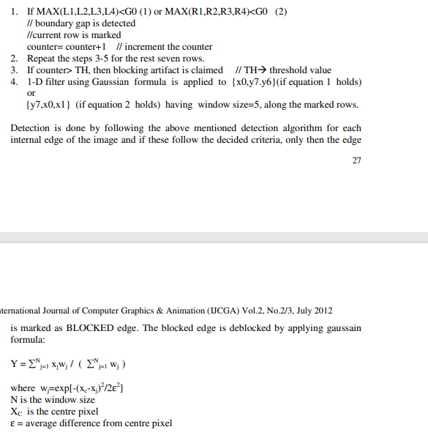

Slide 14
PSNR is a logarithmic scale of the mean squared difference between two sets of values, and it’s defined as:
PSNR = 20 log10 (255/√MSE)
Where MSE = ∑ (Bi − Ai)/n
where i = 0 to n and n is the number of pixels in the image.
This blockiness measure is a gauge of how different the corresponding pixel values are between two images.
Because a blocky image is different from the original, PSNR is an acceptable measure, and hence the primary measure used to compare the proposed method.
However, two images with completely different levels of perceived blockiness may have almost identical PSNR values.
Segment-3

Slide 15
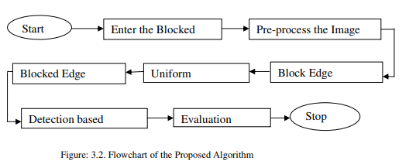

Slide 16
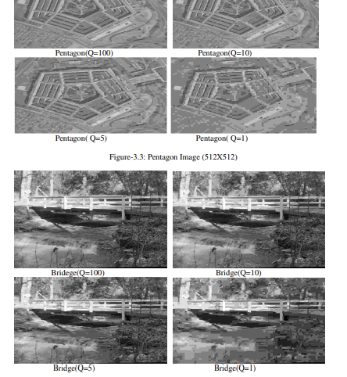
Seven images have been selected for checking the validation of the proposed algorithm. All are 512X512 .jpg images at different quality factors. Image quality is not a single factor but is a composite of at least five factors: contrast, blur, noise, artifacts, and distortion.

Slide 17
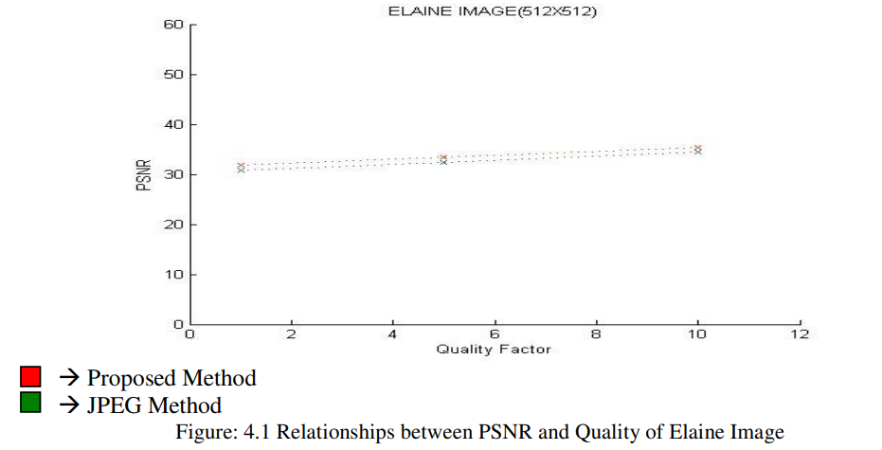
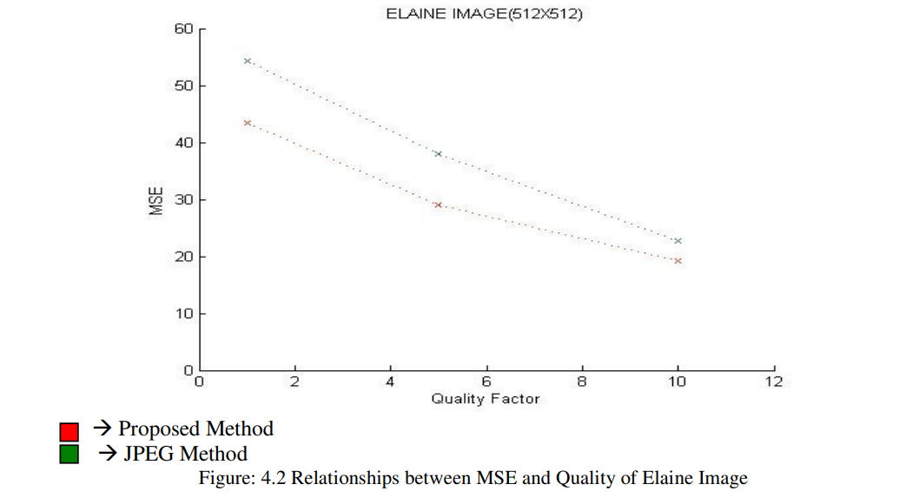
The graph shows the relationship between PSNR and an Image using JPEG Method (green) and Proposed Method (red). From the plot we can see that there is increase in PSNR value of image with the use of proposed method .
It is clear from the plot that there is decrease in MSE value of image with the use of proposed method over the JPEG method. This decrease represents improvement in the objective quality of the image.

Slide 18
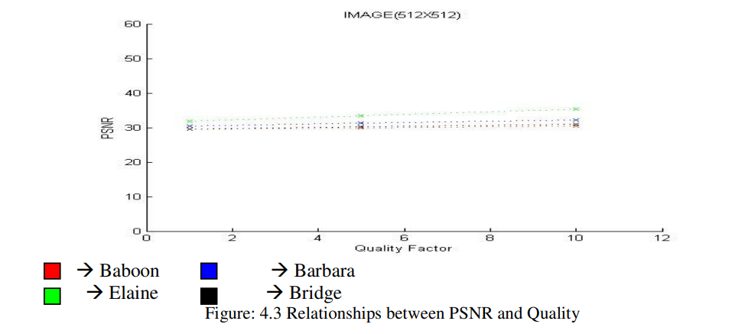
THIRD PLOT
The top-most line (green) representing on of the images, shows the relationship between quality and PSNR value of image obtained by the proposed method , in consent with the fact that PSNR value increases with increase in the quality of image.

Slide 19
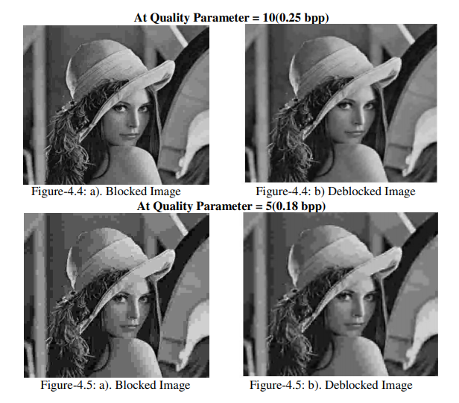
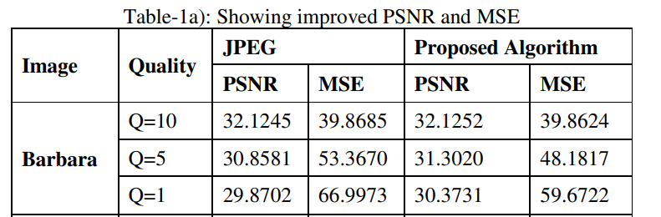
The figure above shows the improvement in deblocked image after application of proposed algorithm.
The algorithm increases the subjective quality of the image.
The table below shows the PSNR and MSE values for test images using JPEG and Proposed Method.
It is clear that algorithm increases the PSNR and decreases the MSE value for quality parameter (Q =10, 5, 1).

Slide 20

The artifacts are removed to some extent as it has quality of the images.
The algorithm also increases the PSNR value of the image. As shown, the blocking artifacts are not removed totally: it is because the information lost in the different steps is irrecoverable.
The algorithm only deals with pixel values (spatial domain) and tries to manipulate the pixel values.
The extent of blocking artifacts can also be reduced by manipulating the DCT coefficients, as quantization is applied on the DCT coefficients.
CONCLUSION

Slide 21

Thank you for your attention!

