Slide 1
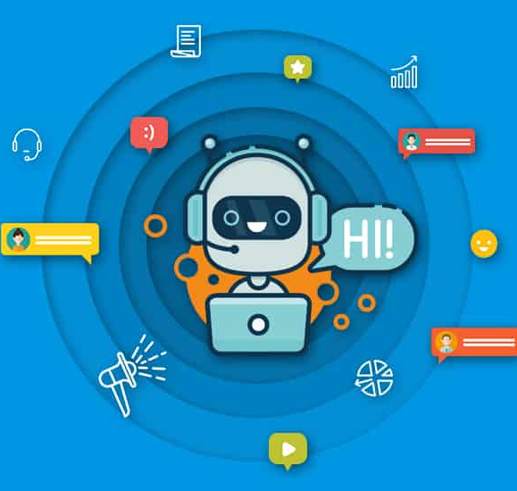

PROJECT PROPOSAL
CHIARA SAVOLDI 5014502
MY FIRST CHATBOT

Slide 2
INTRODUCTION
My project is related to the creation of a Chatbot, which is a software designed for interacting with humans in voice or text-based conversation.
Since one of my passions, which I am not able to “practise” in this period concerns travel, I decided to create a Bot, able to help tourists in a big city like Paris or London, competent to suggest the best places to eat, the sites of interest or some information about public transport.
The bot can answer general questions starting from “ How are you”, up to telling a joke.
The name I chose is “InfoTour”, where “info” stands for information, “tour” stands for tour around the city.

Slide 3
LIST OF LIBRARIES
From chatterbot import ChatBot
From flask import Flask, render_template, request
From chatterbot.trainers import ListTrainer, ChatterBotCorpusTrainer
Import os

Slide 4
Python Os module allows us to interact with the operating system in several ways;
ChatterBot is a library that easy provide automated responses to user’s input. I create an instance of the class Chatbot for defining my Bot;
Flask is a framework for creating web applications;
ChatterBot Corpus Trainer allows the ChatBot to be trained using data from the ChatterBot dialog corpus and will give more conversation to the Bot;
List trainer allows the ChatBot to be trained using a list of strings, which represents a possible conversation between the Bot and every user;

Slide 5
PYTHON CODE
I divided my project into four Python scripts:
INITIALIZE_INTERFACE.PY
INITIALIZE_CHATBOT.PY
CONVERSATION.PY
APP.PY

Slide 6
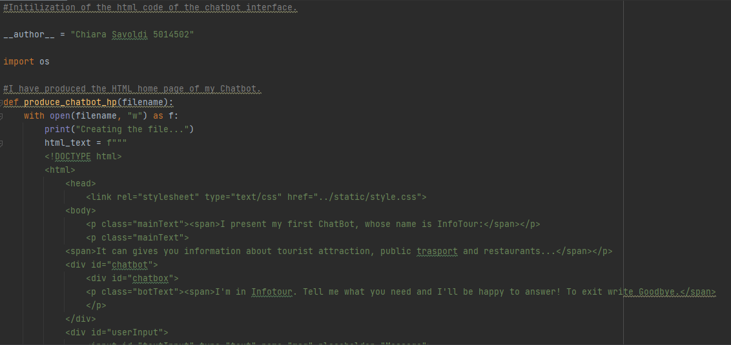
INITIALIZE_INTERFACE.PY

Slide 7
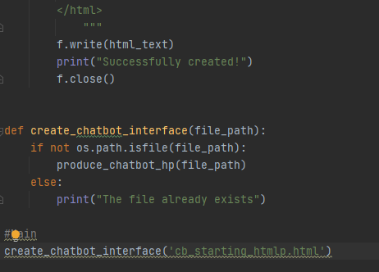
INITIALIZE_INTERFACE.PY

Slide 8
..\SavoldiChiara5014502_Project\Chatterbot\initialize_interface.py Let’s see my code.
I defined the function produce_chatbot_hp, which receives in input the name of a file. Its purpose is to create an HTML file that opens my Bot’s introduction webpage.
My idea is to provide a short presentation of the Bot and a space to implement a short chat with “him” ;
The second function create_chatbot_interface check whether at the specified path is an existing regular file or not: if yes, it prints the message 'The file already exists', otherwise it creates the HTML file.

Slide 9
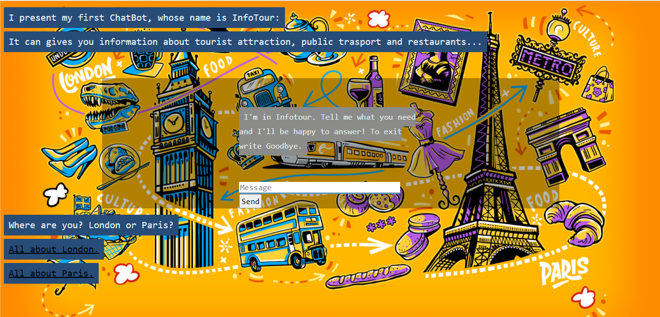

Slide 10
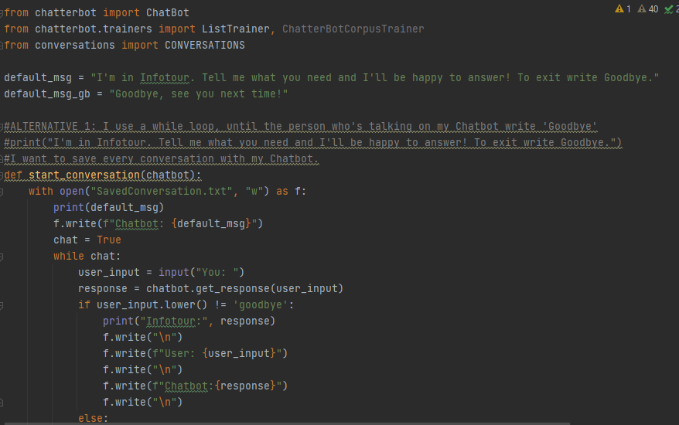
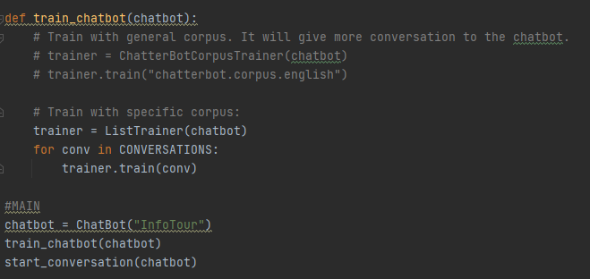

INITIALIZE_CHATBOT.PY

Slide 11
..\SavoldiChiara5014502_Project\Chatterbot\initialize_chatbot.py
I created the start_conversation (chatbot) function. I settled a default message from my Chatbot, to be printed every time the function is called.
It creates and opens the 'SavedConversation' file, which will save every conversation between users and chatbot.
If the user does not write 'Goodbye' he will be able to continue talking to the bot.
The second function, train_chatbot (chatbot), trains the Chatbot using a conversation “one query, one answer”.
I also write some lines of code to train the Bot with general corpus. It will give more conversation to the Bot. Each corpus is just a sample of various input statements and their responses for the bot to train itself with.

Slide 12
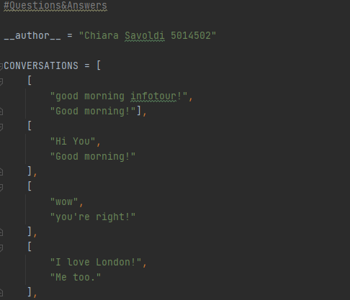
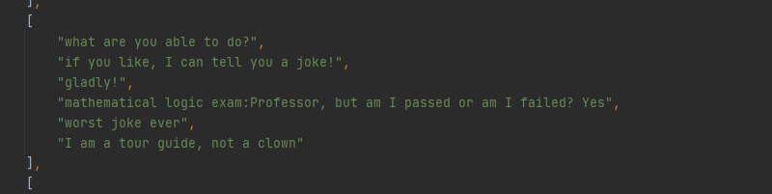
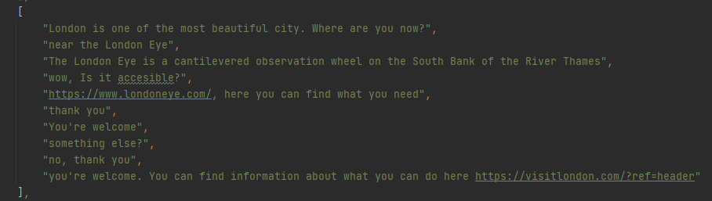
It includes a list of lists, each containing the possible user input and the response that the Bot should give.
CONVERSATION.PY

Slide 13
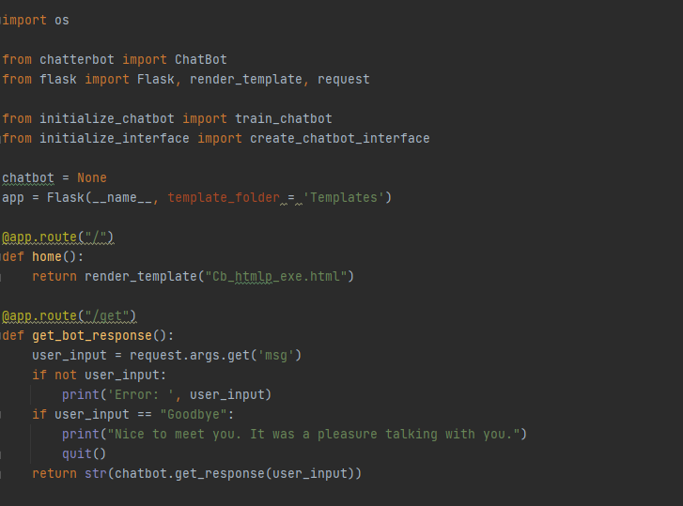
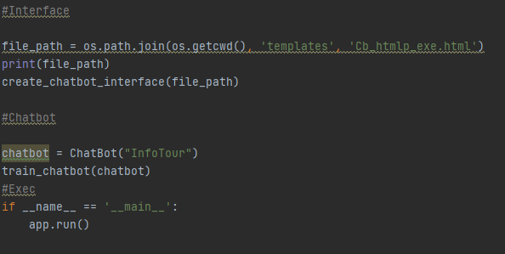
APP.PY

Slide 14
I defined the application to allow a conversation with the Bot from my web page;
I proposed the initial presentation web page to which I added some lines of Javascript and Css code.
I defined my bot, the render_template function, which takes the name of my HTML page as a parameter and automatically sends it to the browser. Finally, the get_bot_response () function which, if the request is successful, applies the usual get_response () function of the Chatterbot library to the Chatbot, to receive a response after a user input from the web page.
..\SavoldiChiara5014502_Project\Chatterbot\app.py

Slide 15
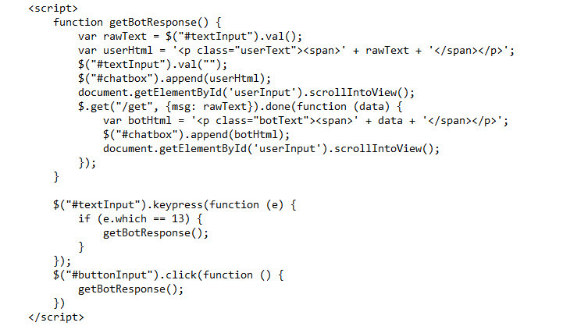
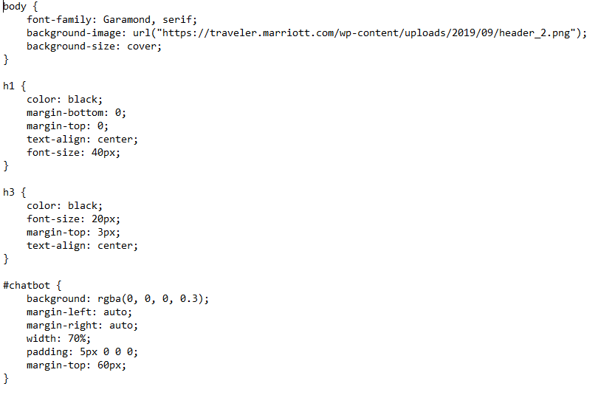
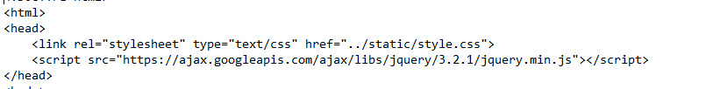
The link that calls the file.css is <link rel = "stylesheet" type = "text / css" href = "file.css">
The javascript code is insert directly in the "body" section of the html code of the page, enclosed in these tags: <script> code </script>

Slide 16

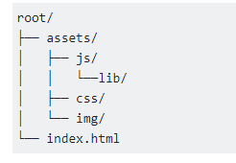
ANALYSE JAVASCRIPT
function getBotResponse(): I defined the function getBotResponse which does not receive any parameter;
var rawText = $("#textInput").val(); → Return the value attribute of the element with ID = #textInput;
I clean the box to not make the person delete the text to send another message;
$(selector).append(content, function(index,html)), where content specifies the content to insert. One of the possible values are HTML elements, while function(index,html), which is optional, specifies a function that returns the content to insert;
document.getElementById('userInput').scrollIntoView(); → are a useful way to quickly access a specific item, so the element on which scrollIntoView () is called is visible to the user;
$.get("/get", {msg: rawText}).done(function (data) {}→ The done is like you are saying ‘if the get goes alright do the function function(data);
The keypress() method triggers the keypress event or attaches a function to run when a keypress event occurs. The onclick event occurs when the user clicks on an element and runs a specified line of code when you click a HTML object that has the onclick attribute. I catch the enter from the keyboard and the pressing of the botton.

Slide 17

ANALYSE CSS
I first added a background image to my webpage and defined its size which must cover all the web page.
The class attribute is used to point to a class name in a style sheet, to my css file. I also used in my JavaScript to access and manipulate elements with the specific class name. For example, we have two <div> elements with a class attribute with the value of "chatbox". All of the two <div> elements will be styled equally according to the .chatbot style definition in the css file.

Slide 18
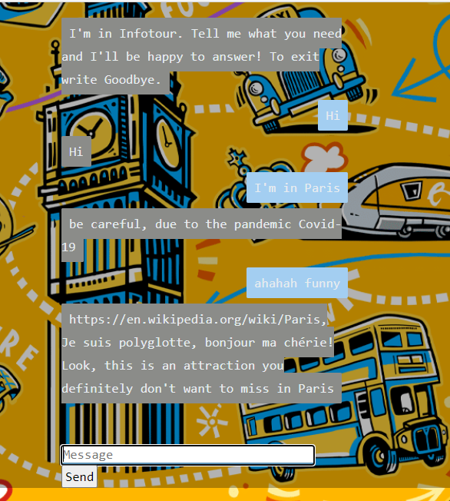
LET’S TALK WITH «INFOTOUR!»

Slide 19

Thank you for your attention!

