Slide 1

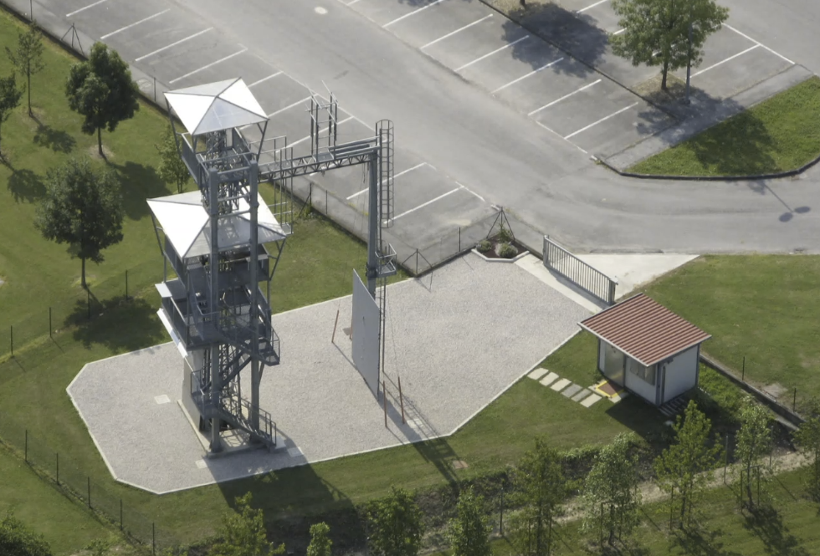
Progetto SOSTA (System for Observation, Storage and Testing Analysis)
Centro Studi Materiali e Tecniche
for
Aaaa
Bbbb
Cccc
dddd

Slide 2
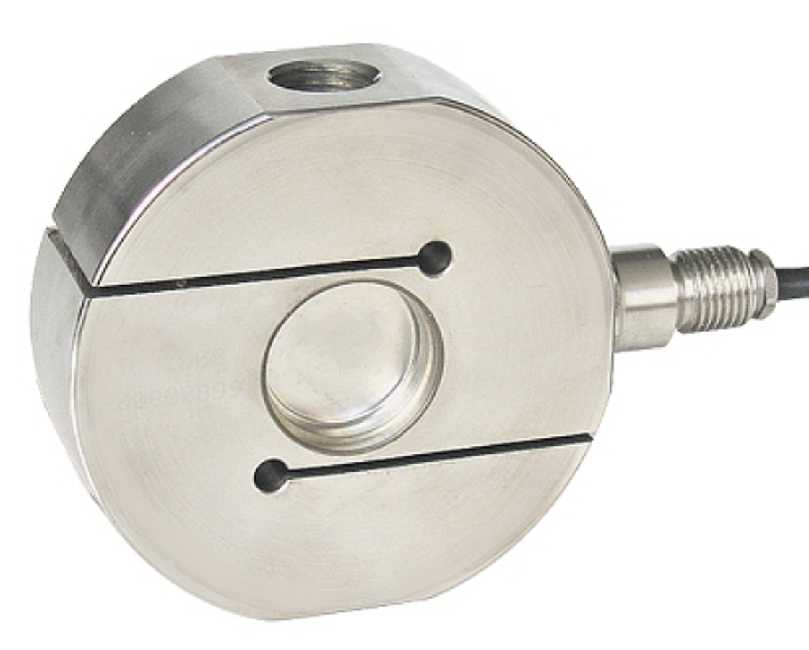
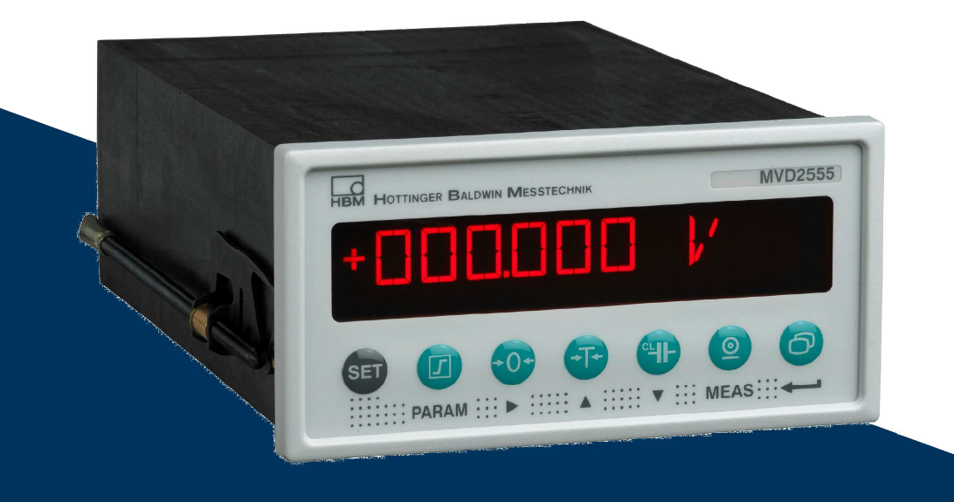

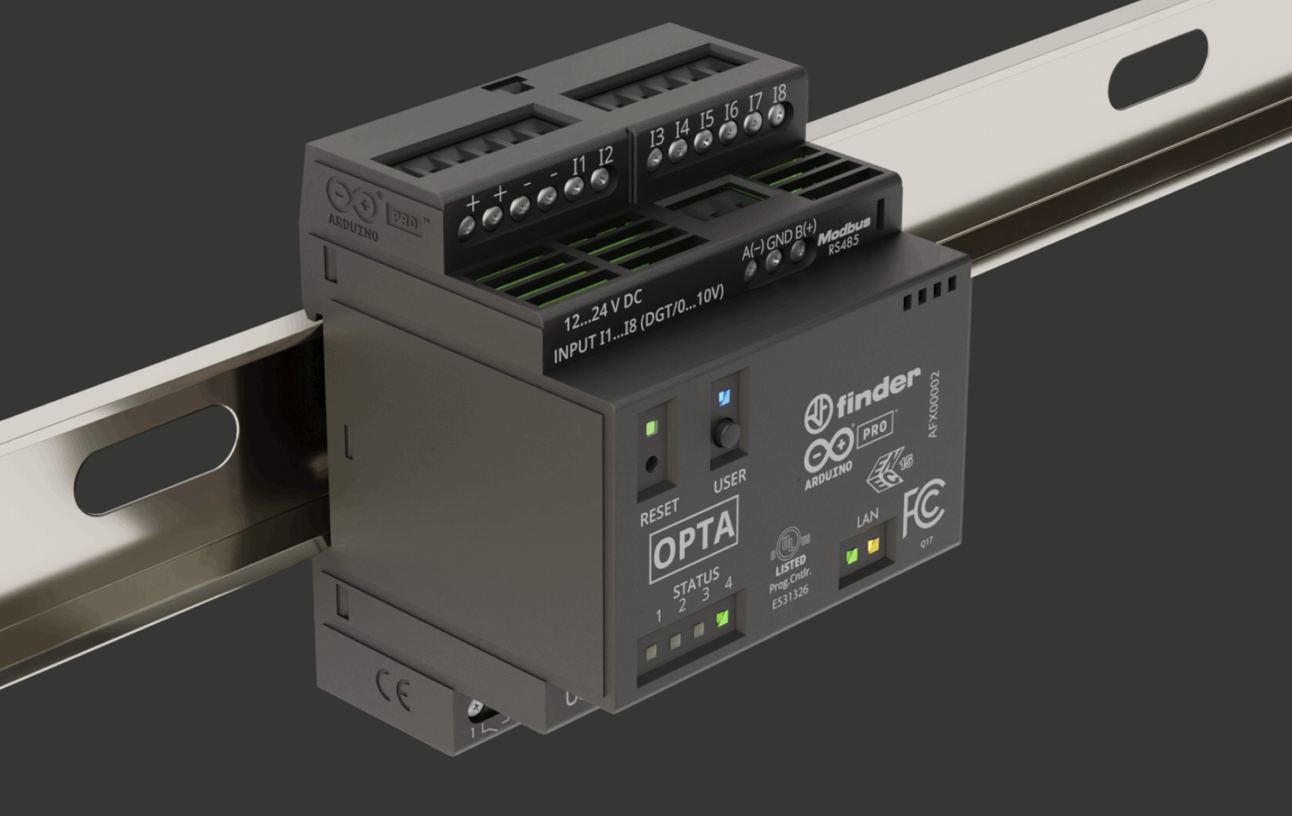
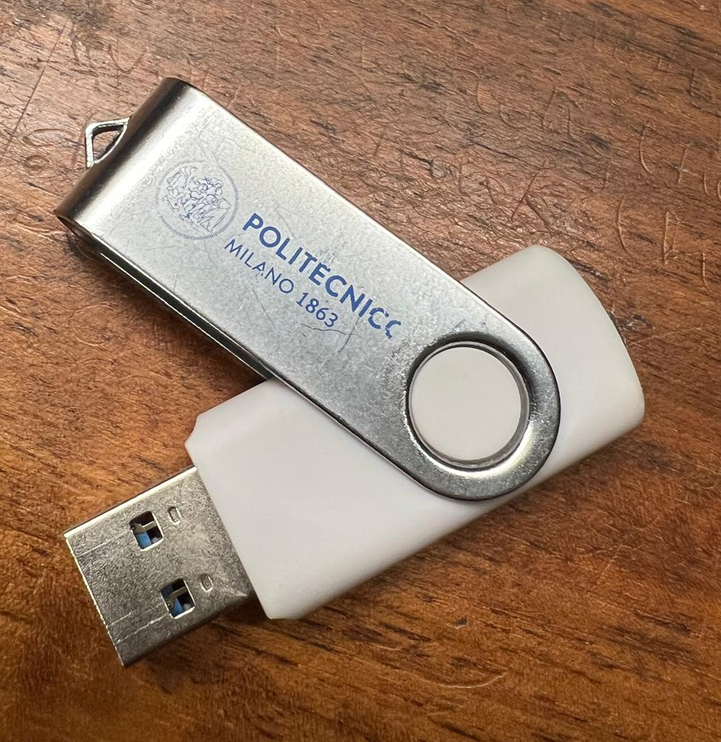

Architecture solution
LAUMAS CTL500
ARDUINO OPTA

Slide 3
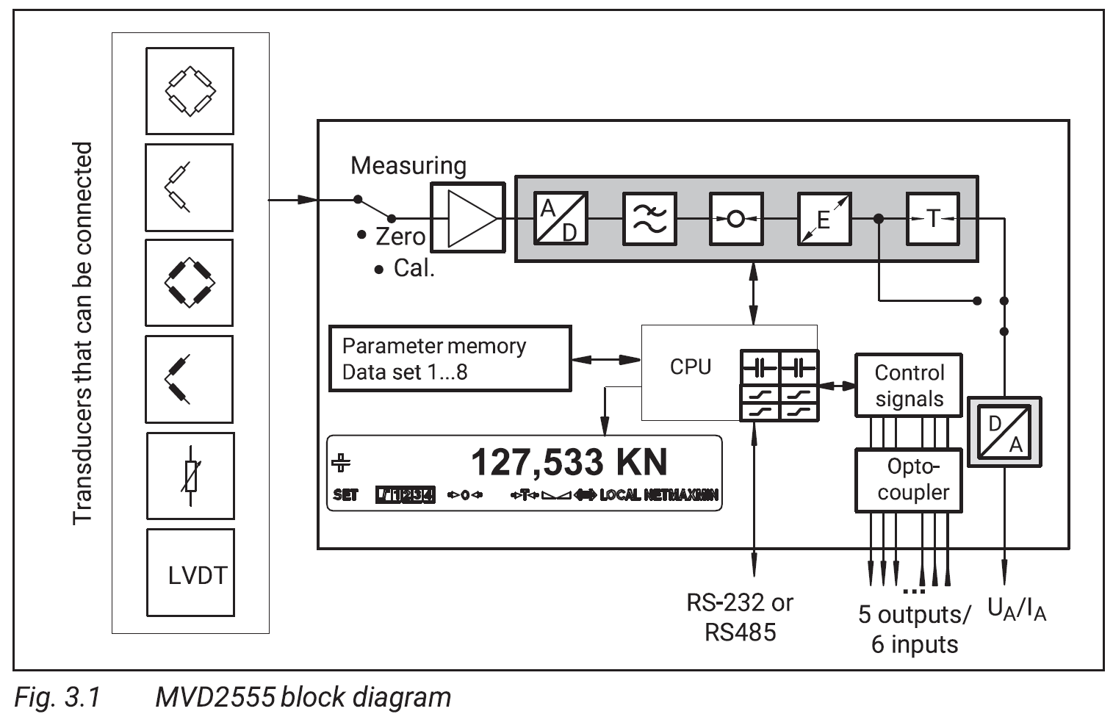
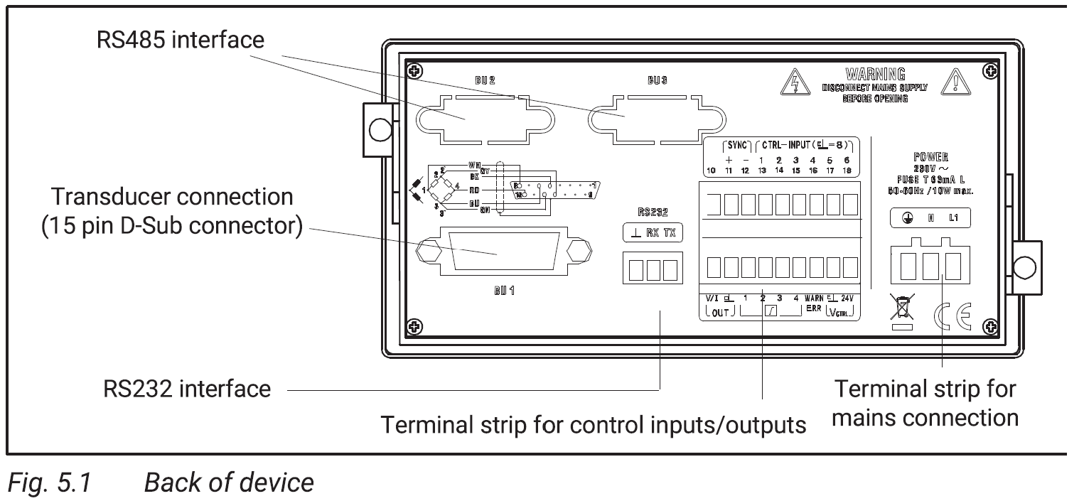
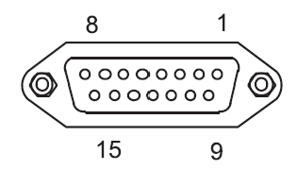

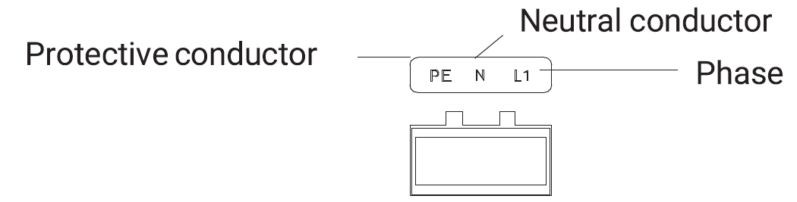
MVD2555
Collegamento Cella → MVD
1 cavo→ 6 fili
Non usiamo
Alimentazione
Collegamento MVD → OPTA
(next slide)

Slide 4
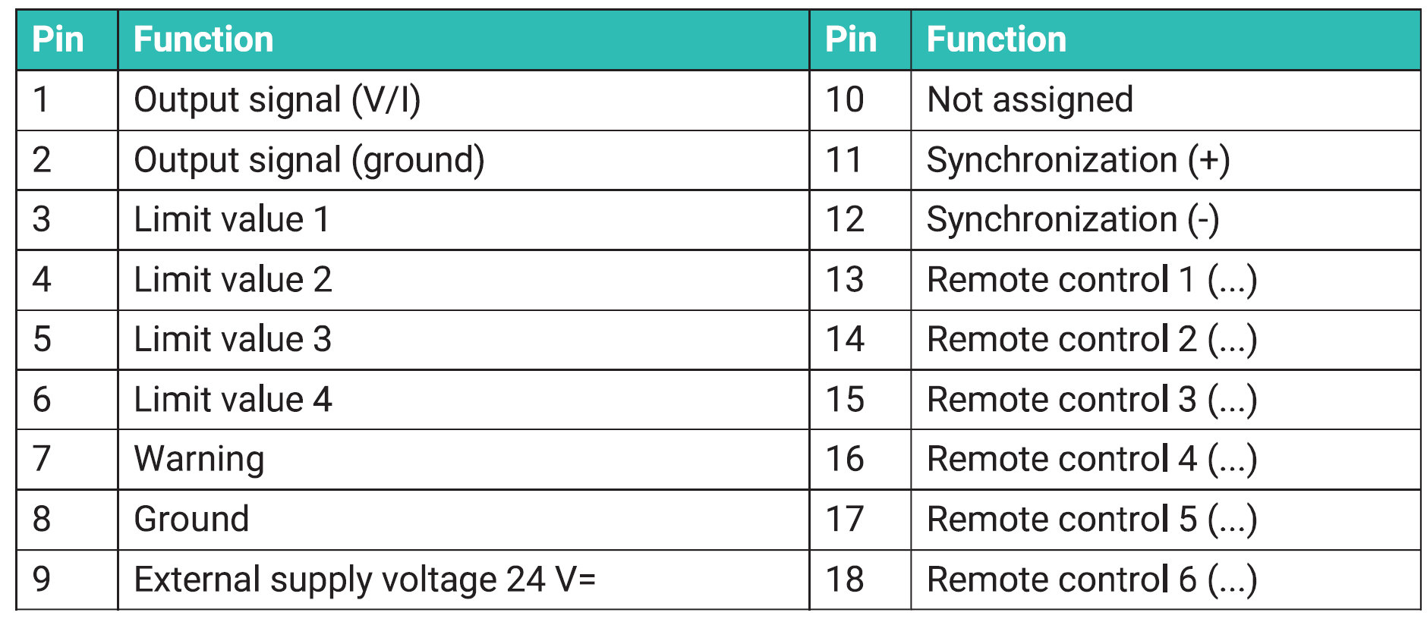
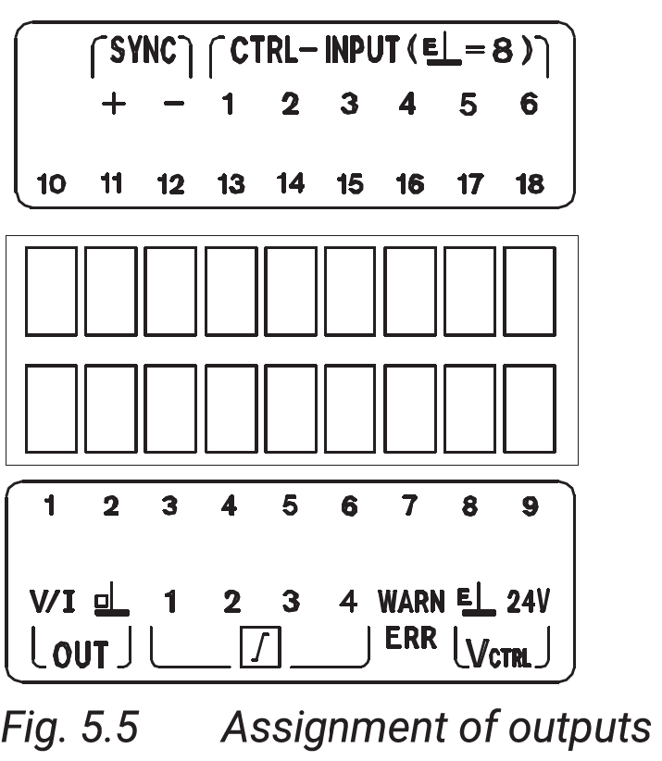
MVD → OPTA
INPUT
13 =
14 =
15 =
16 =
17 =
18 =
1
OUTPUT
3 =
4 =
5 =
6 =
7 =
1 = OUT (0–10 V o 4–20 mA) → Opta AI 2 = GND → Opta GND

Slide 5
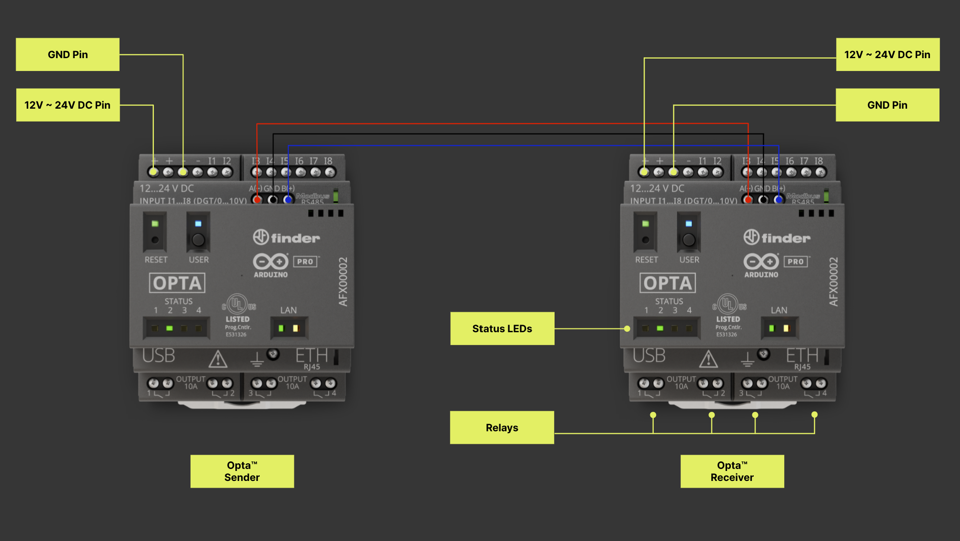

Slide 6
Thank you for your attention

