Slide 1


Explore What’s Possible.
Advisor
Azure
Revenue
IoT
Innovate
Datacenter
Applications
Transform
Analytics
Modernize
Business
Cloud

Slide 2

DevOps & Containers Workshop …”Innovating ahead of the curve”
Presented by
Justin the Great -

Slide 3
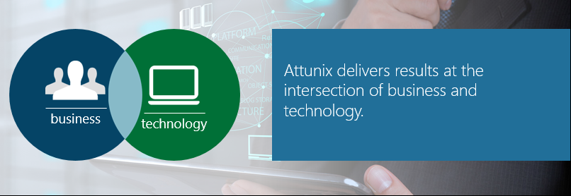
The Attunix Difference
We take a business-first approach to your cloud journey, helping you transform and differentiate your business.
Directly map to your business goals
Accentuate what makes you unique
Gold Certified Microsoft Cloud Provider
Microsoft Partner of The Year - West

Slide 4






Attunix Solutions
Attunix provides technology advising and systems integration to help you get more from your operations with core services that bring your vision to life, including:
Modern Datacenter
Application Modernization
Advanced Analytics
Internet of Things
Managed Services
Apps & Infrastructure
Data & AI
Notes:
At Attunix we break down our offerings into 5 key areas.
10 years ago we started off doing App Modernization on Azure, which lead to Development, Machine Learning and IOT. We then added Advanced Analytics, EDW, Big Data and SQL migrations to our practice.
More recently we added Modern Data Center to our portfolio of offerings. The point here is that we cover a lot of ground – Traditionally partners would be brought in for a specific workload, BUT what if your customer wants a front and PaaS solution which connects to a backend IaaS solution and you need to incorporate security along the way? Which partner do you bring in for that? This is why Radian chose Attunix
Attunix is your trusted cloud advisor. We take a business-first approach to your cloud journey that directly maps to your goals and accentuates what makes your business unique. Get more from your operations with solutions that bring your vision to life.
PULL US IN AT THE ACCOUNT LEVEL FOR A DEEPER & BROADER ENGAGEMENT AND HIGHER CONSUMPTION (EXAMPLE KORN FERRY)

Slide 5
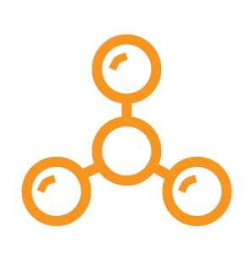
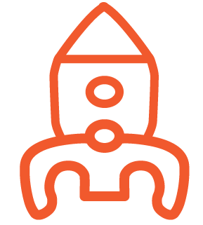

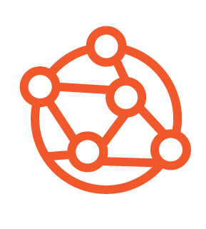

Attunix Solution Alignment
Application Modernization
Internet of Things
Advanced Analytics
Modern Datacenter
Modern Datacenter
Application Modernization
Cloud Readiness
Cloud Migration | DC Consolidation
VMware | Hyper-V | OSS | Windows | Linux
Governance | Compliance
DR | Backup | Cloud Storage
Security | Express Route
NetApp | F5 | Barracuda
Intelligent Apps
Azure PaaS/IaaS Apps & Services
Xamarin Mobile App Development
Application Migration & RePlatform
Cloud Assessments
DevOps
VSTS/TFS, Azure CDI
Advanced Analytics
Internet of Things (IoT)
Cortana Intelligence
Machine Learning
Cognitive Services & Azure Bot Service
Big Data –Hadoop | Data Lake | Data Factory
R Server
Power BI | SSRS Mobile
SQL Server 2016 | SSRS | SSIS & Azure EDW
Azure Hardware Starter Kits
Azure Toolkit (Azure Device Agents)
IoT Hub & IoT Edge
Streaming Analytics
Monitoring & Gateway Devices
Service-driven operative model
Open Source DevOps
Kubernetes
Docker
CoreOS
Terraform
Puppet
Chef
Jenkins
Ansible
Managed Service Practices
CIO Insights | Rapid Remediation | Application360
DR | Infrastructure360 | Digital Transformation

Slide 6

















Cloud Focused IT Transformation Services
Attunix Modern
Datacenter
Practice
Security
Backup
Compliance
Linux
Disaster Recovery
Modern Datacenter
Practice
Monitoring
IaC Dev/Ops
Identity Management
Data Synchronization
Optimization
Migration
Dev/Test Labs
Datacenter
Assessments
Cloud VDI
Notes:
IaC = Infrastructure as Code
Make the center circle a Cloud Icon
New logo needed for Ident. Mgmnt. (Finger Print) or man with shield
Change logo datacenter assessment

Slide 7
Thank You

