Slide 1

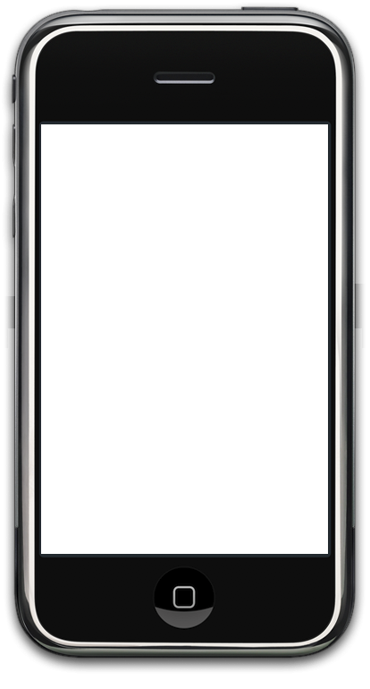
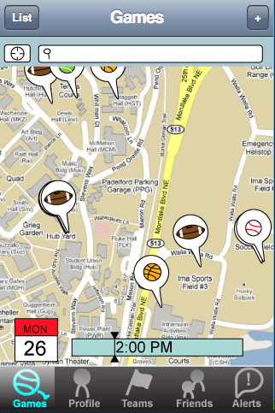
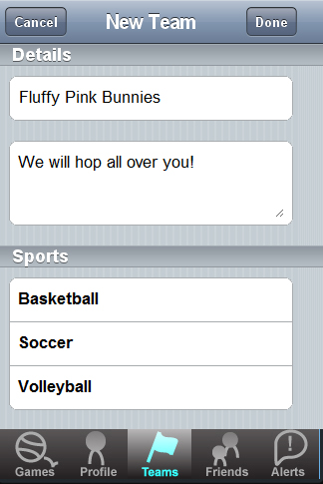
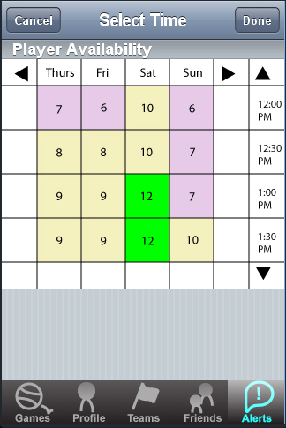
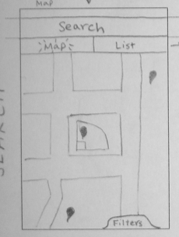
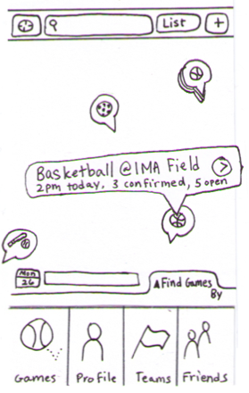
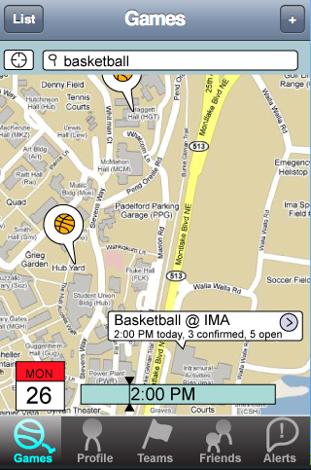
PickUp makes it easy
to find, schedule,
and organize casual sporting activities.
Overview
There are many hurdles to find and play pickup sports games.
PickUp makes it easier to find people nearby with shared sporting interests, similar skill level, and compatible schedules.
PickUp Lets You…
Find nearby Games with search functionality and several filtering options
Create Games for any sport
Create Teams and manage them
Schedule Games based on when all the invited players are available
Design Iteration
PickUp’s map interface evolved significantly from initial sketch to interactive prototype.
Ian Crofoot . Sunil Garg . Mitch Ishimitsu . Daniel Swisher
http://www.cs.washington.edu/education/courses/cse440/09au/projects/pickup/
CSE 440
Autumn 2009

