Slide 1
Section 1
Proposal Brainstorm

Slide 2

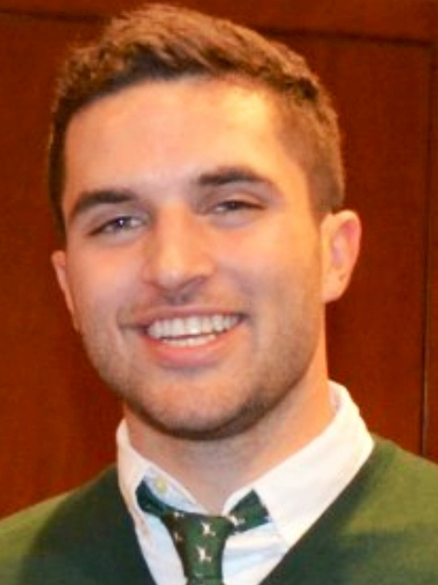
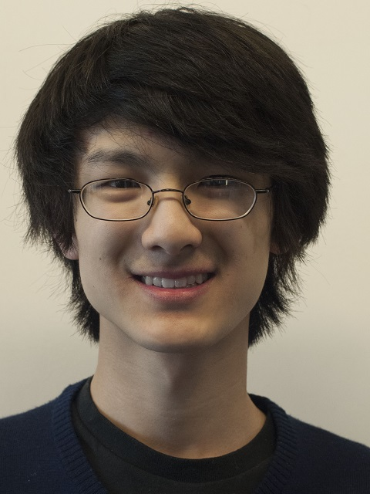
Introductions
Daniel Epstein
Bradley Jacobson
King Xia

Slide 3
Proposal brainstorm
Close your laptop
Groups of 4 brainstorm
Write down ideas as you come up with them

Slide 4
Brainstorming ground rules
There are no dumb ideas
Build on ideas: “Yes and …” not “No but …”
Quantity over quality
If you’re stuck find inspiration elsewhere (box of random crap from the dollar store)

