Slide 1


Data Loading & Migration for Database Management Systems
Speaker: Adam Dziedzic
Advisor: Prof. Aaron Elmore
Notes:
Hello everyone. Tonight, I have a pleasure to talk to you about: „Data loading and migration for Database Management Systems”. We’ll focus primarily on PostgreSQL database. My name is Adam Dziedzic and I’m from University of Chicago, where I pursue my PhD.

Slide 2



CSV vs. DBMS
DBMS
BIG RAW DATA files
Expensive raw analysis
Fresh data = interesting data but unexplored
Exponential growth
ACID guarantees
SQL interface
Top query performance & convenient, fast analysis
Linear complexity of loading
Notes:
Parfait gave an excellent introduction to databases. Let me just add a few pieces.
Let’s compare data stored in CSV format and in a database. On the one hand, we have: 1) First, BIG RAW DATA files that should be analyzed. On the other hand, databases provide ACID guarantees. Atomicity, either a whole set of operations is executed or neither of them. Data is consistent. Many users can access the data simultaneously. Data is durable so we don’t have to worry if our system crashes because we can recover our data. 2) Second, the analysis of raw data is expensive while a DBMS exposes SQL interface, which enables us to easily query the data. 3) Next, the newly generated data is provided usually in a raw format, this latest data is of great interest but left unexplored because of the expensive raw analysis. In contrast, DBMS provides top-notch query performance and user friendly, convenient, and fast data analysis. 4) Finally, the only problem is the exponential growth of raw data, however, the complexity of data loading is linear, which prohibits us from moving all the raw data to databases.

Slide 3
CSV vs. DBMS
DBMS
BIG RAW DATA files
Expensive raw analysis
Fresh data = interesting data but unexplored
Exponential growth
ACID guarantees
SQL interface
Top query performance & convenient, fast analysis
Linear complexity of loading
Only a small fraction of raw data is loaded to DBMSs [IDC 12]
Notes:
In fact, only a small fraction of raw data is loaded to DBMSs. So, we’ll analyze how to accelerate the data loading process to a DBMS and have faster the data-to-insight time.

Slide 4
How to accelearate data loading & migration?
Loading:
CSV vs. DBMS
General principles
Thread/Process Level Parallelism
Identify Bottlenecks
Using Storage Devices
Data level parallelism (SIMD)
Migration:
Leverage Diverse Databases
CSV vs. Binary format
Notes:
My talk is divided into 2 main sections: 1) First, we will focus on how to load data FASTER to PostgreSQL and other databases by leveraging parallelism and appropriate storage systems. 2) Second, we will talk about how to accelerate migration from PostgreSQL to other databases using binary formats.

Slide 5
Data Loading
LOAD
DBMS
Notes:
First of all, by data loading, we mean a transformation from a raw text file, such as CSV, to a database internal binary format.

Slide 6
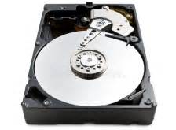
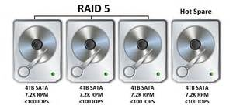
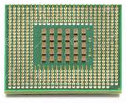
Data Loading
LOAD
DBMS
Read
Process
Write
HDD
RAID-0 (24 disks)
Notes:
We read the CSV data from a disk, then process the data on many CPUs, we have to parse them, convert from text to binary format and create tuples. Finally, we write the data in a database binary format to DBMS files on the target storage, which in this case is 24 disks in RAID-0 configuration.

Slide 7
Data Loading: general principles
DON’T USE SLOW INSERT INTO or prepared statements.
USE BULK LOADING COPY INTO in PostgreSQL, MonetDB, Vertica, parallel load via external tables in Oracle, bulk insert in SQLServer.
Ask you data provider for:
Dividing the raw data into many files (few GBs) and load them in parallel - the fastest method to achieve good performance;
Data in a binary format and a fast parser to process them;
Clean your data:
PostgreSQL ABORTS loading when data is ill-formatted;
Other databases store ill-formatted rows in reject tables or error files but all the well-formatted rows are loaded.
Notes:
These are the general principles for data loading. Don’t use the “INSERT INTO” statements. It’s convenient but very slow. Instead, use bulk loading which in PostgreSQL is done via the copy into statement. Ask your data provider for dividing the data into a collection of many files (a few GBs each), so that you can easily load them in parallel – which is the easiest way to accelerate your data loading. If your data provider can prepare the data in a binary format and a parser for the binary data, then you can leverage even the faster binary loading. Clean your data before loading into PostgreSQL. If one of your input rows is ill-formatted, PostgreSQL will abort the process, maybe after a few hours, which is very inconvenient. Other systems are less radical, they store ill-formatted rows in separate error files or reject tables but all the well-formatted data is loaded.

Slide 8
BULK Data Loading
LOAD
DBMS
How long does it take to load data into PostgreSQL?
Notes:
Now, we know that we should use bulk loading. So, how long does it take to bulk load data into PostgreSQL?

Slide 9
Data Loading – current state of the art
TPC-H data 10GB, 2 sockets, 8 cores/socket, 2GHz, 20MB L3, 64GB RAM, from HDD->DAS, RHEL 6
Database | Loading time (seconds)
PostgreSQL | 395.39
DBMS-B (commercial column-store) | 234.94
MonetDB (open-source column-store) | 149.11
DBMS-A (commercial row-store) | 137.59
Notes:
We analyzed the data loading to 4 very well known Database Management Systems. To this end, we load data from TPC-H benchmark (which is a standard benchmark used in database community, for example, its largest table lineitem contains 17 columns of different types: ints, dates, doubles, strings, etc.), data size is 10 GB and we tune the systems. The slowest system is PostgreSQL, for which the loading took about 400 sec. Then Loading is about 2X faster for DBMS-B and about 3X faster for MonetDB and DBMS-A. The question is can we do better, especially for PostgreSQL? (Due to legal restrictions, the names of the commercial database systems are not disclosed.)
The disclosure of the database names would violate the database license.

Slide 10
Data Loading – current state of the art
TPC-H data 10GB, 2 sockets, 8 cores/socket, 2GHz, 20MB L3, 64GB RAM, from HDD->DAS, RHEL 6
Database | Loading time (seconds)
PostgreSQL | 395.39
DBMS-B (commercial column-store) | 234.94
MonetDB (open-source column-store) | 149.11
DBMS-A (commercial row-store) | 137.59
PARALLEL loading to PostgreSQL (with a single reader) | 104.37
How to improve the performance of data loading?
Notes:
We wrote our own tool for parallel data loading to PostgreSQL and were able to speedup the process by about 4X. Parallelism is the key for fast data loading. In this talk, we’ll focus on how we can improve the data loading process, especially to PostgreSQL. Let’s start from pinpointing where the problem is.

Slide 11
How to accelearate data loading and migration?
Loading:
CSV vs. DBMS
General principles
Thread/Process Level Parallelism
Identify Bottlenecks
Using Storage Devices
Data level parallelism (SIMD)
Migration:
Leverage Diverse Databases
CSV vs. Binary Migration
Notes:
To find out how to accelerate the data loading process, first, we have to identify where the bottlenecks are.

Slide 12
Resource utilization during Data Loading
Read
Process
Write
LOAD:
Notes:
We’ll analyze the loading process in terms of what’s happening in 3 stages: during reading data from disk, processing on a CPU and writing to the target storage.

Slide 13
Read bandwidth underutilized
DBMS-A, TPC-H 10 GB from HDD to DAS, 16 threads, measured with sar (System Activity Reporting)
Notes:
Here we present how the read bandwidth is used by DBMS-A during data loading. The x axis represents time in seconds. The y axis represents the utilization of the resource. The disk could sustain many more reads, however, the loading process uses only about 50% of the available read bandwidth.

Slide 14
Low CPU utilization
DBMS-A, TPC-H 10 GB from HDD to DAS, 16 threads, measured with sar (System Activity Reporting)
Notes:
CPU usage is significant only when we read data from disk, and there are dips otherwise. CPU usage is also only on the level of about 50%.

Slide 15
Write bandwidth underutilized
DBMS-A, TPC-H 10 GB from HDD to DAS, 16 threads, measured with sar (System Activity Reporting)
Notes:
The disk could sustain many more writes, however, the loading process buffers data to be written to disk and flushes them in one go which causes the peaks.

Slide 16
Alternating cycles in resource utilization
DBMS-A, TPC-H 10 GB from HDD to DAS, 16 threads, measured with sar (System Activity Reporting)
Notes:
The dips during reads and CPU usage occur exactly for peaks in writes when data is flushed to disk.

Slide 17
Unable to saturate resources
Read
Process
Write
LOAD:
DBMS-A, TPC-H 10 GB from HDD to DAS, 16 threads, measured with sar (System Activity Reporting)
Notes:
The general trend is that we are unable to saturate the resources. Neither CPU, nor read and write bandwidth of the underlying storage devices. Let’s find why.

Slide 18
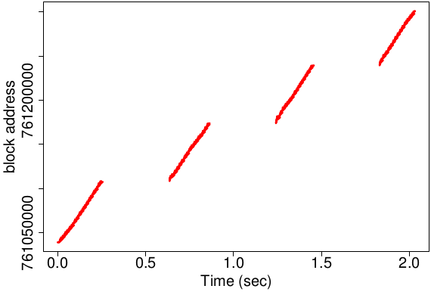
What causes the read bandwidth underutilization?
MonetDB
Sequential reader
Orders TPC-H 10 GB HDD -> DAS, 16 threads, iosnoop
Read patterns
Notes:
To find out why the read bandwidth is underutilized, we plot read patterns using iosnoop. The x axis represents time in sec, the y axis represents addresses of blocks on disk. This database reads the data from disk in a sequential manner, block by block, with a single reader.

Slide 19
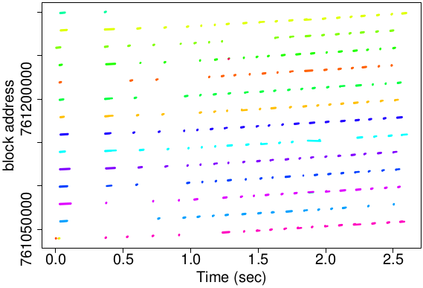
Read patterns
Reading orders file from TPC-H 10 GB; from HDD to DAS, 16 threads
MonetDB
Sequential reader
DBMS-A
Parallel readers
Random I/O causes underutilization
Notes:
On the other hand, the DBMS-A spawns many processes, each color on the right-hand graph represents a separate process, each of them reads from distinct locations on disk. The source storage is a typical hard drive that cannot sustain many random reads, thus the random I/O causes read bandwidth underutilization.

Slide 20
Storage aware PostgreSQL: serial vs. parallel reader
TPC-H 10 GB from HDD to DAS; loading times: PCOPY 111 sec vs. PPARSE 104 sec
Serial reader improves read utilization
# readers depends on input device
Notes:
The database should be aware of the underlying storage and take advantage of it for faster data loading. When the underlying input storage is a hard drive, then it is much faster to read data serially. This improves the read utilization. The main lesson is that the # of readers depends on the input device. If you have a fast storage which can sustain many simultaneous reads, then read data in parallel.

Slide 21
How to accelearate data loading and migration?
Loading:
CSV vs. DBMS
General principles
Thread/Process Level Parallelism
Identify Bottlenecks
Using Storage Devices
Data level parallelism (SIMD)
Migration:
Leverage Diverse Databases
CSV vs. Binary format
Notes:
While sequential accesses are certainly useful for slow HDD-based data sources, it might be beneﬁcial to use multiple readers on data sources that can sustain large number of random I/O-s like SSDs. Thus, another way to eliminate the random input path I/O bottleneck and the bursts of writes is to use faster input and output storage media.

Slide 22
Storage device for parallel READERS
TPC-H 10 GB, 16 threads, target storage: DAS
Source storage: from HDD to SSD
2X
Notes:
What happens when we provide a better storage device for reads? Instead of a hard drive, we use SSD. This has no impact on vanilla PostgreSQL, where loading is purely CPU bound. For parallel loading to PostgreSQL using our tool PCOPY, we are able to decrease the loading time by about 25%. For DBMS-A the decrease is more than 2X. The difference between PCOPY and DBMS-A is due to different patterns of parallel reads.

Slide 23
Storage device for parallel READERS
TPC-H 10 GB, 16 threads, target storage: DAS
Source storage: from HDD to SSD
2X
Single reader on HDD & Parallel readers on SSD
Notes:
Use a single reader from a typical hard drive and multiple paralel readers on fast storage devices, such as SSD or DAS.

Slide 24
Storage device for WRITES
TPC-H 10 GB, 16 threads, target storage: DAS
Target storage: from DAS to ramfs
Notes:
What happens when we provide a better storage device for writes? Instead of a DAS with 24 disks in RAID-0 configuration, we use ramfs – now the database resides in main memory. Once again, this has almost no impact on vanilla PostgreSQL, where loading is purely CPU bound. For parallel loading to PostgreSQL using our tool PCOPY, we are able to decrease the loading time by about 20%. For DBMS-A the decrease is about 30%. The difference between PCOPY and DBMS-A is due to the fact that PostgreSQL relies on a file system, while DBMS-A can bypass the file system.

Slide 25
Best case storage scenario
DBMS-A, TCP-H 10 GB, from ramfs to ramfs, 16 threads
Device Bandwidth: 12.8 GB/sec
Read Rate: 250 MB/sec
Notes:
Data loading is a CPU-intensive task - a fact that becomes apparent after using the fastest data source and destination storage combination. For the best case storage scenario, we are able to saturate the CPU usage, in this case for DBMS-A with 16 threads on 16 cores. Where does the CPU time go?

Slide 26
Where does the CPU time go?
10 int columns, 10 GB, VTune + code inspection
Notes:
We present the CPU breakdown analysis for PostgreSQL and MonetDB. Both systems spend the majority of their processing time on performing parsing, data type conversion, and tokenizing. Parsing – finding new line delimiters; Conversion, called deserialization – from text to binary formats; Tokenizing – finding fields.

Slide 27
Where does the CPU time go?
10 int columns, 10 GB, VTune + code inspection
Use SIMD for faster parsing
Notes:
Modern CPUs are provided with wide SIMD registers. We can accelerate, for example, parsing by using SIMD. In lieu of reading character at a time and checking if it’s a new line, we can load many characters into the SIMD register and check in one go, if any of the characters is a new line.

Slide 28
How to accelearate data loading and migration?
Loading:
CSV vs. DBMS
General principles
Thread/Process Level Parallelism
Identify Bottlenecks
Using Storage Devices
Data level parallelism (SIMD)
Migration:
Leverage Diverse Databases
CSV vs. Binary format
Notes:
The migration process is export + loading. Providing an efﬁcient data migration tool is essential to take advantage of superior processing from that specialized databases. We want to choose the most performant system for a given task. We’ll show how binary formats can accelerate the data migration process.

Slide 29
Data Migration: leverge features of diverse databases
MIGRATE
DBMS B
DBMS A
OLTP (row oriented)
Analytics (column oriented)
Notes:
Finally, we’ll discuss how to migrate data between different DBMSs.

Slide 30
Current approach: CSV migration
CSV format
1,”Adam”,6.00; 2,”Aaron”,7.00
DBMS X
DBMS Y
Data already loaded to the source database
Notes:
Most databases support data export and loading in the CSV format. Thus, in many cases the data between systems is exchanged in this raw format that boils down to starting from scratch and loading raw CSV data to DBMS Y. Can we do better? Please, note that the data is already parsed and deserialized (converted) in DBMS X, in the source database. Can we leverage the fact?

Slide 31
Our approach: binary migration
Binary format X
TRANSFORM
Binary format Y
1001 -> 0110
1001
0110
SINGLE (destination) binary format: Y
0010101
DBMS X
DBMS Y
Notes:
Our approach is two folded. First, we can export data in the source binary format, transform it on the fly, and load the data in destination binary format to DBMS Y. Second, we can modify the source database DBMS X and generate the destination format directly, without any intermediate transformation.

Slide 32
Data Migration from PostgreSQL to SciDB
MIMIC II data - waveform(int, int, double)
TRANSFORMATION is 3X, DIRECT is 4X faster than CSV migration
Notes:
The x axis represents data size in GBs and the y axis represents time in seconds. We migrate the waveform data from PostgreSQL to SciDB. The first approach migrates data in CSV format. This approach is easy to implement and most databases support CSV import/export. The second approach exports binary data from PostgreSQL, then transforms the data to SciDB binary format on the fly and loads the data to SciDB. This approach is external to the systems and not invasive. This method was 3X faster than CSV-based migration. Finally, for the third approach we modified PostgreSQL to immediately generate the data in SciDB binary format such that data is directly loaded to SciDB. The last method is invasive since we have to modify the internals of a the systems but gives the best performance: being 4X faster than CSV migration.
We show that loading the binary data to SciDB is much faster than CSV loading.
Blue line – external transformation is not invasive.

Slide 33
Breakdown: migration from PostgreSQL to SciDB
Slow CSV loading
Notes:
We break down the migration process into its stages and show how much time each of them takes.
This result is expected. The migration process is divided into export from PostgreSQL and loading to SciDB. The slow CSV loading to SciDB is the bottleneck in this case.

Slide 34
Breakdown: migration from PostgreSQL to SciDB
Notes:
PostgreSQL binary format is verbose and for this data, the size of the same data in PostgreSQL binary format was bigger than the size of the same data in the CSV format. It was very unexpected, but it takes longer to export data from PostgreSQL than to load them to SciDB.

Slide 35
Breakdown: migration from PostgreSQL to SciDB
Use Fast Direct Binary Migration

Slide 36
Conclusions
Parallelism is the key:
Ask the data provider for splitting the data during generation and BULK load the data files in parallel;
Tune your database and set up parallel loading;
Use SIMD (data level parallelism) for faster parsing.
Optimize I/O to fully utilize CPU:
Input I/O path with single (HDD) or parallel reader (SSD);
Output I/O path to reduce pauses caused by data ﬂushes.
Binary data format for data transfers:
Select a single, concise, SIMD-friendly & binary format.
Notes:
To sum up.
Parallelism is the key:
Ask the data provider for splitting the data during generation, BULK load the data files in parallel;
Tune your database, and set up parallel loading;
Use SIMD (data level parallelism) for faster parsing.
Optimize I/O to fully utilize CPU:
input I/O path to fully leverage the storage device;
output I/O path to reduce pauses caused by data ﬂushes.
Binary data format for data transfers:
Select a single, concise, SIMD-friendly & binary format

Slide 37
Thank you

Slide 38
Backup slides

Slide 39
Faster loading, export & migration for PostgreSQL
Load - external loader for PostgreSQL:
Read data from many input files using many psql clients;
External parallel loader that is aware of storage devices.
Export:
Both, parallel export in CSV format and export in a specific (non-postgres) binary format require changes to the PostgreSQL’s source code.
Migrate = export + load:
CSV: no changes to the database required (unless parallel);
Binary: either external transformation or internal changes.

Slide 40
Hardware acceleration for Parsing
Instruction
Data
Instruction
Data
SISD
SIMD
Result
Result
Notes:
A typical CPU processing is a single instruction for a single data item. However, modern processers contain wide registers where many data items can be stored. We can execute a single instruction for many data items. The best example is that when we parse a CSV file we want to find new line delimiters. We can do it in a traditional way and read character by character and check if it is a new line. Whereas, when we use SIMD, we can load 64 character into 512 bit long SIMD register and check in one go if any of the 32 characters is a new line.

Slide 41
SIMD: for parsing lines in input CSV file
TPC-H Data Loading to PostgreSQL
SIMD gives 1.6X speedup for parsing lines
Notes:
We investigated how SIMD can be used for faster CSV parsing during data loading to PostgreSQL. Finding lines requires many comparisons for each character (check if the next character is a comma, vertical bar or a quotation mark). Thanks to SIMD, we skip many if-else comparisons for each character, as they are executed much faster using a single equal any operation. We applied the SIMD parsing to PostgreSQL and were able to achieve 1.6X speedup while loading TPC-H data in raw format.

Slide 42
How to accelearate data loading, export and migration?
Loading:
Intro: CSV vs. DBMS, and basic recommendations;
Thread/process level parallelism;
Identify the bottlenecks;
Impact of storage devices;
Data level parallelism (hardware accelerator: SIMD).
Export:
Extract database pages (collection of rows) to separate files with many processes.
Migration:
Single, concise, and binary data format for direct data migration.
Notes:
My talk is divided into 3 main sections: 1) how to load data FASTER to PostgreSQL and other databases by leveraging parallelism and appropriate storage system. 2) Second, how to speed-up export data from PostgreSQL with many processes and 3) Finally, how to accelerate migration from PostgreSQL to other databases using binary formats.

Slide 43
Data Export: don’t get locked into a database vendor
EXPORT
DBMS
Notes:
Data loading is a persistent analysis bottleneck.
By data loading, we mean a transformation from a raw file, such as CSV, to a database internal binary format.
On one hand, we have an enormous amount of data that has to be analyzed. Loading the data is very expensive and even impossible because of the exponential growth of data while the data loading process is linear in its complexity. Additionally, the newly generated, fresh data are of great interest and the pace in which data is generated prohibits an instant loading to a database.
On the other hand, once the data is in a database, the SQL interface and top query performance makes the data analysis much more convenient.
The ACID guarantees, especially transactions provide data semantics that are very easy to deal with.
Take into account the fact that there are estimates of about 40 zettabytes of all data, I mean all digital bits, by 2020*. [IDC12].
Like the physical universe, the digital universe is large – by 2020 containing nearly as many digital bits as there are stars in the universe. It is doubling in size every two years, and by 2020 the digital universe – the data we create and copy annually – will reach 44 zettabytes, or 44 trillion gigabytes.
From 2013 to 2020, the digital universe will grow by a factor of 10 – from 4.4 trillion gigabytes to 44 trillion. It more than doubles every two years.\
I. Logical motivation

Slide 44
Parallel Export from PostgreSQL
CLIENT 1
PAGE 1
PAGE 1
FILE 1
PAGE 2
PAGE 2
FILE
FULL SCAN
ROUND-ROBIN FOR PAGES
CLIENT 2
PAGE 3
PAGE 3
FILE 2
PAGE 4
PAGE 4
Current single-threaded export
New parallel export
Notes:
Another drawback is that PostgreSQL does not support parallel export. Currently, it scans data page by page in a single thread and ouputs the rows to a single file. We can do much better if we assign pages to different clients or export processes, each of which exports rows to a separate file.
Many databases can load data in parallel from separate clients. For instance, the input data that should be loaded to a single table in a database could be provided as a collection of ﬁles (instead of one single ﬁle for the whole table). However, many databases do not support parallel data export. This section presents how we enable parallel export from PostgreSQL. The default implementation of data export from PostgreSQL executes a full table scan, processes data row by row, and outputs a single ﬁle. This process could be parallelized in two ways. Thelogicalapproachistodistributetherowsfromatableinaround-robinfashiontoseparateﬁles. This approach guarantees that the sizes of the output ﬁles will be almost the same (with possible small differences of a single row size). However, this requires each of the clients to fully scan the sametable,eventhoughapartoftheprocesseddataiseventuallyexported. Thephysicalapproach distributes data on the level of pages, which every database table is organized into. The pages can be distributed in round-robin fashion to separate ﬁles. The sizes of the output ﬁles are also evenly distributed with possible differences of a single page size. Each client processes and exports (to a single ﬁle) part of a table (subset of its pages), instead of the whole table. Additionally, batches of pages are processed by each client to improve sequential I/O. The sequence (batch) size is a parameter that has to be found experimentally or provided by a database optimizer, which can use statistics on number of rows in a table and number of rows per page, so that output data ﬁles are similarly sized.
In a database, each table is physically divided into pages (also called blocks) usually 4 KB or more, and pages contain rows.

Slide 45
Parallel export from PostgreSQL
TPC-H benchmark, 10 GB, CSV format
CURRENT EXPORT
Notes:
Currently, the export from PostgreSQL in a single thread is very slow because it works in a single thread and executes a full table scan.

Slide 46
Parallel export from PostgreSQL
TPC-H benchmark, 10 GB, CSV format
CURRENT EXPORT
PARALLEL EXPORT
New Parallel export 20X faster than Current export
Notes:
For the export part, we modify PostgreSQL to support parallel export, which is 20X faster then the single-threaded one with 32 threads, so this process scales very well.

Slide 47
Reducing data loading overheads: related work
Reduced
Access
NoDB
RAW
Data Vaults
Invisible
loading
MISO
Optimized
Code Path
Instant Loading
SIMD
GPUs
FPGAs
HW
Notes:
Data vaults aim at symbiosis between loaded data and data stored in external repositories. Data vaults are developed in the context of MonetDB and focus on providing DBMS functionality over scientific file formats, emphasizing on array-based data. The concept of just-in-time access to data of interest is further extended to efficiently handle semantic chunks: large collections of data files that share common characteristics and are co-located by exploiting metadata that describe the actual data (e.g. timestamps in the file names).

Slide 48
TPC-H data 10 GB, 16 threads

Slide 49
Experimental Setup
Hardware
Dual socket 8 cores Intel(R) Xeon(R) CPU E5-2640, main memory: 64 GB
HDD: 4 x 500 GB 10k RPM SATA disks Max read/write throughput: 170 MB/s, 160 MB/s
DAS: 24 x 558 GB 10k RPM SATA disks (RAID-0)
Max read/write throughput: 1100 MB/s, 330 MB/s
SSD: 3 x 200 GB, Max read/write throughput: 565 MB/s, 268 MB/s
Software
Red Hat Enterprise Linux 6.6 (Santiago - 64bit) with kernel version2.6.32
Row-oriented DBMSs: PostgreSQL (v. 9.3.2), DBMS-A
Column-oriented DBMSs: MonetDB (v. 11.19.9), DBMS-B
PostgreSQL parallel external loaders: PCOPY and PPARSE
Datasets
benchmark (TPC-H, TPC-C, SDSS) and real-world (Symantec, MIMIC-II)
Notes:
To this end, we carry out an empirical analysis of data loading in three dimensions: hardware, software and application workload.
The analysis studies four systems: a commercial row-store (DBMSA), an open-source row-store (PostgreSQL [2]), a commercial column-store (DBMSB), and an open-source column-store (MonetDB [1]). To preserve anonymity due to legal restrictions, the names of the commercial database systems are not disclosed.

Slide 50
Storage devices
Name | Capacity | Configuration | Read speed | Write speed | RPM
HDD | 1.8 TB | 4 x HDD (RAID-0) | 170 MB/sec | 160 MB/sec | 7.5k
DAS | 13 TB | 24 x HDD (RAID-0) | 1100 MB/sec | 330 MB/sec | 7.5k
SSD | 550 GB | 3 x SSD (RAID-0) | 565 MB/sec | 268 MB/sec | N/A
ramfs | 64 GB | N/A | 12.8 GB/sec | 12.8 GB/sec | N/A

Slide 51
Single threaded vs. Parallel data loading
100GB TPC-H data,
from HDD to DAS
Notes:
These experiments examine how much beneﬁt a DBMS can achieve by performing data loading in a parallel fashion. Generally, parallel loading improves data loading performance in comparison to single-threaded loading in many cases. However, scaling is far from ideal, as loading time does not reduce commensurately with the number of cores used. In fact, there are cases where a 16X increase in the degree of parallelism fails to bring any improvement at all (e.g. DBMS-B for the Symantec dataset).
---------------------------------------------------------------------------------------------------------------------------------------------------------------------
PCOPY – out external loader that invokes multiple PostgreSQL COPY commands in parallel. PCOPY differs from other systems that support parallel loading as native feature in that it uses PostgreSQL as a testbed to show how parallelism can be introduced to an existing RDBMS without tweaking its internal components. PCOPY is a multithreaded application that takes as input the ﬁle to be loaded into the database, memory maps it, computes aligned logical partitions, and assigns each partition to a different thread. Each thread sets up a pipe and forks off a PostgreSQL client process that runs the COPY command conﬁgured to read from a redirected standard input. Then the thread loads the data belonging to its partition by writing out the memory mapped input ﬁle to the client process via the pipe.

Slide 52
Single threaded vs. Parallel data loading
100 GB TPC-H data,
from HDD to DAS
2.9X
Sublinear speedup for 16 threads
Notes:
In this setting, the best improvement was 2.9X, so the speedup is clearly sublinear. Let’s analyze why.

Slide 53
Impact of storage
TPC-H SF 10 GB, 16 threads
Slow source storage bottlenecks all systems
Write bottleneck when source storage is fast
Notes:
To examine the impact of the underlying data storage on parallel loading, we run an experiment where we use as input a 10GB instance of TPC-H and vary the data source and destination storage devices.
In the x axis we present different DBMSs, y axis represents the loading time in seconds.
On your left hand side, we keep a hard drive as the source storage and change the destination storage.
We can see the change in destination storage does not impact the loading time. Thus, the slow source media bottlenecks all systems.
On the right hand side, we keep the same destination storage, DAS (Direct Attached Storage, in the RAID-0 setup with 24 disks). Using a faster data source storage accelerates loading for all the systems (e.g., going from HDD to SSD). Nevertheless, the difference between the conﬁgurations that use SSD- and ramfs-based source storage is marginal, which implies that the write performance of DAS eventually becomes a bottleneck for very fast input devices.
Lesson that we learned is that many organizations store the raw data on a slow storage, such as HDD, and DBMSs are stored on fast storage devices such as DAS. The loading has to run in parallel to be fast so either the DBMSs have to be aware of the underlying storage or the data before loading should be moved to a good quality storage that can handle many parallel I/Os efficiently.

Slide 54
Best-case storage scenario
DBMS-A, from ramfs to ramfs, 16 threads
TPC-H 10 GB, 16 threads
Device Bandwidth: 12.8 GB/sec
Read Rate: 250 MB/sec
100% CPU utilization, yet B/W still underutilized
Notes:
To further look into the write bottleneck, we plot the loading time when we vary the data destination storage while using ramfs – the fastest option – as the data source storage.
Let’s focus first on the left hand side graph.
The observed behavior varies across systems: DBMS-B has little beneﬁt from ramfs because of its thread overprovisioning; the numerous low-priority threads it spawns get pre-empted often.
For PCOPY and DBMS-A, using ramfs as the data destination storage achieves the best overall performance. Loading time reduces by 1.75× for DBMS-A and 1.4× for PCOPY when ramfs is used as the destination storage compared to DAS. This clearly shows that DAS, despite being equipped with a battery-backed cache for buffering writes, is still a bottleneck to data loading due to the negative impact that dirty data ﬂushing has on the data loading pipeline.
On the rith hand side we present the CPU utilization (y axis) during loading with time in seconds on the x axis. Only DBMS-A reaches 100% CPU utilization, with its performance eventually becoming bound by the CPU-intensive data parsing and conversion tasks.
Our analysis shows that the way in which DBMSs issue read requests and the degree of parallelism they employ has an effect on the read throughput achieved.

Slide 55
Resource utilization
DBMS-A, TPC-H SF=10 from HDD to DAS, 16 threads
Unable to saturate resources
Notes:
So, let’s focus on the read bandwidth. The i/o wait statistic is a useful indicator of I/O performance - but it does tell us that the system can handle more computational work. Just because a CPU is in i/o wait state does not mean that it can't run other threads on that CPU – but in this case we run solely data loading for a single system at a time; that is, iowait is simply a form of idle time. I/O wait tell us if the system was waiting for an I/O request to complete when the counters were collected.
We are wondering why only about 50% of the disk read throughput is used. When we plot the I/O Wait for the DBMS-A, we can see that it’s very high. In comparison, when we plot I/O wait for MonetDB, it’s very low.
The I/O wait of DBMS-A corresponds directly to the reads from disk and is high.
MonetDB does have insignificant I/O wait.
DBMS-A, in contrast to MonetDB, spends a non-trivial portion of time waiting for I/O, which explains the low CPU utilization. Still, read throughput utilization of DBMS-A barely exceeds 60% even in the best case. This clearly indicates that DBMS-A issues random read I/O requests during parallel data loading which causes high I/O delays and an underutilization of CPU resources.
Let’s see the details about this phenomenon.

Slide 56
Resource utilization: I/O & CPU
Understand the lack of scalability under parallel loading
Analyze the utilization of resources:
CPU
I/O
What is the alternative view of the previous figures?
Notes:
To understand the reason behind the lack of scalability under parallel data loading, next we’ll look into CPU and I/O resource usage patterns to identify where time goes during the data loading process. We’ll present an alternative view of the previous figure where we monitor the usage of system resources (CPU, and I/O reads and writes) when a 10 GB version of TPC-H data is loaded using parallel loaders for various DBMSs. As before, raw data is initially stored on HDD and the database is stored on DAS.

Slide 57
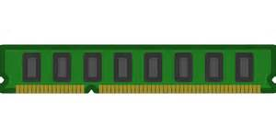

Impact of storage
A typical DBMS setup underutilizes I/O bandwidth and CPU
Problem: random I/O for parallel loading from HDD
How different storage sub-systems affect data loading speed?
DBMS
STORAGE
Notes:
The previous experiments showed that a typical DBMS setup under-utilizes both I/O bandwidth as well as the available CPU resources because of the time it spends waiting for random I/O completion. This section studies the underutilization issue from a hardware perspective; how different storage sub-systems affect data loading speed? We focus on the parallel loading.

Slide 59
Impact of storage devices
TPC-H data 10 GB, 16 threads
Slow source storage bottlenecks all systems
Write bottleneck when source storage is fast
Notes:
To examine the impact of the underlying data storage on parallel loading, we run an experiment where we use as input a 10GB instance of TPC-H and vary the data source and destination storage devices.
In the x axis we present different DBMSs, y axis represents the loading time in seconds.
On your left hand side, we keep a hard drive as the source storage and change the destination storage.
We can see the change in destination storage does not impact the loading time. Thus, the slow source media bottlenecks all systems.
On the right hand side, we keep the same destination storage, DAS (Direct Attached Storage, in the RAID-0 setup with 24 disks). Using a faster data source storage accelerates loading for all the systems (e.g., going from HDD to SSD). Nevertheless, the difference between the conﬁgurations that use SSD- and ramfs-based source storage is marginal, which implies that the write performance of DAS eventually becomes a bottleneck for very fast input devices.
Lesson that we learned is that many organizations store the raw data on a slow storage, such as HDD, and DBMSs are stored on fast storage devices such as DAS. The loading has to run in parallel to be fast so either the DBMSs have to be aware of the underlying storage or the data before loading should be moved to a good quality storage that can handle many parallel I/Os efficiently.

Slide 60
High cost of Data Migration
2 nodes, each 4 cores 3.10 GHz, 4 MB L3, 16 GB RAM, SSD 250 GB, Ubuntu 14.04
METHOD | TIME (sec)
From PostgreSQL to SciDB (MIMIC II data, 10 GB)
CSV (common approach) | 772
From S-Store to SciDB (TPC-C data, 10 GB)
CSV (common approach) | 823
Notes:
The migration differs from loading in a few ways. The most important difference is that data at both ends resides already in DBMSs in their specific binary formats.

Slide 61
High cost of Data Migration
2 nodes, each 4 cores 3.10 GHz, 4 MB L3, 16 GB RAM, SSD 250 GB, Ubuntu 14.04
METHOD | TIME (sec)
From PostgreSQL to SciDB (MIMIC II data, 10 GB)
CSV (common approach) | 772
Direct parallel binary migration with compression | 75
From S-Store to SciDB (TPC-C data, 10 GB)
CSV (common approach) | 823
Parallel (16 X) direct binary migration | 100
Data migration can be improved
Notes:
Data migration can also be improved and we’ll show you how.

Slide 62
Polystore: ”One size does not fit all”
Metadata
Text
Scientific data
Streams of data
PostgreSQL
Accumulo
SciDB
S-Store
1 | Adam | …
12
Aaron Elmore
1
Aaron | Mike
Adam | Rob
12
Aaron
12| Aaron | …
1
Adam Dziedzic
Adam
34| Mike | …
34
Mike Stonebraker
1 | 32
12 | 45
…
Polystore couples diverse data models
Notes:
This is a polystore - a system that tightly couples different databases. So, when does the polystore needs data loading and migration?

Slide 63
Single-threaded data loading
TPC-H
Symantec
Dataset characteristics matter
Effect of compression
Notes:
The time taken to load data into a DBMS depends on both the dataset being loaded and the architecture used by the DBMSs. The x axis represents the data size in GB and the y axis represents the loading time in seconds.
We load TPC-H and Symantec data. We observe that changing the input data influences the loading time. DBMSs are stressed differently by the different datatypes involved in each of the workloads. The loading of text data to DBMS-B is much slower because of compression used. We observed that across all workloads there in no a single system that always outperforms the others. A common pattern across all experiments in the single-threaded case is that the evaluated systems are unable to saturate the 170 MB/sec I/O bandwidth of the HDD – the slowest input device used in this study. The next section examines whether data parallelism accelerates data loading.

Slide 64
Single vs. parallel data loading
TPC-H data,
from HDD to DAS
1 thread
16 threads
Speedup 16 threads | PCOPY | MonetDB | DBMS-A | DBMS-B
TPC-H 100 GB | 2. 8 | 1.7 | 1.3 | 2.8
Symantec 100 GB | 1.9 | 2. 2 | 0.88 | -
Sublinear speedup for 16 threads
Notes:
These experiments examine how much beneﬁt a DBMS can achieve by performing data loading in a parallel fashion. We keep the same graph for single-threaded loading of the TPC-H data on the left-hand side and show loading of the same data with 16 threads. We keep the y axis the same in both graphs. We present detailed numbers in the table. Generally, parallel loading improves data loading performance in comparison to single-threaded loading in many cases. However, scaling is far from ideal, as loading time does not reduce commensurately with the number of cores used. In fact, there are cases where a 16X increase in the degree of parallelism fails to bring any improvement at all (e.g. DBM-S for the Symantec dataset).
PCOPY – out external loader that invokes multiple PostgreSQL COPY commands in parallel. PCOPY differs from other systems that support parallel loading as native feature in that it uses PostgreSQL as a testbed to show how parallelism can be introduced to an existing RDBMS without tweaking its internal components. PCOPY is a multithreaded application that takes as input the ﬁle to be loaded into the database, memory maps it, computes aligned logical partitions, and assigns each partition to a different thread. Each thread sets up a pipe and forks off a PostgreSQL client process that runs the COPY command conﬁgured to read from a redirected standard input. Then the thread loads the data belonging to its partition by writing out the memory mapped input ﬁle to the client process via the pipe.

Slide 65
Data Migration from S-Store to PostgreSQL & SciDB
Enhanced data export from S-Store
Binary PostgreSQL
Binary SciDB
Parallel export via partitioning
MAIN
MEMORY
PARTITION
1
PARTITION
2
Notes:
TRANSITION: we analyzed how binary data formats can be used for faster data migration – which reduced the time spend on parsing and deserialization. Our experimental analysis showed that we also should apply parallelism for faster data migration.
Once we understand the binary formats, we want to understand the parallel migration.
We modified S-Store and enabled data export in native binary formats for PostgreSQL and SciDB.
S-Stores divides data into partitions. We export data in parallel from each partition.

Slide 66
Data Migration from S-Store to PostgreSQL & SciDB
5.7 X
3 X
Faster parallel migration: 3 X for binary format & 5.7 X for CSV
Notes:
S-Store supports parallel data export out-of-the-box because of the partitioning, but what about other databases? Let’s analyze, for instance, PostgreSQL database.
The binary loading from S-Store to SciDB was improved 3X with DOP=16, whereas the CSV loading is improved 5.7X with DOP=16.
The lesson learned is that parallelism boosts the performance of both CSV and binary formats. The CSV benefits a bit more from the parallelism and it’s more CPU hungry – for faster parsing and deserialization.

Slide 67
COMPRESSION for direct binary parallel migration
From PostgreSQL to SciDB, 4 threads, waveform data (int,int,double), 10 GB
RAW DATA
Notes:
This is a combination of different techniques to achieve the final 10X improvement. The aim of the experiment is to investigate if the migration process can benefit from compression when data is transferred via network. The first requirement for this process, to bring any benefit, is to ensure that the speed of the migration is greater than the network throughput. We are able to achieve about 204 MB/sec for parallel binary export from PostgreSQL (level of parallelism 4, export waveform data of size about 10GB in about 50 sec) and 136 MB/sec for binary parallel data loading to SciDB (level of parallelism 4, import waveform data of size about 10GB in about 75 sec). Here we migrate between two machines, each with 4 cores and 1 Gbit network. The migration time without any compression is of speed about 104 MB/sec and takes about 98 sec, which reaches the practical network throughput.
We inspected if COMPRESSION can accelerate the migration via network.

Slide 68
COMPRESSION for direct binary parallel migration
From PostgreSQL to SciDB, 4 threads, waveform data (int,int,double), 10 GB
RAW DATA
COMPRESSED DATA
Lightweight compression for data transfer via network
Notes:
Our experiments show that the lightweigth compression can accelerate data movement via network. The gzip level 2 compression algorithm (with compression level set to 2 from range 1-9) gives us slight improvement which reaches about 113 MB/sec (95 sec) and is roughly equal to the speed of compression for gzip-2. Next, zstd (z-standard), the new compression algorithm from Facebook, is a bit faster than gzip but is bottlenecked on decompression side and allows us to achieve 119 MB/sec.

Slide 69
COMPRESSION for direct binary parallel migration
From PostgreSQL to SciDB, 4 threads, waveform data (int,int,double), 10 GB
RAW DATA
COMPRESSED DATA
Load SciDB bottleneck
Lightweight compression for data transfer via network
Notes:
Finally, lz4 (level 2) and snappy compression algorithms are fast and efficient enough to decrease the migration time to the maximum ingest speed measured for SciDB: about 136 MB/sec (or simply about 75 seconds).
Overall, for the data transfer via network, we are able to accelerate the process by about 25% (to reach its limit) as a result of applying the lightweight compression algorithms.

Slide 70
SIMD: for parsing the lines in input CSV file
Data Loading to PostgreSQL
SIMD gives 1.6X speedup for parsing lines
Notes:
We investigated how SIMD can be used for faster CSV parsing during data loading to PostgreSQL. Finding lines requires many comparisons for each character (check if the next character is a comma, vertical bar or a quotation mark). Thanks to SIMD, we skip many if-else comparisons for each character, as they are executed much faster using a single equal any operation. We applied the SIMD parsing to PostgreSQL and were able to achieve 1.6X speedup while loading TPC-H data in raw format.

Slide 71
Data Migration from PostgreSQL to Accumulo
Notes:
Accumulo adopts diametrically (dajametrikli) different architecture. It’s a NoSQL system.
We explore two data loading/extraction methods in Accumulo and decide when each should be used.
Batch-Writer/Scanner is an internal part of the API provided by Accumulo.
Accumulo requires all records to be sorted by row ID. One method is to directly load unsorted data (using Batch-Writer) and let Accumulo itself complete the ordering task. However, when faced with many records this method is costly since the whole dataset is reshaped, which incurs many network and disk I/O operations. Therefore, direct data loading of unsorted data is only effective for small amount of data. An alternative method is to load pre-sorted data to Accumulo. This requires the data-migration framework to take the responsibility for sorting data during its execution. Considering the distributed nature of Accumulo, we can order data in a MapReduce job during data migration. However, this method is only effective when loading large amount of data, since MapReduce incurs a high startup time. We found that for the migration from PostgreSQL to Accumulo, the crossover point is about 200 MB is this is when we should switch from Batch-Writer to MapReduce.

Slide 72
Data Migration from PostgreSQL to Accumulo
Adaptive data loading method

Slide 73
Future work
Core migrator with a plug-in load/export interface for new DBMSs
Common binary & SIMD-friendly format for DBMS data exchange
Storage aware loading for the reading part & buffered writes handled in a separate thread (no bursts of writes)
Equivalences between physical designs, e.g. mapping indexes in PostgreSQL to dimensions and chunk sizes in SciDB
Improving the diverse analytics by integrating systems that are more homogenous for faster data sharing/migration with optimized code-paths for specialized analysis, e.g. SQL Server
Integration with external Machine Learning tools (e.g. TensorFlow) and better data provisioning for the ML systems (e.g. via SQLite)
Notes:
The data migrator framework for polystore systems have to support a simple way to add a new system. Thus, we work on a core migrator that exposes interfaces for load and export. When a new DBMS are added only these interfaces should be implemented and the migration should be enabled between the new system and all of the other system that are part of a polystore system.
The best scenario would be to extend databases to support different formats for data exchange. This format should be binary and SIMD-friendly.
DBMS should be aware of underlying storage and adjust the way it reads the data. The pipeline should not have any stalls and each stage should work continuously, instead of having the burst of writes to disk.
In the thesis, we also analyze creation of indexes during loading. We can go the extra mile and analyze how the indexes or a physical design in one DBMS could help as to prepare a physical design in the other DBMS. For example, how indexes in PostgreSQL could guide us in determining the dimensions of arrays in SciDB.
There are different ways in which we can cater for diverse analytics. I find the approach taken by Microsoft SQL Server to be very promising. The single system integrates different engines: standard row-oriented and disk based SQL Server, column-oriented Appolo engine for analytics, in-memory database Hackathon for blazingly fast transactions, polybase for integration with Hadoop ecosystem. This is a very interesting approach as the engines are compatible, the data formats are similar and we can optimize the queries even more within the integrated system.
Last but not least, users want to keep the data in DBMS because of the convenience of how we can reason about the data using transactions or by having the easy-to-use SQL interface which is underpinned by very performant query executors. However, there is a plethora of other tools, especially for machine and deep learning, such as TensorFlow. Could we provide the data faster to this tools and provide a better integration between the systems. For a small scale machine learning tasks, could the users use SQLite instead of raw files? SQLite is faster for reading data from disk, as it bypasses many unnecessary open/close operations for files.
==================================================================================
We showed how we can provide faster data analysis with performant load, transform and migrate operations.
(bypass the buffer pool)

Slide 74
Resource usage: CSV wavefrom data loading to SciDB
Load
Redimension
Notes:
The aim of this graph is to show how the usage of resources changes during data migration.

Slide 75
Resource usage: CSV wavefrom data loading to SciDB
Load
Redimension
Compress/Decompress to utilize spare CPU cycles

Slide 76
Resource usage: CSV wavefrom data loading to SciDB
Load
Redimension
What is an optimal degree of parallelism?
Notes:
So, I told you that we should compress/decompress data during loading as we have some spare cpu cycles. So, let’s do it ☺

Slide 77
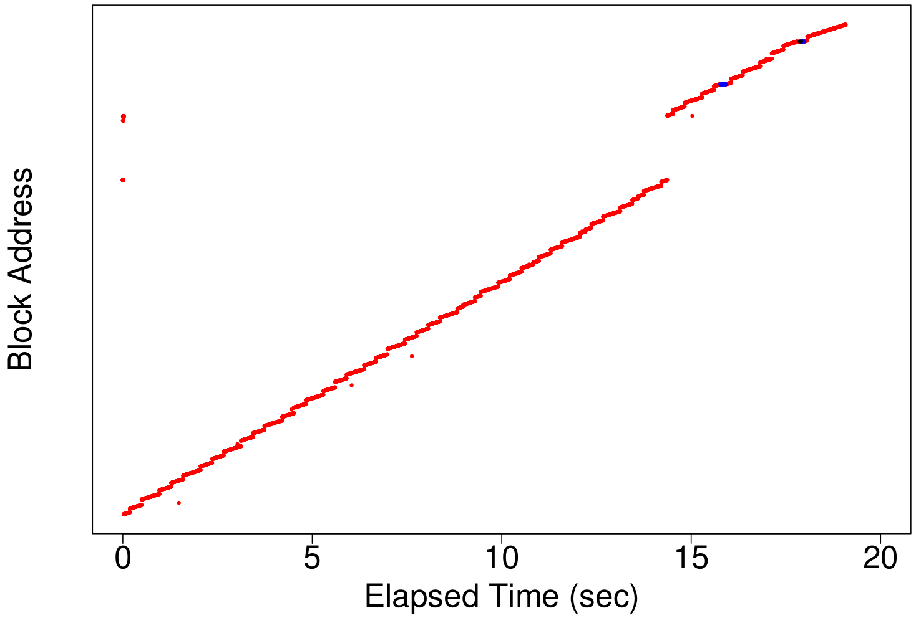
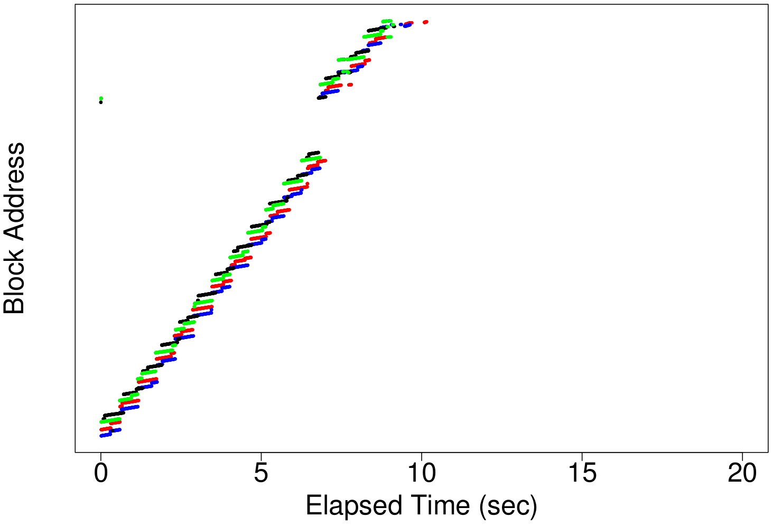
Single-threaded vs. Parallel Export from PostgreSQL
Single-thread export
(1 reader from disk)
4-thread export
(4 readers from disk)

Slide 78
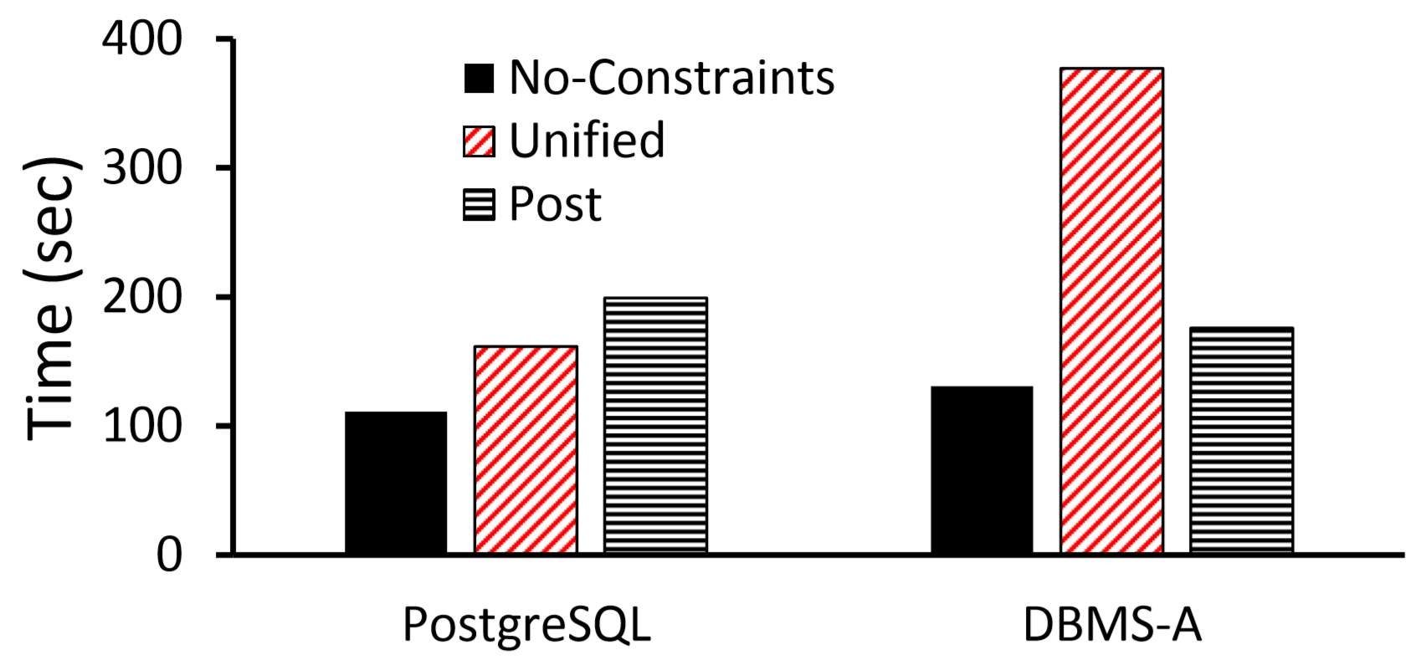
Parallel loading in the presence of PK constraints

