Slide 1
Multilevel (Hierarchical) Modeling: What It Can and Cannot Do (Gelman, 2006)
Presented by irena KAPLAN
November 14, 2018

Slide 2
Why do we need Hierarchical/multilevel models?
Causality
In some situations, we cannot run an experiment with randomized treatment. For example, we cannot randomly assign residents to housing, candidates to districts, or teachers to schools.
What we do have are large and complex data sets, with internal groupings and structures.
For example, houses roll up to blocks, neighborhoods, and districts. This is a hierarchical structure.
Districts and neighborhoods can, on the other hand, form cross groupings.
We need to account for the structure of the observations.

Slide 3
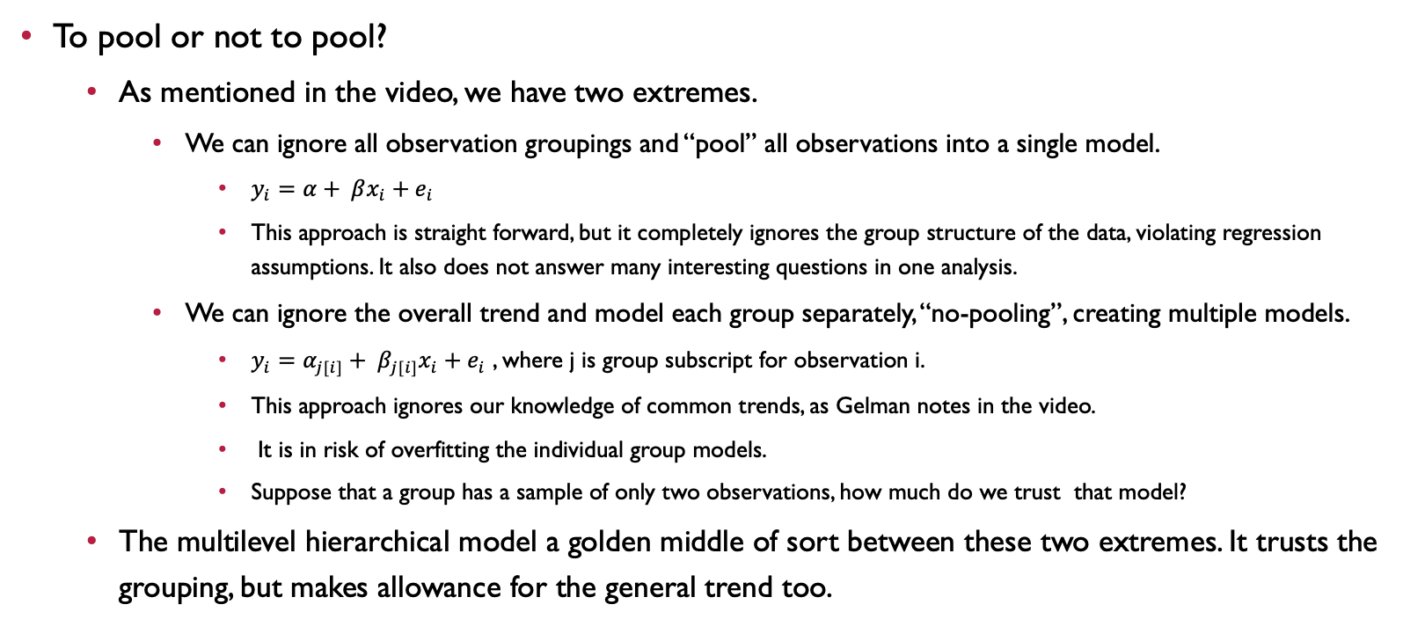
“If you can trust yourself when all men doubt you, But make allowance for their doubting too;” –R. Kipling.
To pool or not to pool?
As mentioned in the video, we have two extremes.
We can ignore all observation groupings and “pool” all observations into a single model.
$y_{i}=α+ βx_{i}+e_{i}$
This approach is straight forward, but it completely ignores the group structure of the data, violating regression assumptions. It also does not answer many interesting questions in one analysis.
We can ignore the overall trend and model each group separately, “no-pooling”, creating multiple models.
$y_{i}=α_{j[i]}+ β_{j[i]}x_{i}+e_{i}$ , where j is group subscript for observation i.
This approach ignores our knowledge of common trends, as Gelman notes in the video.
It is in risk of overfitting the individual group models.
Suppose that a group has a sample of only two observations, how much do we trust that model?
The multilevel hierarchical model a golden middle of sort between these two extremes. It trusts the grouping, but makes allowance for the general trend too.

Slide 4
Setting
Radon is a naturally occurring gas linked to cancer, which you really don’t want to have in your home.
Gelman (2006) picks of 85 Minnesota counties with 919 houses, out of the 80,000 nationally surveyed by EPA, in order to determine whether each county is “safe”.
The data has a hierarchical structure: houses within counties.
Houses have basement measures of radon.
Counties have measures of uranium in the soil.
This calls for a multilevel hierarchical model (in this case it’s a Bayesian model).

Slide 5
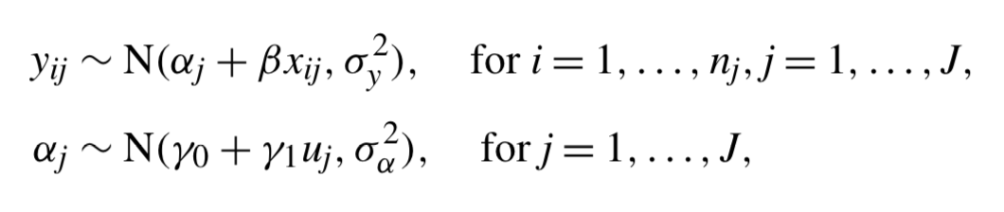
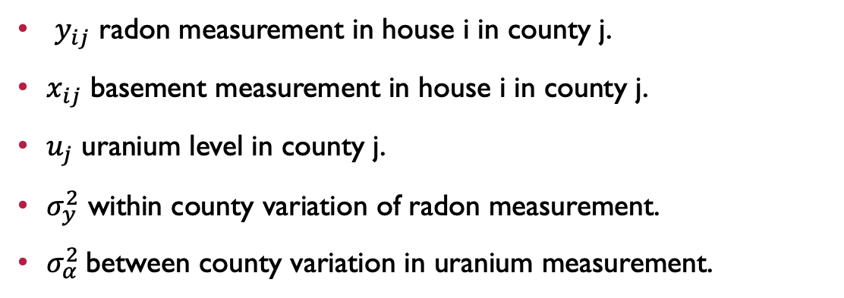
Am example of a simple Hierarchical model with varying intercept
$y_{ij}$ radon measurement in house i in county j.
$x_{ij}$ basement measurement in house i in county j.
$u_{j}$ uranium level in county j.
$σ_{y}^{2}$ within county variation of radon measurement.
$σ_{α}^{2}$between county variation in uranium measurement.

Slide 6
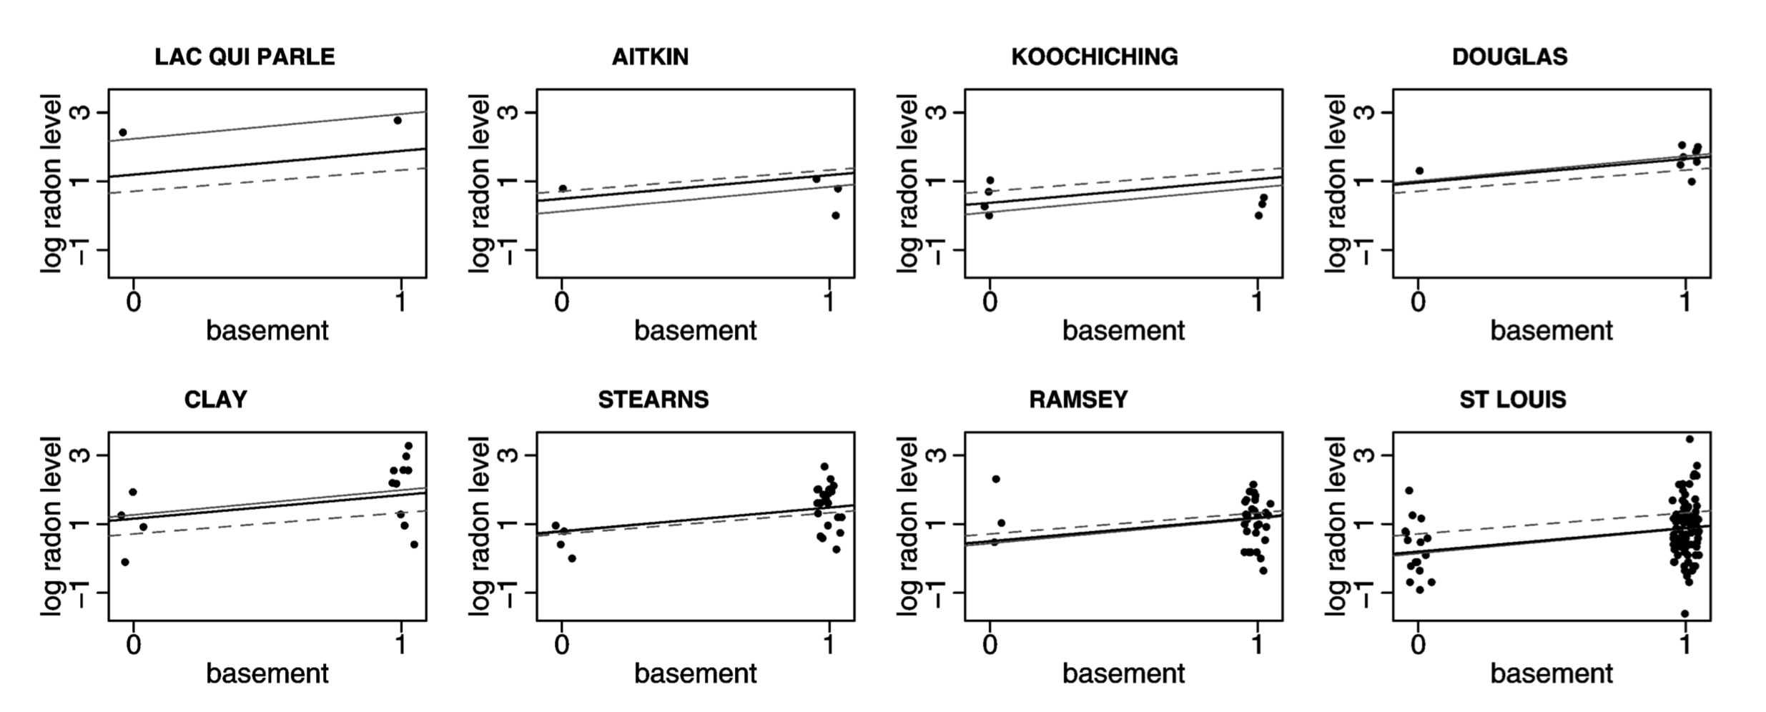
Am example of a simple model with varying intercept

Slide 7
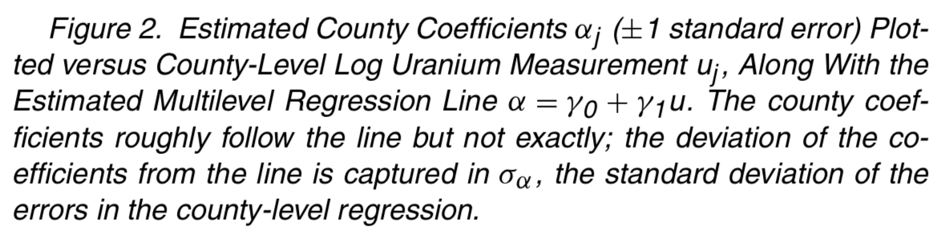
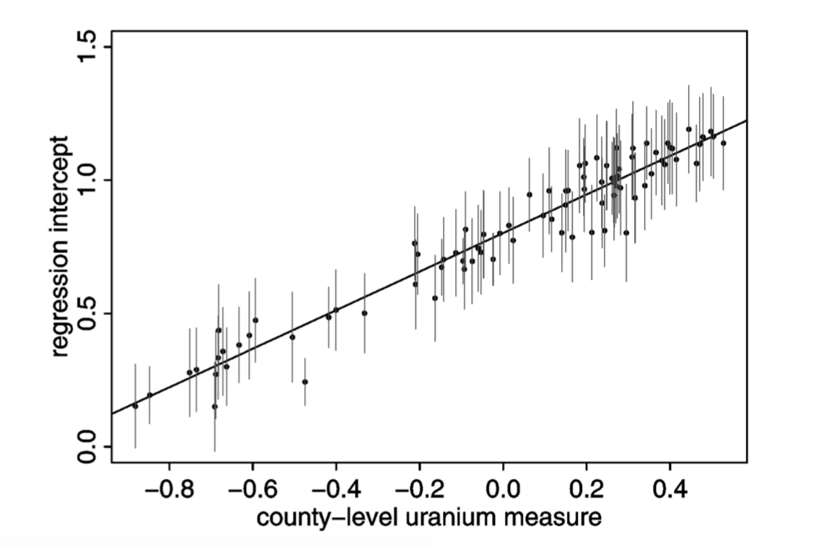
The model allows us to utilize individual observations, adjusting them to the general trend.
This allows us to predict the levels of radon in new counties (adjacent counties in different states, for example).
We can further expand the model to explore the effect of basements on radon levels in homes.

Slide 8
Further Reading
R packages
Rstan: http://mc-stan.org/users/interfaces/rstan
lme4: https://cran.r-project.org/web/packages/lme4/lme4.pdf
Data and software for Gelman and Hill’s book on hierarchical multivariate models: http://www.stat.columbia.edu/~gelman/arm/software/

Slide 9
Useful References
Gelman’s paper on radon in Minnesota counties: http://www.stat.columbia.edu/~gelman/research/published/multi2.pdf
An unabbreviated version of Gelman’s 2015 talk at the New York R conference: https://www.youtube.com/watch?v=ObS1hkOxyPA
Slides from the talk: http://www.stat.columbia.edu/~gelman/presentations/call_me_bayesian.pdf
A book on hierarchical models by Gelman and Hill: https://www.amazon.com/Analysis-Regression-Multilevel-Hierarchical-Models/dp/052168689X
Kipling’s works: https://www.amazon.com/Works-Rudyard-Kipling-500-works-ebook/dp/B002VWLMAC

