Slide 1
PROJECT CLEAR WATER
Renel Chesak and Callin Osborn
github.com/rchesak/Chicago-Beaches

Slide 2
CONTEXT
20 public beaches in Chicago
E. Coli beach cultures take too long to get results back
USGS model used to predict (old method)

Slide 3
MOTIVATIONS
Show citizens
How clean the beaches are
Which beaches are related
Swimmable beach days at each beach
What factors influence E. Coli levels
Criteria used for decision making
Allow citizens to play “Data Scientist”

Slide 4
Methodologies/findings
https://rchesak.shinyapps.io/e-coli-beach-predictions/

Slide 5
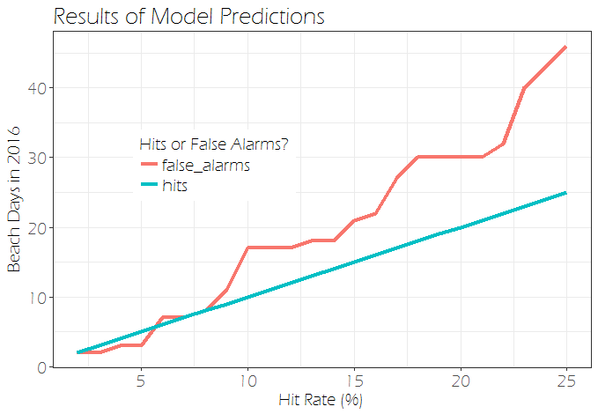
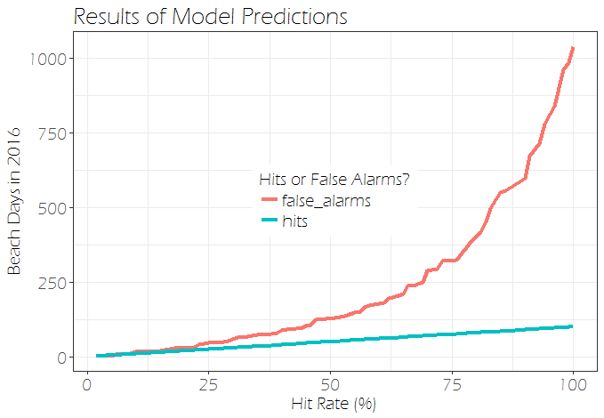
OPTIMIZATION PROBLEM
A 6% hit rate is optimal
False alarms lead to lost revenue from unnecessarily closing a beach

Slide 6
IMPLICATIONS AND CONCLUSIONS
Related beaches help predict each other
Precipitation is the only strong environmental predictor
Open-source modeling
Cultivates an informed and engaged community

Slide 7

Questions
GitHub:
github.com/rchesak/Chicago-Beaches

