Slide 1
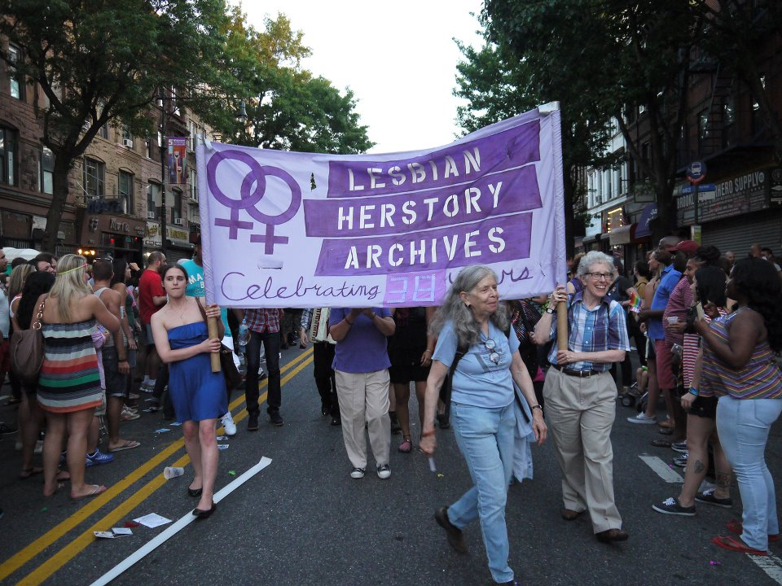
“In memory of the voices we have lost”

Slide 2
“How do you want to be memorialized?”
“The mission has always been, to not just protect and preserve, but to really figure out how to give back to the community our own cultural history. We’ve sort of been denied access to our own history… It’s very easy for everybody to feel isolated. So we said, ‘wait a minute, we have to stop this process of the loss of history.’”
      Deborah Edel, Co-founder of the Lesbian Herstory Archives
Source: http://www.youtube.com/watch?v=yvWitSa3PwA

Slide 3
Statement of Purpose
“The Lesbian Herstory Archives exists to gather and preserve records of Lesbian lives and activities so that future generations will have ready access to materials relevant to their lives. The process of gathering this material will uncover and collect our herstory denied to us previously by patriarchal historians in the interests of the culture which they serve. We will be able to analyze and reevaluate the Lesbian experience; we also hope the existence of the Archives will encourage Lesbians to record their experiences in order to formulate our living herstory.”
Source: http://www.lesbianherstoryarchives.org/history.html

Slide 4
Principles
All Lesbian women must have access to the Archives; no academic, political, or sexual credentials will be required for use of the collection; race and class must be no barrier for use or inclusion.
The Archives shall be housed within the community, not on an academic campus that is by definition closed to many women.
The Archives shall be involved in the political struggles of all Lesbians.
Archival skills shall be taught, one generation of Lesbians to another, breaking the elitism of traditional archives.
The community should share in the work of the Archives.
Funding shall be sought from within the communities the Archives serves, rather than from outside sources.
The community should share in the work of the Archives.
The Archives will always have a caretaker living in it so that it will always be someone's home rather than an institution.
The Archives will never be sold nor will its contents be divided.
Source: http://www.lesbianherstoryarchives.org/history.html

Slide 5
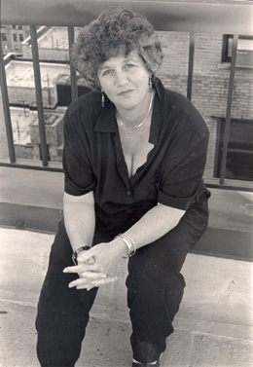
Background
In 1972, a group of women and men from the City University of New York founded the Gay Academic Union (GAU).
The next year, Joan Nestle of GAU, and her then-partner Deborah Edel, formed a separate, off-shoot group to discuss sexism and other issues that had arisen in the membership.
In 1974, and with the help of Julia Stanley, Mabel Hampton, Sahli Cavallo, and Pamela Oline, the beginnings of a grassroots lesbian archive was born. Regular consciousness-raising meetings and discussions were held.
Photo: http://www.joannestle.com

Slide 6
“…all lesbians were worthy of inclusion in herstory…if you have the courage to touch another woman, you are a famous lesbian.”
      Joan Nestle

Slide 7
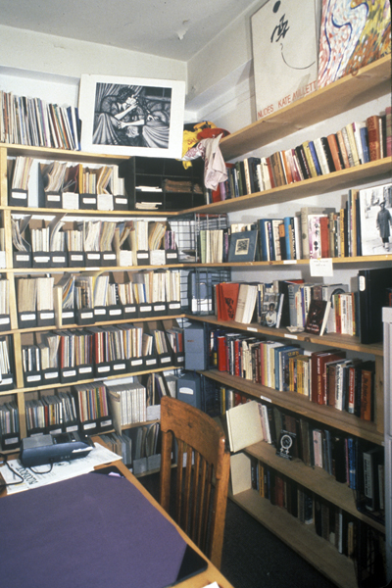
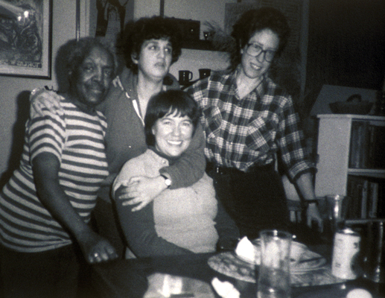
Background, cont’d
By 1975, Joan Nestle’s apartment in the Upper West Side of Manhattan became the home of the Lesbian Herstory Archives (LHA)
The LHA contains books, unpublished works, buttons, clothes, CDs, DVDs, periodicals, films, photographs, conference proceedings, and more -- all, with few exceptions, donated to the Archives
Other contributors to the LHA have included Judith Schwartz (pictured), a lesbian historian, and Georgia Brooks, who founded the first Black Lesbian Studies group at the LHA
Photos: http://www.lesbianherstoryarchives.org/history.html

Slide 8
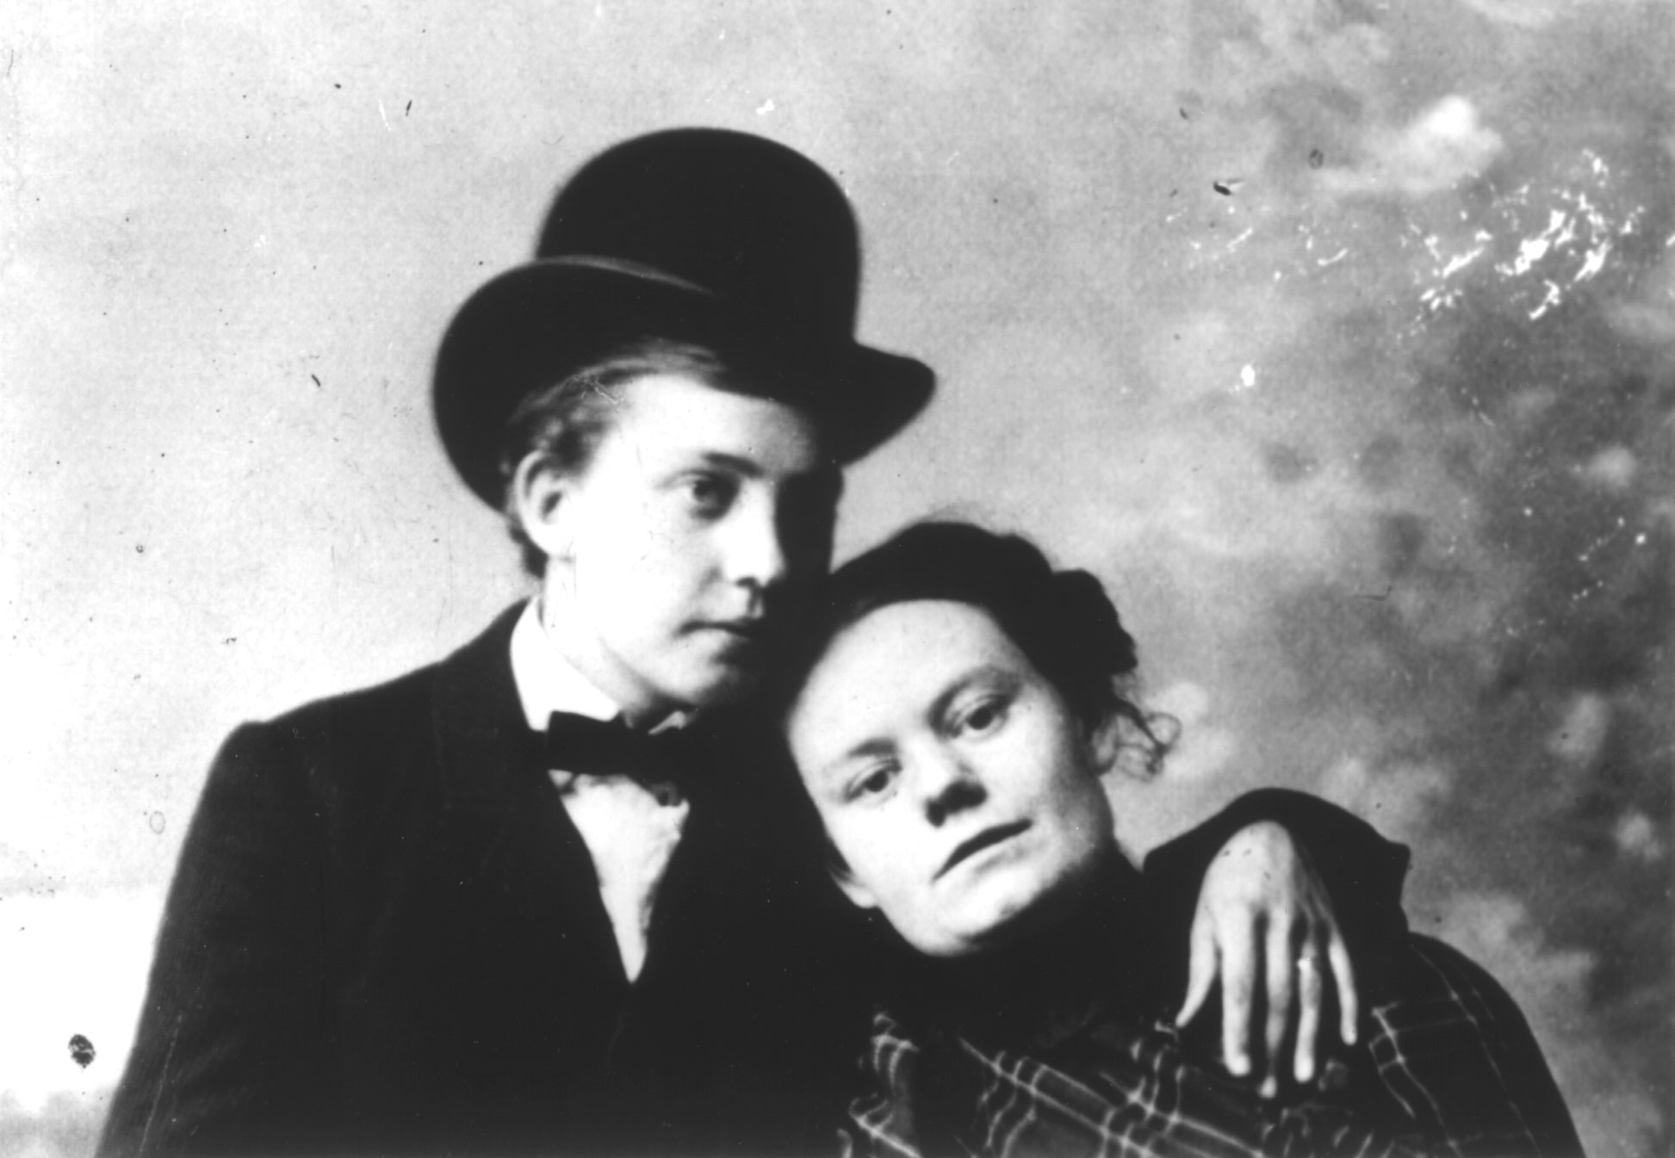
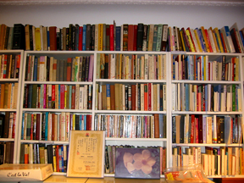
Collections
Tens of thousands of works for, by, and about lesbians
Fiction, biography, autobiography, and literary criticism (largest section)
Poetry and prose anthologies (including “survival literature” written from 1930s-60s)
Non-fiction, including oral herstories, lesbian feminism, lesbian theory, culture, sports, health, sexuality, etc.
Reference and special collections
International collection
Red Dot Collection (donated to the LHA by Jane Kogan of the New York chapter of the Daughters of Bilitis after its disbandment in 1971)
Photos: http://www.lesbianherstoryarchives.org/tourcoll.html, http://ur.umich.edu/9899/Jun07_99/11.htm

Slide 9
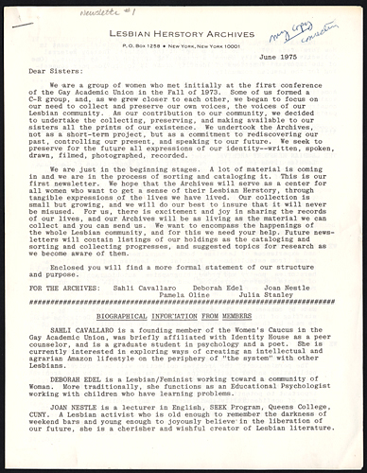
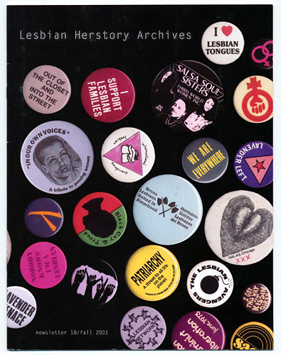
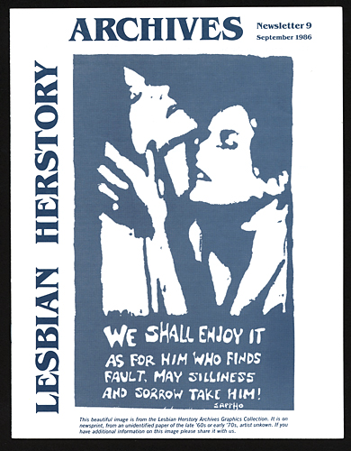
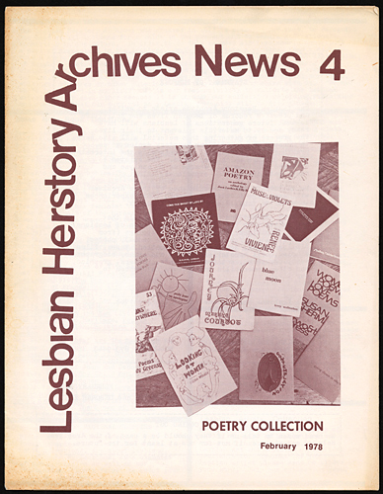
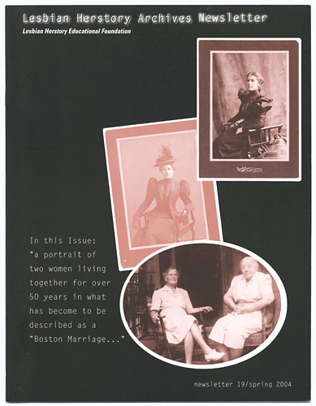
Newsletters
LHA’s first newsletter was published in June 1975 at the behest of several other lesbian, gay, and feminist publications; they are free of charge and produced by the hard work of volunteers, as is everything at the LHA.
Photos: http://www.lesbianherstoryarchives.org/newsletters.html

Slide 10
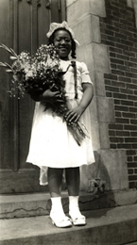
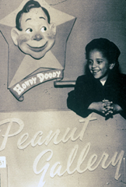
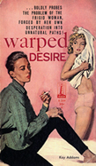
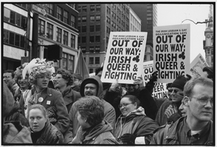
Exhibits
The Archives house 4 traveling exhibits
  Queer Covers: Lesbian Survival Literature
    Literature and erotica featuring campy, butch/fem icons and covers
  Keepin’ On: Images of African American Lesbians
  Audre Lorde
  Irish Lesbian and Gay Organization
Photos: http://www.lesbianherstoryarchives.org/exhibits.html

Slide 11
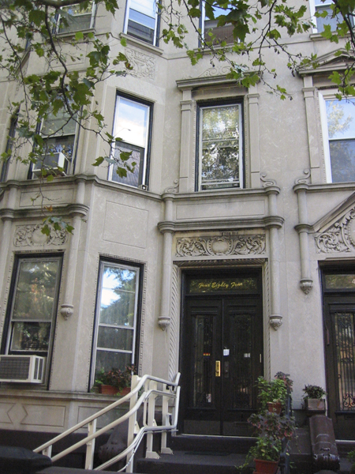
More Recent History
The Archives moved to Park Slope, Brooklyn, in June 1993 to accommodate the growing collection.
  “The bank was dubious about taking a risk on our non-hierarchical collective with no guaranteed source of income, but we raised money to pay back the bank in record time.”
  Not-for-profit resource center
Photo: http://www.lesbianherstoryarchives.org/tourintro.html

Slide 12
Parallels?
Jagose
Gayle Rubin
Sedgwick
Faderman

Slide 13
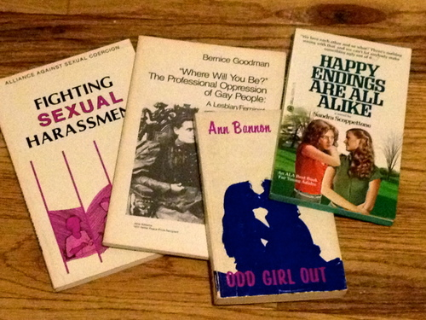

Slide 14
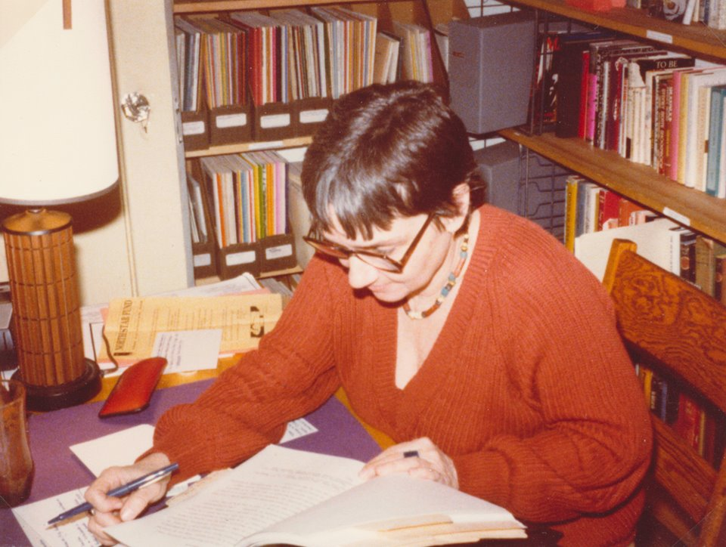

Slide 15
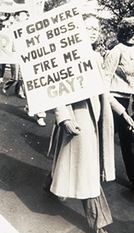
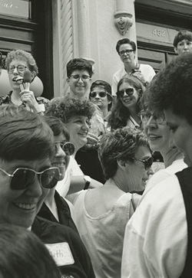

Slide 16
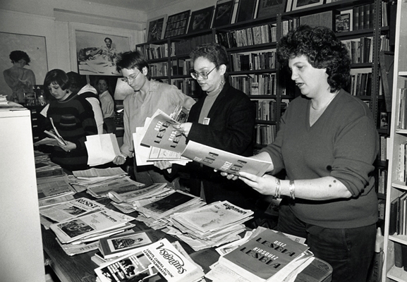

Slide 17
