Slide 1
Tutorial for Database setting & Demo
Team#13
Peng, Junyi A20358525
Huang, Yitong A20385942
Zhang, Rui A20365519

Slide 2
Tutorial

Slide 3
A. Database Set up
Database configuration file is under the fold BS/src/main , which named MainClass.java, import the whole fold into your computer, compile the file and run the code and please make sure you set up the right environment in tutorial#2.

Slide 4
B. Demo Set up
Import the demo project into your computer, make sure set the environment in tutorial#4 and run the four codes files listed:
BookFrame.java (for CREATE operation)
ProductOrderFrame.java (for READ operation)
CustomerOrder.java (for UPDATE operation)
MemberShipFrame.java (for DELETE operation)

Slide 5
Demo

Slide 6
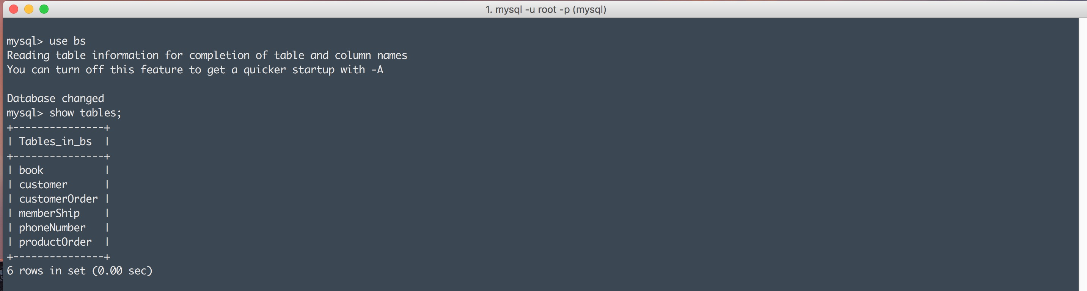
Show database
There are six tables in the BS database as show below

Slide 7
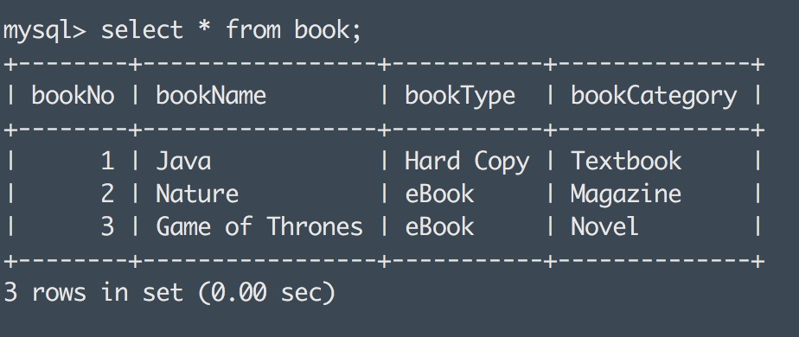
book table

Slide 8
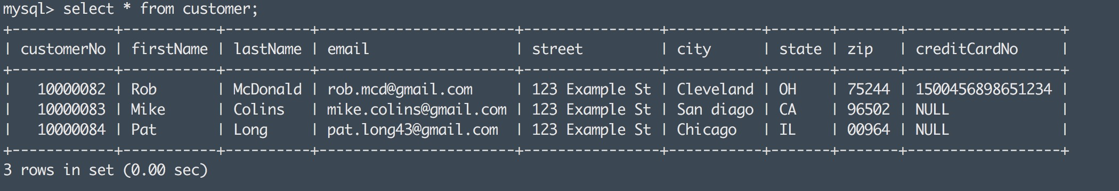
customer table

Slide 9
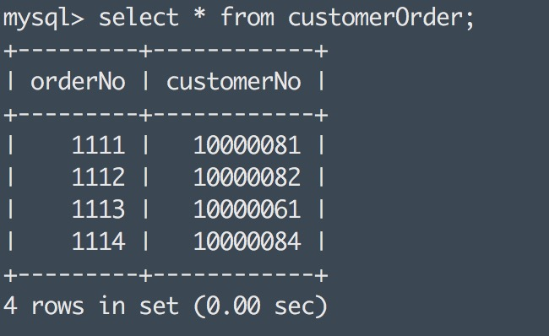
customerOrder table

Slide 10
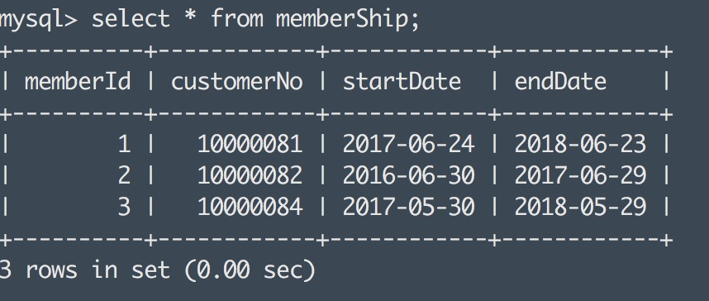
memberShip table

Slide 11
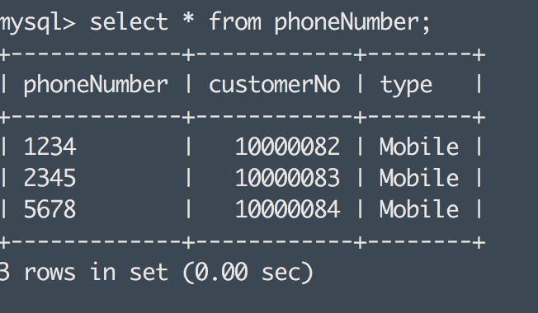
phoneNumber table

Slide 12
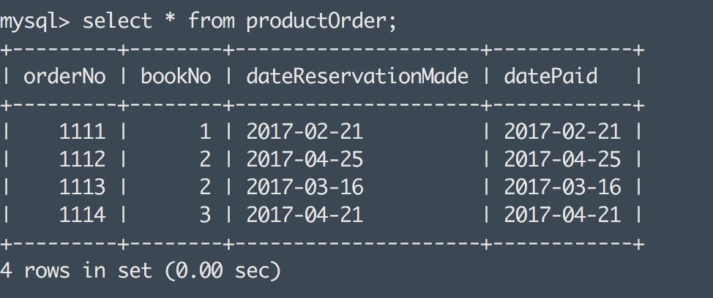
productOrder table

Slide 13
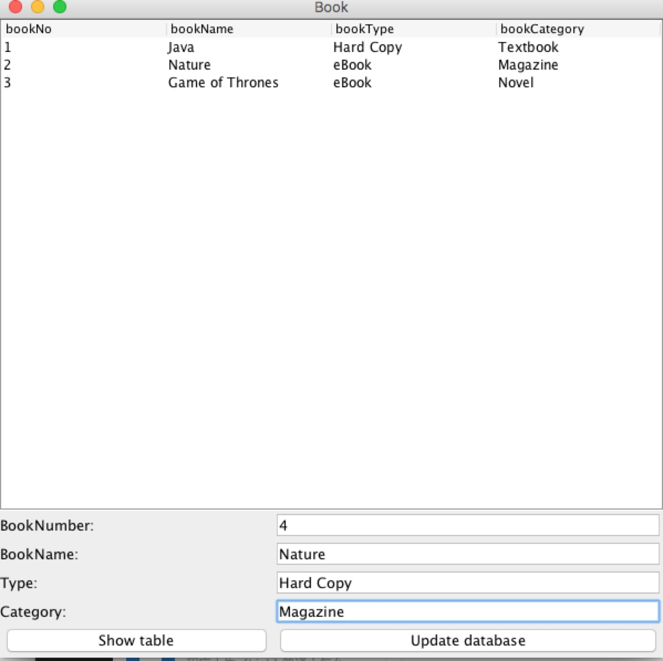
CREATE
Run the BookFrame.java file, and you can see the frame as shown in the picture.
Now, we need add a new book which bookNo is 4, bookName is Nature, Type is Hard Copy, and category is Magazine. Fill the data into the column as shown in the picture.
Enter data into column

Slide 14
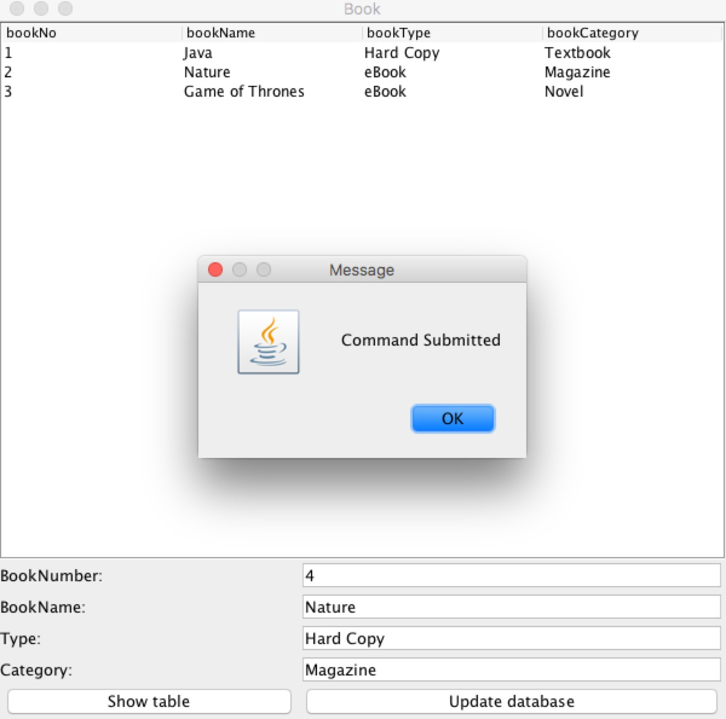
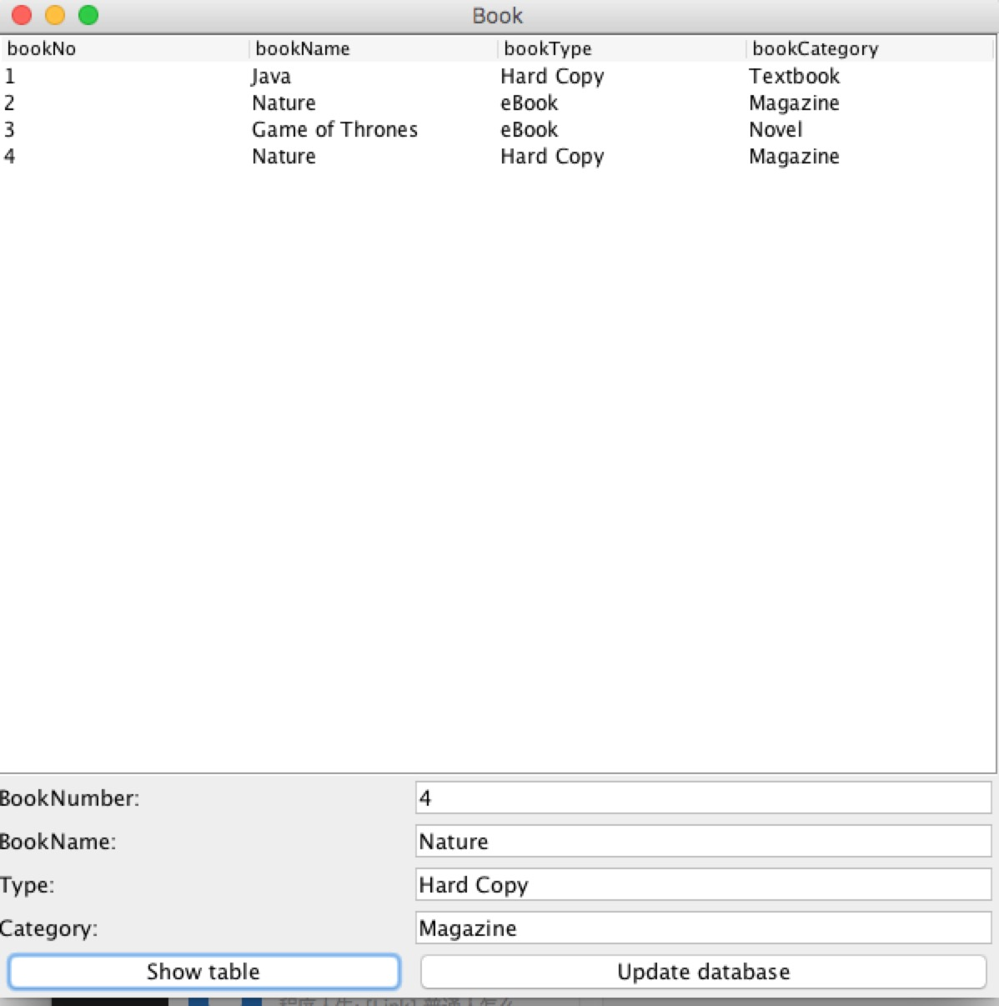
CREATE
After click update button, you will see the message box
Click show table button, it will return the latest table of book
Click this button, you will create a insert query to DB

Slide 15
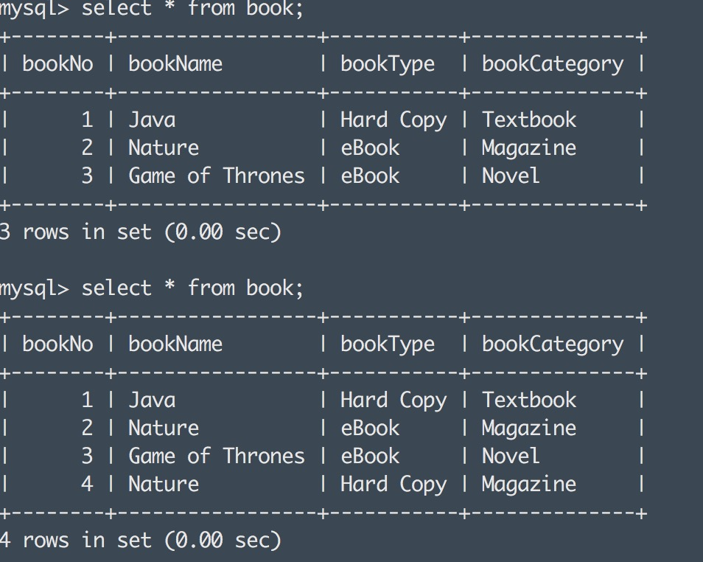
Verification on terminal

Slide 16
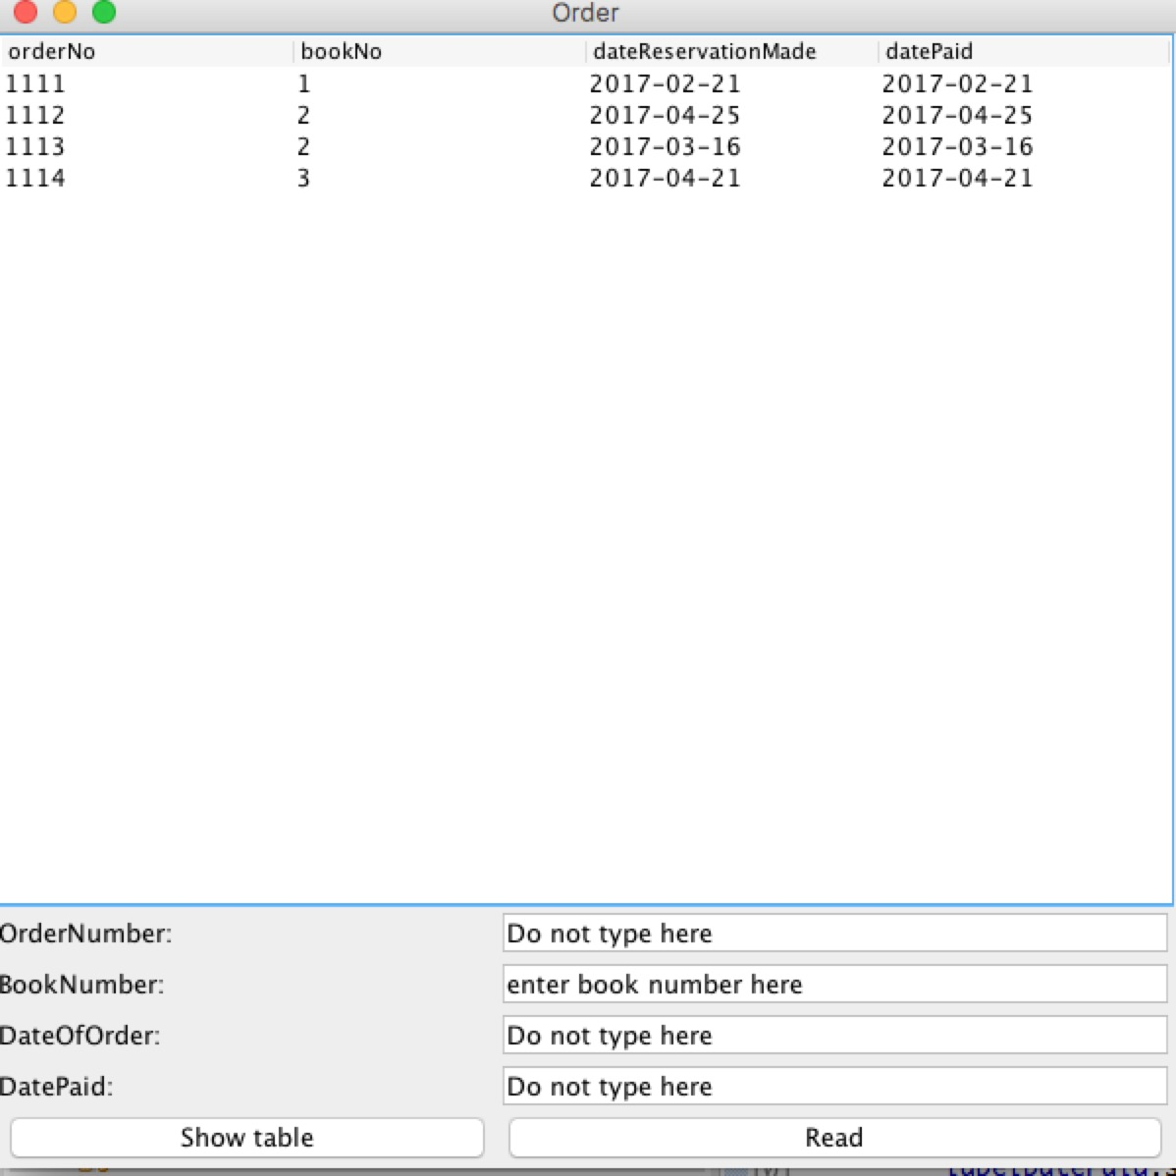
READ
Run ProductOrderFram.java file and the frame is shown in the picture
If I want to get all information of bookNo 2, then enter 2 into the BookNumber column.
Enter 2 into the column

Slide 17
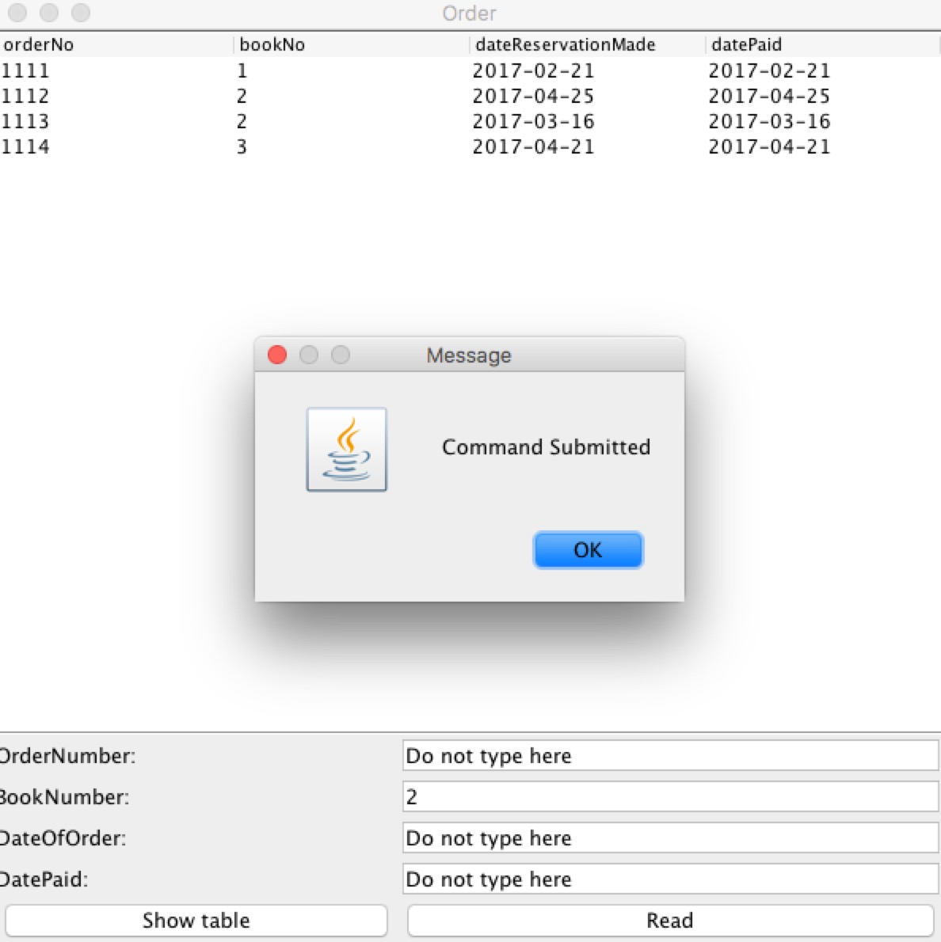
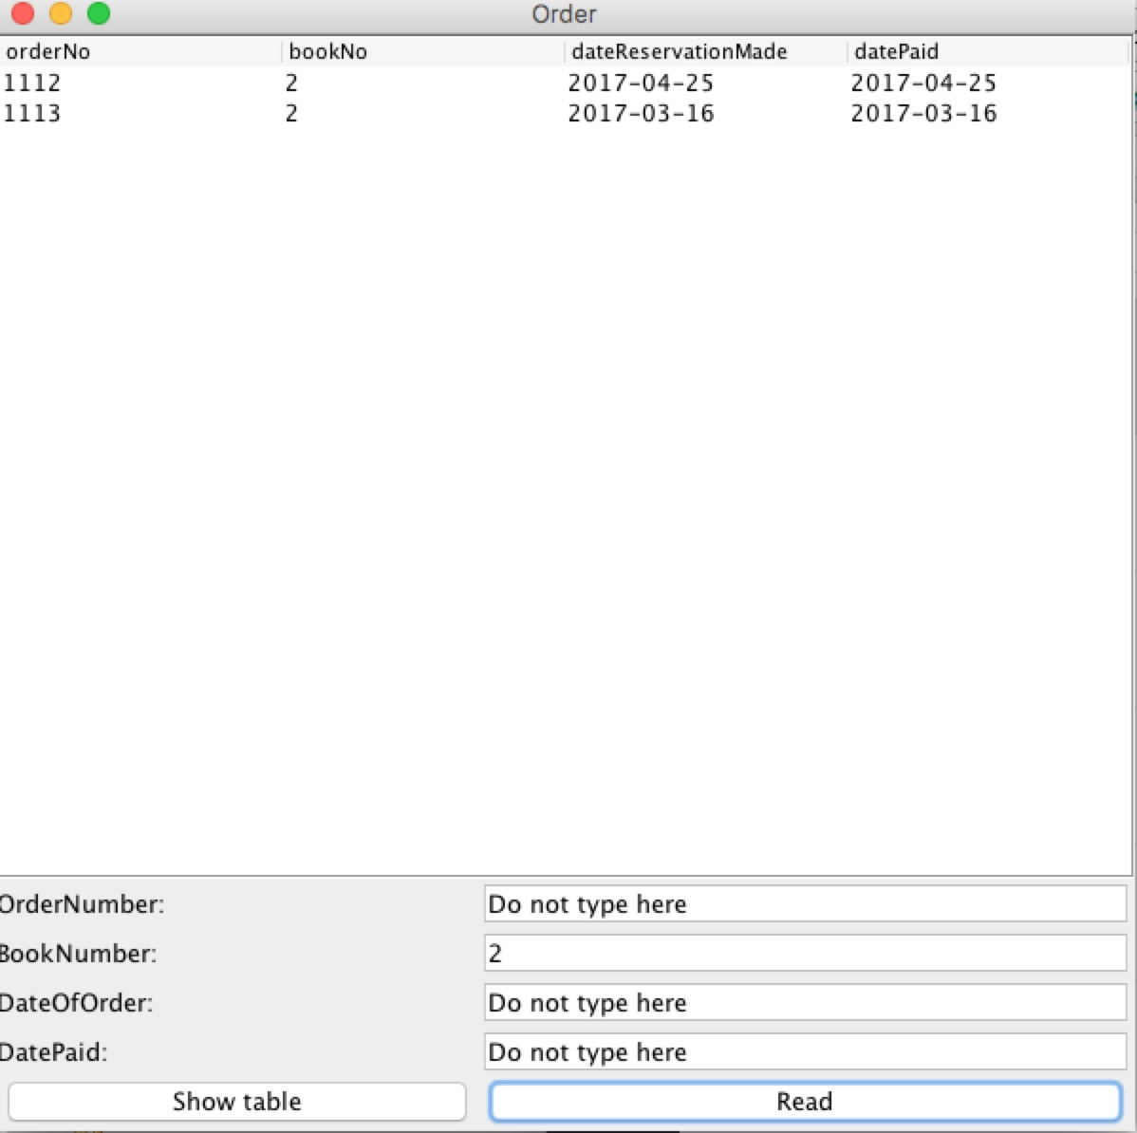
READ
After click ok button, you will see the information list here
After click update button, you will see the message box
Click Read button, you will create a select query to DB

Slide 18
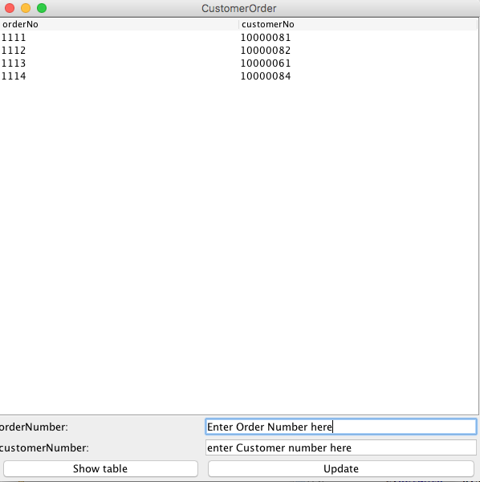
UPDATE
Run the CustomerOrderFrame.java file, and CustomerOrder table is shown in the picture.
We want to change customerNo 10000061 to 10000083, so we will enter orderNo 1113 and expected customerNo 10000083 into columns.
enter orderNo 1113 and expected customerNo 10000083 into columns.

Slide 19
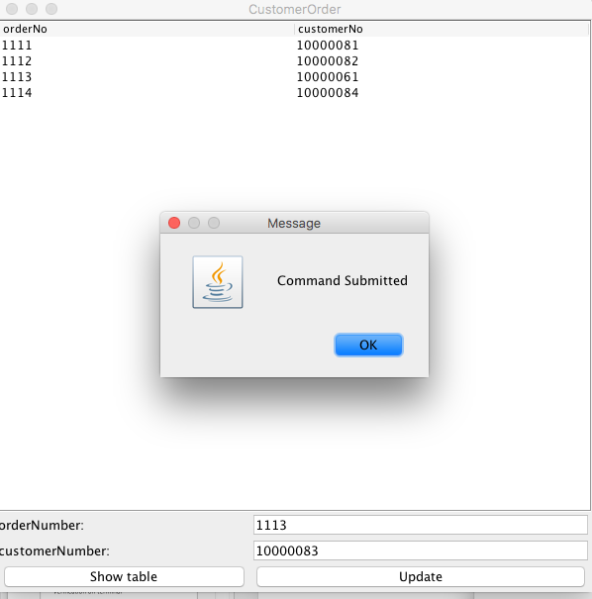
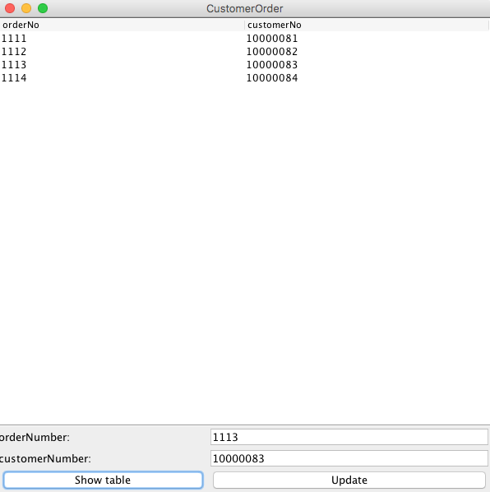
UPDATE
Click update button, you will create a update query to DB
Click show table button, it will return the latest table of customerOrder

Slide 20
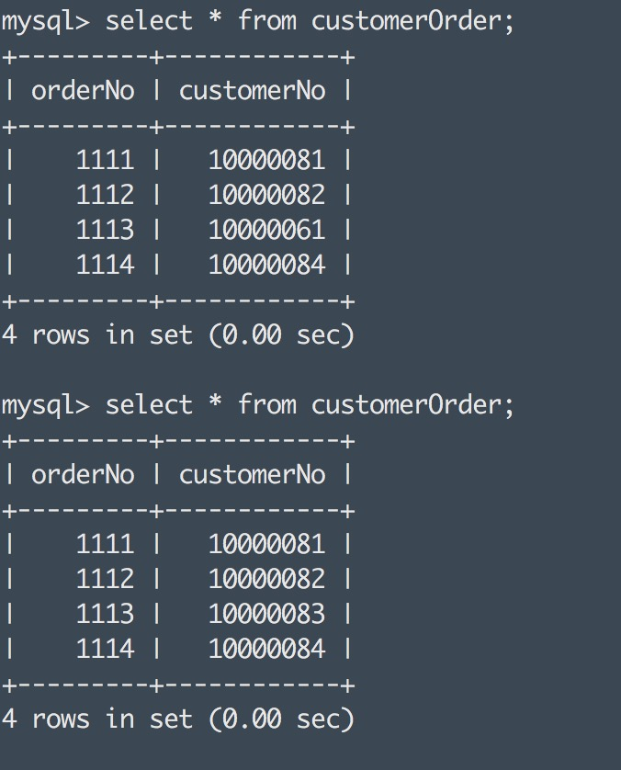
Verification on terminal

Slide 21
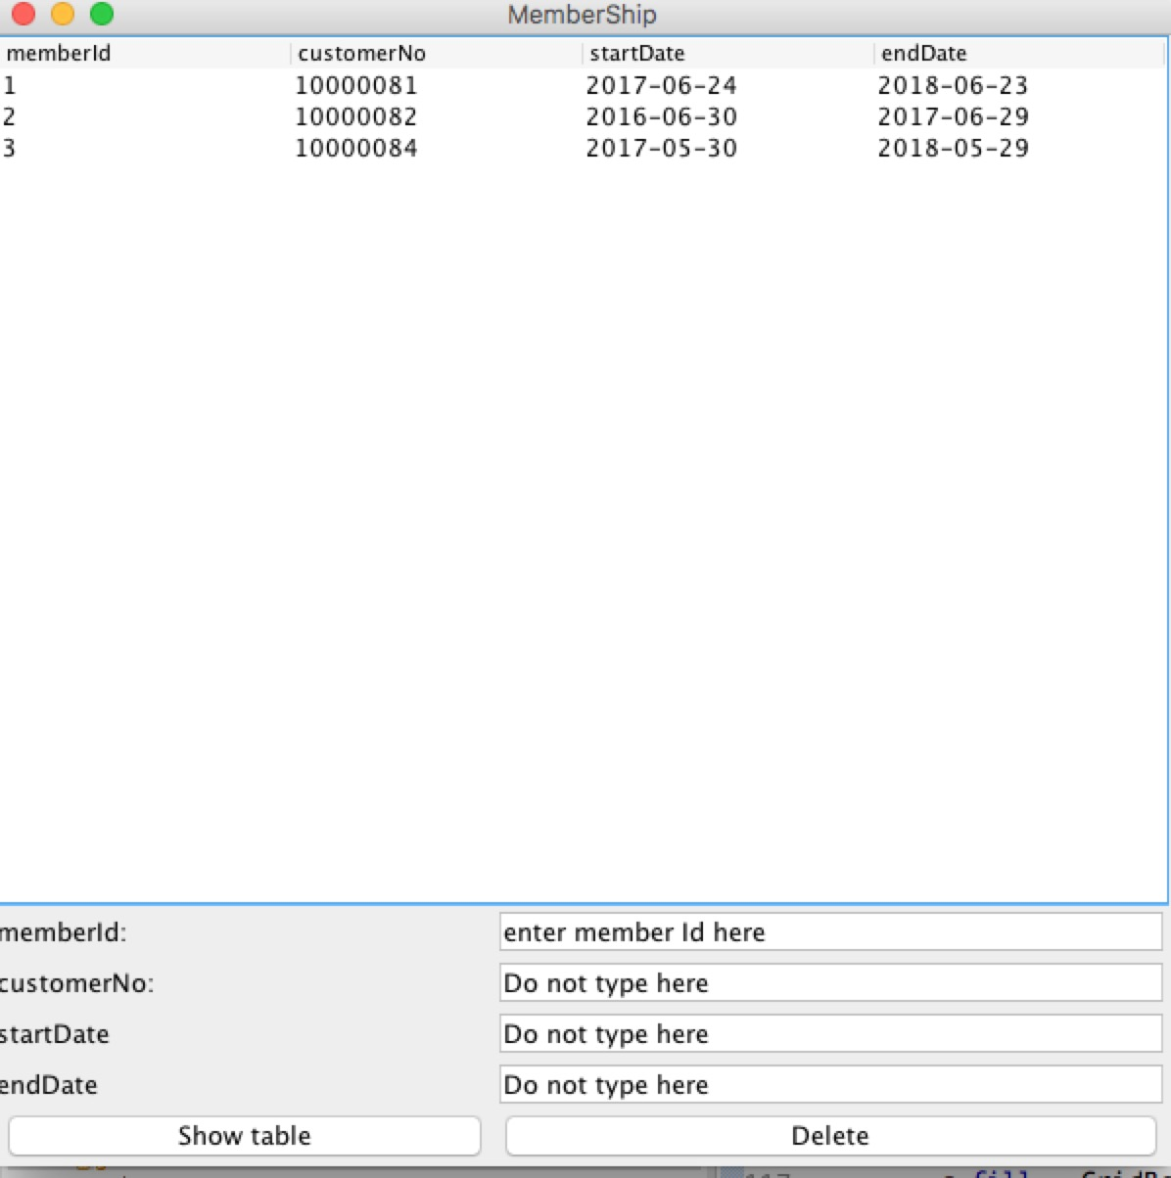
DELETE
Run MemberShipFrame.java and the memberShip table is shown in the picture.
As we can see, customer 10000082 membership is expired so we want to delete it.
Enter 2 into memberId column.
Enter 2 into column

Slide 22
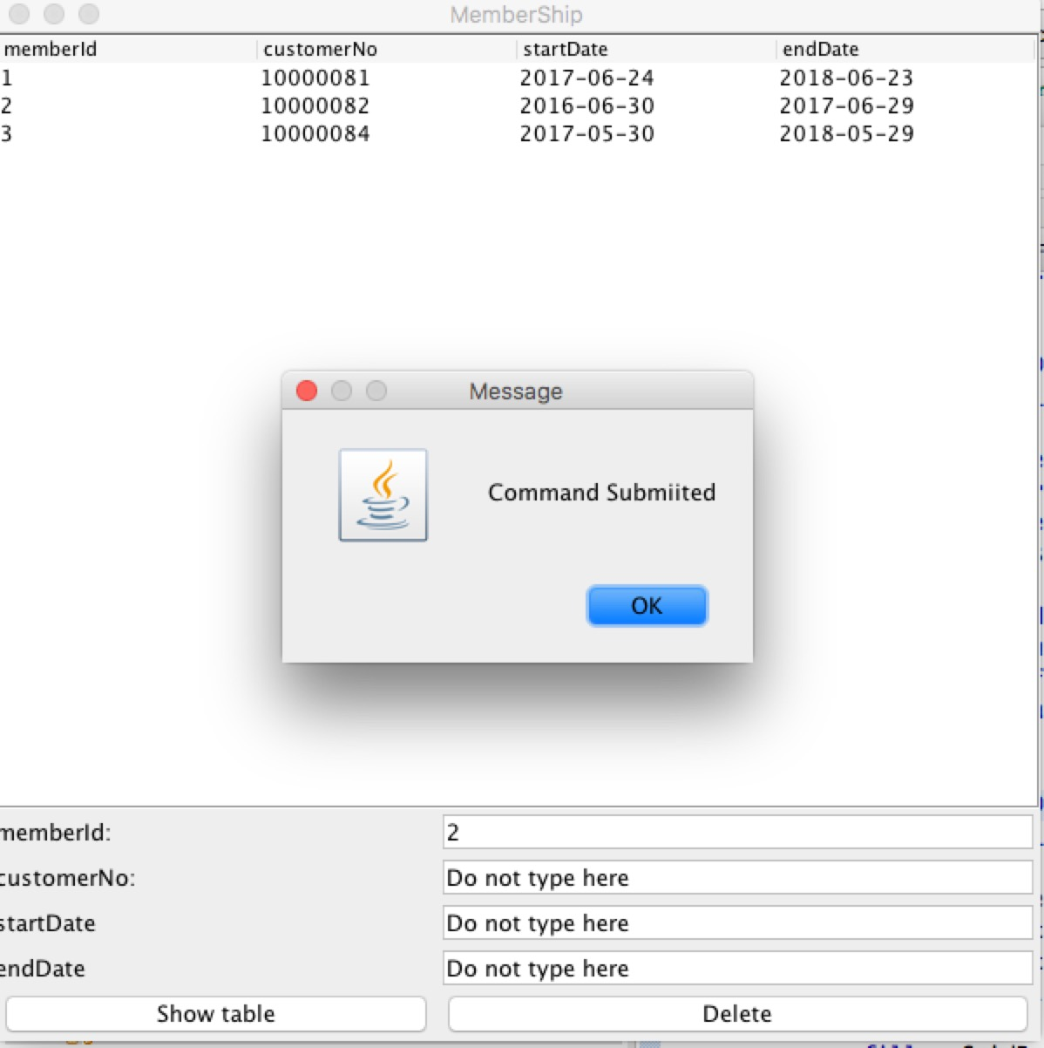
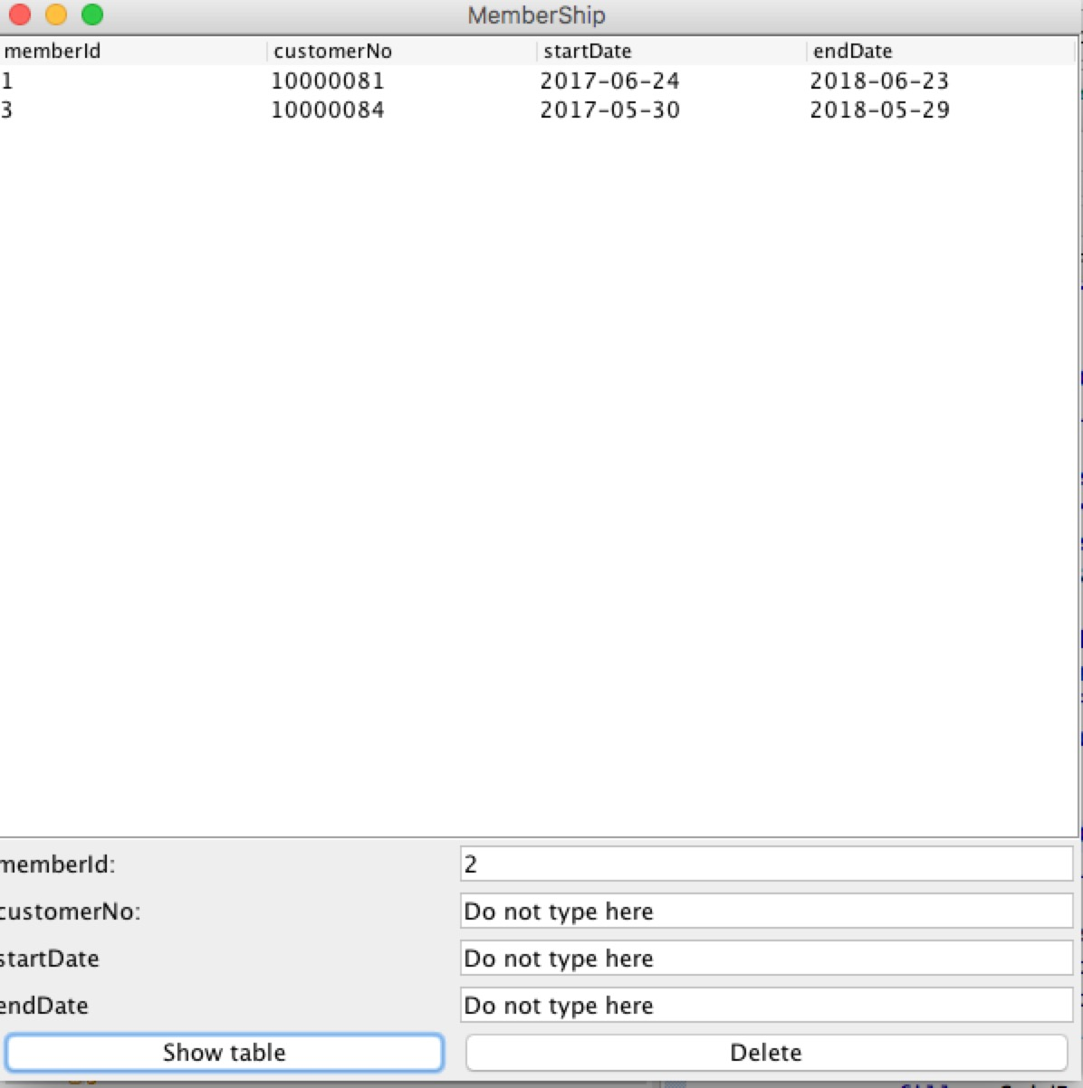
DELETE
Click delete button, you will create a delete query to DB
Click show table button, it will return the latest table of memberShip

Slide 23
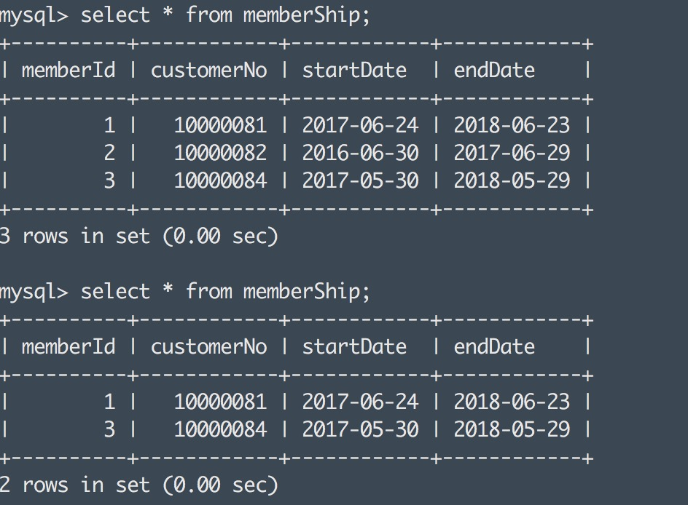
Verification on Terminal

