Slide 1
THE UNIVERSITY OF CHICAGO
Master of Science in Applied Data Science
GridIQ
Forecasting ERCOT Hourly Electricity Demand
An end-to-end data-engineering and forecasting pipeline
Team Isobar · Shane Dunkle · Joel · Emma · Monica
ADSP 31012 · Data Engineering Platforms for Analytics · Spring 2026
Notes:
Presenter: Shane. Hook: ERCOT runs ~90% of Texas's grid on an islanded interconnection. ~45s.

Slide 2
OVERVIEW
PRESENTER — SHANE
Agenda
I
The problem & the data
III
Data architecture & stores
II
Exploratory analysis
IV
Forecasting & findings
THE UNIVERSITY OF CHICAGO · M.S. IN APPLIED DATA SCIENCE
1
Notes:
Presenter: Shane. Four parts, four presenters. ~25s.

Slide 3
OVERVIEW
PRESENTER — SHANE
Executive summary
5
43,824
6 + 2
3
years of ERCOT
data (2021–2025)
validated
hourly records
SQL star tables +
Mongo & Neo4J
forecasting
models compared
What we built. A reproducible pipeline that ingests five years of federal ERCOT demand data, loads it into a relational star-schema warehouse alongside document and graph stores, and forecasts demand 24 hours ahead — benchmarked against ERCOT’s own operational forecast.
Headline finding. Temperature is the dominant driver of demand — adding cooling/heating degree-days materially cuts 24-hour-ahead error. A residual gap to ERCOT reflects load-zone weather and generation-schedule data unavailable in public sources.
THE UNIVERSITY OF CHICAGO · M.S. IN APPLIED DATA SCIENCE
2
Notes:
Presenter: Shane. The 'remember one slide' slide. ~50s.

Slide 4
PART I
The Problem & The Data
Why ERCOT demand forecasting matters — and the federal data behind it
THE UNIVERSITY OF CHICAGO · M.S. IN APPLIED DATA SCIENCE

Slide 5
PART I · PROBLEM & DATA
PRESENTER — SHANE
Business case & objectives
Why ERCOT demand forecasting matters
Project objectives
ERCOT operates the grid for ~90% of Texas load on an islanded interconnection — limited ability to import power in a crunch.
Accurate demand forecasts drive reserve planning, generator dispatch, and market pricing.
Winter Storm Uri (Feb 2021) exposed the cost of demand–supply mismatch: days-long statewide outages.
A natural capstone for data engineering: high-volume, time-series, multi-source.
Ingest 5 yrs of ERCOT data into relational + NoSQL stores
Profile demand patterns — temporal, quality, accuracy
Forecast demand 24 h ahead; benchmark vs ERCOT
Deliver an interactive dashboard and insights
THE UNIVERSITY OF CHICAGO · M.S. IN APPLIED DATA SCIENCE
3
Notes:
Presenter: Shane. Anchor on Uri. ~60s.

Slide 6
PART I · PROBLEM & DATA
PRESENTER — EMMA
Data source & profile
Source. U.S. EIA-930 ‘BALANCE’ bulk files — balancing authority ERCO (ERCOT), hourly.
Field | Description
demand_mw | Actual hourly electricity demand (target)
demand_forecast_mw | ERCOT’s own day-ahead forecast (benchmark)
net_generation_mw | Total net generation
total_interchange_mw | Net imports / exports
18 fuel columns | Generation by fuel type (from 2024)
At a glance
43,824 hourly rows (Jan 2021 → Jan 2026, UTC)
Schema evolved 44 → 65 columns at 2024
Gap-free in UTC; 57 imputed rows (0.13%)
Stored as Parquet for fast columnar reads
THE UNIVERSITY OF CHICAGO · M.S. IN APPLIED DATA SCIENCE
4
Notes:
Presenter: Emma. Flag the 44→65 schema evolution. ~60s.

Slide 7
PART I · PROBLEM & DATA
PRESENTER — EMMA
Ingestion & corralling (ETL)
I
Acquire
II
Concatenate
III
Clean
Pull EIA-930 bulk CSVs, 2021–2025 (10 half-year files)
Union all years; reconcile 44- vs 65-column schemas
De-duplicate (keep-last); UTC datetime index; drop unused fields
IV
Impute
V
Enrich
VI
Stage
Forward-fill short gaps; flag every fill with is_imputed
solar_night_flag; snake_case names; source-file lineage
Write validated Parquet — the single source of truth
THE UNIVERSITY OF CHICAGO · M.S. IN APPLIED DATA SCIENCE
5
Notes:
Presenter: Emma. Six steps; is_imputed + lineage = reproducibility. ~75s.

Slide 8
PART II
Exploratory Analysis
Three analytical lenses on five years of demand
THE UNIVERSITY OF CHICAGO · M.S. IN APPLIED DATA SCIENCE

Slide 9
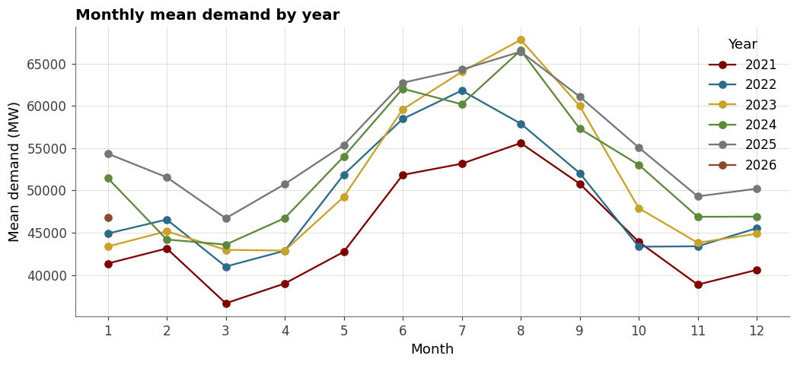
PART II · EXPLORATORY ANALYSIS
PRESENTER — SHANE
Temporal demand patterns
What the data shows
Strong summer peak — AC load in Jul–Aug runs ~40% above spring troughs.
Year-over-year growth — 2025 runs at or above prior years across most months.
Seasonality and temperature dependence motivate our weather features.
Monthly mean demand by year — EDA notebook (Lens 1).
THE UNIVERSITY OF CHICAGO · M.S. IN APPLIED DATA SCIENCE
6
Notes:
Presenter: Shane. Temporal lens — the summer cooling peak dominates; 2021 shows the Winter Storm Uri spike. ~60s.

Slide 10
PART II · EXPLORATORY ANALYSIS
PRESENTER — EMMA
Data quality
What the data shows
57 imputed rows total (0.13%) — 48 of them in Dec 2025, the most recent, least-settled data.
777 solar-night flags — overnight hours flagged for the solar sunrise-edge nuance.
685 demand outliers (IQR) — the extremes are genuine Aug 2023–24 summer peaks (~85,500 MW), not data errors.
Pre-2024 fuel columns are 100% null by design — structured nulls from the schema evolution, not missing data.
0.13%
of rows imputed (57 / 43,824)
685
demand outliers — genuine summer peaks
THE UNIVERSITY OF CHICAGO · M.S. IN APPLIED DATA SCIENCE
7
Notes:
Presenter: Emma. Data-quality lens: clean dataset — imputation is negligible and concentrated in the newest month; the 'outliers' are real Uri/summer extremes, which is reassuring.

Slide 11
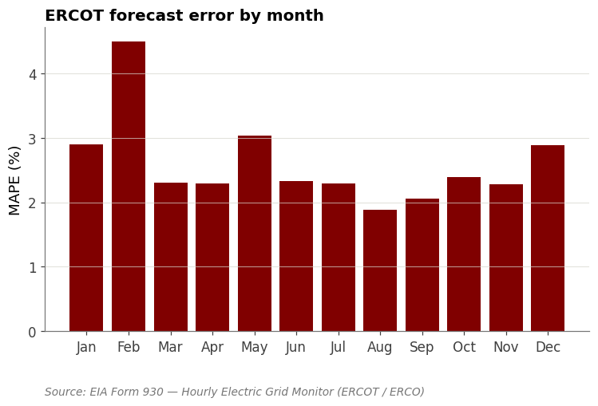
PART II · EXPLORATORY ANALYSIS
PRESENTER — JOEL
ERCOT forecast accuracy
2.49%
ERCOT day-ahead MAPE (2025) — the benchmark
In percentage terms ERCOT errs most in winter — February is the worst month — while the steady summer cooling load is forecast most accurately. Texas winter demand is the volatile, weather-driven case.
ERCOT day-ahead error by month — EDA notebook (Lens 3).
THE UNIVERSITY OF CHICAGO · M.S. IN APPLIED DATA SCIENCE
8
Notes:
Presenter: Joel/Shane. This is the baseline the three models are measured against. Full-sample MAPE 2.58%, 2025 test 2.49%. ~60s.

Slide 12
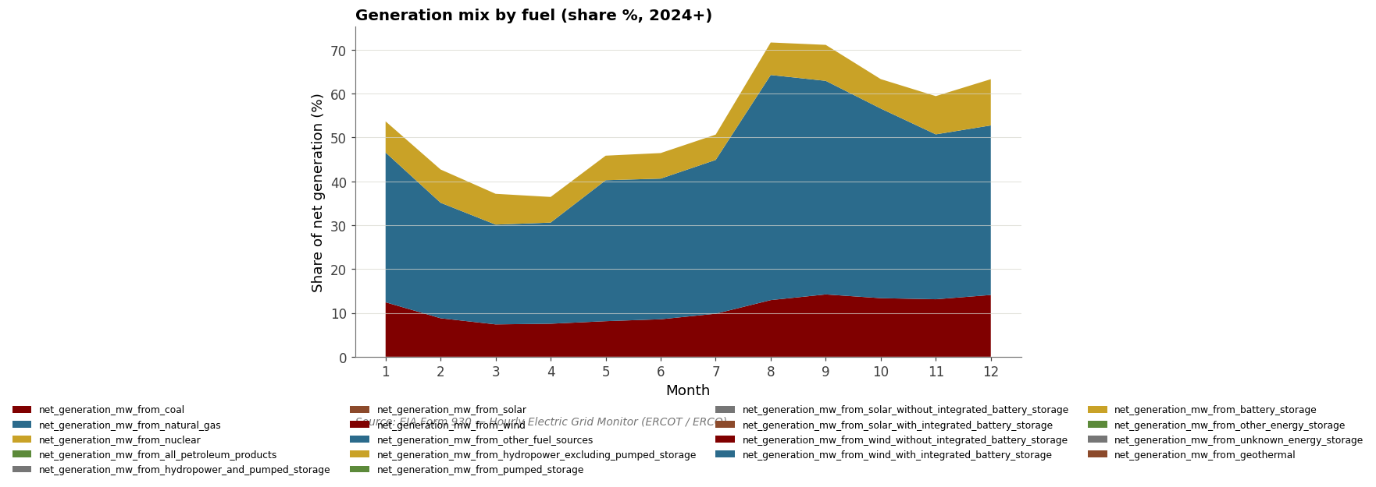
PART II · EXPLORATORY ANALYSIS
PRESENTER — SHANE
Cross-aggregation: fuel mix & balance
Cutting across measures
18 fuel types tracked from 2024; natural gas leads (~31%), with wind, coal, nuclear and solar making up most of the balance.
Solar contributes most during daytime hours — offsetting load when the sun is up.
System-balance check: net generation + interchange tracks demand to within ~180 MW on average — confirms data integrity.
Generation mix by fuel, 2024+ — EDA notebook (Lens 4).
THE UNIVERSITY OF CHICAGO · M.S. IN APPLIED DATA SCIENCE
9
Notes:
Presenter: Shane. Lens 4: fuel mix plus the system-balance integrity check (gap ~ -177 MW mean). ~45s.

Slide 13
PART III
Data Architecture & Stores
One pipeline, three stores — relational, document, and graph
THE UNIVERSITY OF CHICAGO · M.S. IN APPLIED DATA SCIENCE

Slide 14
PART III · DATA ARCHITECTURE
PRESENTER — MONICA
Methodology & data stores
Raw CSVs
ETL
Warehouse
NoSQL
Analytics
→
→
→
→
EIA-930
bulk files
clean · impute
stage
MySQL star
schema (OLAP)
MongoDB +
Neo4J
models +
dashboard
Tooling
Python (pandas, XGBoost, statsmodels, Prophet) on Google Colab
MySQL (relational / OLAP) · MongoDB (document) · Neo4J (graph)
Power BI / Tableau dashboard · shared config & visualization modules for reproducibility
THE UNIVERSITY OF CHICAGO · M.S. IN APPLIED DATA SCIENCE
10
Notes:
Presenter: Monica. Walk the pipeline; name the three stores. ~60s.

Slide 15
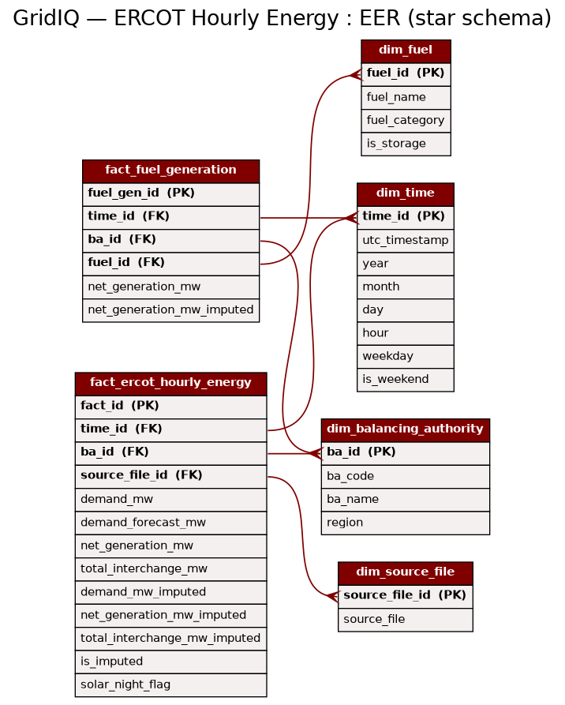
PART III · DATA ARCHITECTURE
PRESENTER — JOEL
Relational star schema
Design
Star schema: two fact tables (hourly energy, fuel generation) around four conformed dimensions.
Dimensions in 3NF; facts hold additive measures — classic OLAP for time-series rollups.
dim_time drives hour/day/season aggregation; dim_source_file preserves lineage.
Surrogate keys; foreign keys enforce referential integrity.
THE UNIVERSITY OF CHICAGO · M.S. IN APPLIED DATA SCIENCE
11
Notes:
Presenter: Joel. Walk the EER; OLTP source vs OLAP star + normalization. ~75s.

Slide 16
PART III · DATA ARCHITECTURE
PRESENTER — JOEL
SQL analysis & insights
Q1 · Peak demand hours
Q2 · Load shape
Top load concentrates in summer late-afternoon / evening — the AC-driven system peak.
Weekday vs weekend profiles differ sharply; mornings ramp earlier on weekdays.
Q3 · Forecast error by month
Q4 · Fuel mix
ERCOT’s percentage error peaks in winter (Feb); the steady summer load is forecast most accurately.
Generation share by fuel (2024+) — context for net-generation vs demand.
THE UNIVERSITY OF CHICAGO · M.S. IN APPLIED DATA SCIENCE
12
Notes:
Presenter: Joel. Four queries; results saved to BI/. ~60s.

Slide 17
PART III · DATA ARCHITECTURE
PRESENTER — MONICA
NoSQL — MongoDB (document store)
One document per hour — 43,824 documents loaded into gridiq.hourly_readings (MongoDB 7.0).
Nested measures + a fuels sub-document (empty pre-2024, populated after) + quality flags — the flexible schema absorbs the 44→65 column evolution with no migration.
Indexed on ts (unique) and (year, month); validated against the data-quality counts — 57 imputed, 777 solar-night.
Aggregation pipeline: avg demand by year, peak-demand hour (85,544 MW, Aug 2024), fuel mix.
Sample document
{
"_id": "2024-01-01T00:00Z",
"ba": "ERCO",
"demand_mw": 44394,
"forecast_mw": 42787,
"net_generation_mw": 44370,
"time": { "year":2024, "month":1, "hour":0 },
"fuels": { "natural_gas":18497,
"wind":10946, "coal":8353,
"nuclear":5115, "solar":1056, ... },
"flags": { "imputed":false,
"solar_night":false }
}
THE UNIVERSITY OF CHICAGO · M.S. IN APPLIED DATA SCIENCE
13
Notes:
Presenter: Monica. Real MongoDB 7.0 — 43,824 hourly documents; counts cross-check the DQ figures (57 imputed, 777 solar-night); peak 85,544 MW Aug 2024. ~60s.

Slide 18
PART III · DATA ARCHITECTURE
PRESENTER — MONICA
NoSQL — Neo4J (graph store)
Property graph of the demand series: every HourlyReading links to its Month → Year and to the BalancingAuthority (ERCO).
A NEXT_HOUR chain threads all 43,824 readings in order — temporal traversal as edges, not self-joins.
Why graph: “walk the timeline” and hierarchy roll-ups are natural traversals, awkward as joins.
Built and validated in Neo4J on the full 5-year series.
Validated graph
Year
6
Month
61
BA · ERCO
1
HourlyReading
43,824
Relationships: RECORDED_IN 43,824 · PART_OF 61 · BELONGS_TO 43,824 · NEXT_HOUR 43,823
THE UNIVERSITY OF CHICAGO · M.S. IN APPLIED DATA SCIENCE
14
Notes:
Presenter: Monica. Real Neo4J graph — 43,824 HourlyReading nodes linked to Month(61) → Year(6) and to the ERCO BalancingAuthority, plus a 43,823-edge NEXT_HOUR chain. ~60s.

Slide 19
PART III · DATA ARCHITECTURE
PRESENTER — MONICA
Choosing the right data store
Store | Model | Best for | Our use
MySQL | Relational star schema | Structured aggregation, time-series rollups, joins | Demand facts + dims; SQL analytics & dashboard
MongoDB | Document | Flexible / semi-structured schema, fast reads | Hourly docs with nested measures & flags
Neo4J | Property graph | Relationship traversal & data lineage | BA → time → fuel → source lineage graph
Takeaway. No single store wins everywhere — relational for analytics, document for flexible ingest, graph for relationships. The pipeline uses each where it is strongest.
THE UNIVERSITY OF CHICAGO · M.S. IN APPLIED DATA SCIENCE
15
Notes:
Presenter: Monica. Be explicit about tradeoffs. ~60s.

Slide 20
PART IV
Forecasting & Findings
A disciplined 24-hour-ahead forecast, benchmarked against ERCOT
THE UNIVERSITY OF CHICAGO · M.S. IN APPLIED DATA SCIENCE

Slide 21
PART IV · FORECASTING & FINDINGS
PRESENTER — SHANE
Forecasting methodology
Horizon
Split
24 hours ahead — a real operational use case, matched to ERCOT’s day-ahead forecast.
Train 2021–2024 · test on held-out 2025. Chronological, no shuffling.
Features
Discipline
Calendar + cyclical encodings · lags (t-24, t-168) · temperature (cooling / heating degrees).
Dropped a 1-hour lag that leaked near-future persistence — keeping the comparison honest.
THE UNIVERSITY OF CHICAGO · M.S. IN APPLIED DATA SCIENCE
16
Notes:
Presenter: Shane. The 'Discipline' card is the rigor moment. ~75s.

Slide 22
PART IV · FORECASTING & FINDINGS
PRESENTER — SHANE
Model comparison (24h-ahead, 2025)
Results — 2025 test year
XGBoost (recent lags + weather) → 4.29%
Prophet (multiplicative seasonality + honest lags) → 4.28% — ties XGBoost
SARIMA (Fourier + degree-days, no demand lags) → 11.42%
ERCOT day-ahead benchmark → 2.49%
Why the spread. Features beat algorithm. Given the same honest inputs — recent demand lags + degree-days — two very different families (boosted trees and additive decomposition) land within 0.01% (4.29 vs 4.28%). SARIMA has no demand lags and trails at 11.42%, the foil that shows recent-demand features, not the model, drive accuracy toward ERCOT.
All three models trained on 2021–2024, tested on the held-out 2025 (8,760 hours).
Lower MAPE is better. ERCOT benefits from load-zone weather and generation schedules unavailable in public data.
THE UNIVERSITY OF CHICAGO · M.S. IN APPLIED DATA SCIENCE
17
Notes:
Presenter: Shane. Full 5-year comparison (train 2021-24, test 2025): XGBoost 4.29%, Prophet 4.28%, SARIMA 11.42%, ERCOT 2.49%. Story: with the same honest demand lags + weather, trees and additive models tie ~4.3%; SARIMA (no demand lags) trails. Features matter more than model family. ~75s.

Slide 23
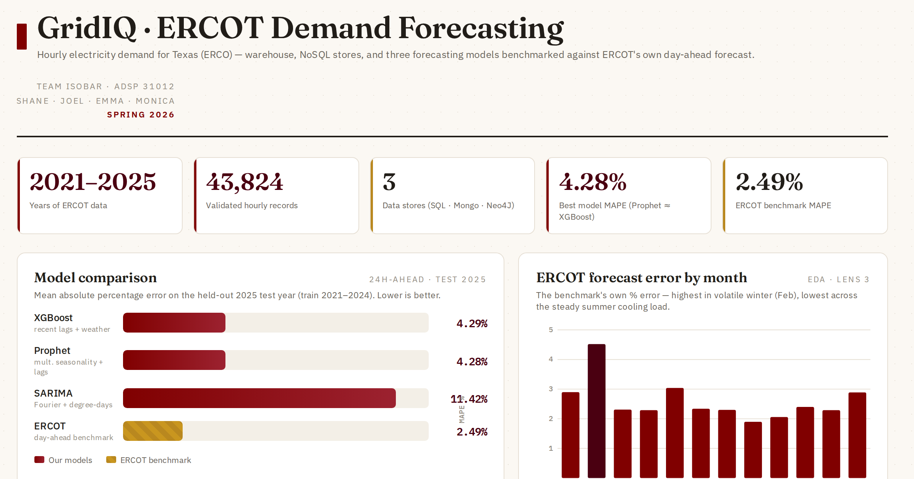
PART IV · FORECASTING & FINDINGS
PRESENTER — SHANE
Dashboard & insights
Dashboard panels
KPI scorecard — data, stores, best model vs benchmark
Model comparison — XGBoost · Prophet · SARIMA vs ERCOT
ERCOT forecast error by month
Three data-store cards (MySQL · MongoDB · Neo4J)
Data-quality summary
Interactive dashboard — live build (HTML / Power BI-ready).
THE UNIVERSITY OF CHICAGO · M.S. IN APPLIED DATA SCIENCE
18
Notes:
Presenter: Shane. Interactive dashboard pulling the three BI/ result sets together — demo live. ~60s.

Slide 24
PART IV · FORECASTING & FINDINGS
PRESENTER — SHANE
Recommendations
1
Operational
2
Modeling
3
Engineering
Invest in weather inputs — temperature is the single largest lever on day-ahead accuracy.
Match the forecast horizon to the decision; guard against persistence leakage in autoregressive features.
Use the right store per need — relational for analytics, document for ingest, graph for lineage.
THE UNIVERSITY OF CHICAGO · M.S. IN APPLIED DATA SCIENCE
19
Notes:
Presenter: Shane. Three recommendations, one per pillar. ~45s.

Slide 25
PART IV · FORECASTING & FINDINGS
PRESENTER — ALL
Lessons learned
Forecast-horizon discipline
One source of truth
A Prophet using a 1-hour demand lag scored 1.56% — beating ERCOT — but that's a 1-hour-ahead task; held to honest 24-hour-ahead, it tells the real story.
Duplicate config / module files broke imports repeatedly — we enforced a single canonical copy.
UTC first
Weather dominates
Storing UTC and deriving local features sidestepped daylight-saving gaps entirely.
Cooling/heating degree-days were the single biggest lever — exogenous data mattered more than model choice.
THE UNIVERSITY OF CHICAGO · M.S. IN APPLIED DATA SCIENCE
20
Notes:
Presenter: split across team. The horizon example is Emma's Prophet work — her 1-hour-lag model scored 1.56% (beating ERCOT), which is exactly why horizon discipline matters; reframed to honest day-ahead it joins the comparison. Leakage + single-source-of-truth are the most credible lessons. ~60s.

Slide 26
APPENDIX
References & tools
U.S. Energy Information Administration — EIA-930 Hourly Electric Grid Monitor (BALANCE files). eia.gov/electricity/gridmonitor
Open-Meteo Historical Weather API — hourly 2-m temperature, ERCOT metros. open-meteo.com
ERCOT — Electric Reliability Council of Texas. ercot.com
Libraries: pandas, XGBoost, statsmodels (SARIMA), Prophet, SQLAlchemy / PyMySQL.
Data stores: MySQL, MongoDB, Neo4J. Visualization: Power BI / Tableau.
THE UNIVERSITY OF CHICAGO · M.S. IN APPLIED DATA SCIENCE
21
Notes:
Complete citations before submission.

Slide 27
THE UNIVERSITY OF CHICAGO
Thank you
Questions & discussion
GridIQ · Team Isobar — Shane · Joel · Emma · Monica | ADSP 31012 · Spring 2026
Notes:
Presenter: Shane closes, then opens the floor. Queue the dashboard before Q&A.

