Slide 1
T
 | T1 | T2 | T3
000001 (having children) | Computing the number of agents needed which is 4,then send them to (000011), (000101), (001001), (010001), (100001).Notice that after sending all the cloning agents, there is still one agent residing node (000001). Release Phase | Case 1:If one of its big neighbors contains a black virus, than its clones spreading to (000001), (000010) will be destroy, but clones spreading to node (000111),(001011),(010011),(100011) will contaminate the nodes. Case 2:If all its neighbors are clean, node (000001) receive nothing. Move phase | Case 1:Start elimination Phase Case 2:Agnets in (000001) move to (000011) Move phase
100000 (without children but has brothers) 110000 (without children and brothers) | Move to (000000) Move phase | Move to (000010) Move phase | Move to (000011) Move phase
Node
Move to (010000)
Move phase
Move to (010001)
Move phase

Slide 2
x
T0
T0
y

Slide 3
x
(x, y)
y

Slide 4
x
y

Slide 5
x
y

Slide 6
x
y

Slide 7
Three agents residing here
One agent residing here

Slide 8
One agent residing here
Two agents residing here
Two agents here including a coordinator

Slide 9
The original black virus
Spreading clones which are killed by agents
New formed black virus node

Slide 10
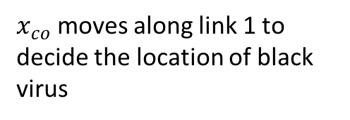
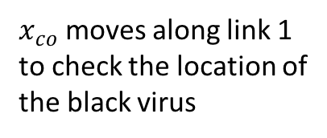
$x_{co}$ moves along link 1 to check the location of the black virus
$x_{co}$ moves along link 1 to decide the location of black virus

Slide 14
x
x
y
y
x
x
x
y
y
y

Slide 15
x
x
x
y
y
x
x
x
y
y
y

Slide 16
x
x
y
y
x
y

Slide 17
x
x
y
y
x
x
y
y

Slide 18
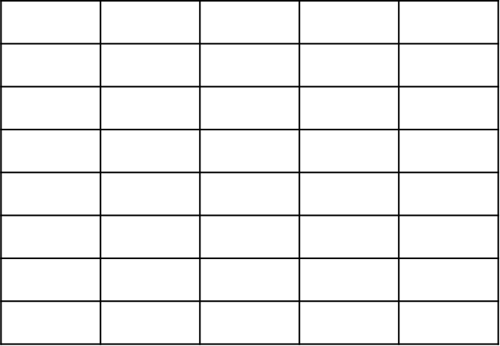
x
x
y
y

Slide 19
x
x
y
y
x
y

Slide 20
x
x
y
y

Slide 21
x
y

Slide 22
x
y

Slide 23
x
y

Slide 24
x
y

Slide 25
x
y

Slide 26
x
y

Slide 27
x
y

Slide 28
x
y

Slide 29
x
y

Slide 30
x
y

Slide 31
x
y

Slide 32
x
y

Slide 33
x
y

Slide 34
x
y

Slide 35
x
y

Slide 36
x
y

Slide 37
x
y

Slide 38
x
y

Slide 39
x
y

Slide 40
x
y

Slide 41
x
y

Slide 42
x
y

Slide 43
x
y

Slide 44
x
y

Slide 45
x
y

Slide 46
x
y

Slide 47


x
$$T_{0}$$
$$T_{0}$$
y

Slide 48


$$x$$
$$y$$
V

Slide 49
$$x$$
V
$$y$$

Slide 50
$$x$$
V
$$y$$

Slide 51
$$x$$
V
$$y$$

Slide 52
$$x$$
V
$$y$$

Slide 53
$$x$$
V
$$y$$

Slide 54
$$x$$
V
$$y$$

Slide 55
$$x$$
V
$$y$$

Slide 56
$$x$$
V
$$y$$

Slide 57
$$x$$
V
$$y$$

Slide 58
$$x$$
V
$$y$$

Slide 59
$$x$$
$$y$$
V

Slide 60
$$x$$
$$y$$
V

Slide 61
$$x$$
$$y$$
V

Slide 62
$$x$$
$$y$$
V

Slide 63
$$x$$
$$y$$
V

Slide 64
$$x$$
$$y$$
V

Slide 65
$$x$$
$$y$$
V

Slide 66
$$x$$
$$y$$
V

Slide 67
$$x$$
$$y$$
V

Slide 68
V

Slide 69
V

Slide 70
V

Slide 71
V

Slide 72
V

Slide 73
V

Slide 74
V

Slide 75
V

Slide 76
V

Slide 77
V

