Slide 1

System.Net.Http, API, & JSON

Slide 2
System.Net.Http
This namespace is designed to provide the following:
HTTP client components that allow users to consume modern web services over HTTP.
HTTP components that can be used by both clients and servers (HTTP headers and messages, for example). This provides a consistent programming model on both the client and the server side for modern web services over HTTP.

Slide 3
System.Net.Http
ByteArrayContent | Provides HTTP content based on a byte array.
DelegatingHandler | A type for HTTP handlers that delegate the processing of HTTP response messages to another handler, called the inner handler.
FormUrlEncodedContent | A container for name/value tuples encoded using application/x-www-form-urlencoded MIME type.
HttpClient | Provides a class for sending HTTP requests and receiving HTTP responses from a resource identified by a URI.

Slide 4
System.Net.Http
HttpClientHandler | The default message handler used by HttpClient in .NET Framework and .NET Core 2.0 and earlier.
HttpContent | A base class representing an HTTP entity body and content headers.
HttpMessageHandler | A base type for HTTP message handlers.
HttpMessageInvoker | A specialty class that allows applications to call the SendAsync(HttpRequestMessage, CancellationToken) method on an HTTP handler chain.

Slide 5
System.Net.Http
HttpMethod | A helper class for retrieving and comparing standard HTTP methods and for creating new HTTP methods.
HttpRequestException | Represents a HTTP request message.
HttpRequestMessage | A base type for HTTP message handlers.
HttpRequestOptions | Represents a collection of options for an HTTP request.
HttpResponseMessage | Represents a HTTP response message including the status code and data.
MessageProcessingHandler | A base type for handlers which only do some small processing of request and/or response messages.

Slide 6
System.Net.Http
MultipartContent | Provides a collection of HttpContent objects that get serialized using the multipart/* content type specification.
MultipartFormDataContent | Provides a container for content encoded using multipart/form-data MIME type.
ReadOnlyMemoryContent | Provides HTTP content based on a ReadOnlyMemory<T>.
SocketsHttpConnectionContext | Represents the context passed to the ConnectCallback for a SocketsHttpHandler instance. .
SocketsHttpPlaintextStreamFilterContext | Represents the context passed to the PlaintextStreamFilter for a SocketsHttpHandler instance.

Slide 7
System.Net.Http
SocketsHttpHandler | Provides the default message handler used by HttpClient in .NET Core 2.1 and later.
StreamContent | Provides HTTP content based on a stream.
StringContent | Provides HTTP content based on a string.
https://docs.microsoft.com/en-us/dotnet/api/system.net.http?view=net-6.0

Slide 8

What is an API
Application Programming Interface

Slide 9

Interfaces
Allows you to control the way it works with the options provided
Abstracts out how it works and it just works
The details are not there.
Has options and evolve over time
You are familiar with Interfaces -> GUI
Users use interfaces
Developers use Interfaces
Think methods
Interfaces on interfaces on interfaces

Slide 10


Interfaces
Abstracts the detail
Interact or communicate with an object
What are we allowed to change or see
User Interface
API is Programmer Interface

Slide 11
API
Abstraction of the implementation
DRY
API is typically referred to Web-based
IT'S NOT JUST WEB
Built in functions on your programming language
Programming Languages are APIs
APIs take care of many of the details we take for granted
Can use different languages because of standardization like JSON.

Slide 12


Web API
https://developer.mozilla.org/en-US/docs/Web/API
People have already done most of the work for us
Frameworks
Asp.net Core
Assist with code
Focus on the business problem
What are APIs have you worked with?

Slide 13
Remote API
Do not have space on local machines to store EVERYTHING!
Allows us to connect to outside code and databases
Get computational power remotely.
Google Translate AR app!
Try it out
Style of Programming using Remote API
SOAP
RPC
REST
https://stackify.com/soap-vs-rest/

Slide 14
Representational State Transfer (RESTful)
Sits on top of Web Technologies
Refer back to HTTP lecture
If your website constraints to REST it is known as RESTful
Client-Server Architecture (Previous Lecture)
Statelessness (Previous Lecture)
Layered System
Cacheability
Uniform Design
Code on Demand

Slide 15
Server-Side / Client Server / Request - Response
Refer back to Client Server Lecture
Passing information through headers and body
Stateless
GET / POST
Error Codes

Slide 16
Resources
Everything can be represented by a resources.
Modelling out data and objects is a resources.
See CRUD Operations

Slide 17
HTTP Methods and CRUD
POST - /{resource}
Add or “Create” that object
GET - /{resources}/{id}
”Read” or get all resources, or specifiy an Id to get one specific resource.
PUT/PATCH - /{resource}/{id}
”Update” that object (PUT requires all properties, PATCH only what you want to change
DELETE /{resource}/{id}
“Delete” that object

Slide 18
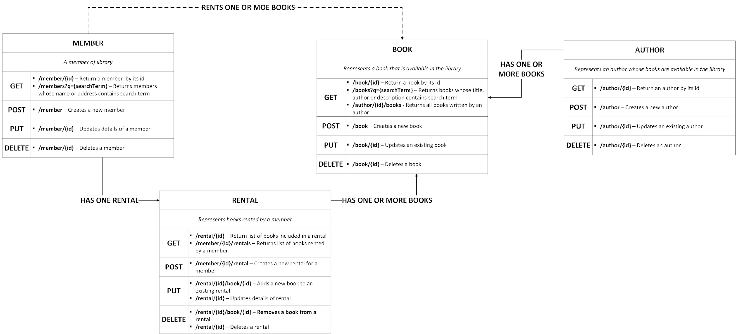

Slide 19
Layered System
Allows you to deploy the API on a server
Store data on another server
Authenticate requests on a different server
A client cannot tell that they are living on different servers.

Slide 20
Cacheable
Allows data to be stores
Done to improve response time
Allows for scalability
REST wants resources to be cached when applicable

Slide 21
Code on demand
Send resources in a static, structured, and standard format.
XML
JSON
JavaScript Object Notation
a lightweight data-interchange format
easy for humans to read and write
easy for machines to parse and generate.
We will come back to this

Slide 22
Uniformed Interface
Simplified and decouples the architecture
HTTP -> CRUD Operations
Make a request get a standard response
Refer back to Code on demand
Everything is a resource call

Slide 23
API Security
API security is the protection of the integrity of APIs—both the ones you own and the ones you use.
Business use API to connect services
As well as to transfer data.
API can expose sensitive data.
Web API security is concerned with the transfer of data through APIs.
REST APIs use HTTP and TLS (HTTPS)

Slide 24
Best Practices
Use tokens. Establish trusted identities and then control access to services and resources by using tokens assigned to those identities.
Use encryption and signatures. Encrypt your data using a method like TLS(see above). Require signatures to ensure that the right users are decrypting and modifying your data, and no one else.
Identify vulnerabilities. Keep up with your operating system, network, drivers, and API components. Know how everything works together and identify weak spots that could be used to break into your APIs. Use sniffers to detect security issues and track data leaks.

Slide 25
Best Practices
Use quotas and throttling. Place quotas on how often your API can be called and track its use over history. More calls on an API may indicate that it is being abused. It could also be a programming mistake such as calling the API in an endless loop. Make rules for throttling to protect your APIs from spikes and Denial-of-Service attacks.
Use an API gateway. API gateways act as the major point of enforcement for API traffic. A good gateway will allow you to authenticate traffic as well as control and analyze how your APIs are used.

Slide 26
API Management Security
An API key that is a single token string (i.e. a small hardware device that provides unique authentication information).
Basic Authentication (APP ID / APP Key) that is a two token string solution (i.e. username and password).
OpenID Connect (OIDC) that is a simple identity layer on top of the popular OAuth framework (i.e. it verifies the user by obtaining basic profile information and using an authentication server).

Slide 27
ViewModel / Data Transfer Object (DTO)
Expose the data you only want to expose.
*Demo this out later.

Slide 28
JSON
JavaScript Object Notation

Slide 29

JSON
Lightweight data-interchange format
Easy to read and write
Easy for machines to parse
Language independent, but structure like C-family languages

Slide 30
JSON is built on two structures
A collection of name/value pairs. (I may refer to these as key/value pairs)
May realize these as an object, record, struct, dictionary, hash table, keyed list, or associative array
An ordered list of values.
May realize these as an array, vector, list, or sequence.

Slide 31
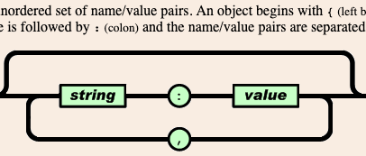
JSON Object

Slide 32
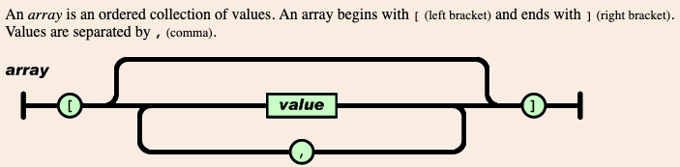
JSON Array

Slide 33
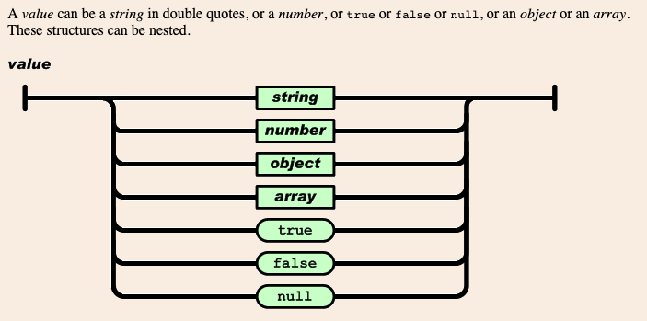
JSON Value

Slide 34
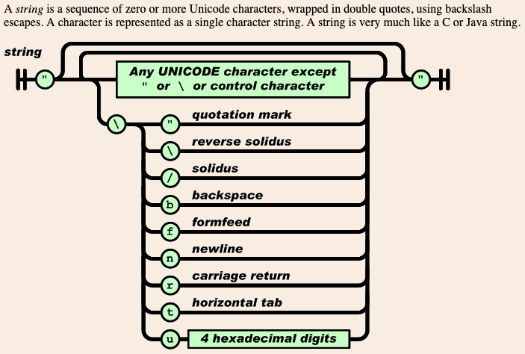
JSON String

Slide 35
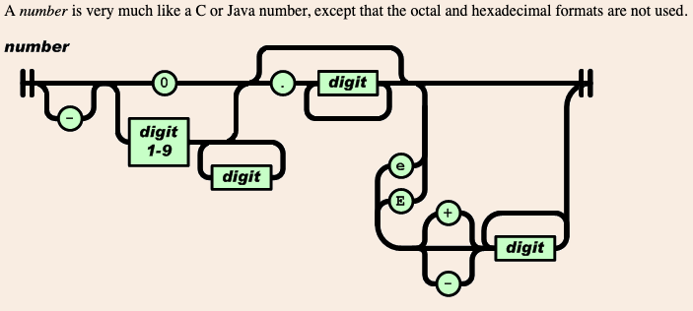
JSON Number

Slide 36
JSON Example
POSTMAN
Using Google Books API

