Slide 1
bytebuffer
byte[] bytes
序号 | 值
5
4
3 | 1
2 | v
1 | a
0 | 3
int capacity = 6
int 0<=limit<=6
int 0<=position<=6

Slide 2
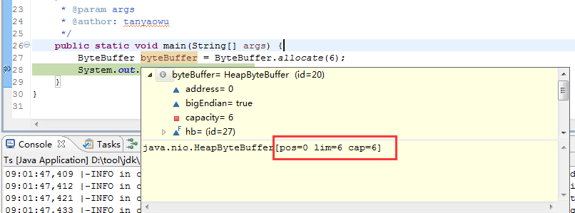
bytebuffer
byte[] bytes
序号 | 值
5 | 0
4 | 0
3 | 0
2 | 0
1 | 0
0 | 0
capacity==6
limit==6
position==0

Slide 3
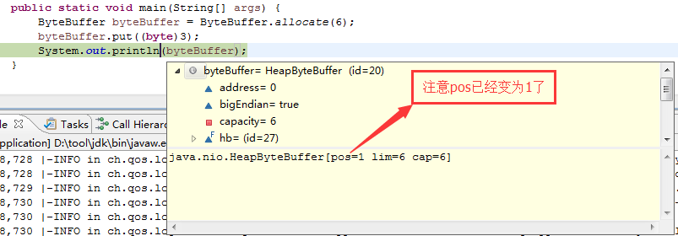
bytebuffer
byte[] bytes
序号 | 值
5 | 0
4 | 0
3 | 0
2 | 0
1 | 0
0 | 3
capacity==6
limit==6
position==1

Slide 4
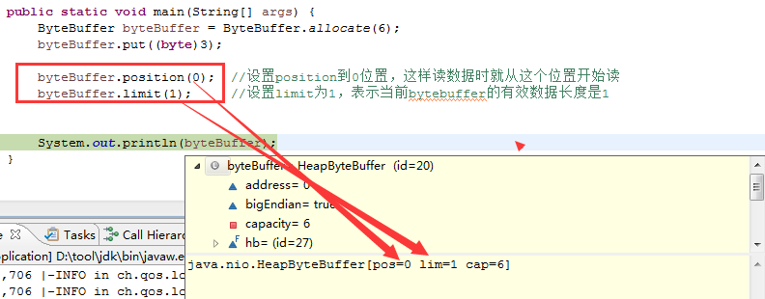
bytebuffer
byte[] bytes
序号 | 值
5 | 0
4 | 0
3 | 0
2 | 0
1 | 0
0 | 3
capacity==6
limit==1
position==0

Slide 5
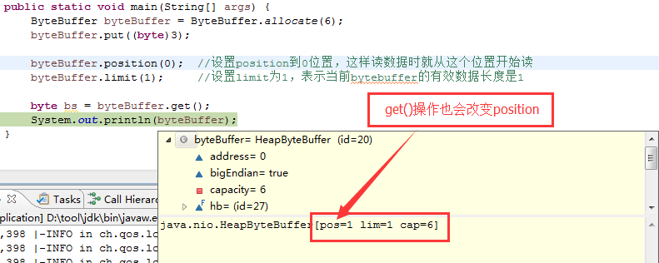
bytebuffer
byte[] bytes
序号 | 值
5 | 0
4 | 0
3 | 0
2 | 0
1 | 0
0 | 3
capacity==6
limit==1
position==1

